Slide 1
IQ puzzles and brain teasers
Level 1BB

Slide 2
IQ Puzzle 1
Level 1B
Which number is missing?

Slide 3
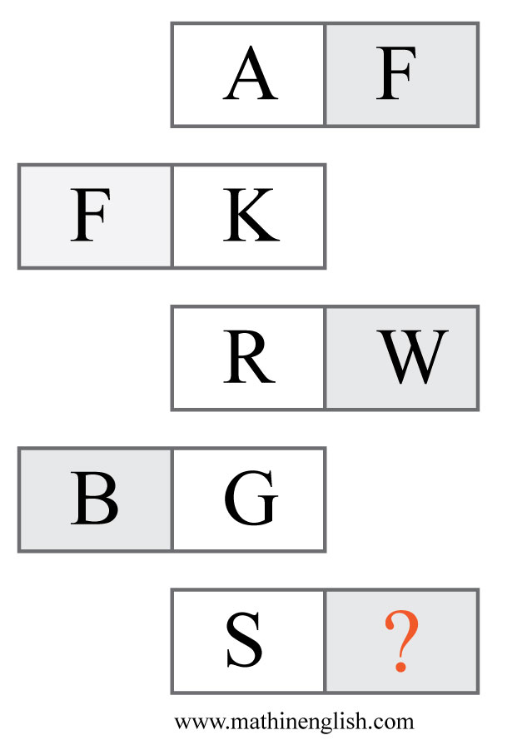
IQ Puzzle 2
Level 1B
Which letter is missing?

Slide 4
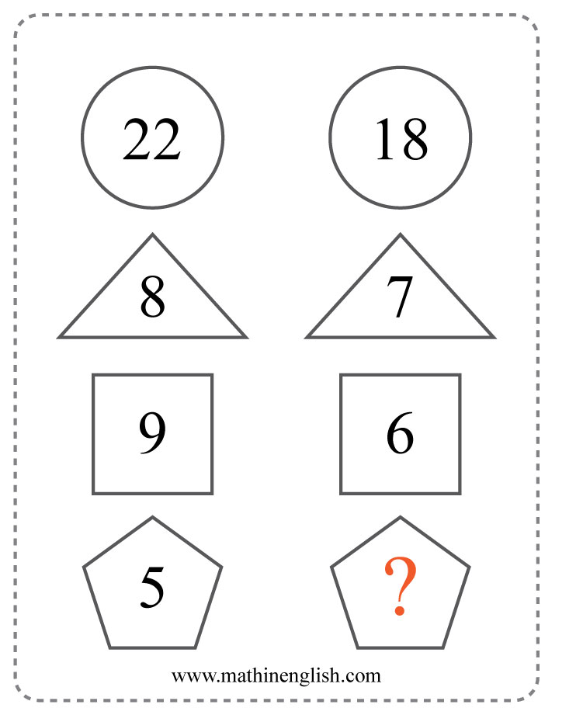
IQ Puzzle 3
Level 1B
What is the missing number?

Slide 5
IQ Puzzle 4
Level 1B
What number is needed here?

Slide 6
IQ Puzzle 5
Level 1B
Which number is missing?

Slide 7
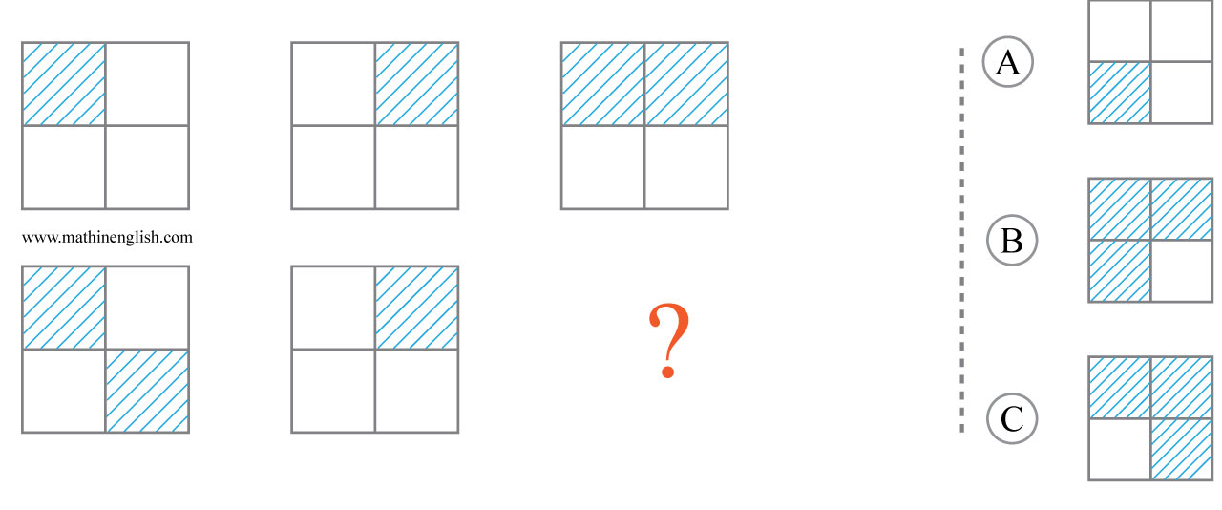
IQ Puzzle 6
Level 1B
Which option is correct?

Slide 8
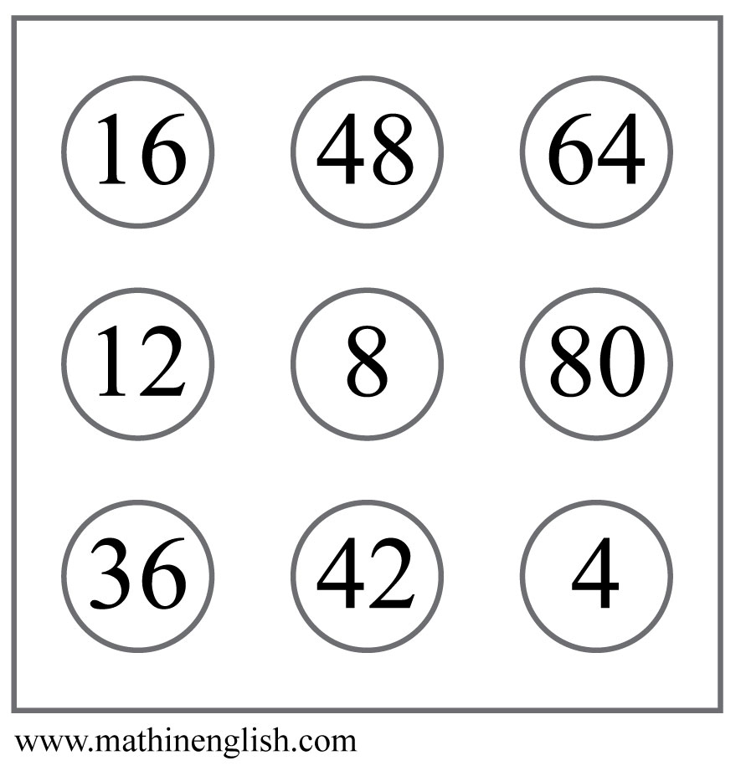
IQ Puzzle 7
Level 1B
Which number is the odd out?

Slide 9
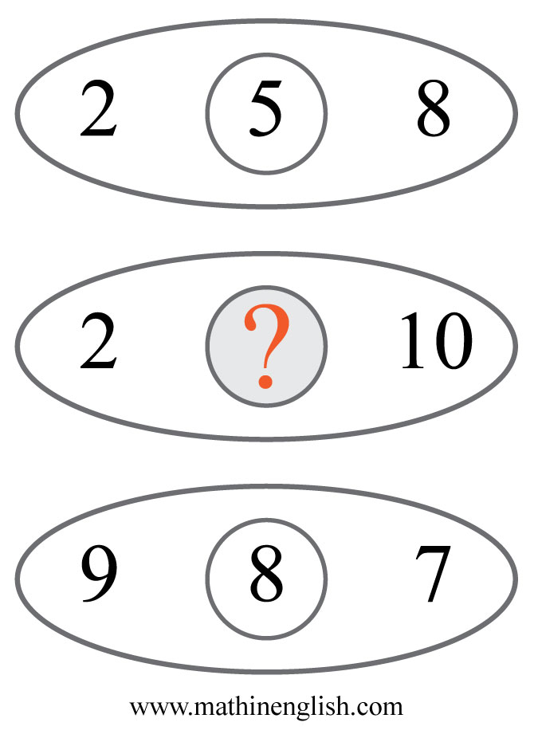
IQ Puzzle 8
Level 1B
Which number completes the pattern?

Slide 10
IQ Puzzle 9
Level 1B
Which letter is missing?

Slide 11
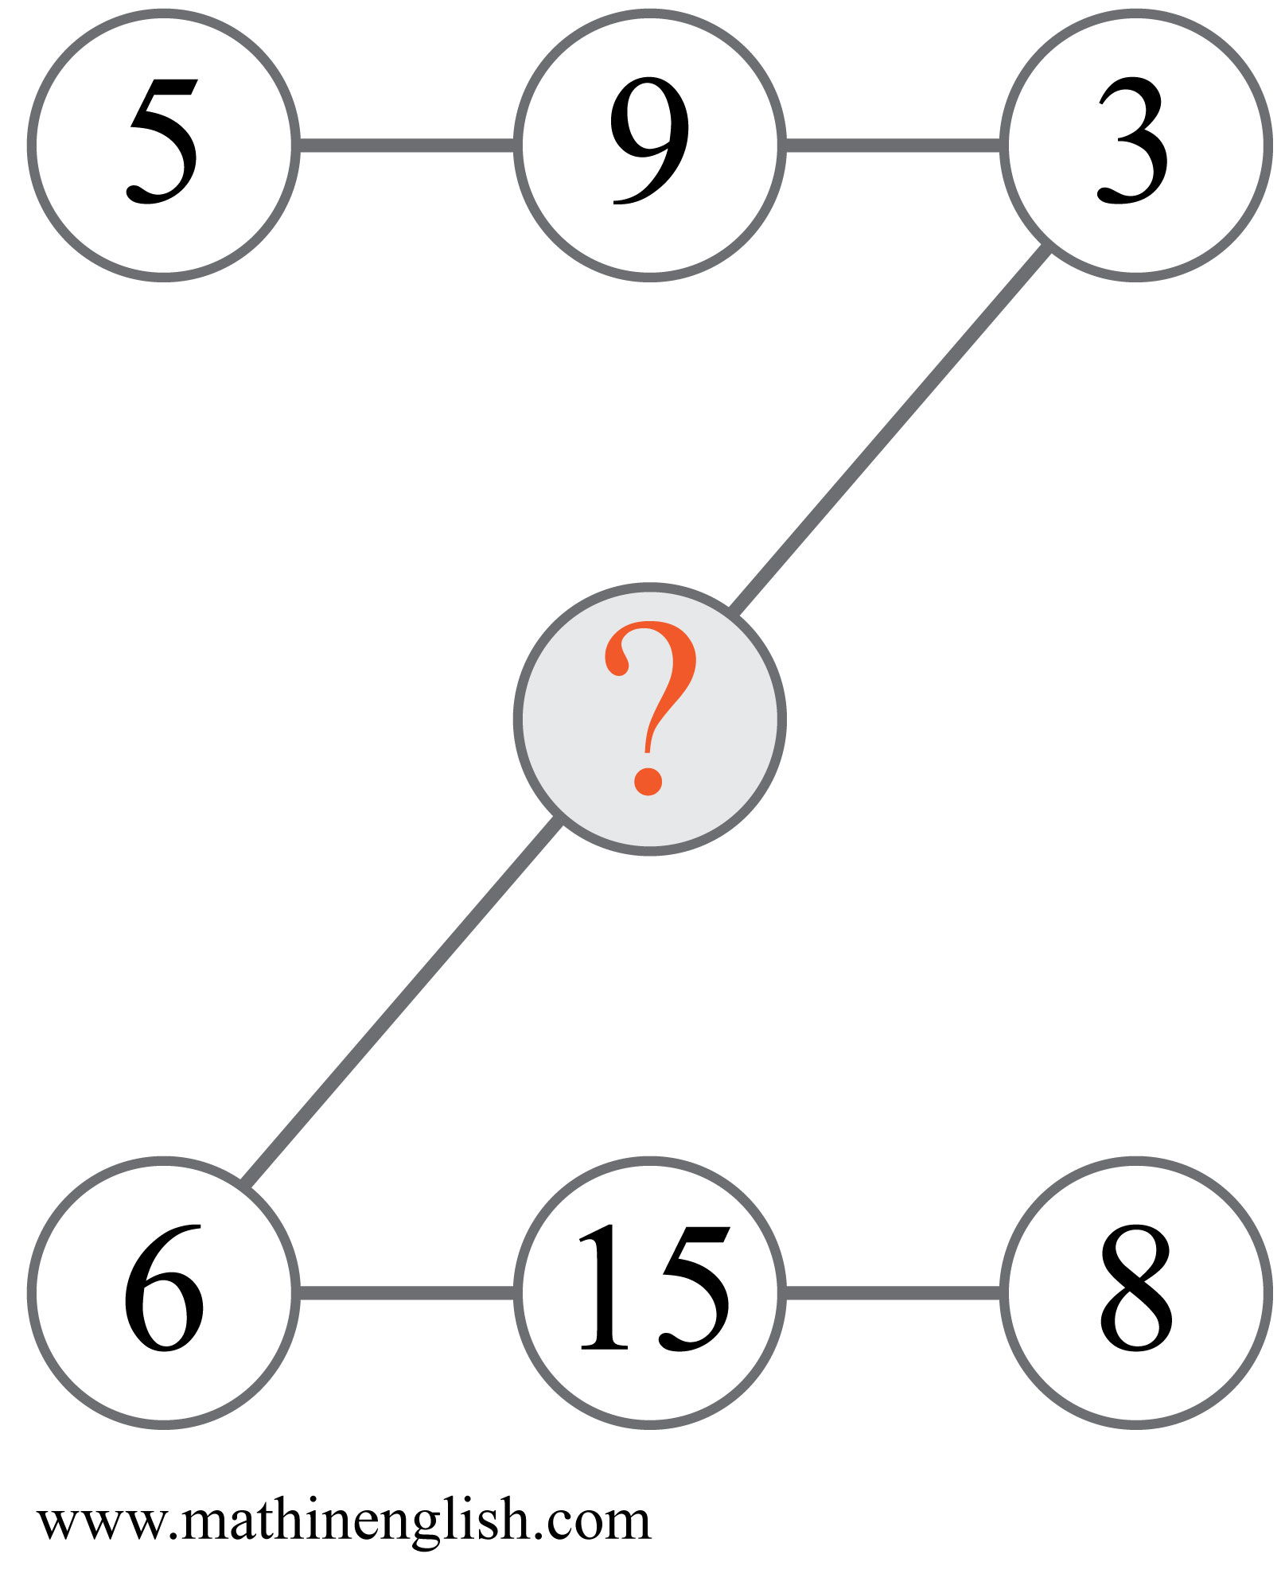
IQ Puzzle 10
Level 1B
Which number is missing?

Slide 12
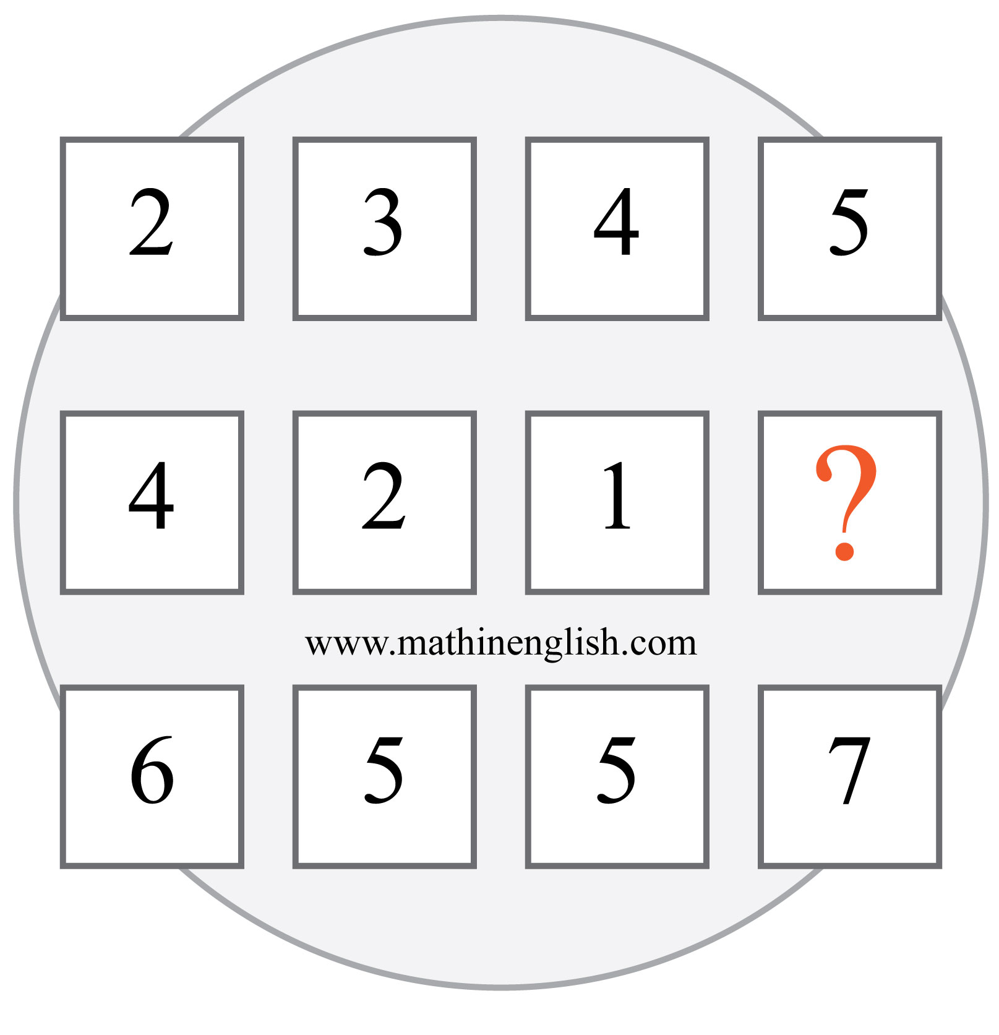
IQ Puzzle 11
Level 1B
Which number is missing?

Slide 13
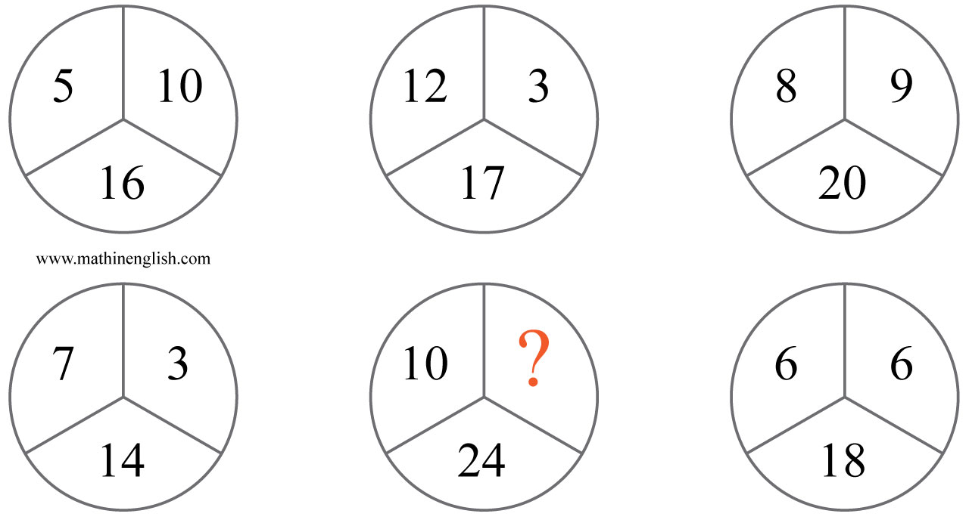
IQ Puzzle 12
Level 1B
Which number is missing?

Slide 14
IQ Puzzle 13
Level 1B
Which number is missing ?

Slide 15
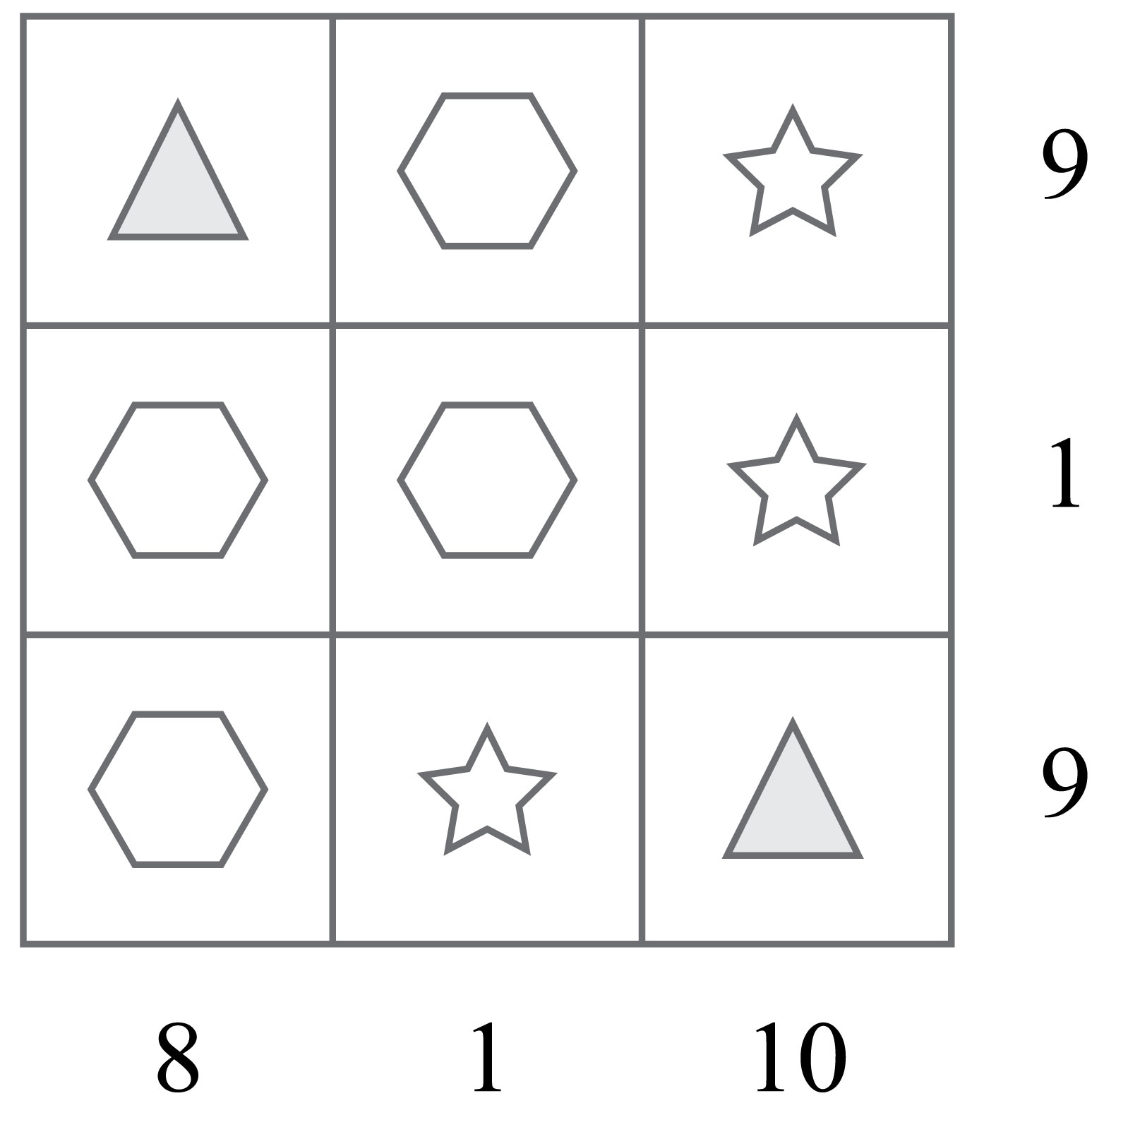
IQ Puzzle 14
Level 1B
What is the value of the star?

Slide 16
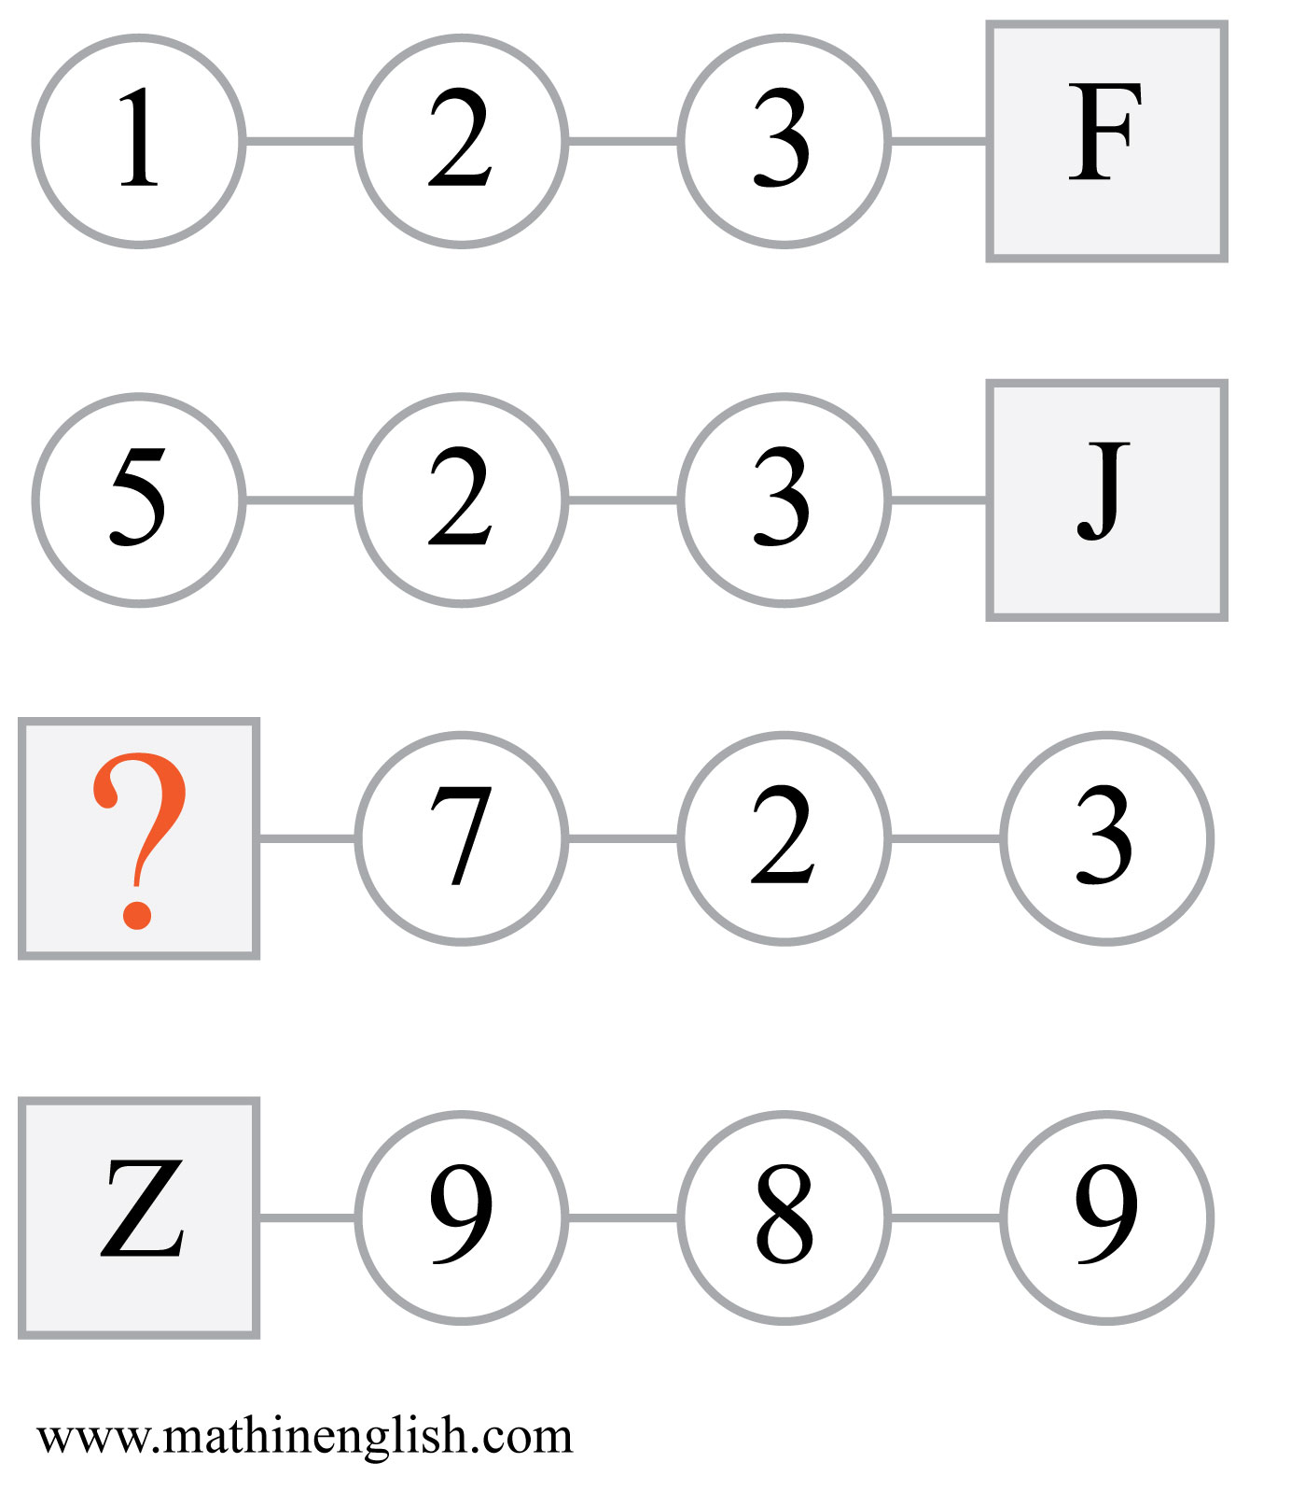
IQ Puzzle 15
Level 1B
Which letter is missing?

Slide 17
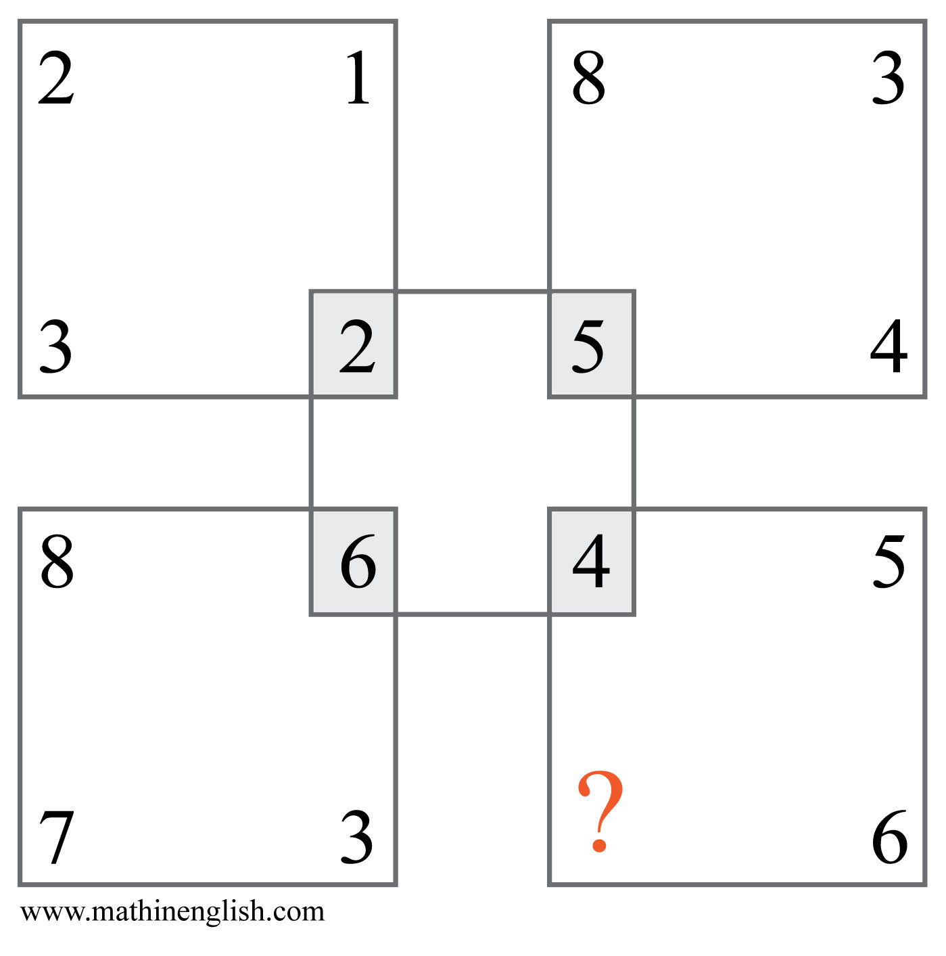
IQ Puzzle 16
Level 1B
Which number is missing?

Slide 18
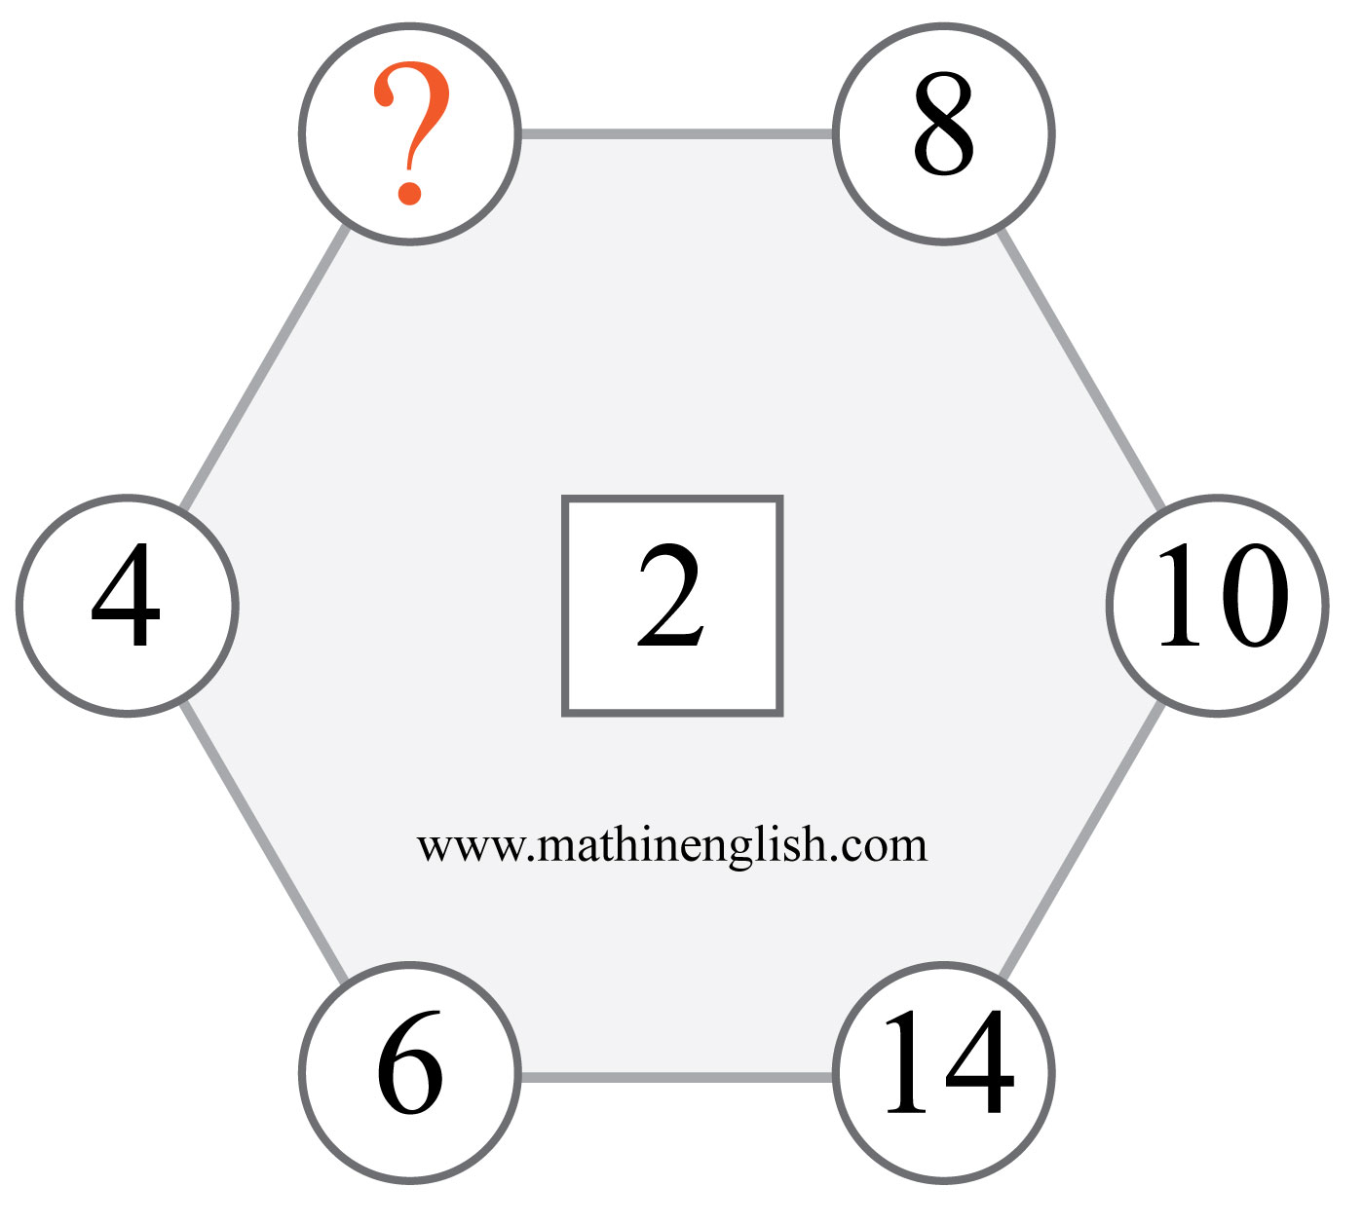
IQ Puzzle 17
Level 1B
Which number is missing?

Slide 19
IQ Puzzle 18
Level 1B
Which number is missing?

Slide 20
IQ Puzzle 19
Level 1B
Which numbers are missing?

Slide 21
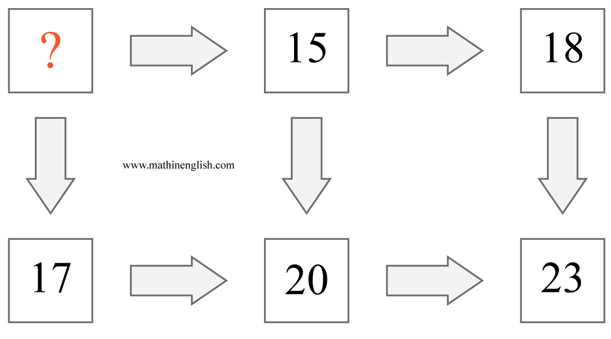
IQ Puzzle 20
Level 1B
Which number is missing?

Slide 22
Answers to puzzles 1 to 4
puzzle 1 : 4
The 4 numbers in each circle add up to 15.
puzzle 2 : X
Add 5 letters to S.
puzzle 3 : S
The 3 other shapes add up to the value of the circle.
puzzle 4 : 6
All numbers in a triangle form the number range 3 to 8.
Copyright: www.mathinenglish.com
Level 1B

Slide 23
Answers to puzzles 5 to 8
puzzle 5 : 5
Divide the sum of the 3 corner numbers of the triangle by 2.
puzzle 6 : C
The shaded parts of the left and right squares in each row are added
to form the shaded area of the 3rd square.
puzzle 7 : 42
42 is the only number that is not a multiple of 4.
puzzle 8 : 6
The average of the numbers on the left and the right.
Copyright: www.mathinenglish.com
Level 1B

Slide 24
Answers to puzzles 9 to 12
puzzle 9 : J
E is 5 and E plus E makes 10, which is the letter value of J.
puzzle 10 : 10
Take the sum of 6 and 3 and add a 1.
puzzle 11 : 2
Add the digits in the top row to those in the 2nd row to get the 3rd
row.
puzzle 12 : 9
Add the 2 smaller top numbers in each circle and add respectively a
1, 2, 3, 4, 5 and 6.
Copyright: www.mathinenglish.com
Level 1B

Slide 25
Answers to puzzles 13 to 16
puzzle 13 : 5
With a 5 the average of the 4 numbers in the cross is 6.
puzzle 14 : 8
Looking at the 2nd column, the star is either a 0 or a 1.
puzzle 15 : L
Add 7, 2 and 3 to get 12, which stands for number letter L.
puzzle 16 : 1
The sum of the 3 corner numbers in each square needs to be divided
by 3 to get the middle number.
Copyright: www.mathinenglish.com
Level 1B

Slide 26
Answers to puzzles 17 to 20
puzzle 17 : 12
12 as a multiple of 2 is missing.
puzzle 18 : 34
Subtract respectively 8, 7, 6 , 5 and so on.
puzzle 19 : 14 and 19
Add 3 to the sum of the rows and columns in the 3rd square.
puzzle 20 : 12
Add 3 for horizontal arrows and add 5 for vertical arrows.
Copyright: www.mathinenglish.com
Level 1B

