Slide 1

IQ puzzles and brain teasers
Level 2D

Slide 2
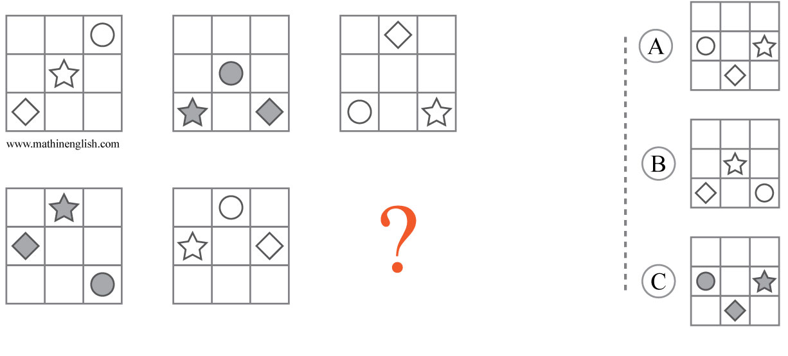



IQ Puzzle 1
Level 2D
Which option is correct?

Slide 3
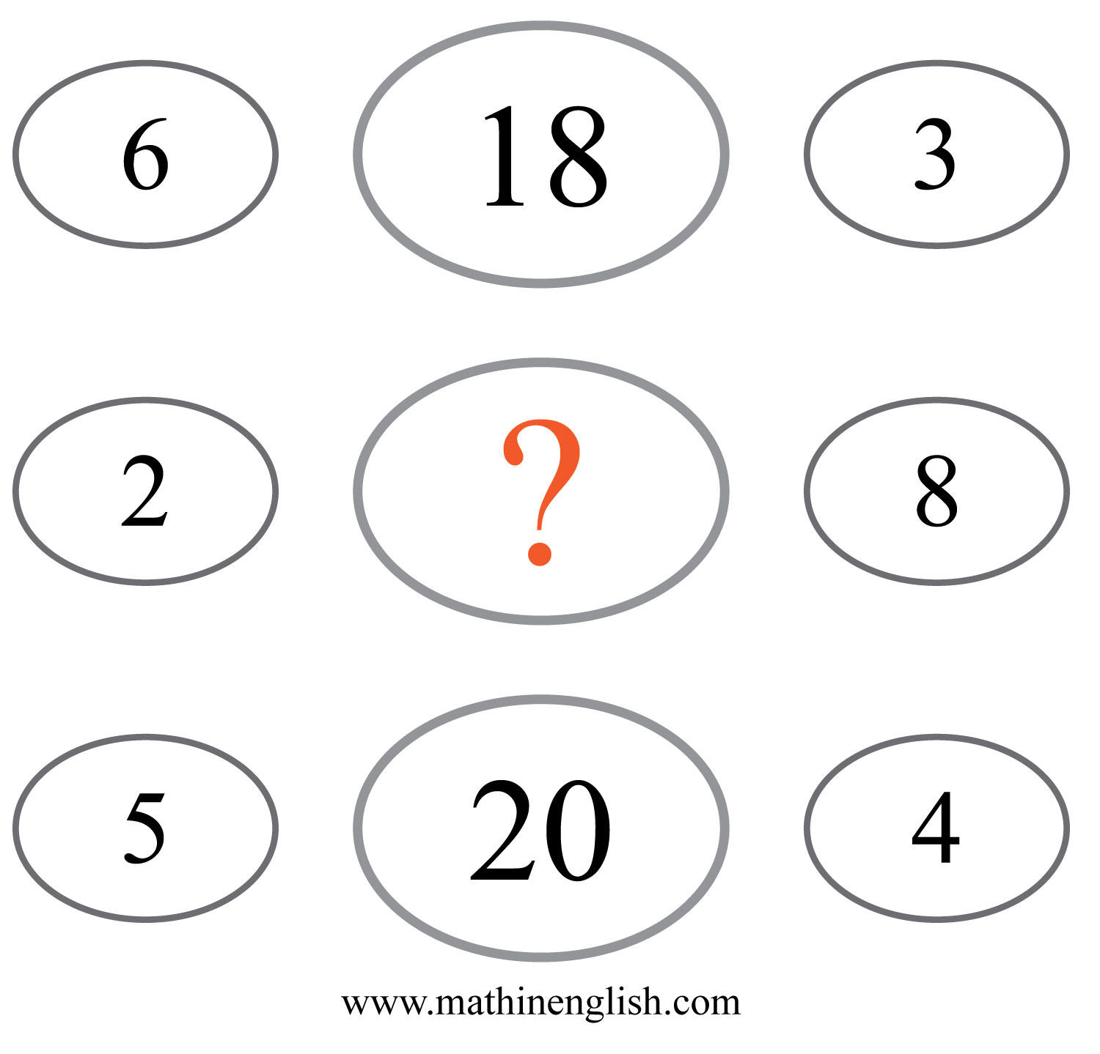
IQ Puzzle 2
Level 2D
Which number is missing?

Slide 4
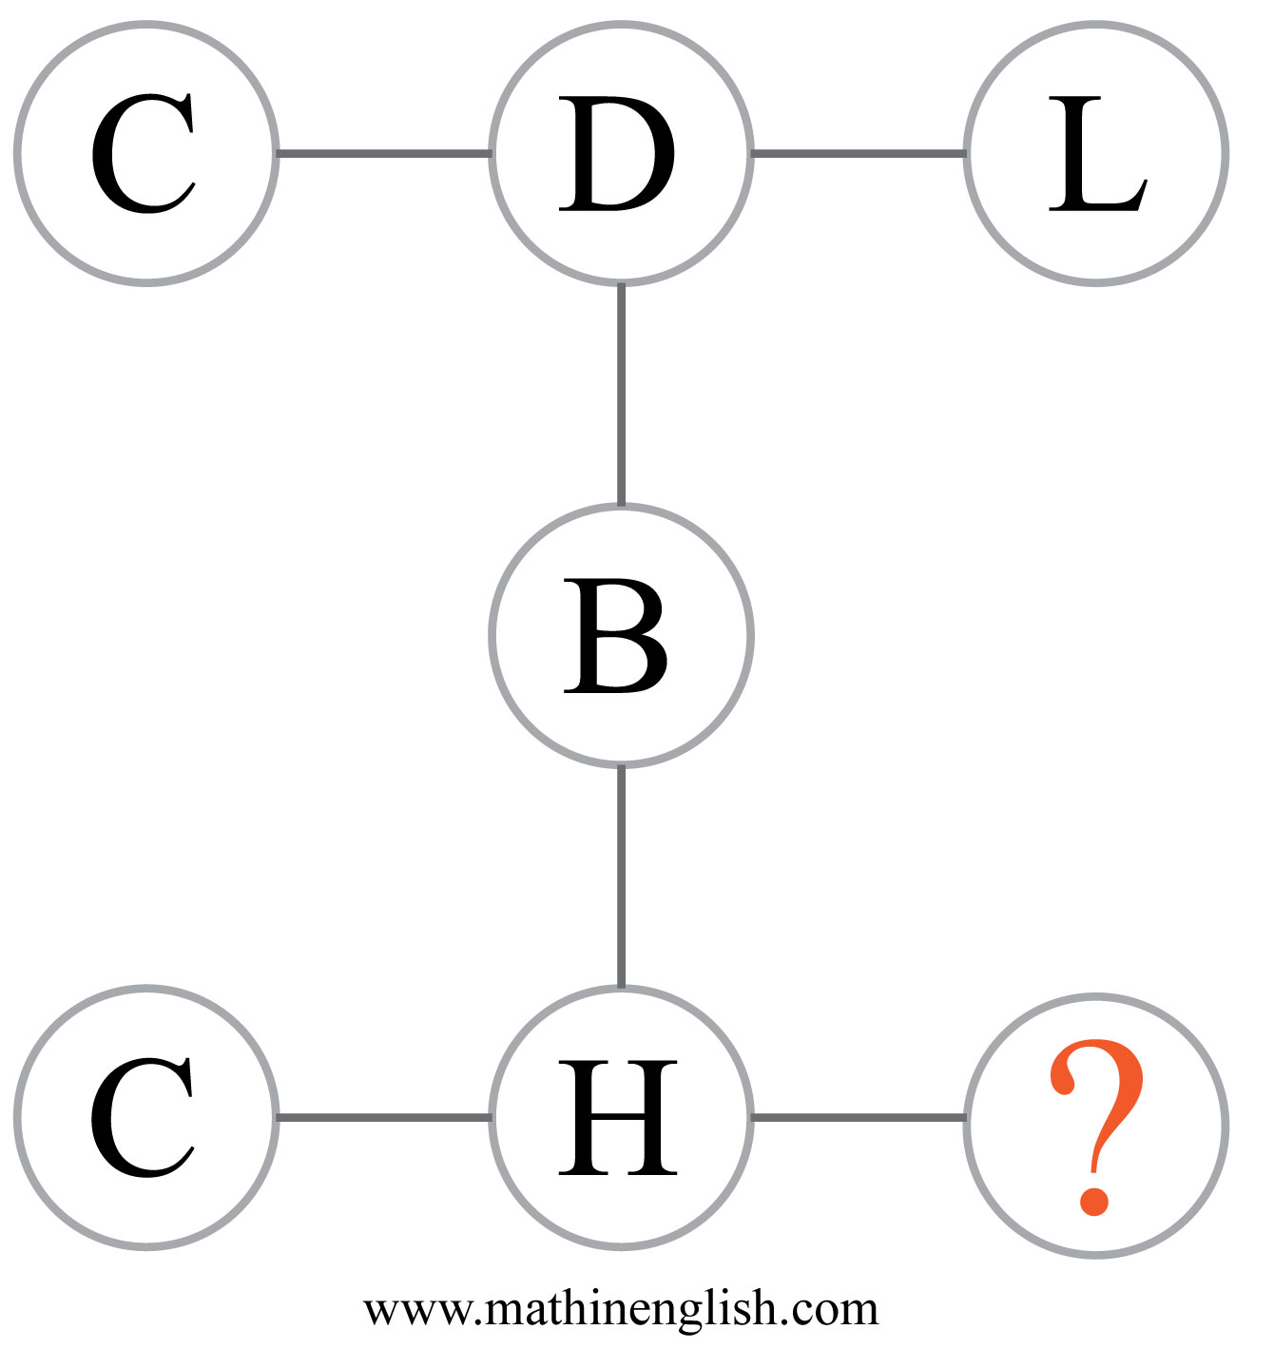
IQ Puzzle 3
Level 2D
What is the missing letter?

Slide 5
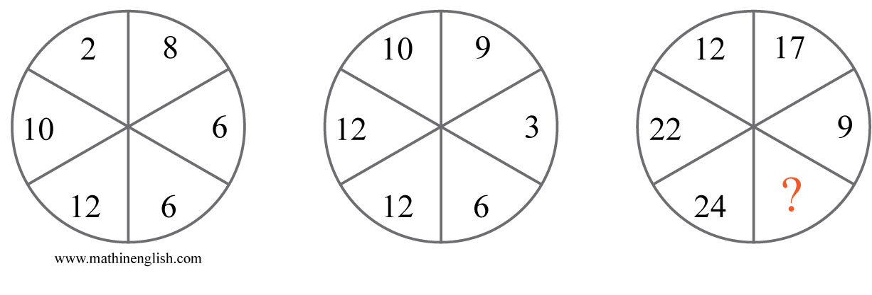
IQ Puzzle 4
Level 2D
What number is needed here?

Slide 6
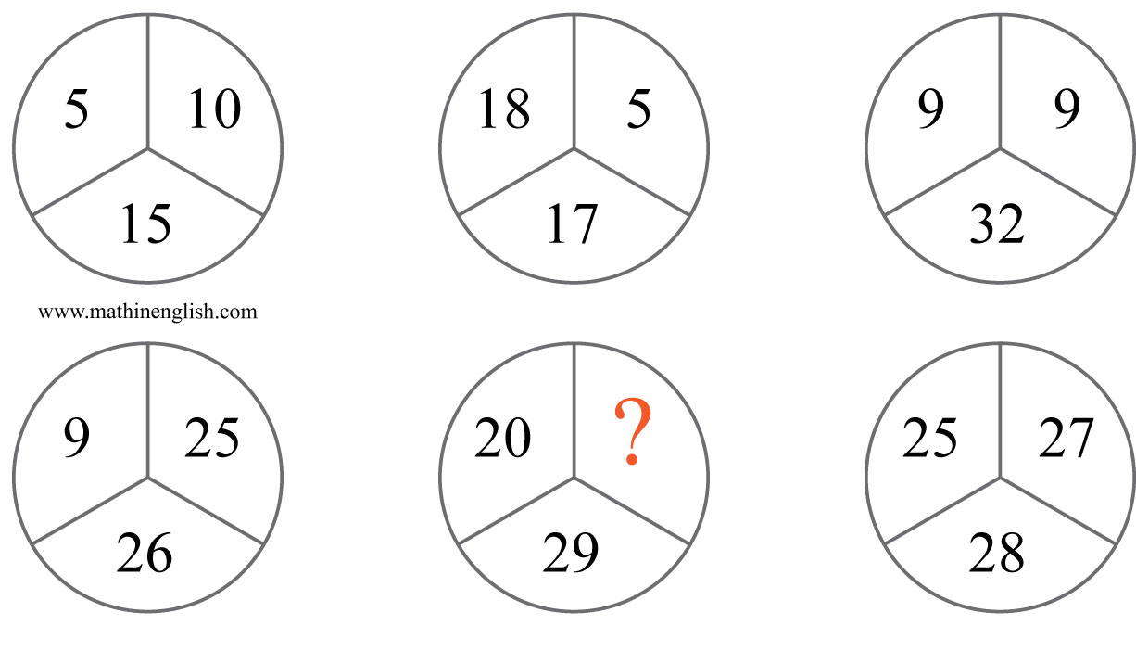
IQ Puzzle 5
Level 2D
Which number is needed?

Slide 7
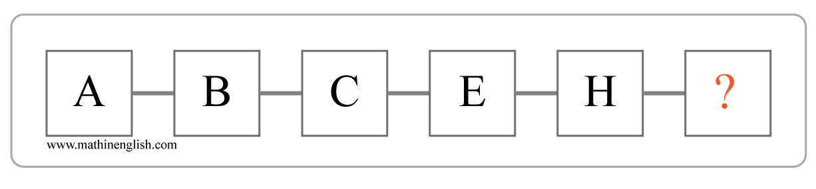
IQ Puzzle 6
Level 2D
Which letter is missing?

Slide 8
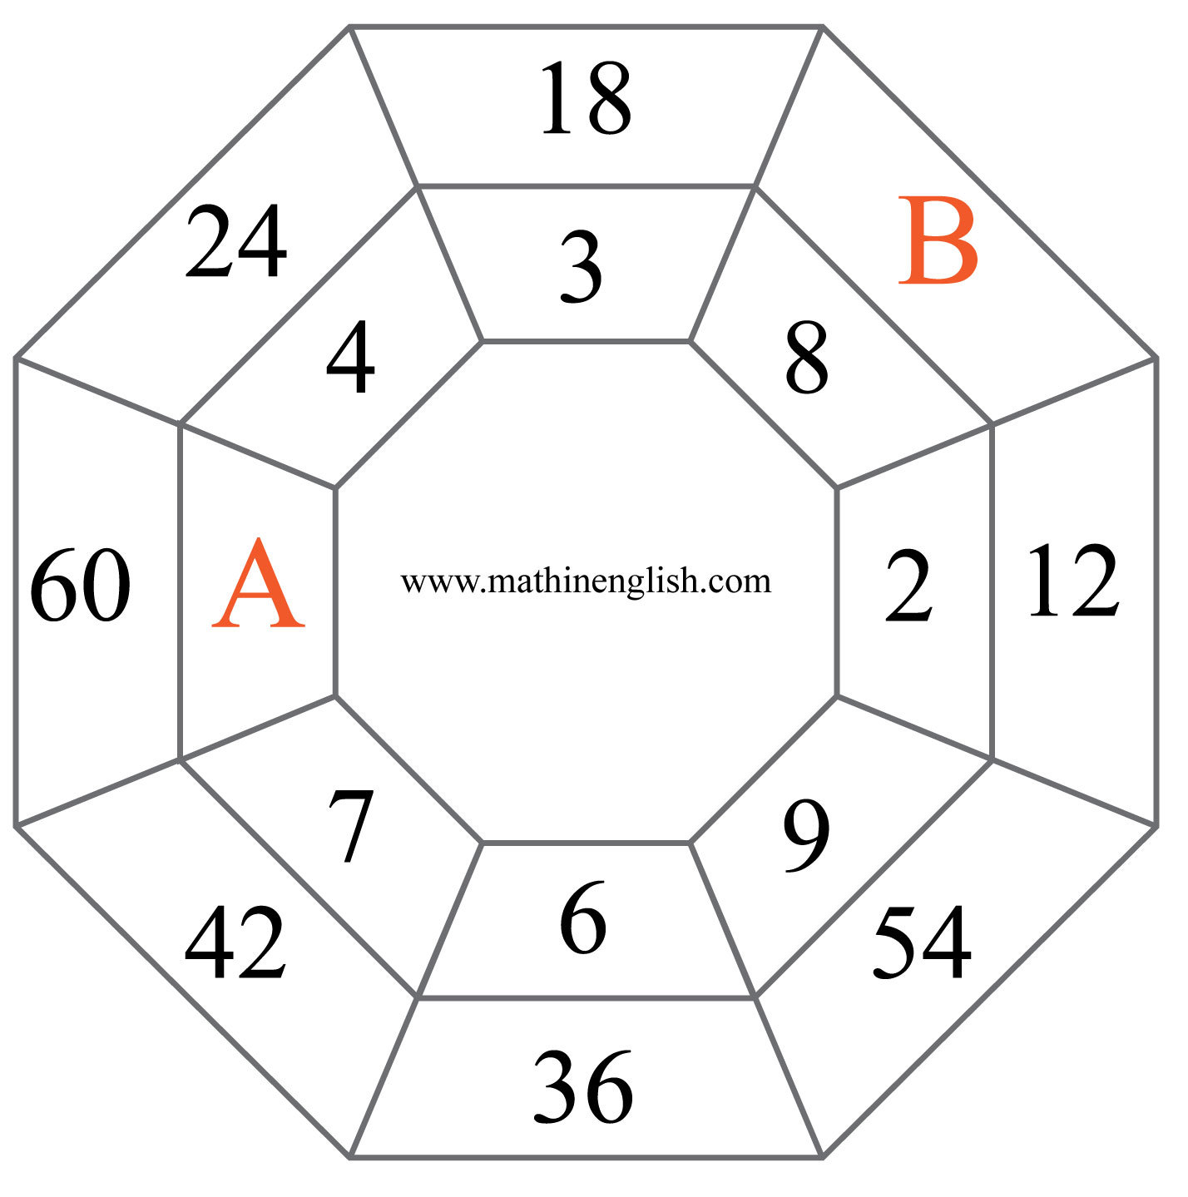
IQ Puzzle 7
Level 2D
What is the value of A and B?

Slide 9
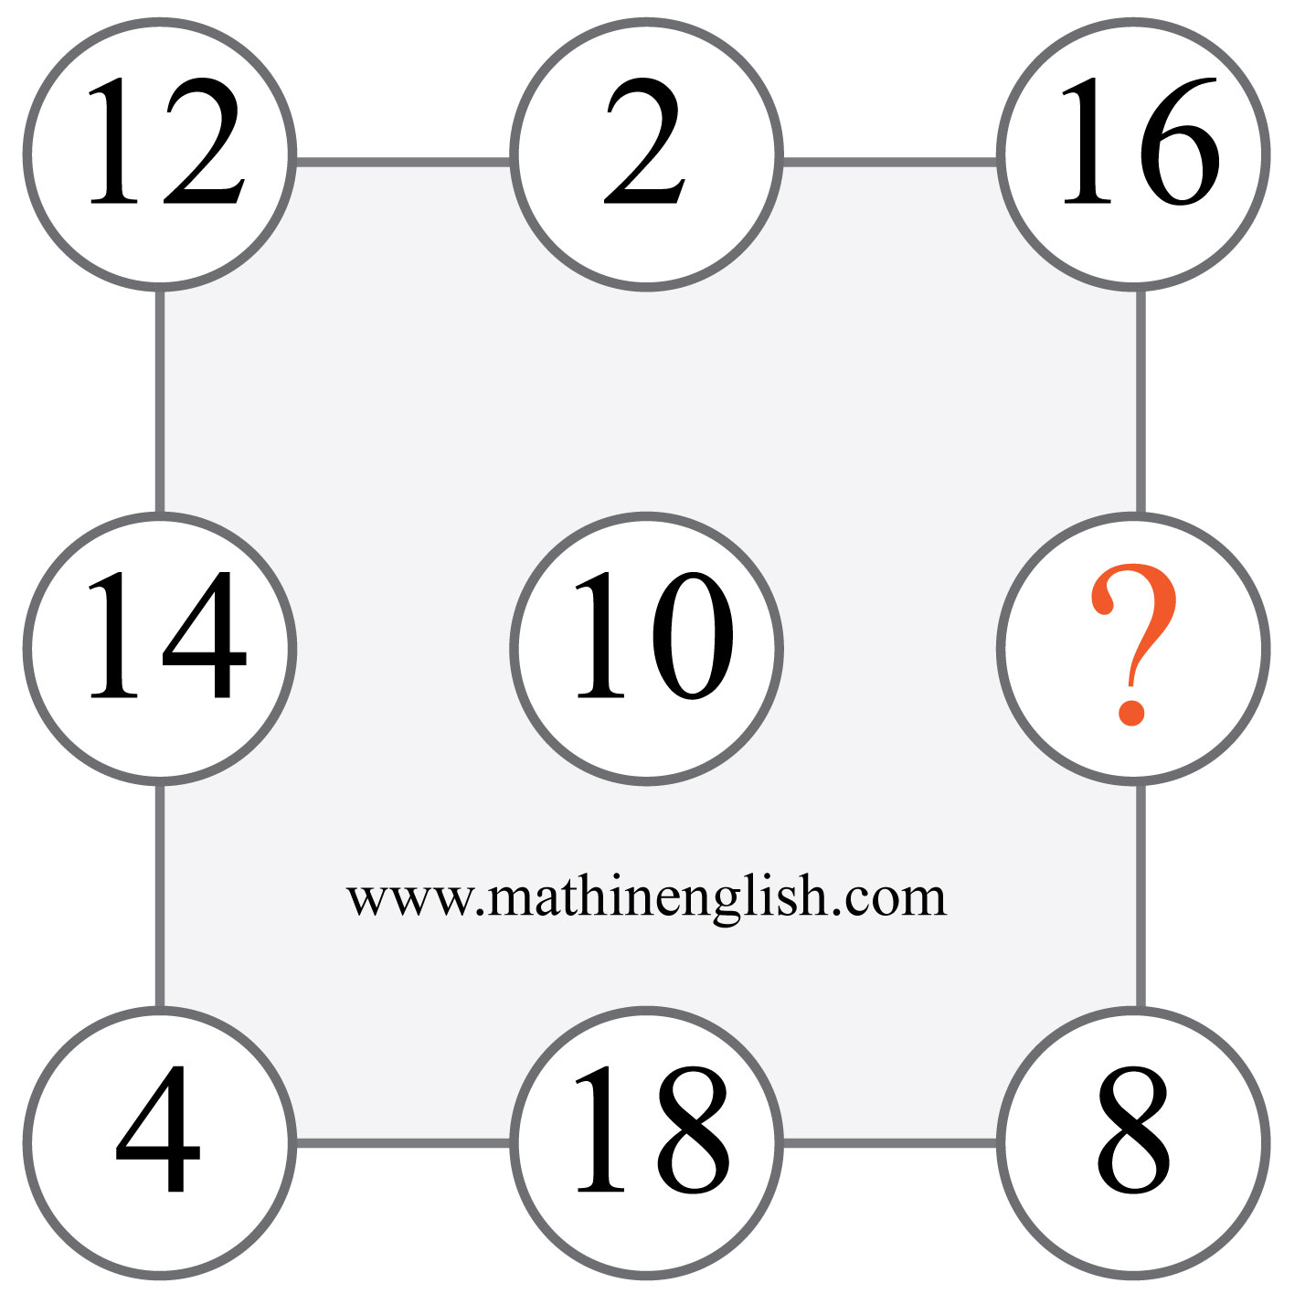
IQ Puzzle 8
Level 2D
Which number completes the pattern?

Slide 10
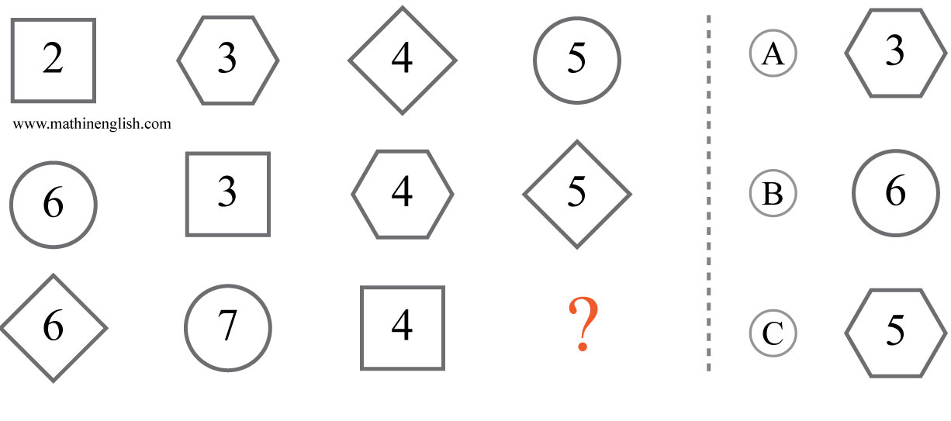
IQ Puzzle 9
Level 2D
Which option is correct?

Slide 11
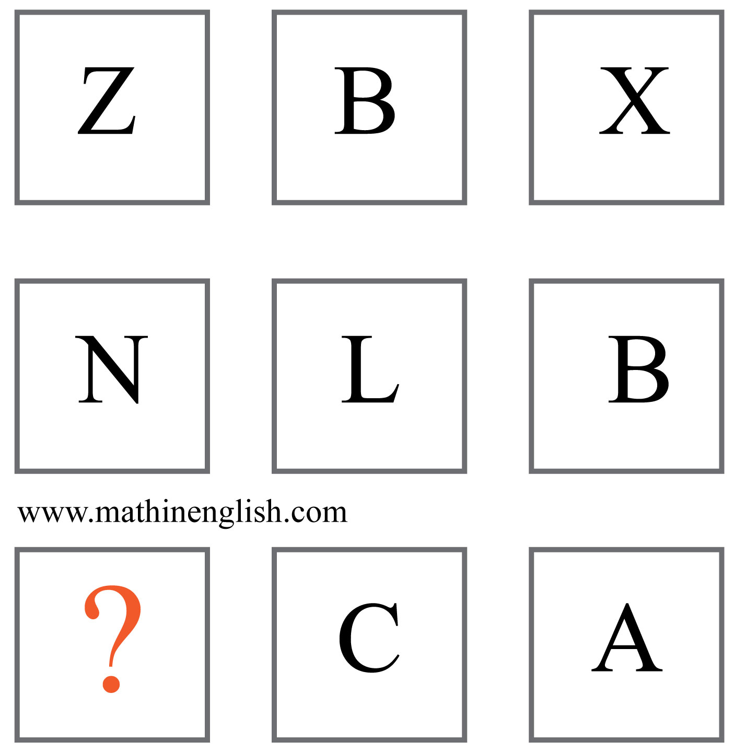
IQ Puzzle 10
Level 2D
Which letter is missing?

Slide 12
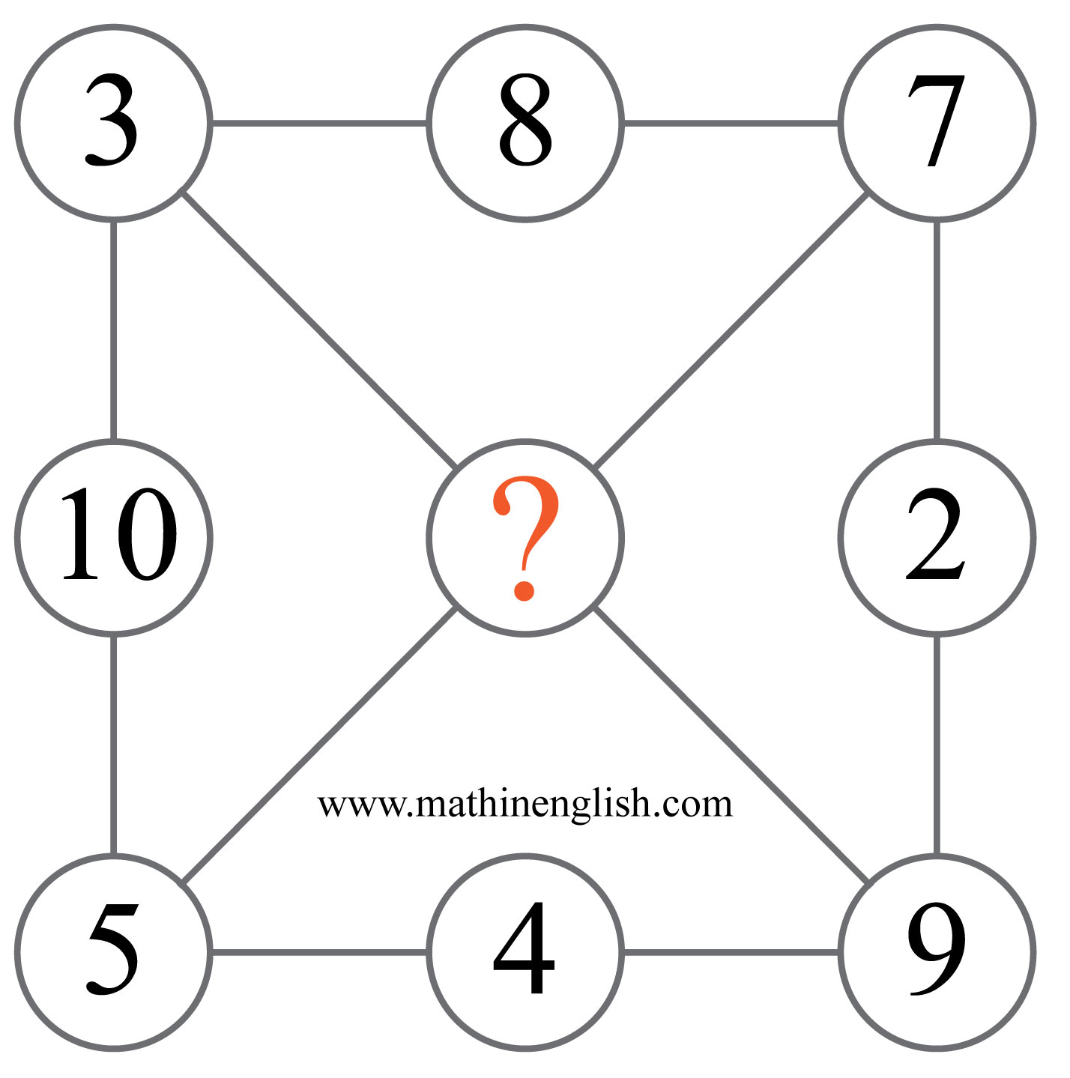
IQ Puzzle 11
Level 2D
Which number is missing?

Slide 13
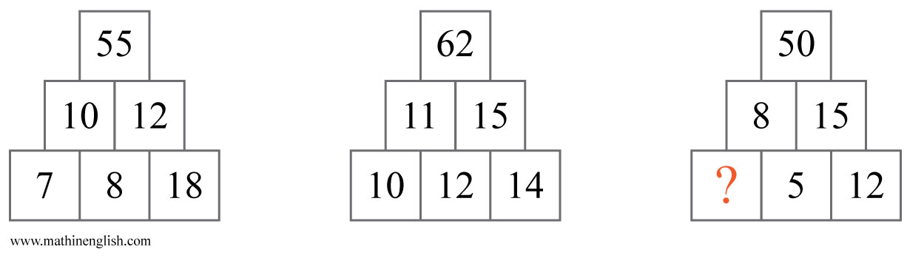
IQ Puzzle 12
Level 2D
Which number is missing?

Slide 14

IQ Puzzle 13
Level 2D
Which letter is missing?

Slide 15
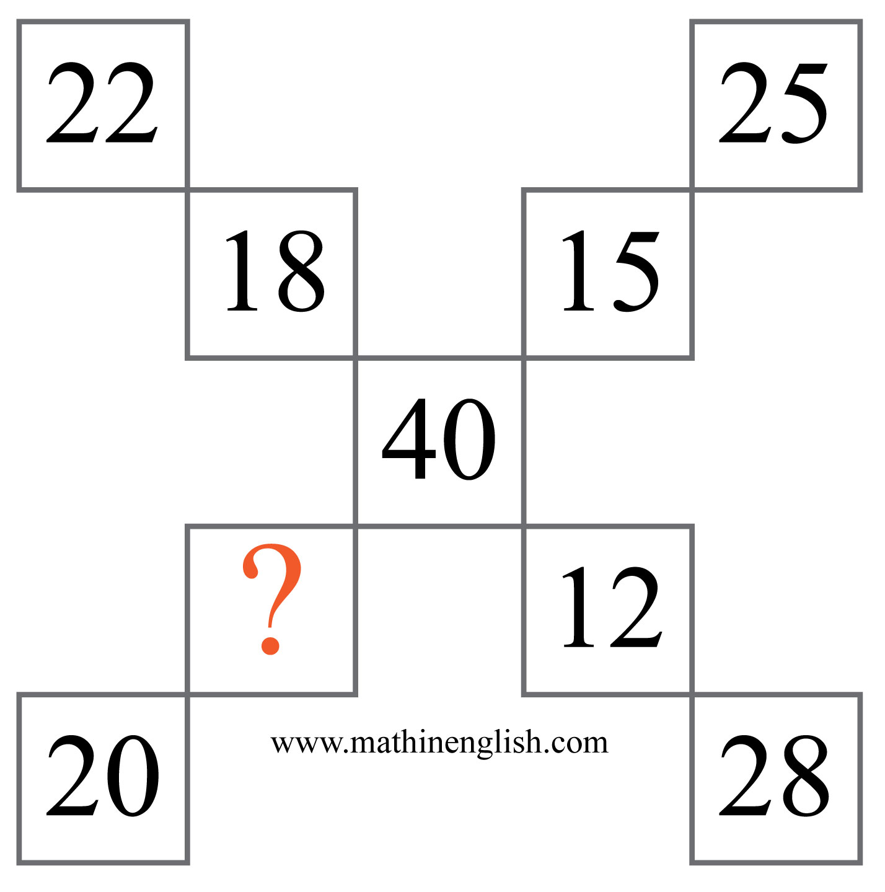
IQ Puzzle 14
Level 2D
What is the missing number?

Slide 16
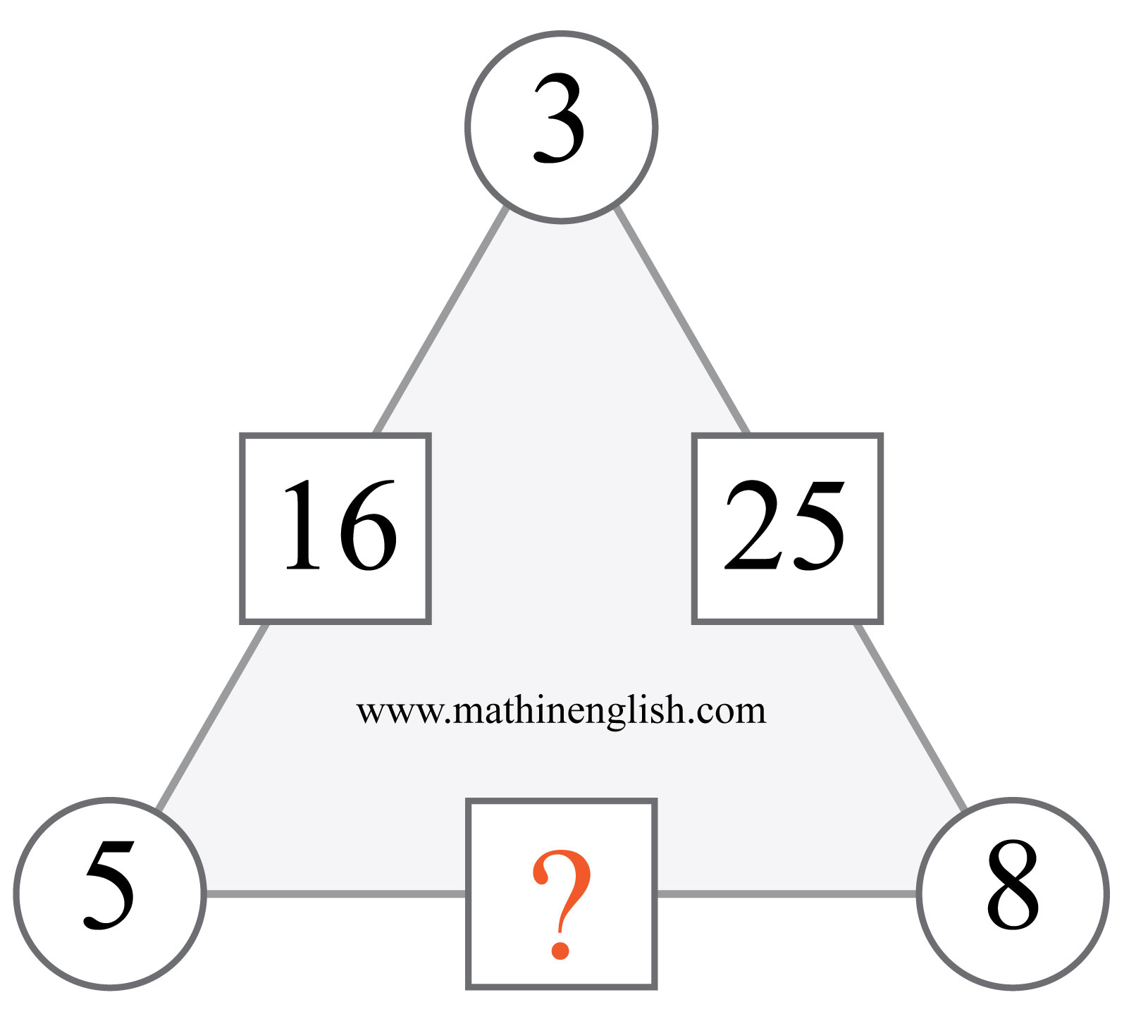
IQ Puzzle 15
Level 2D
Which number is missing?

Slide 17
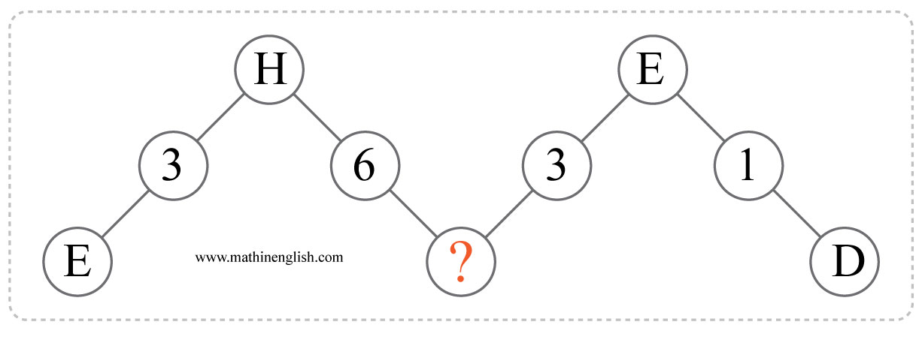
IQ Puzzle 16
Level 2D
Which letter is missing?

Slide 18
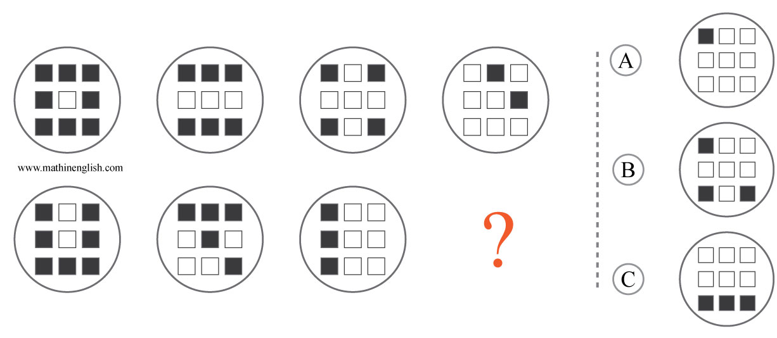
IQ Puzzle 17
Level 2D
Which option is correct?

Slide 19
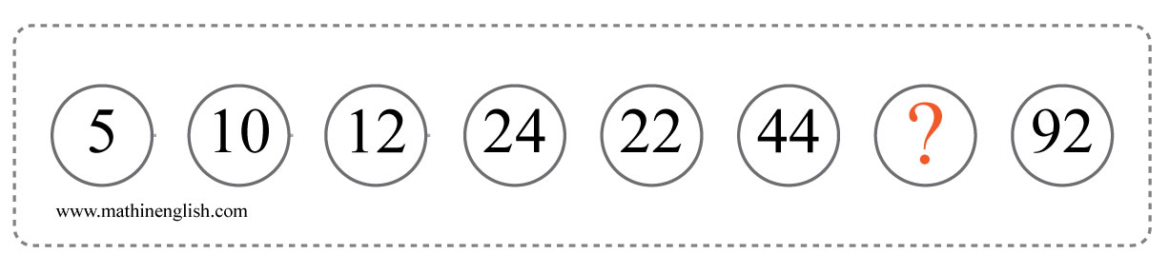
IQ Puzzle 18
Level 2D
Which number is missing?

Slide 20
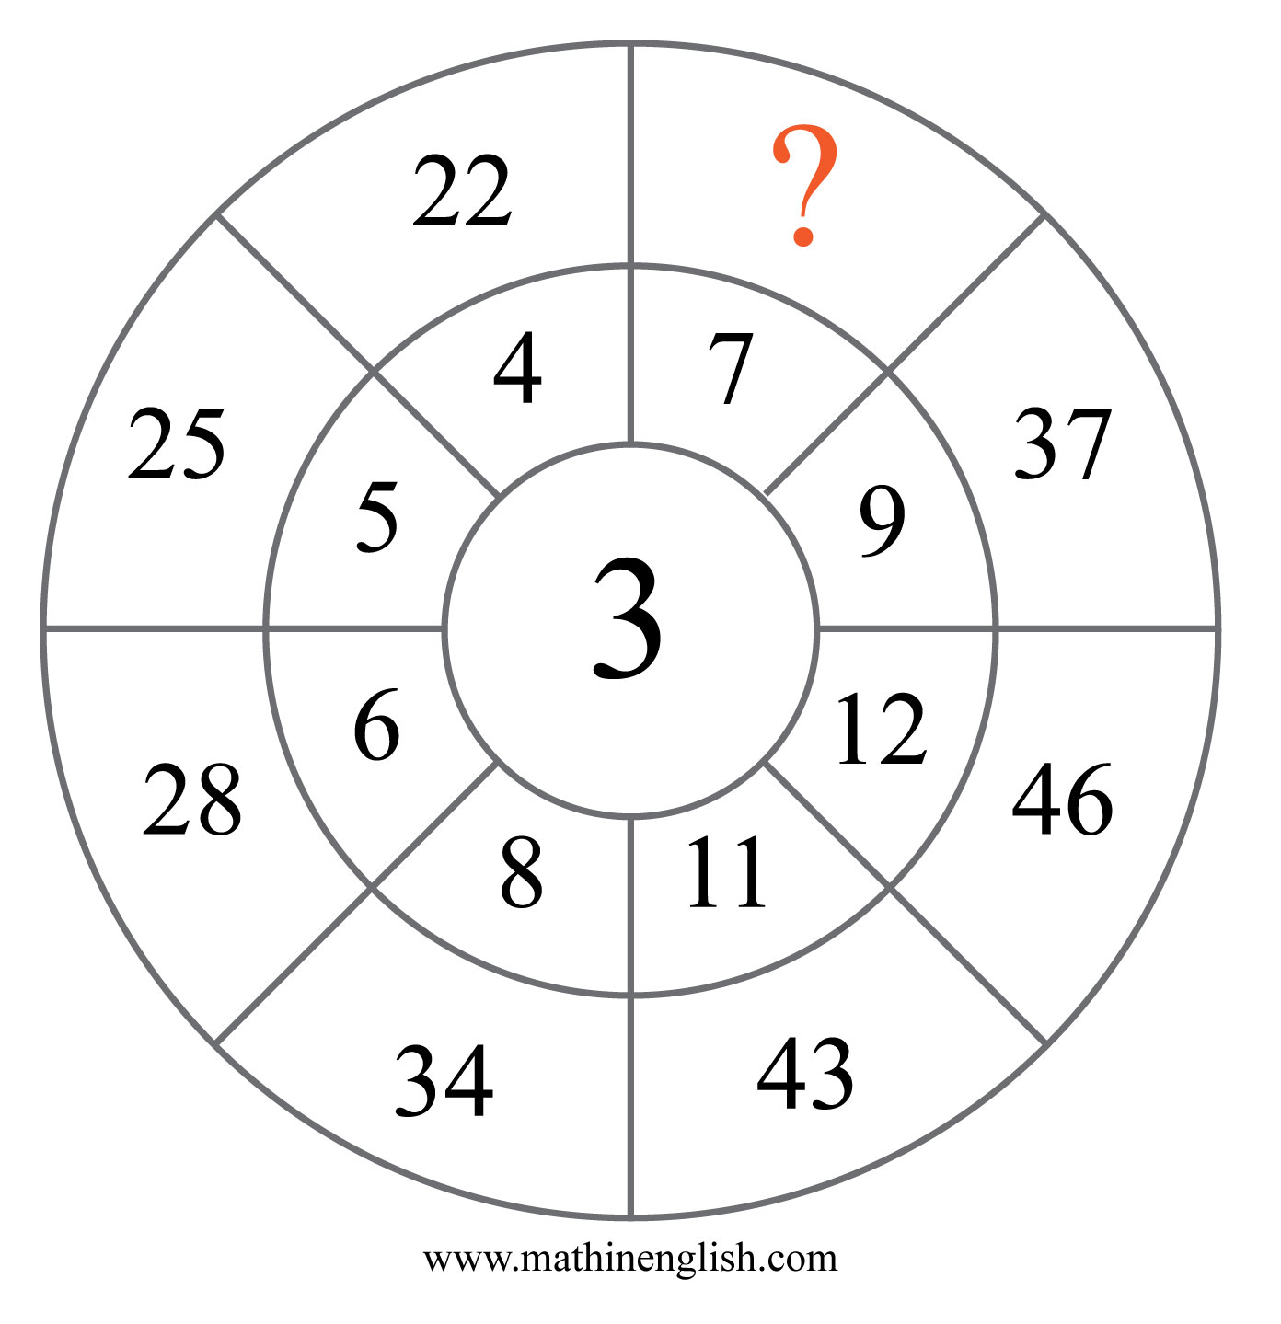
IQ Puzzle 19
Level 2D
Which number is missing?

Slide 21
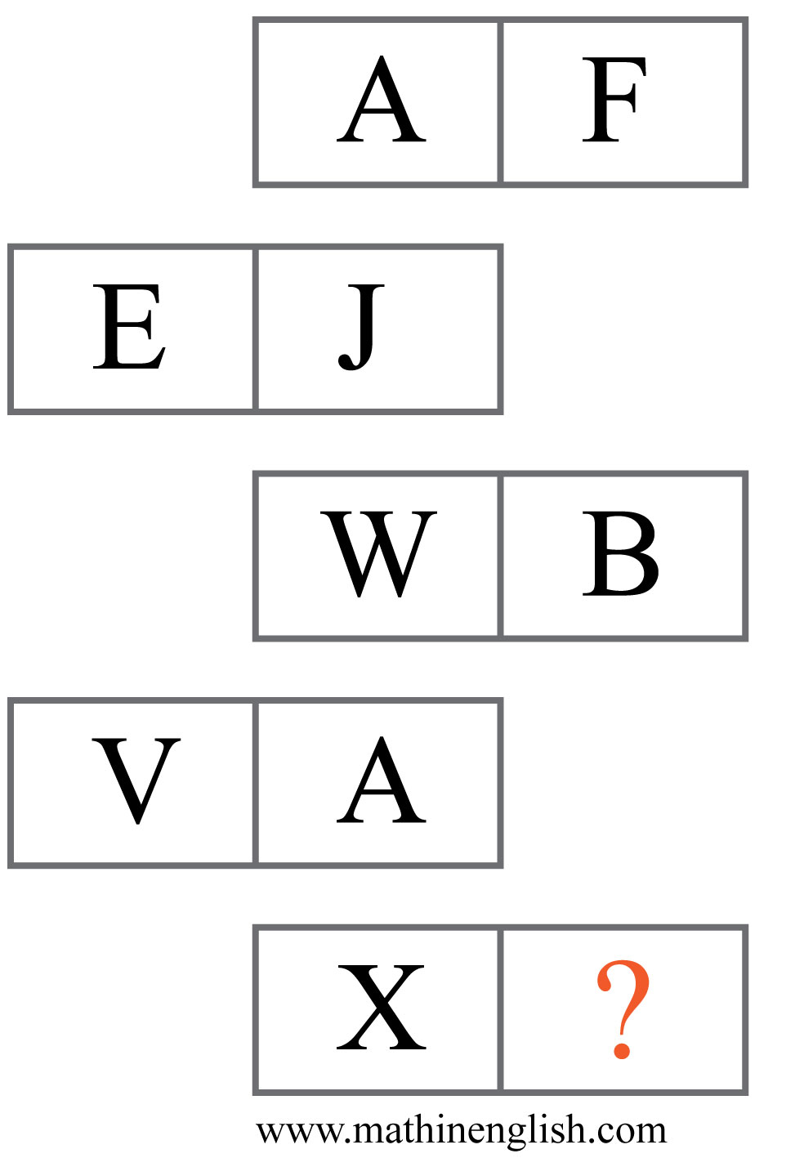
IQ Puzzle 20
Level 2D
Which letter is missing?

Slide 22
Answers to puzzles 1 to 4
puzzle 1 : C
The shapes move 2 positions in the next shape and alternate
between shaded and non shaded.
puzzle 2 : 16
Multiply the left and right number to get the middle number.
puzzle 3 : X
Multiply the letter values in each row or column to get the 3rd
letter in each row or column.
puzzle 4 : 12
The numbers in the first 2 circles add up to the numbers, in the same
place, in the 3rd circle.
Copyright: www.mathinenglish.com
Level 2D

Slide 23
Answers to puzzles 5 to 8
puzzle 5 : 21
The sums of the circles follow the pattern 30,40,50, 60 and so on.
puzzle 6 : M
The letter values of E and H add up to 13, M.
puzzle 7 : 58
Multiply the inner numbers by 6 to get the outer numbers. A = 10 and B = 48
puzzle 8 : 6
Each row ad column adds up to 30.
Copyright: www.mathinenglish.com
Level 2D

Slide 24
Answers to puzzles 9 to 12
puzzle 9 : C
The 4 shapes change 1 place in each row and go up by +1.
puzzle 10 : D
Subtract the value of the 2nd cell from the 1st to get the 3rd.
puzzle 11 : 6
Each row or column adds up to 18.
puzzle 12 : 10
The first 2 rows in each pyramid add up to the top number.
Copyright: www.mathinenglish.com
Level 2D

Slide 25
Answers to puzzles 13 to 16
puzzle 13 : I
Multiply the number of sides of each shape by 3 to get the letter value.
puzzle 14 : 20
Each ‘leg’ adds up to 40, the middle number.
puzzle 15 : 41
Multiply the opposite corner numbers and add 1 to the product.
puzzle 16 : B
The middle numbers are the difference between the 2
connecting letter values.
Copyright: www.mathinenglish.com
Level 2D

Slide 26
Answers to puzzles 17 to 20
puzzle 17 : A
In both rows, the next circle contains -2 shaded squares.
puzzle 18 : 46
The puzzles follows a x2 + 2 pattern.
puzzle 19 : 31
Multiply the numbers in the outer and inner ring and add 10 to the product.
puzzle 20 : C
Add 5 to each letter on the left. Add 5 to X gives C.
Copyright: www.mathinenglish.com
Level 2D

