Slide 1

IQ puzzles and brain teasers
Level 2E

Slide 2
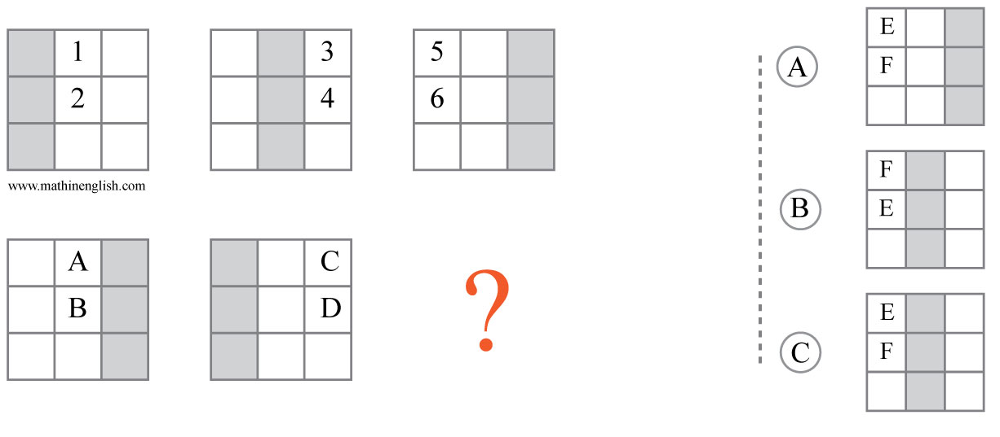



IQ Puzzle 1
Level 2E
Which option is correct?

Slide 3
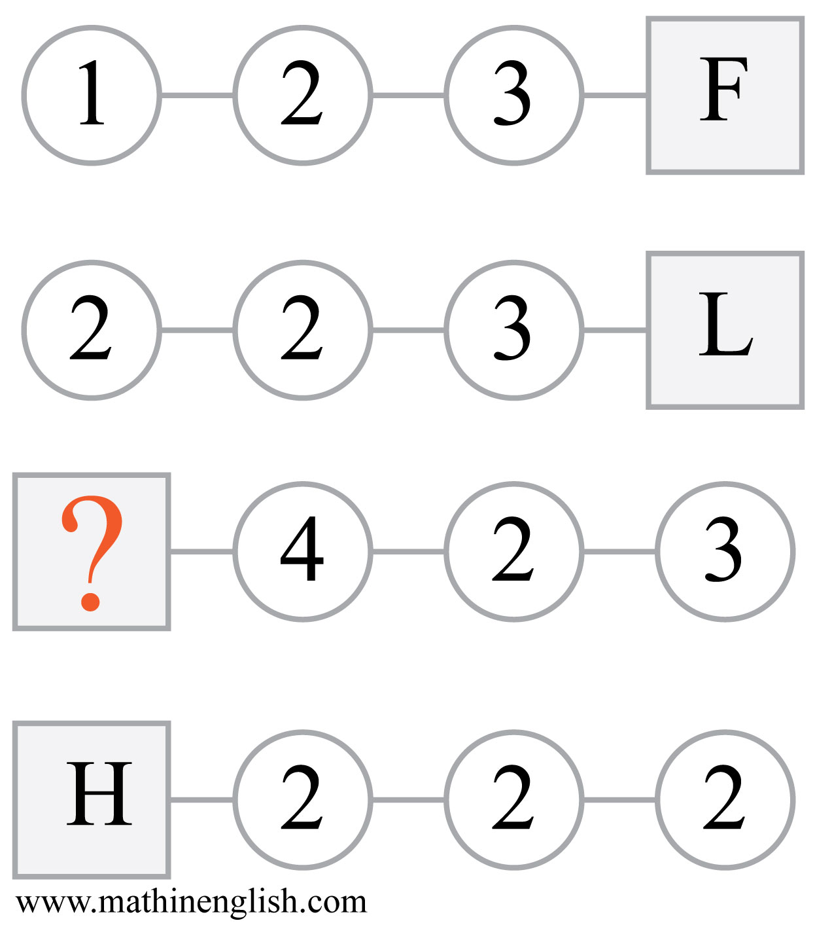
IQ Puzzle 2
Level 2E
Which letter is missing?

Slide 4
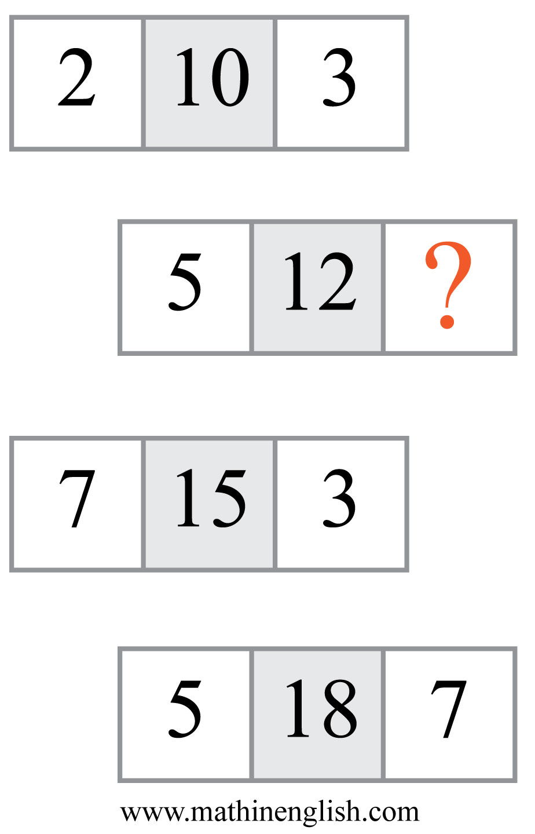
IQ Puzzle 3
Level 2E
What is the missing number?

Slide 5
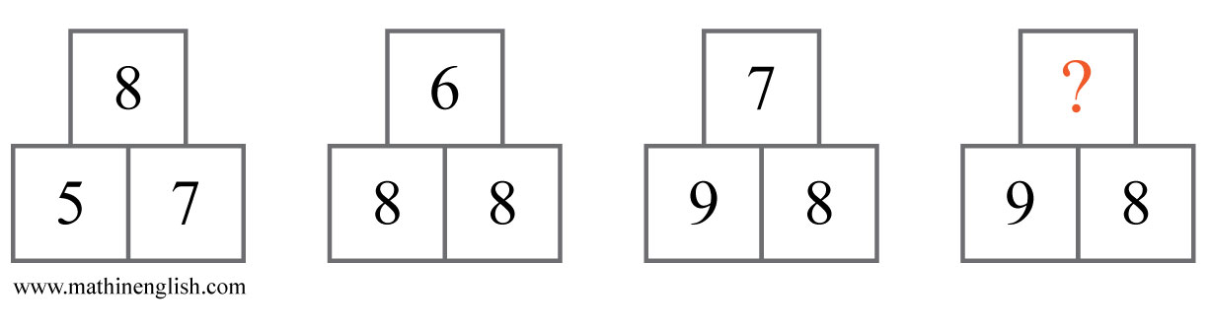
IQ Puzzle 4
Level 2E
What number is needed here?

Slide 6
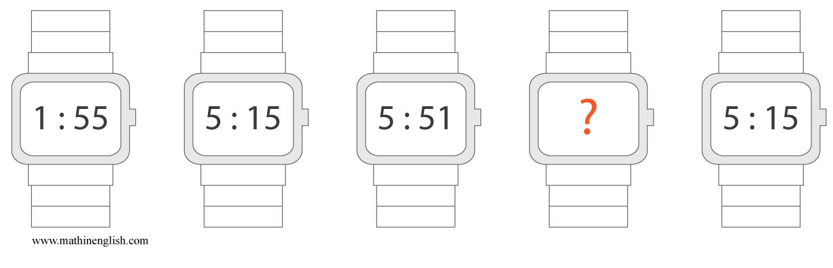
IQ Puzzle 5
Level 2E
What is the missing time?

Slide 7
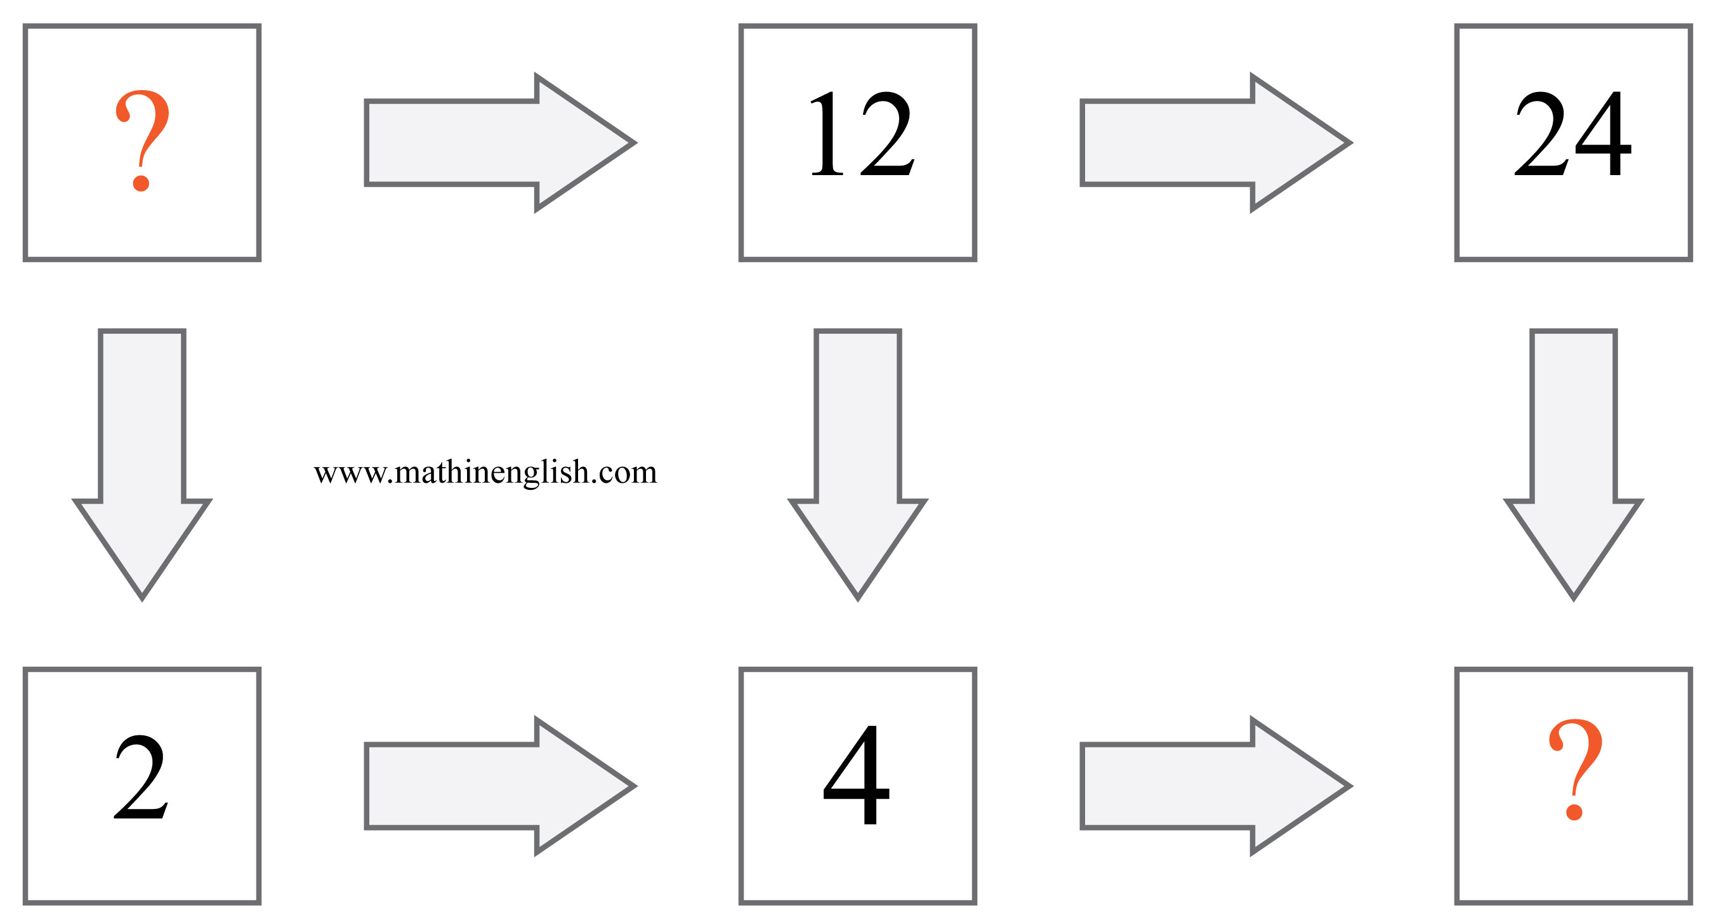
IQ Puzzle 6
Level 2E
Which number is missing?

Slide 8
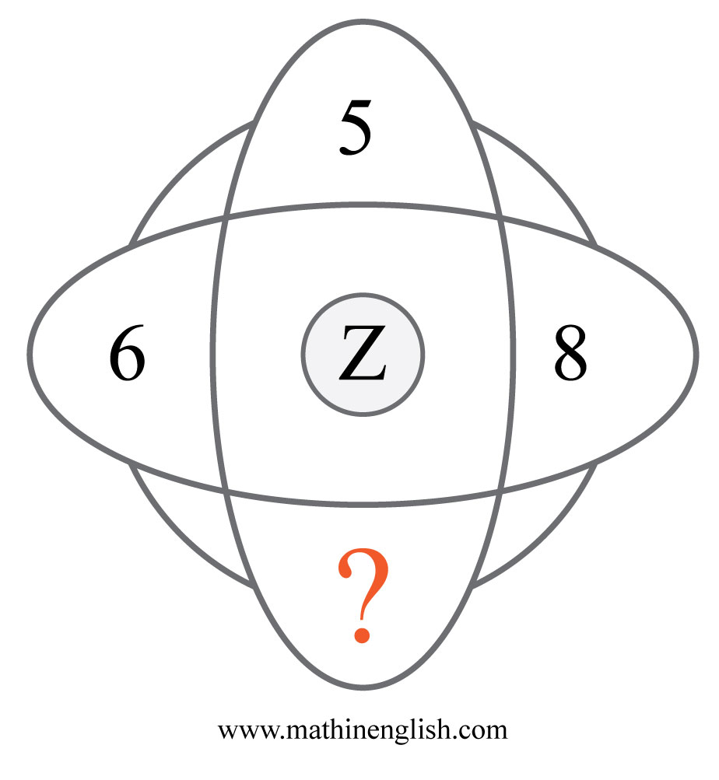
IQ Puzzle 7
Level 2E
Which number is missing?

Slide 9
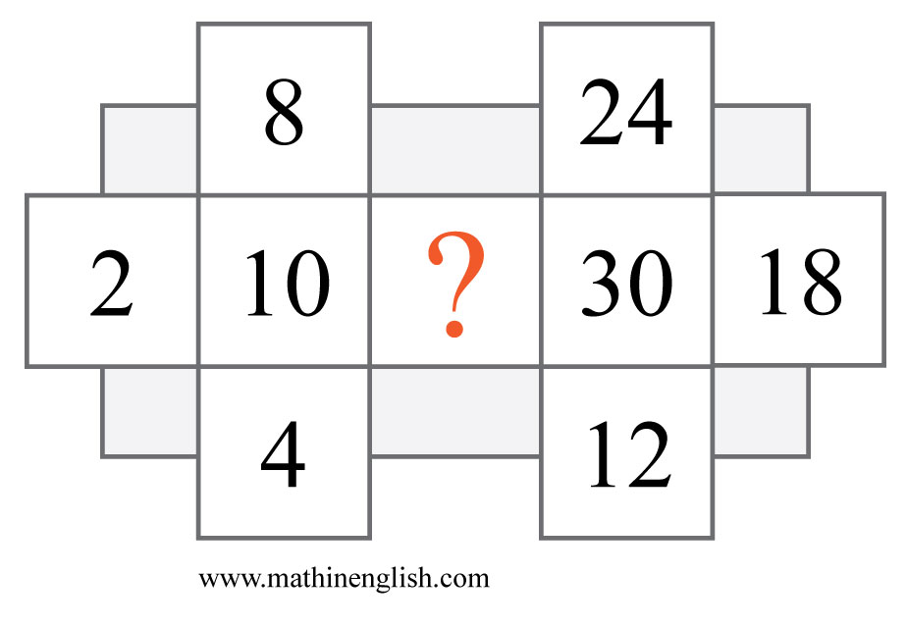
IQ Puzzle 8
Level 2E
Which number completes the puzzle?

Slide 10
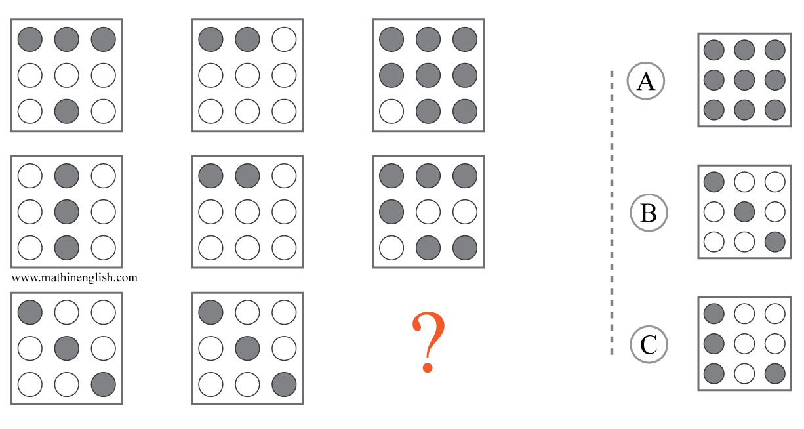
IQ Puzzle 9
Level 2E
Which option is correct?

Slide 11
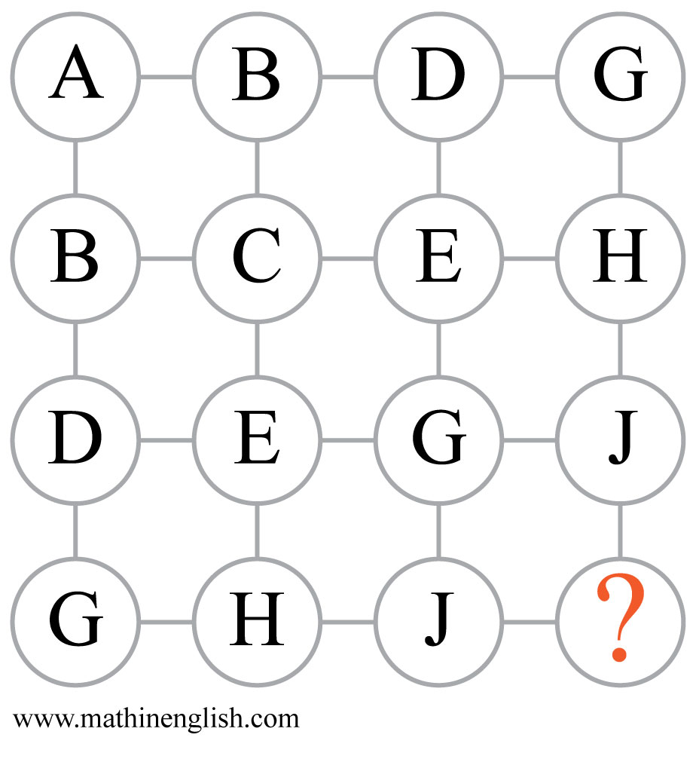
IQ Puzzle 10
Level 2E
Which letter is missing?

Slide 12
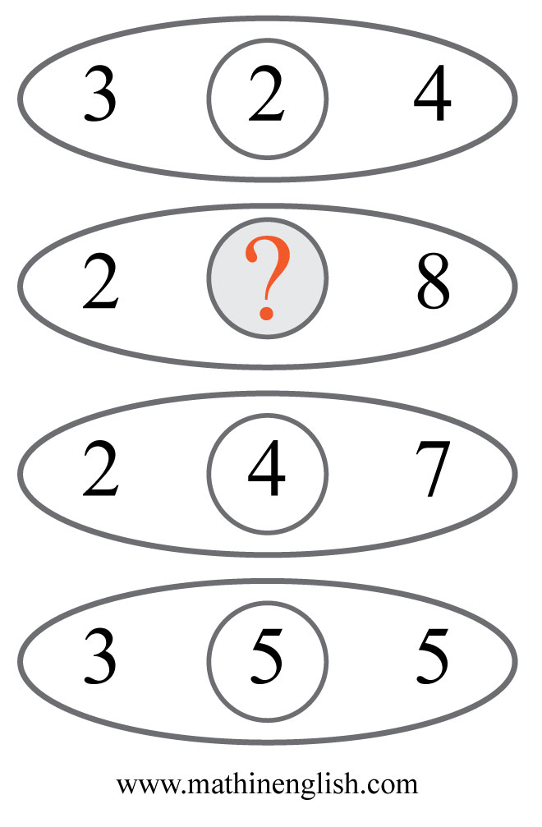
IQ Puzzle 11
Level 2E
Which number is missing?

Slide 13
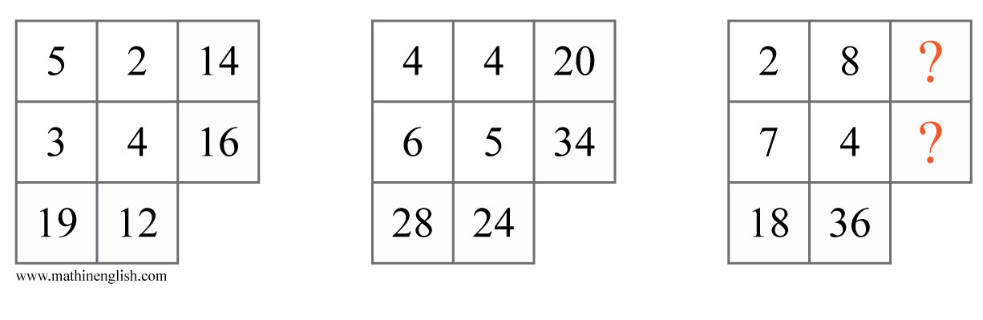
IQ Puzzle 12
Level 2E
Which numbers are missing?

Slide 14
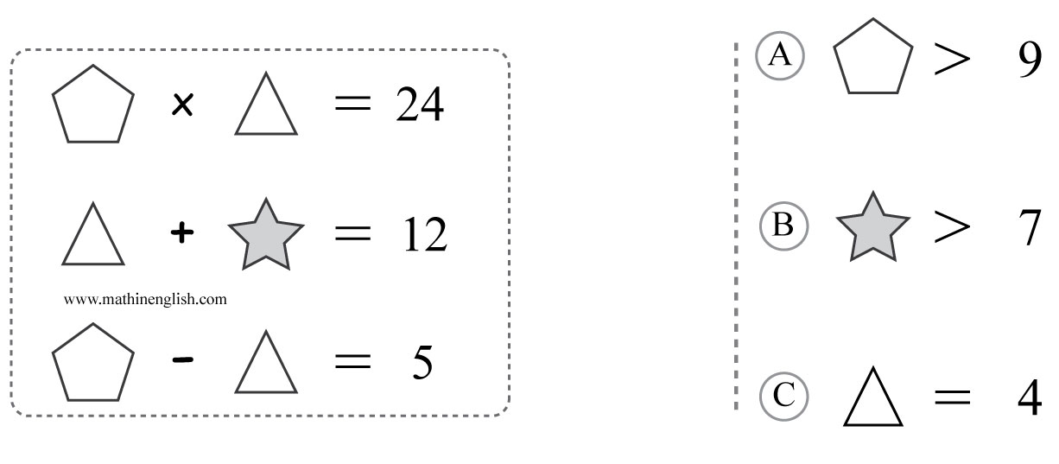
IQ Puzzle 13
Level 2E
Which option is correct?

Slide 15
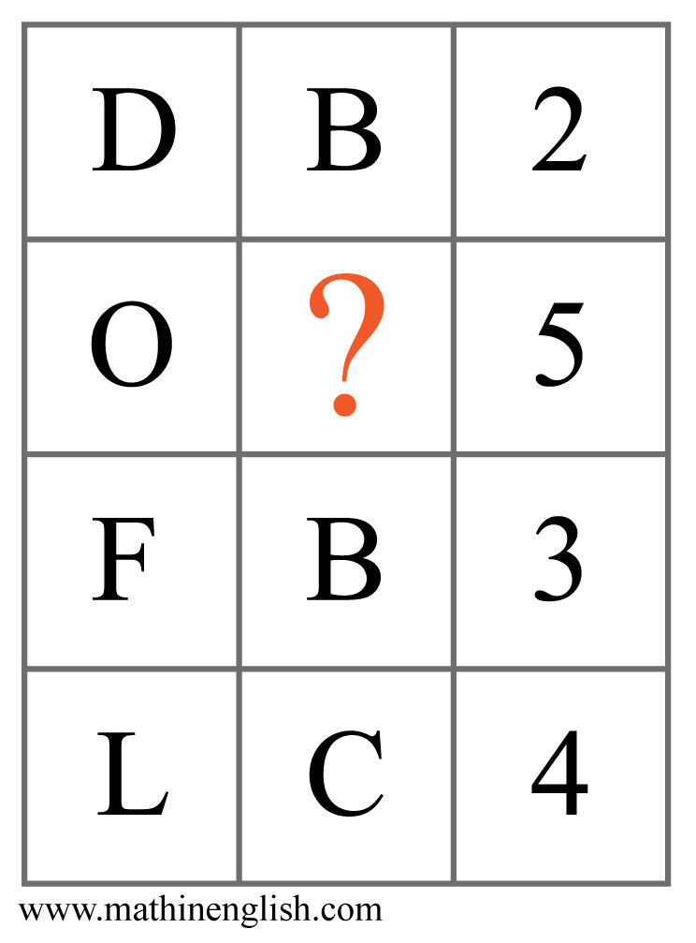
IQ Puzzle 14
Level 2E
Which letter is missing?

Slide 16

IQ Puzzle 15
Level 2E
Which letter is the odd one out?

Slide 17
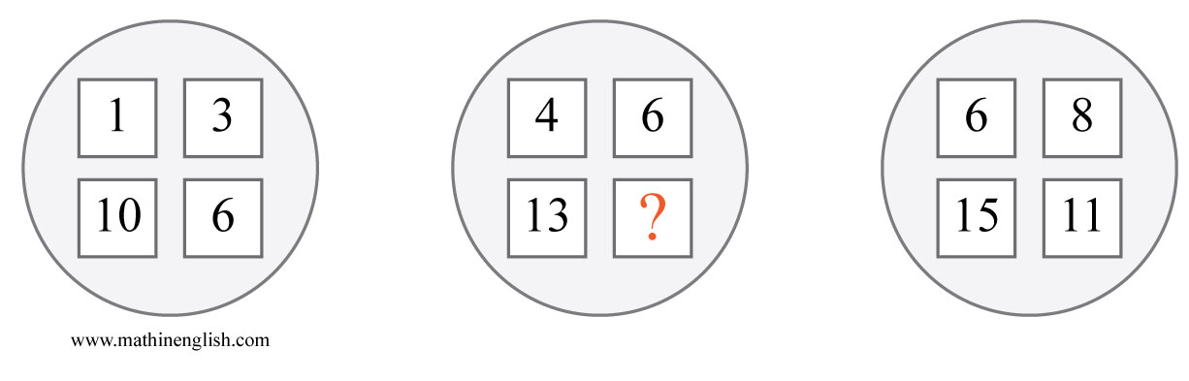
IQ Puzzle 16
Level 2E
Which number is missing?

Slide 18
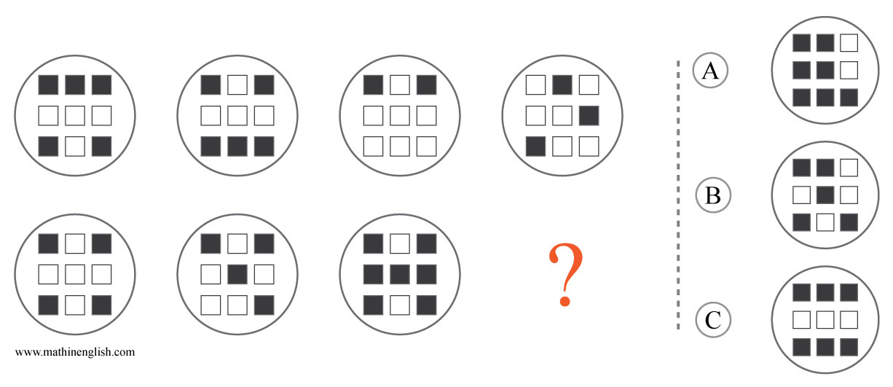
IQ Puzzle 17
Level 2E
Which option is correct?

Slide 19
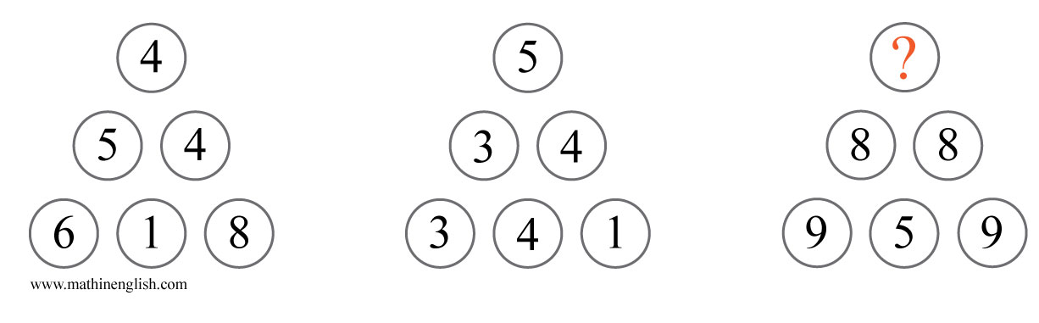
IQ Puzzle 18
Level 2E
Which number is missing?

Slide 20
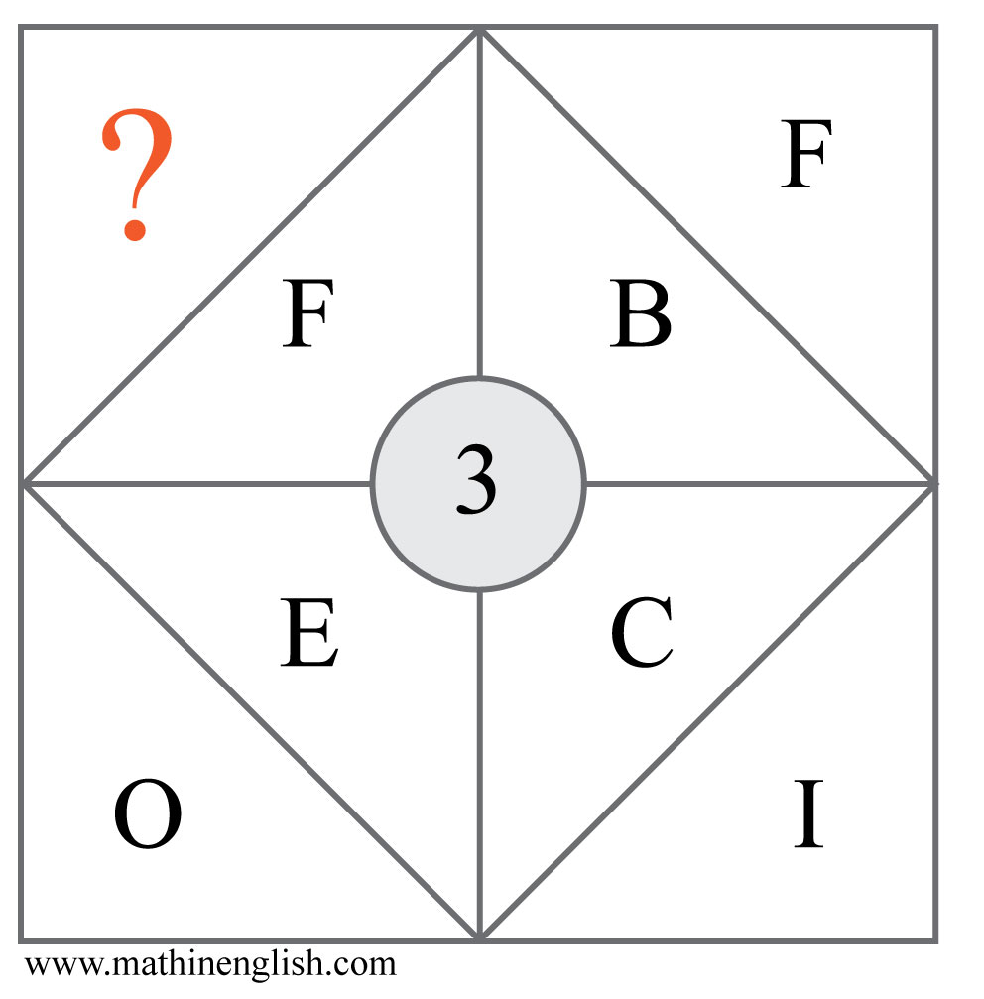
IQ Puzzle 19
Level 2E
Which letter is missing?

Slide 21
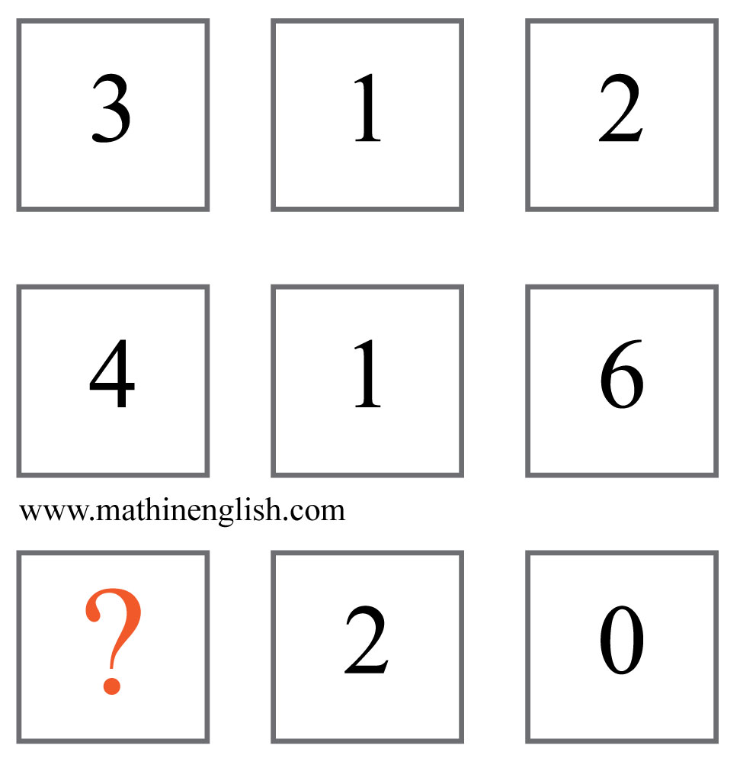
IQ Puzzle 20
Level 2E
Which number is missing?

Slide 22
Answers to puzzles 1 to 4
puzzle 1 : C
The shaded colums and numbers move 1 step horizontally in each next square with the numbers and letters increasing in value and alternating position.
puzzle 2 : X
Multiply the 3 circles to get the letter value in each row.
puzzle 3 : 3
Each row of blocks follows a +5 pattern starting with a sum of 15
in the first row.
puzzle 4 : 9
The sums of the 3 numbers in each pyramid follow a +2 pattern,
starting with 20.
Copyright: www.mathinenglish.com
Level 2E

Slide 23
Answers to puzzles 5 to 8
puzzle 5 : 1:55
The 3 digits 155 rotate 1 position in each next watch.
puzzle 6 : 6 and 8
Numbers multiply by 2 horizontally and divide by 3 vertically.
puzzle 7 : 7
All 4 numbers add up to 26, or Z.
puzzle 8 : 6
The left cross has a pattern of multiples of 2, the cross on the
right multiples of 6.
Copyright: www.mathinenglish.com
Level 2E

Slide 24
Answers to puzzles 9 to 12
puzzle 9 : A
Multiply in each row the number of shaded dots of the 1st square
with those of the 2nd to get the 3rd.
puzzle 10 : M
Each row and column follows a +1. +2, +3 pattern in values.
puzzle 11 : 6
The pattern is left times right, minus 10.
puzzle 12 : 20 and 32
Multiply the 2 digits in each row and columns and add a 4 to the product.
Copyright: www.mathinenglish.com
Level 2E

Slide 25
Answers to puzzles 13 to 16
puzzle 13 : B
Given the first line, the pentagon and triangle pair can either be
12-2, 6-4 or 8-3.
puzzle 14 : C
In each line the 2nd and 3rd cell multiplied are equal to the 1st.
puzzle 15 : Q
Q is the only letter with an odd letter value.
puzzle 16 : 9
From the top left cell and going clockwise the sequence follows
a +2, +3, +4 pattern.
Copyright: www.mathinenglish.com
Level 2E

Slide 26
Answers to puzzles 17 to 20
puzzle 17 : C
In each vertical pair there are 9 shaded squares.
puzzle 18 : 9
The cells of the first 2 pyramids add up the identical one in the 3rd.
puzzle 19 : R
3 times F equals 18, which is the letter value of R.
puzzle 20 : 5
Multiply the 1st cell in each row by 4 to get the digits in the 2nd and 3rd cell.
Copyright: www.mathinenglish.com
Level 2E

