Slide 1
IQ puzzles and brain teasers
Level 3A

Slide 2
IQ Puzzle 1
Level 3A
What number of pips is missing?

Slide 3
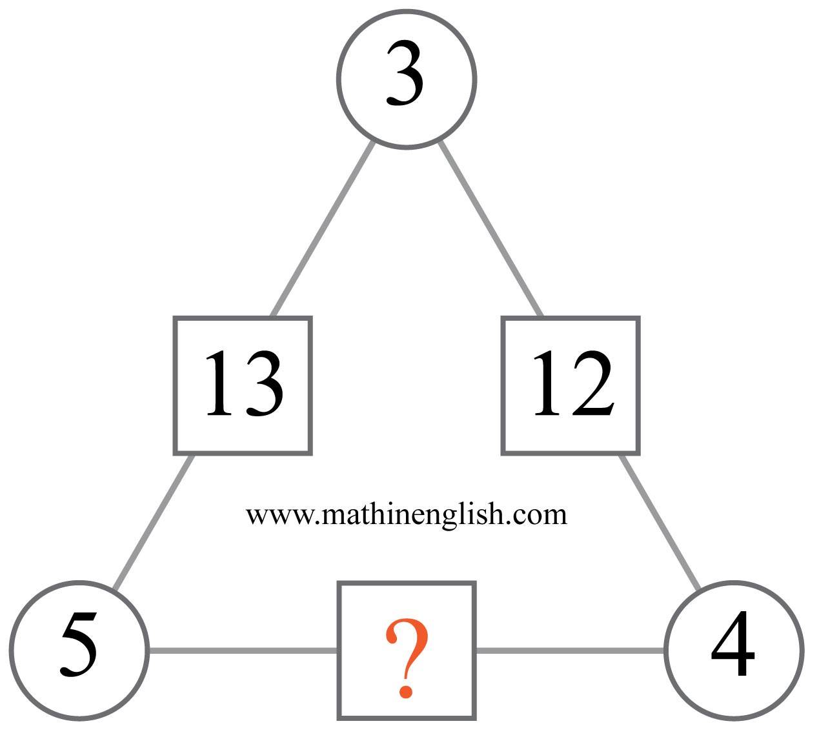
IQ Puzzle 2
Level 3A
Which number is missing?

Slide 4
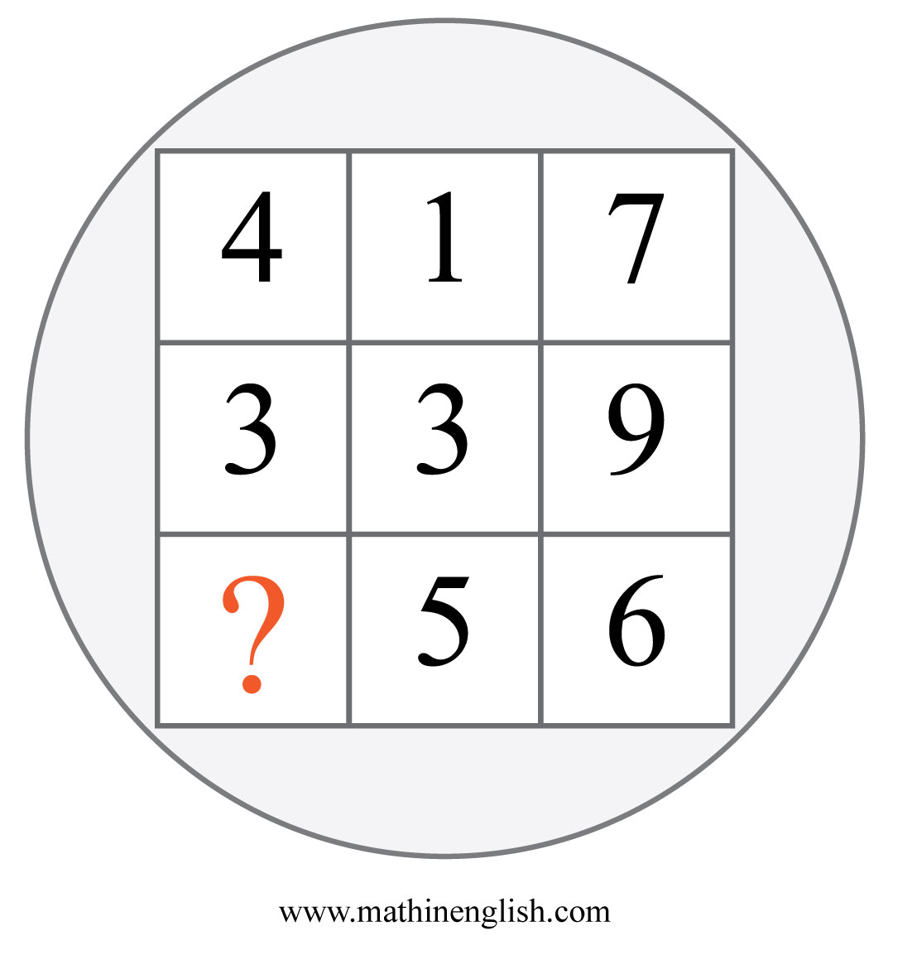
IQ Puzzle 3
Level 3A
What is the missing number?

Slide 5
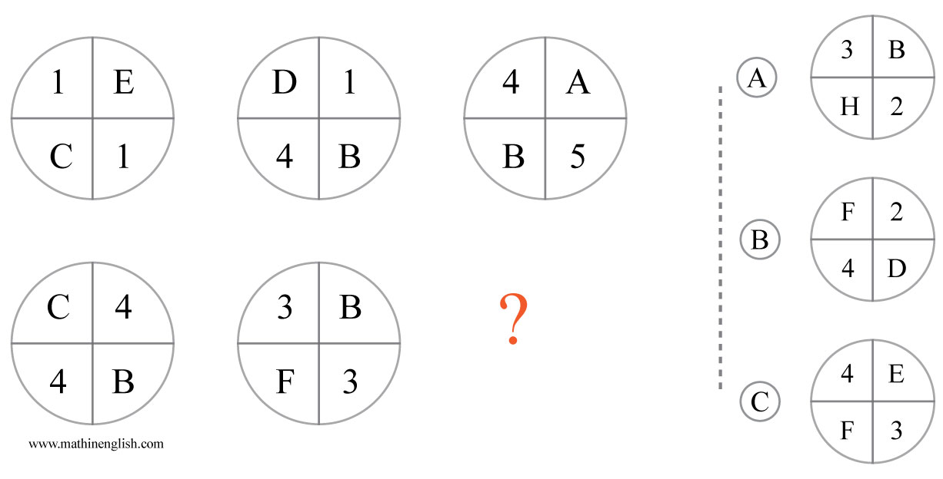
IQ Puzzle 4
Level 3A
Which option is correct?

Slide 6
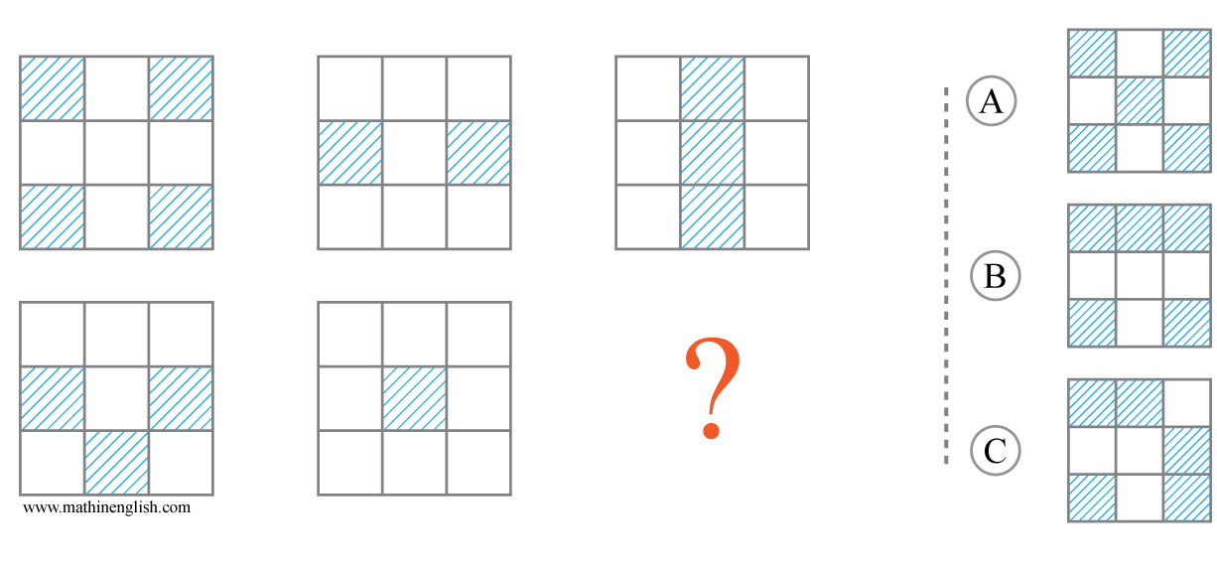
IQ Puzzle 5
Level 3A
Which option is correct?

Slide 7
IQ Puzzle 6
Level 3A
Which letter is missing?

Slide 8
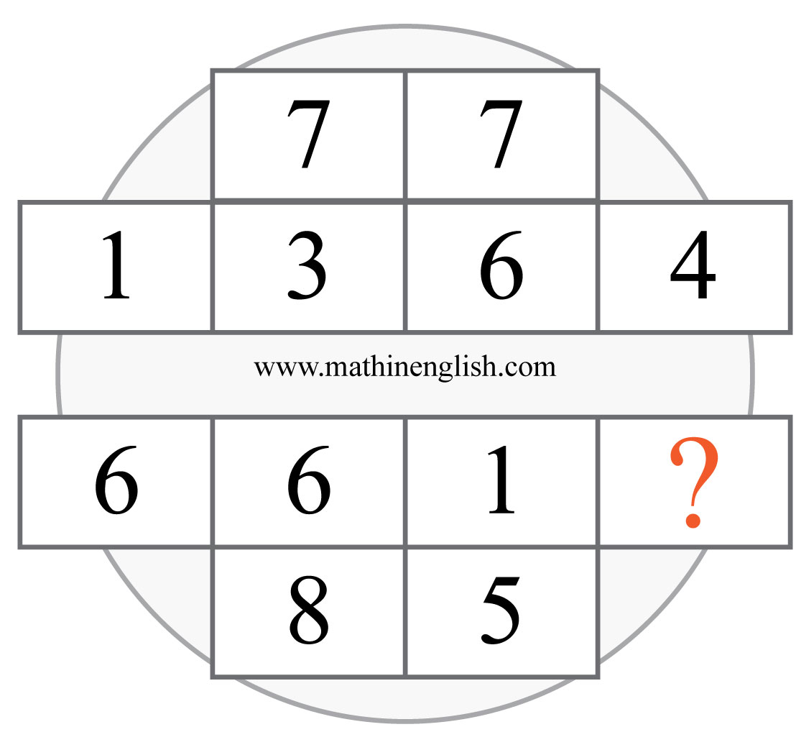
IQ Puzzle 7
Level 3A
Which number is missing?

Slide 9
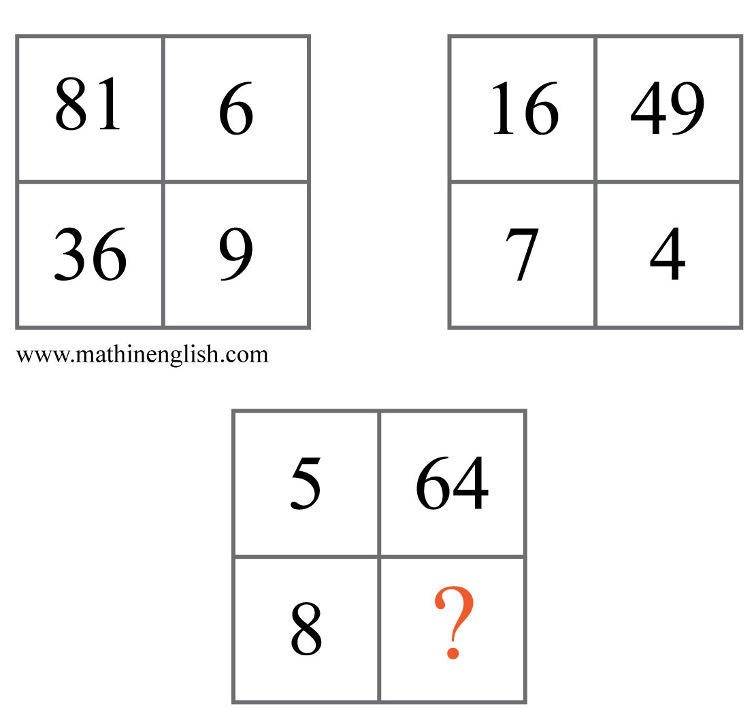
IQ Puzzle 8
Level 3A
Which number is needed here?

Slide 10
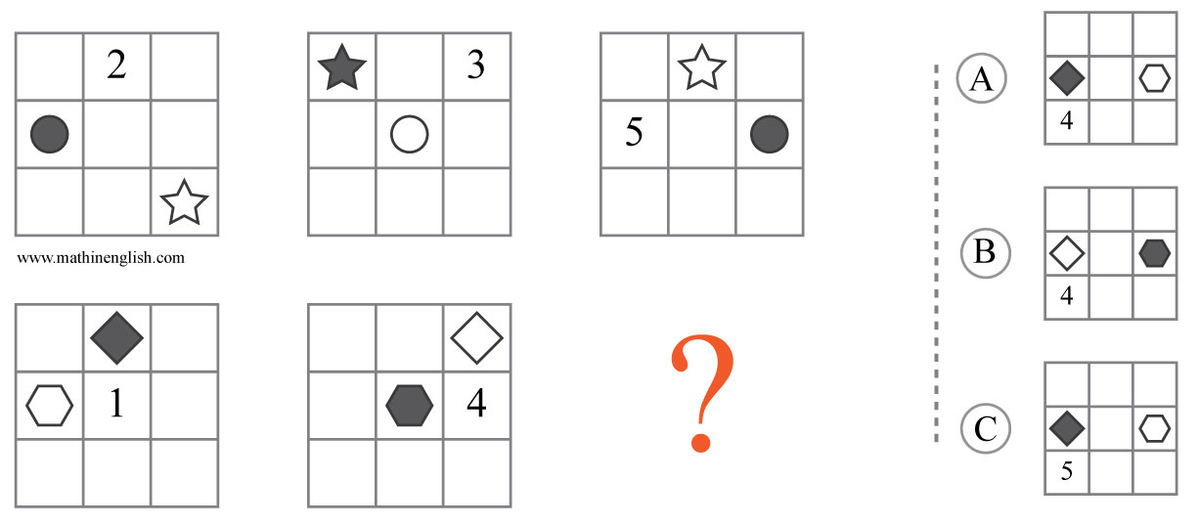
IQ Puzzle 9
Level 3A
Which option is correct?

Slide 11
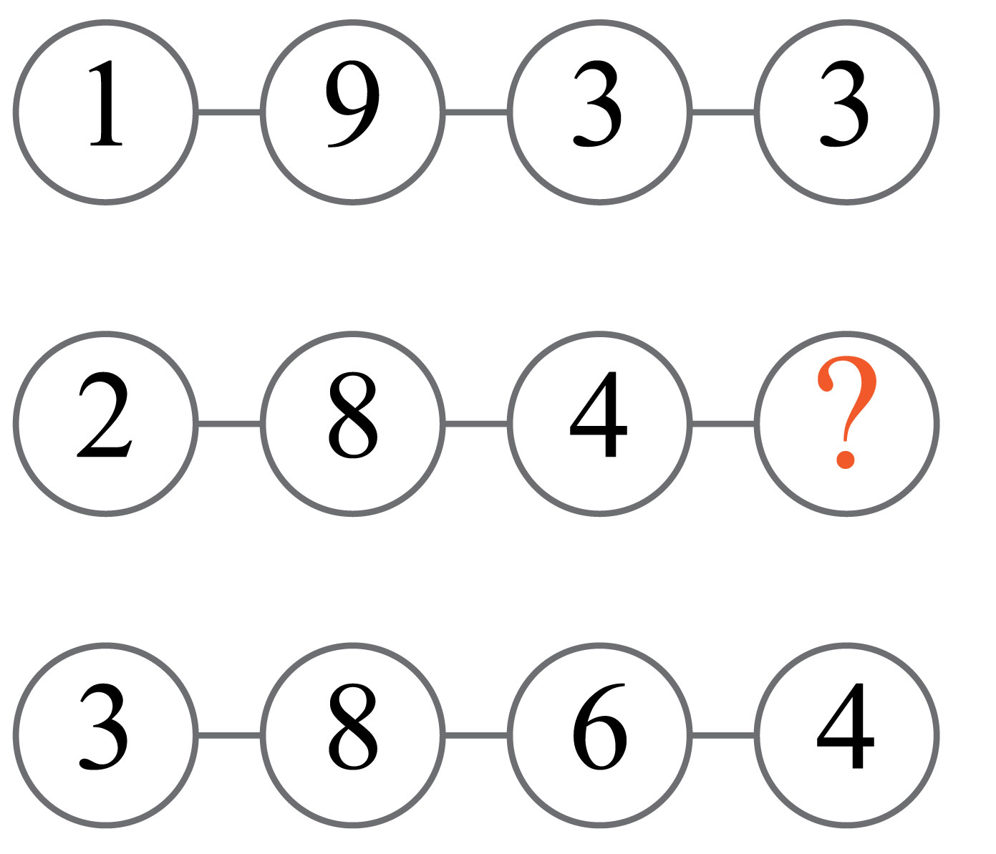
IQ Puzzle 10
Level 3A
Which number is missing?

Slide 12
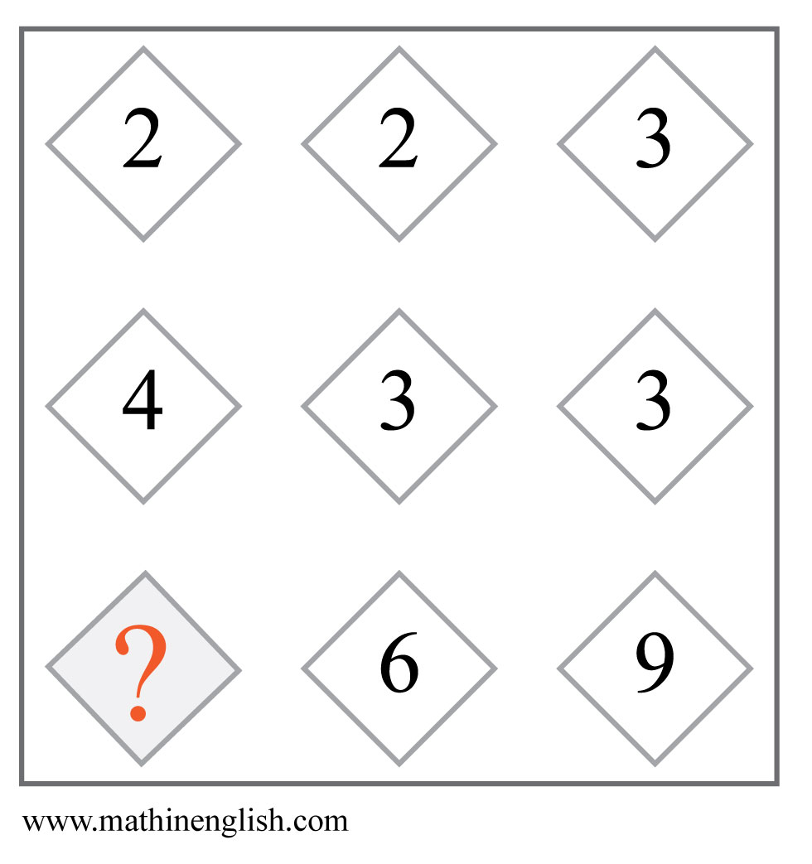
IQ Puzzle 11
Level 3A
Which number is missing?

Slide 13
IQ Puzzle 12
Level 3A
Which number is missing?

Slide 14
IQ Puzzle 13
Level 3A
What is the missing time ?

Slide 15
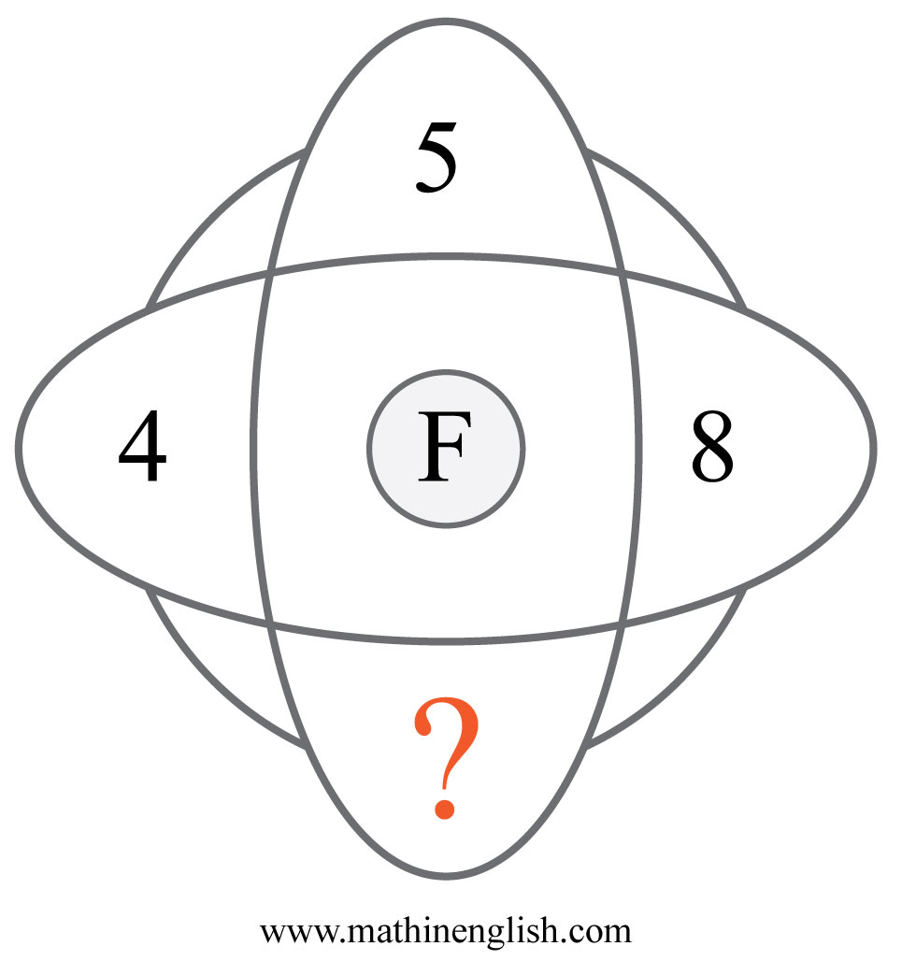
IQ Puzzle 14
Level 3A
What is the missing number?

Slide 16
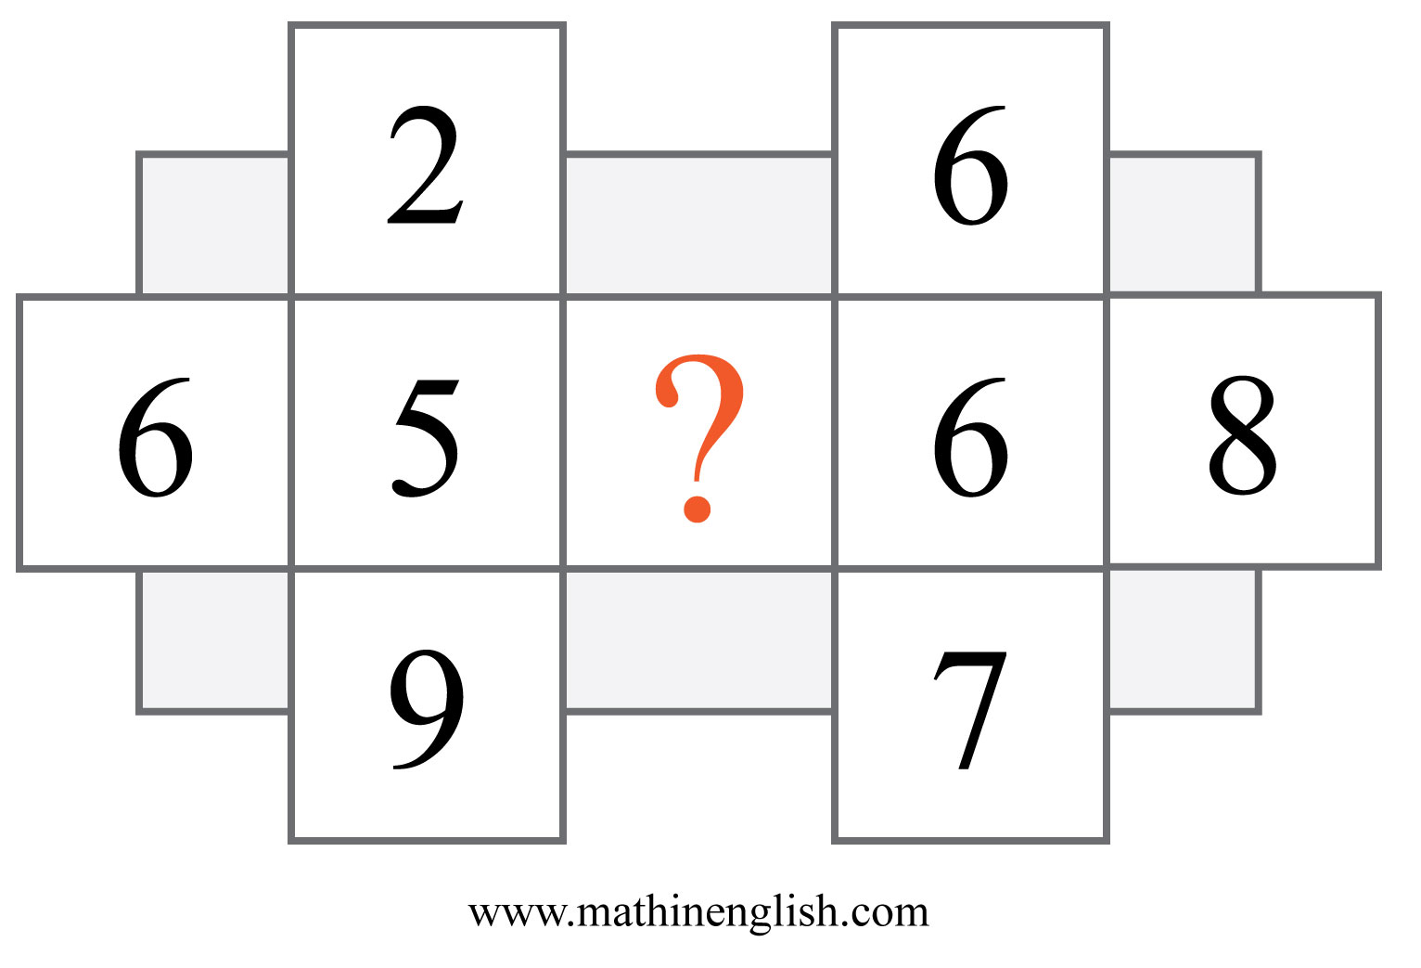
IQ Puzzle 15
Level 3A
Which number is missing?

Slide 17
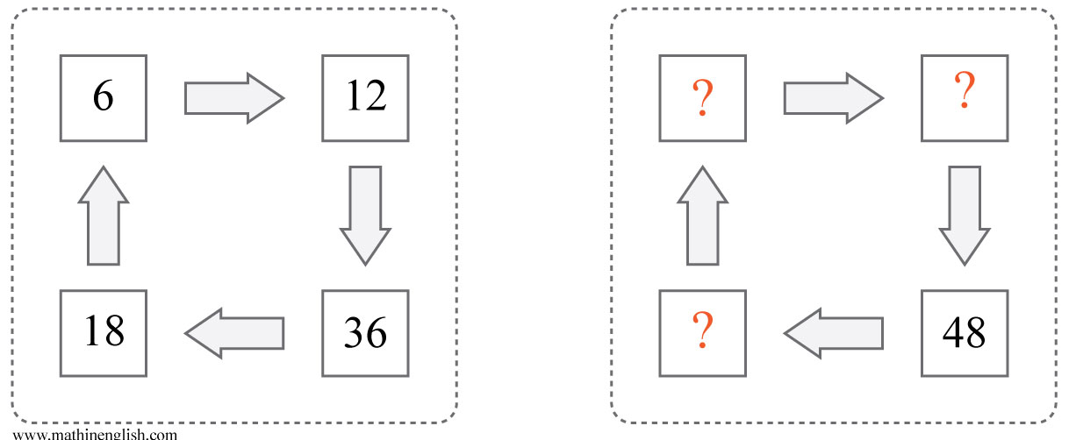
IQ Puzzle 16
Level 3A
Which 3 numbers are missing?

Slide 18
IQ Puzzle 17
Level 3A
Which letter is missing?

Slide 19
IQ Puzzle 18
Level 3A
Which number is missing?

Slide 20
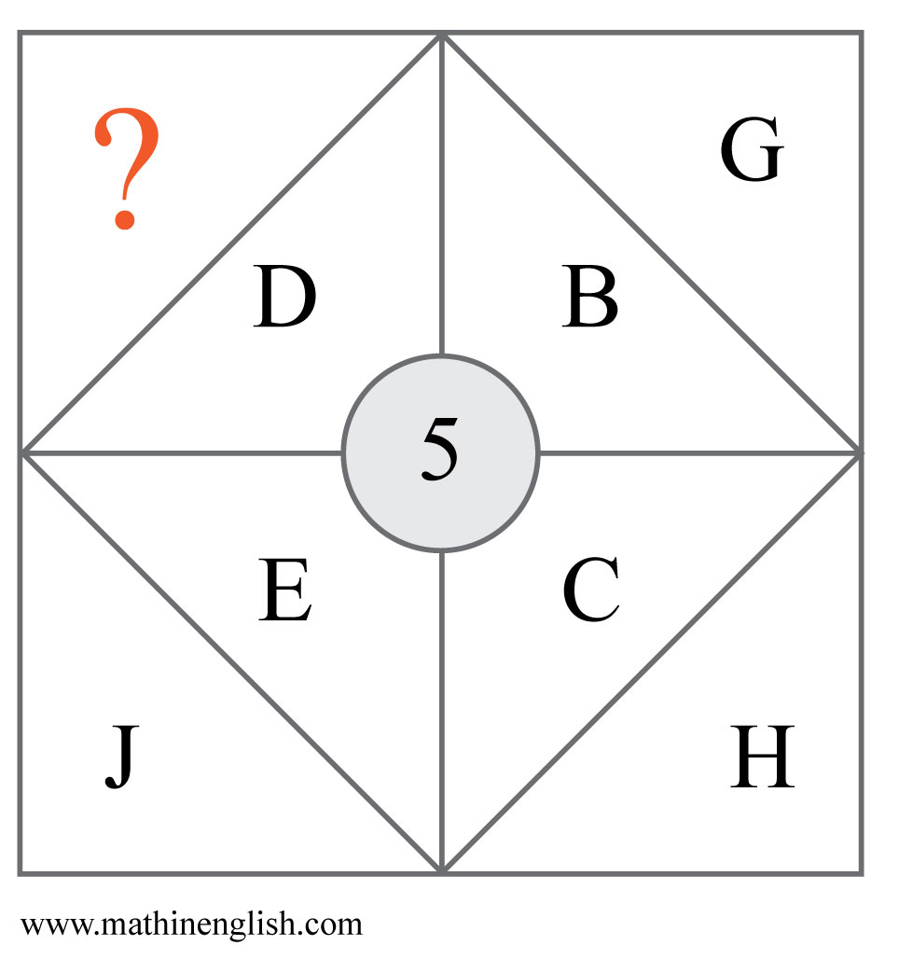
IQ Puzzle 19
Level 3A
Which letter is missing?

Slide 21
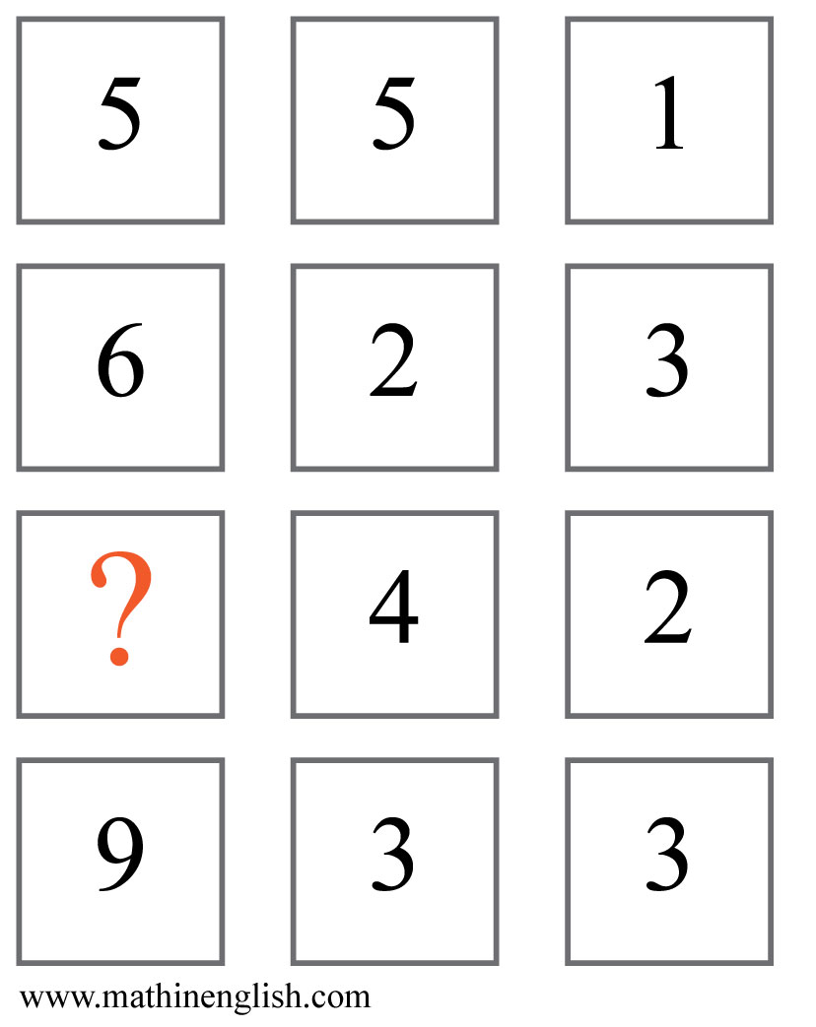
IQ Puzzle 20
Level 3A
Which number is missing?

Slide 22
Answers to puzzles 1 to 4
puzzle 1 : 5
The dominoes follow a +1, + 2, +3 , + 4 and +5 pattern.
puzzle 2 : 14
Add 5 to the sum of a pair of corner numbers to get the middle number.
puzzle 3 : 7
Add 417 and 339 to get 756.
puzzle 4 : A
The sum of the numbers and letter values in each circle follows
a + 1 pattern, with a sum of 15 in the 6th circle.
Copyright: www.mathinenglish.com
Level 3A

Slide 23
Answers to puzzles 5 to 8
puzzle 5 : B
The shaded parts of the 3 squares in each row added together cover
a complete square.
puzzle 6 : O
Multiply the letter value when the arrow points up and divide
the value when the arrow is down.
puzzle 7 : 9
66 and 19 make 85.
puzzle 8 : 25
The opposite number pairs in each square are square roots and
base numbers.
Copyright: www.mathinenglish.com
Level 3A

Slide 24
Answers to puzzles 9 to 12
puzzle 9 : C
The numbers and symbols move 1 place in the next square. The symbols change from shaded to non shaded and the numbers of the first 2 squares add up to the one in the 3rd.
puzzle 10 : 4
The first 2 cells in each row multiplied are equal to the product of the 3rd and 4th cell.
puzzle 11 : 8
Multiply the first 2 numbers in each columns to get the 3rd.
puzzle 12 : J
The letter in the center is the average of the other numbers in each set.
Copyright: www.mathinenglish.com
Level 3A

Slide 25
Answers to puzzles 13 to 16
puzzle 13 : 7:25
The time increases by 1:50 in each next watch.
puzzle 14 : 7
The value of F in the center is the average of the opposite numbers.
puzzle 15 : 3
The center number in each cross is the average of its adjacent numbers.
puzzle 16 : 8, 16 and 24
The sequence follows a x 2 x 3 ÷2 ÷ 3 pattern.
Copyright: www.mathinenglish.com
Level 3A

Slide 26
Answers to puzzles 17 to 20
puzzle 17 : G
The numbers around the star are multiples of 7 (= G).
puzzle 18 : 98
The sequence follows a pattern of times 2, minus 2.
puzzle 19 : I
The difference in letter values of each corner pair is 5.
puzzle 20 : 8
Multiplying the 2nd and 3rd cell in each row equals the 1st cell.
Copyright: www.mathinenglish.com
Level 3A

