Slide 1
IQ puzzles and brain teasers
Level 3C

Slide 2
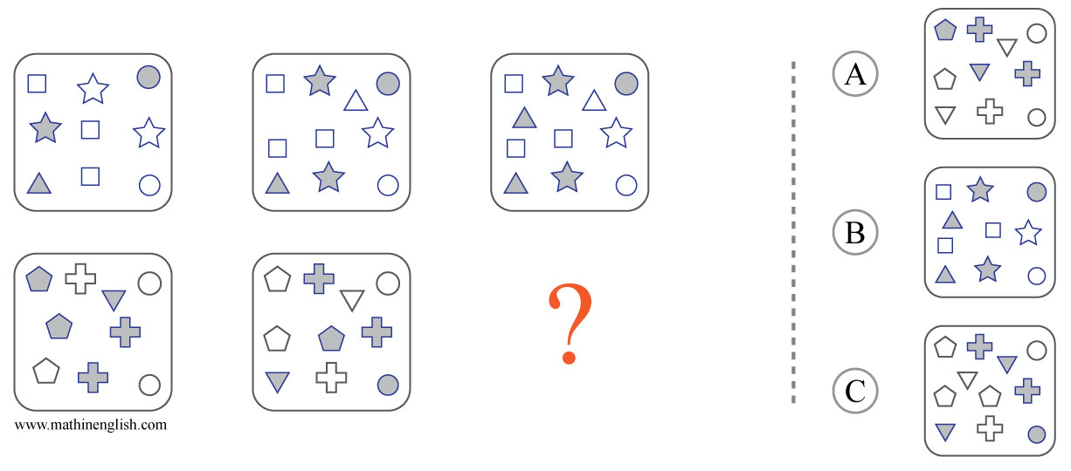
IQ Puzzle 1
Level 3C
Which option is correct?

Slide 3
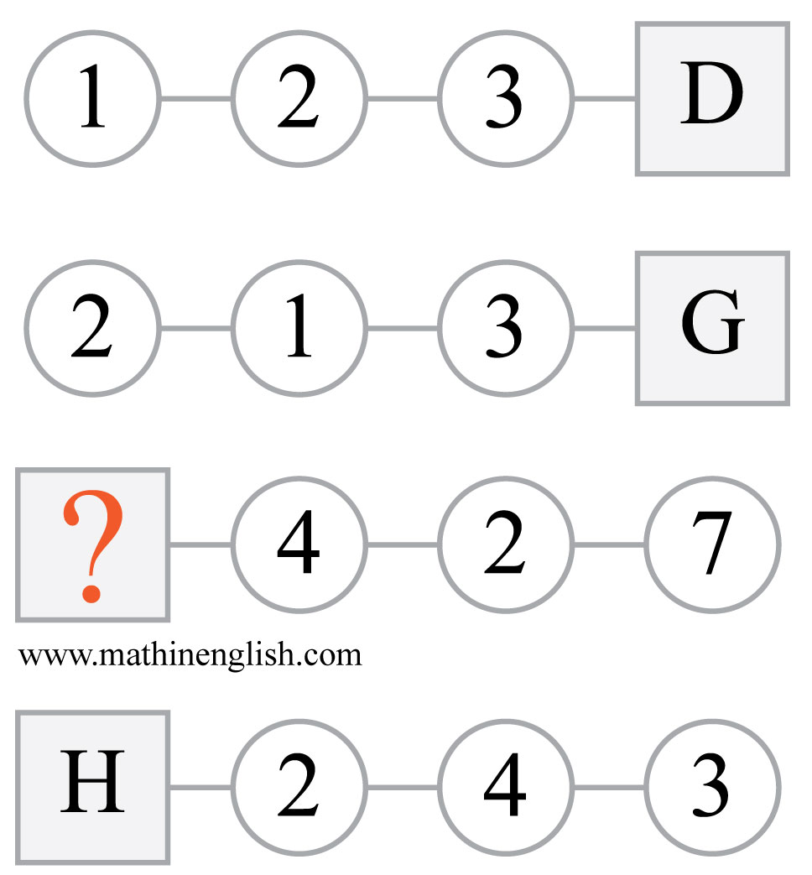
IQ Puzzle 2
Level 3C
Which letter is missing?

Slide 4
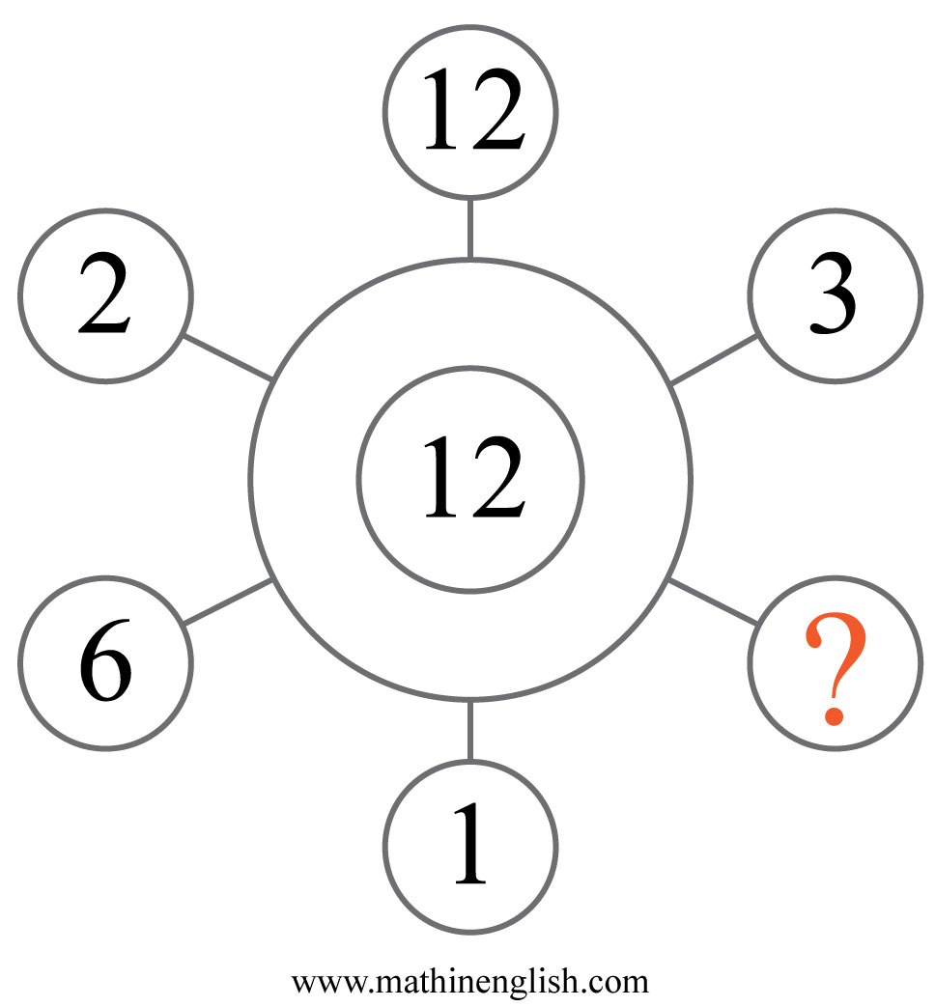
IQ Puzzle 3
Level 3C
What is the missing number?

Slide 5
IQ Puzzle 4
Level 3C
What number is needed here?

Slide 6
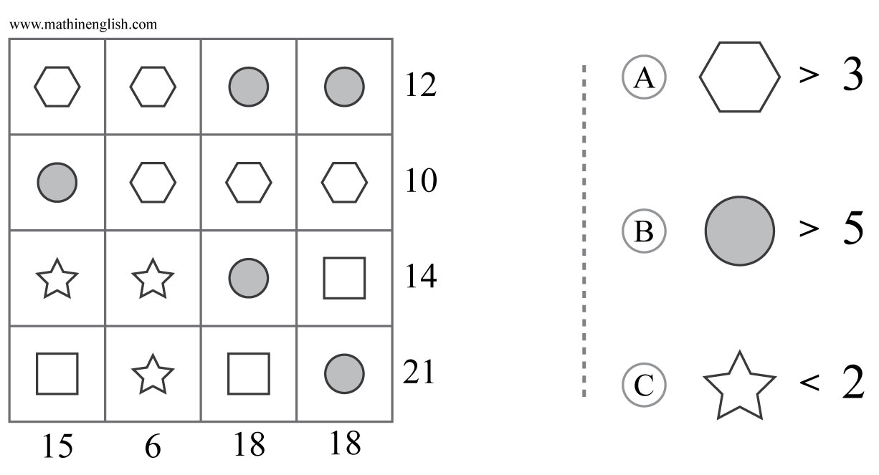
IQ Puzzle 5
Level 3C
What is the correct option?

Slide 7
IQ Puzzle 6
Level 3C
Which number is missing?

Slide 8
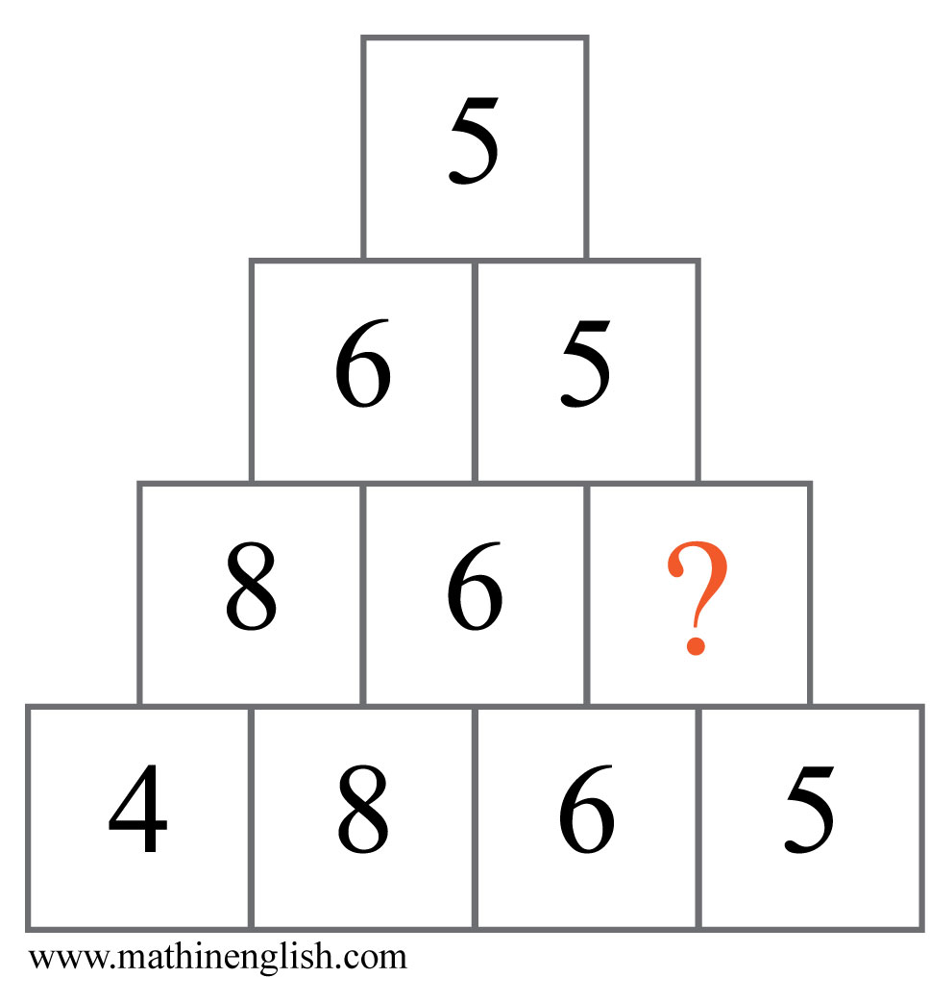
IQ Puzzle 7
Level 3C
Which number is missing?

Slide 9
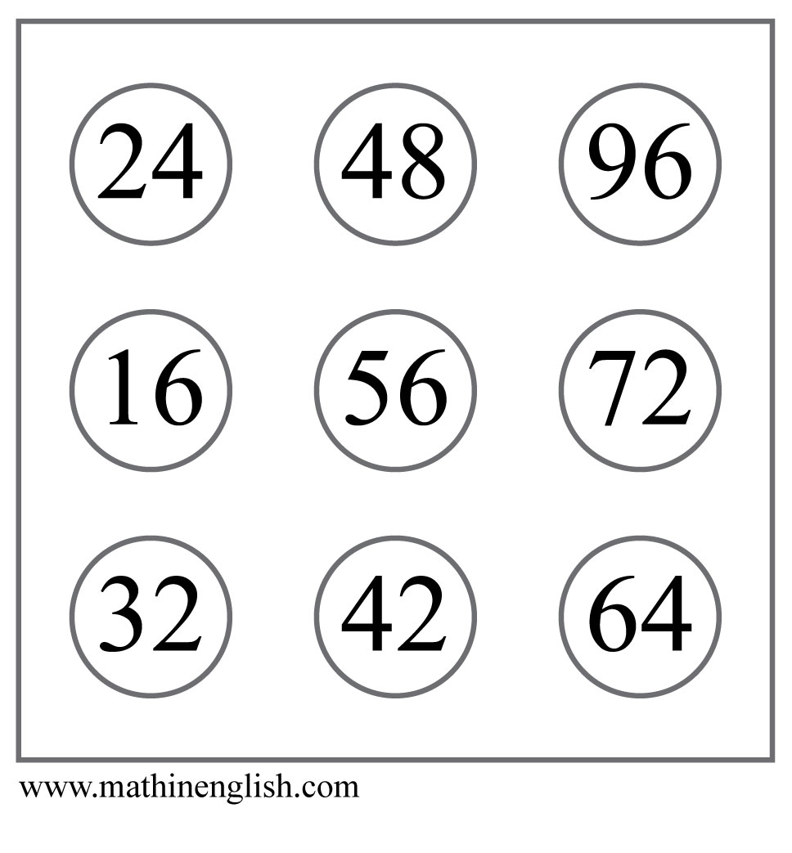
IQ Puzzle 8
Level 3C
Which number is the odd one out?

Slide 10
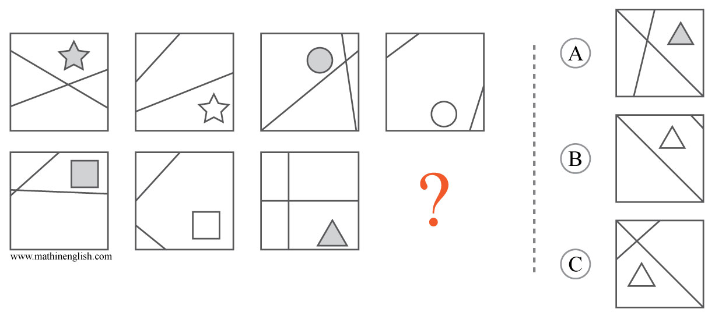
IQ Puzzle 9
Level 3C
Which option is correct?

Slide 11
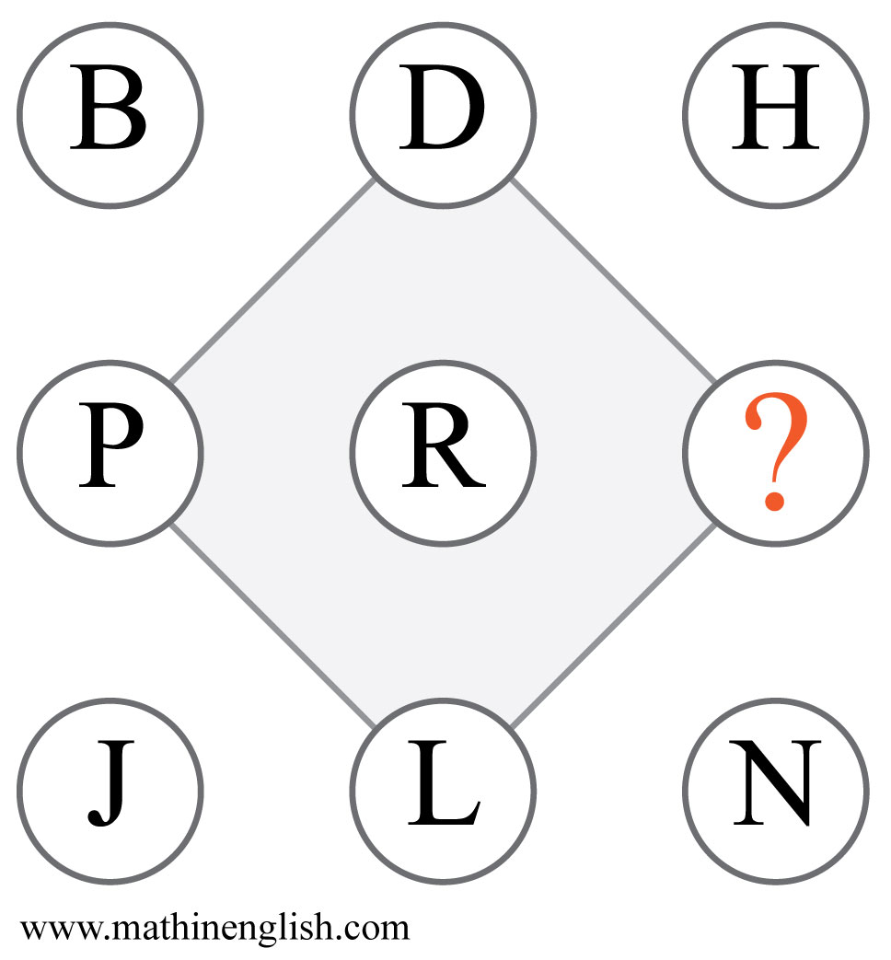
IQ Puzzle 10
Level 3C
Which letter is missing?

Slide 12
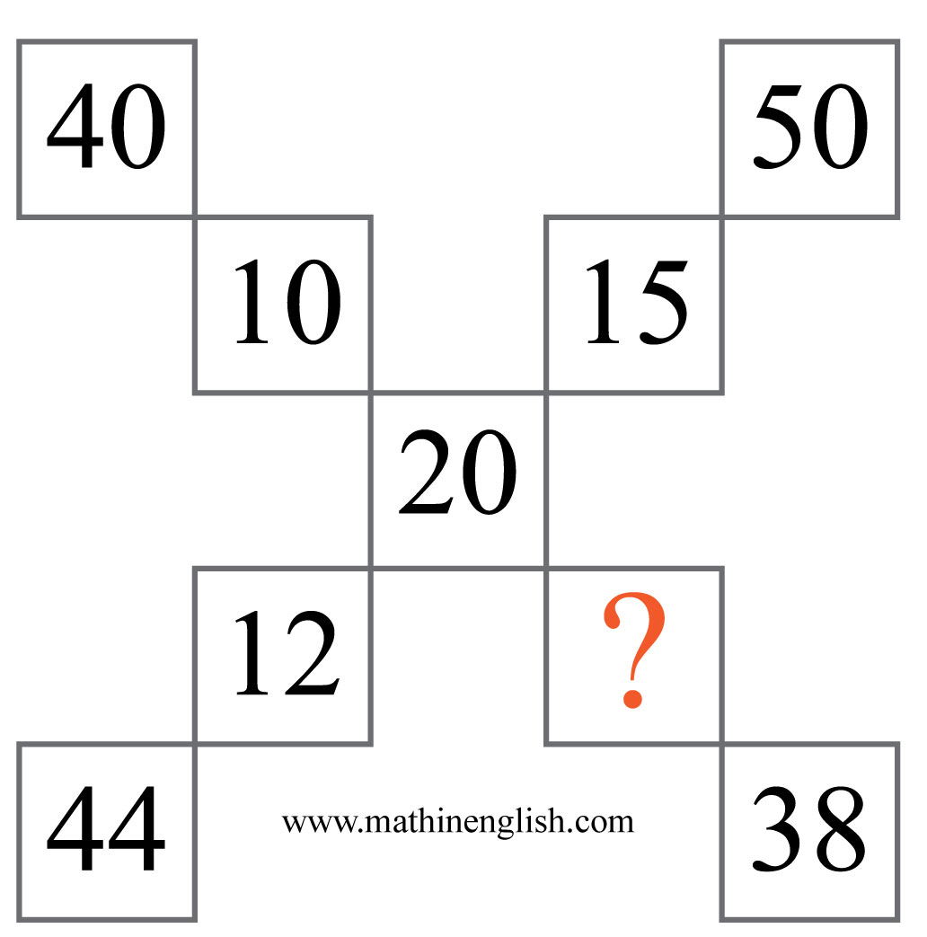
IQ Puzzle 11
Level 3C
Which number is needed here?

Slide 13
IQ Puzzle 12
Level 3C
Which numbers are needed here?

Slide 14
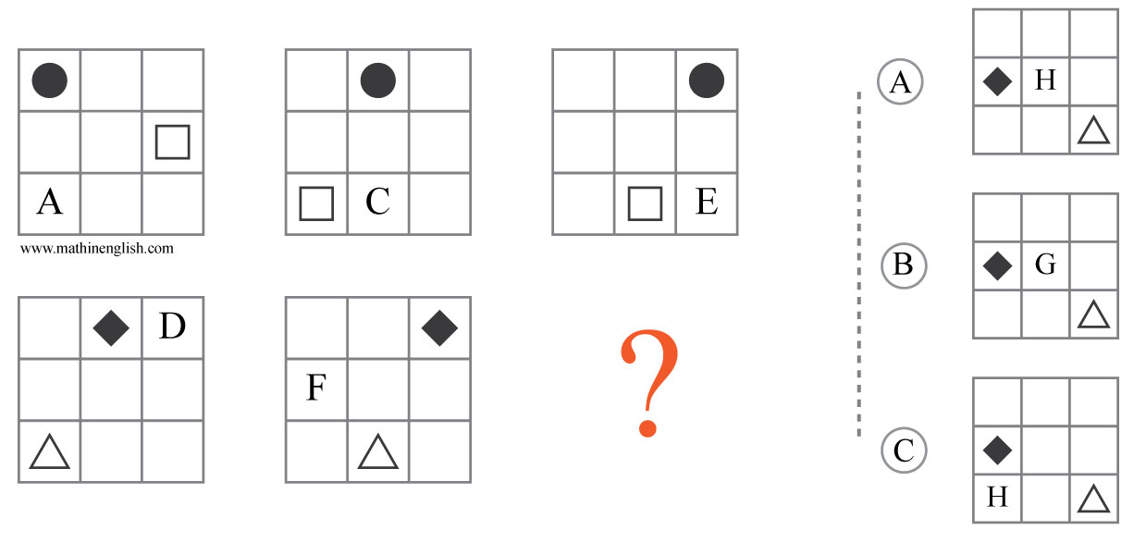
IQ Puzzle 13
Level 3C
Which option is correct?

Slide 15
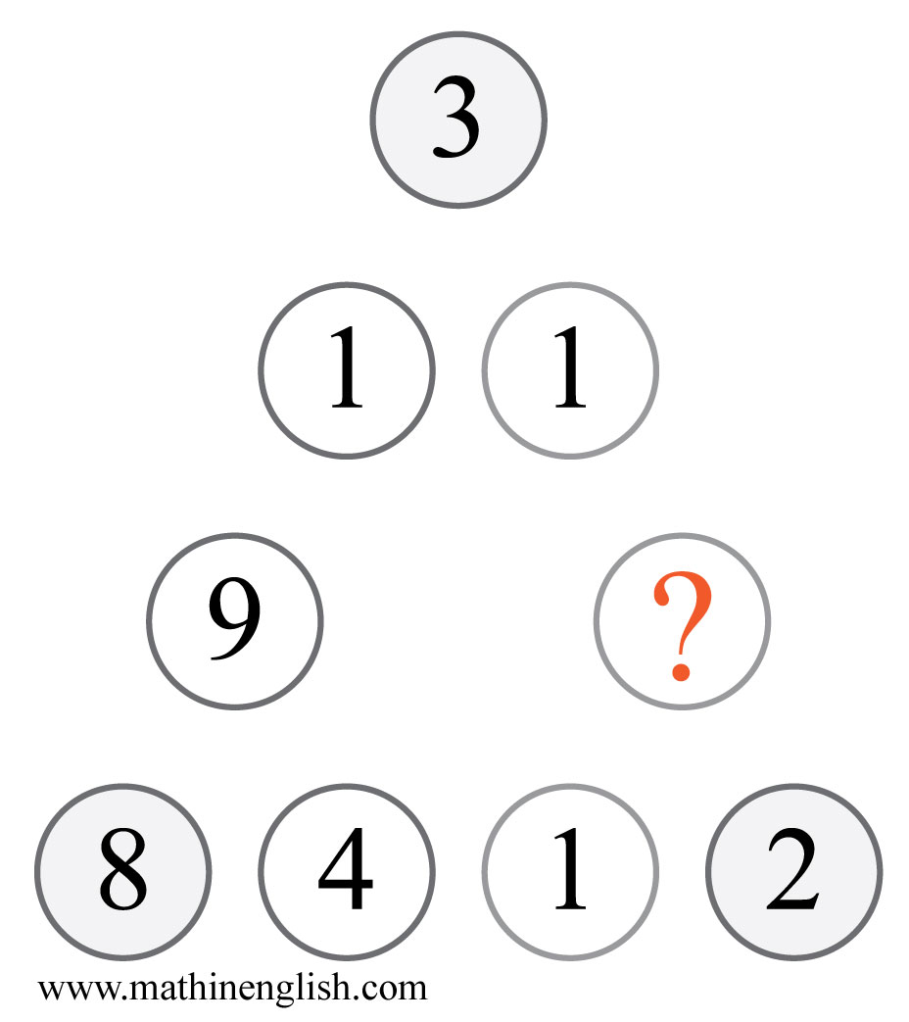
IQ Puzzle 14
Level 3C
Which number completes this puzzle?

Slide 16
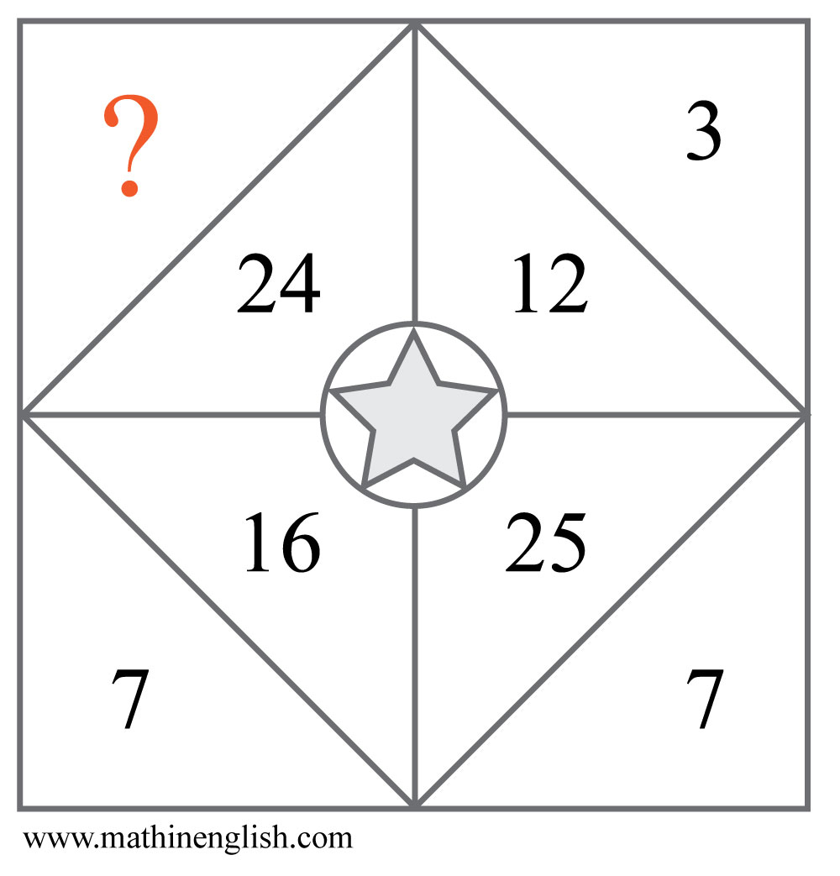
IQ Puzzle 15
Level 3C
Which number is missing?

Slide 17
IQ Puzzle 16
Level 3C
Which letter is missing?

Slide 18
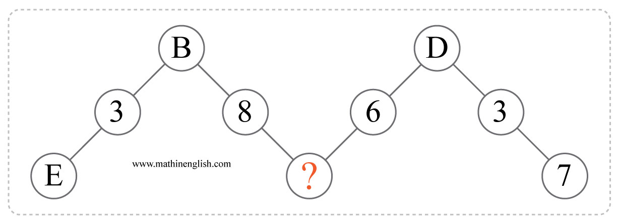
IQ Puzzle 17
Level 3C
Which letter is needed here?

Slide 19
IQ Puzzle 18
Level 3C
Which number is missing?

Slide 20
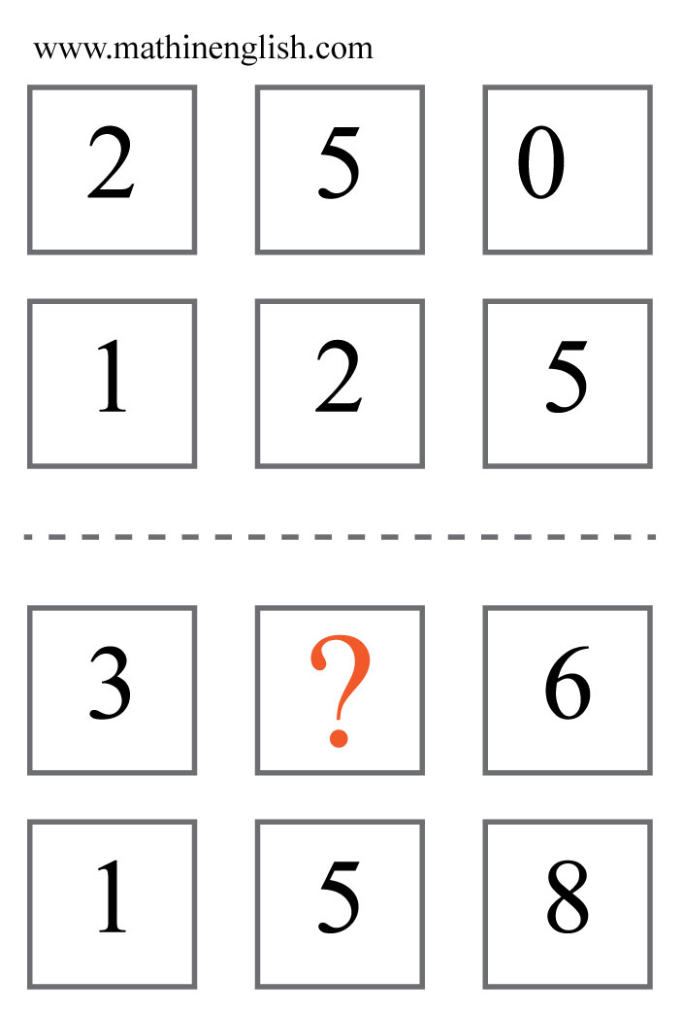
IQ Puzzle 19
Level 3C
Which number is missing?

Slide 21
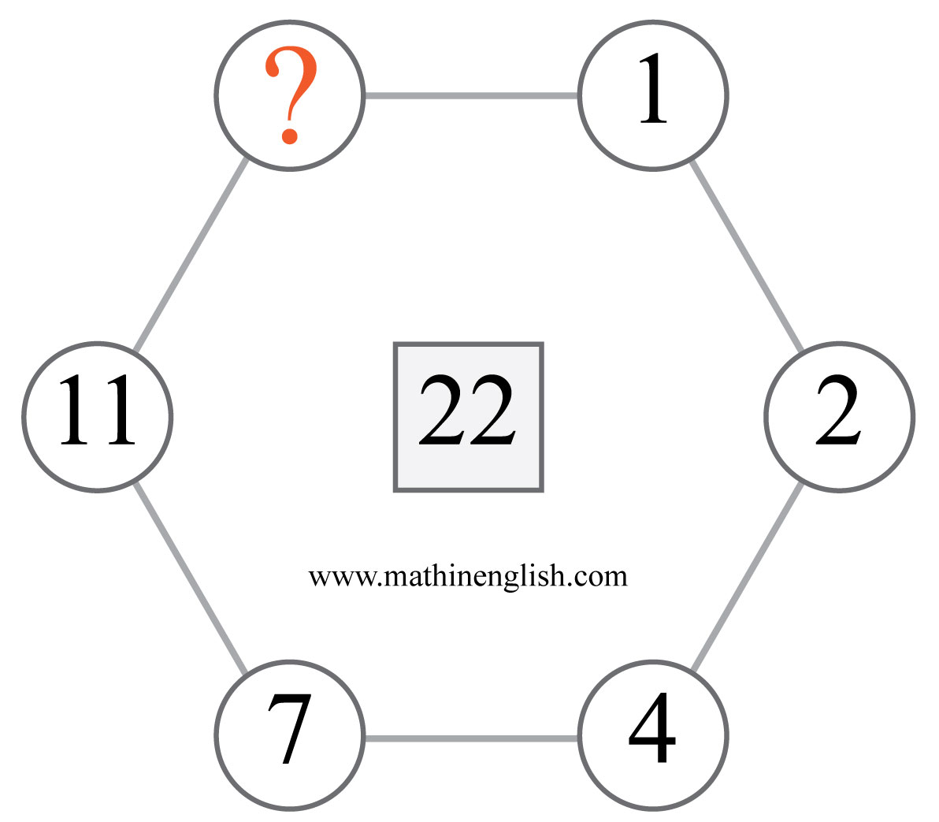
IQ Puzzle 20
Level 3C
Which number is missing?

Slide 22
Answers to puzzles 1 to 4
puzzle 1 : C
Each row follows a 9, 10, 11 pattern of number of symbols.
puzzle 2 : F
The first 2 circles in each row divided by the 3rd gives the value of the letter in the square.
puzzle 3 : 4
The numbers 1,2,3,4,6 and 12 are the factors of 12.
puzzle 4 : 27
Each pyramid contains the first 6 multiples of 6, 5 and 9.
Copyright: www.mathinenglish.com
Level 3C

Slide 23
Answers to puzzles 5 to 8
puzzle 5 : C
The circle is 4, hexagon 2, square 8 and star 1.
puzzle 6 : 3
In each triangle, multiply the adjacent cells and add 2.
puzzle 7 : 5
Only the last digits of a lower row are in a higher row.
puzzle 8 : 42
42 is not a multiple of 8.
Copyright: www.mathinenglish.com
Level 3C

Slide 24
Answers to puzzles 9 to 12
puzzle 9 : B
The sequence follows an intersecting and not intersecting,
and a shaded and not shaded pattern.
puzzle 10 : F
The sequence contains the multiples of 2 up to 18 in letter values.
puzzle 11 : 9
Add the center number to 2 times a adjacent cell to get the 3rd
number on the outside.
puzzle 12 : 3 and 47
The sequence follows a +5, ×2 pattern.
Copyright: www.mathinenglish.com
Level 3C

Slide 25
Answers to puzzles 13 to 16
puzzle 13 : A
All shapes and letters move 1 place in the next square. The
letters also follow a +2 pattern.
puzzle 14 : 6
16, the middle cells, is half of the corner digits 3 and 2 (32).
puzzle 15 : 6
In each part, the 2 digits of the inner number add up to the 1 digit
number.
puzzle 16 : C
C of circle, S of square and so on.
Copyright: www.mathinenglish.com
Level 3C

Slide 26
Answers to puzzles 17 to 20
puzzle 17 : J
Take the difference between the top and bottom to get the middle
number. E - B = 3.
puzzle 18 : 11
The 4 numbers in the 1st square follow a + 1 pattern. + 2 in the
2nd, and so on.
puzzle 19 : 1
The 2 top numbers are double the value of the 2 bottom numbers.
puzzle 20 : 16
Starting with the numbers follow a +1, +2, +3, +4, +5, +6 pattern.
Copyright: www.mathinenglish.com
Level 3C

