Slide 1

IQ puzzles and brain teasers
Level 3D

Slide 2
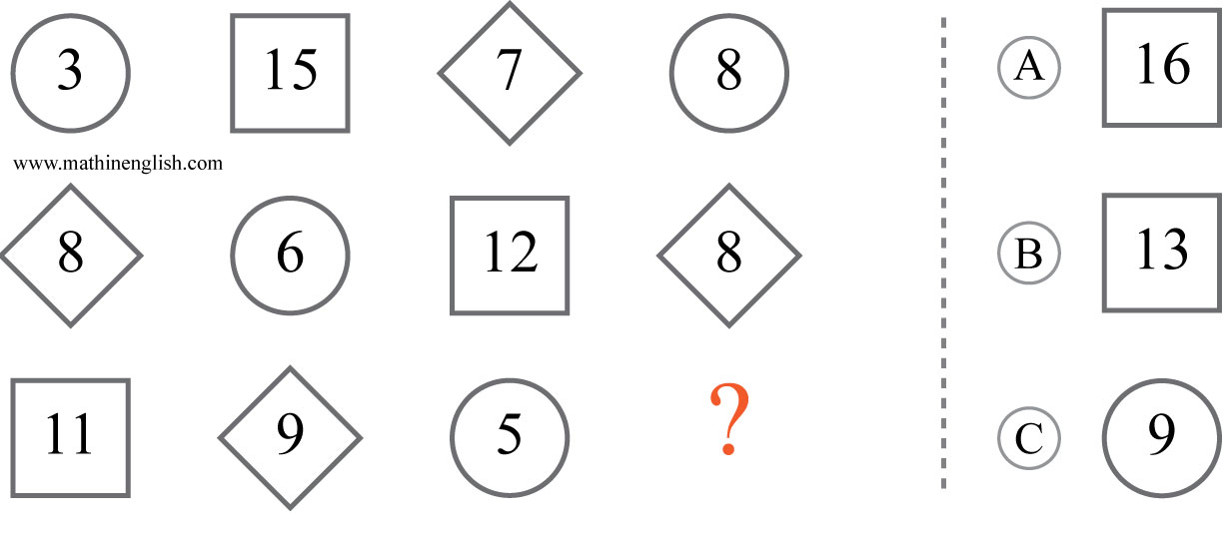



IQ Puzzle 1
Level 3D
Which option is correct?

Slide 3
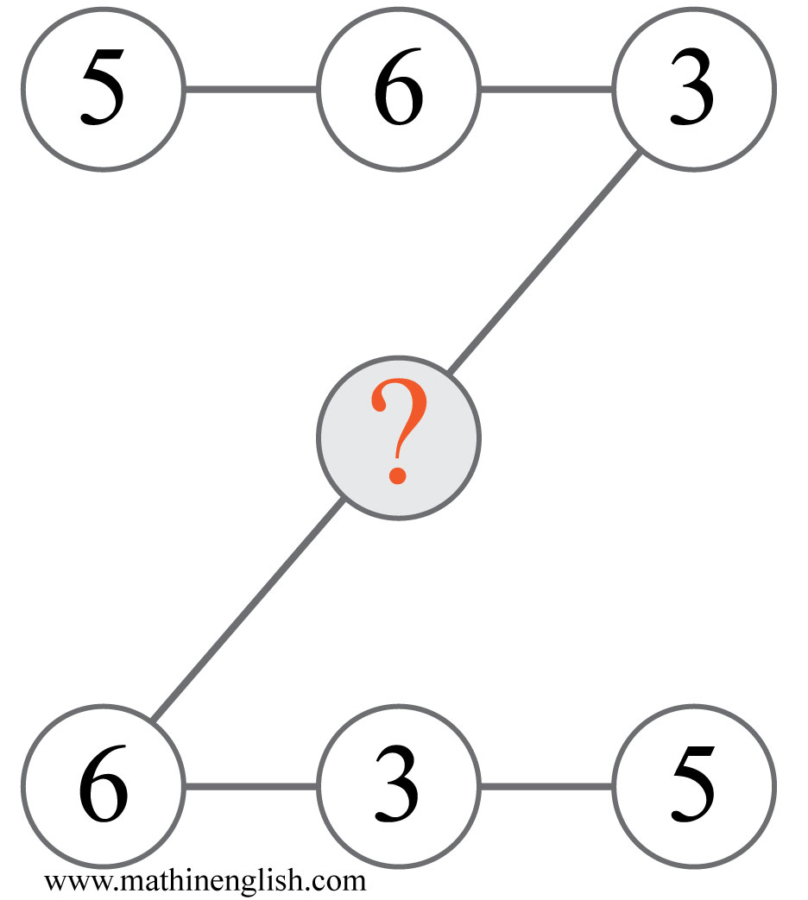
IQ Puzzle 2
Level 3D
Which number is missing?

Slide 4
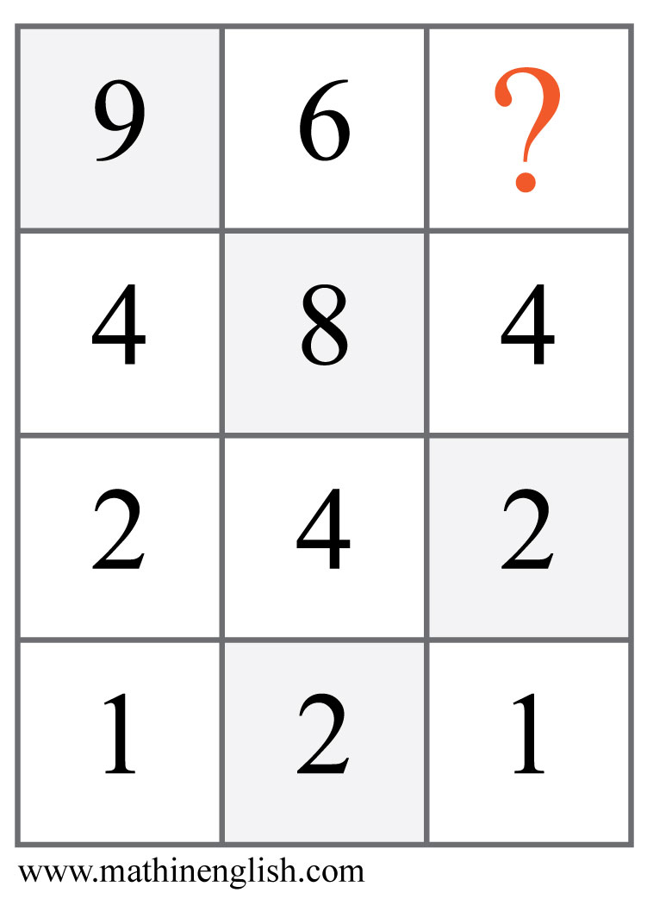
IQ Puzzle 3
Level 3D
What is the missing number?

Slide 5
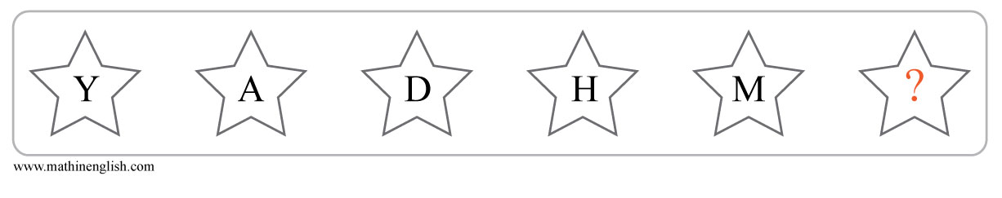
IQ Puzzle 4
Level 3D
What letter is needed here?

Slide 6
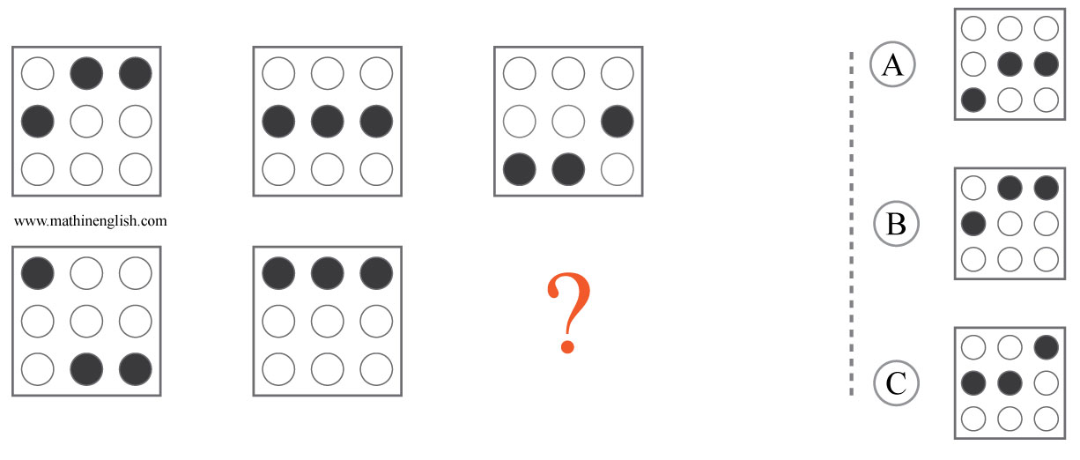
IQ Puzzle 5
Level 3D
Which option is the correct one?

Slide 7
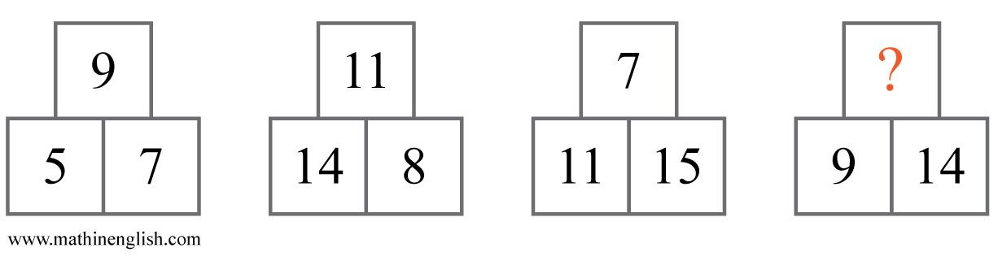
IQ Puzzle 6
Level 3D
Which number is missing?

Slide 8
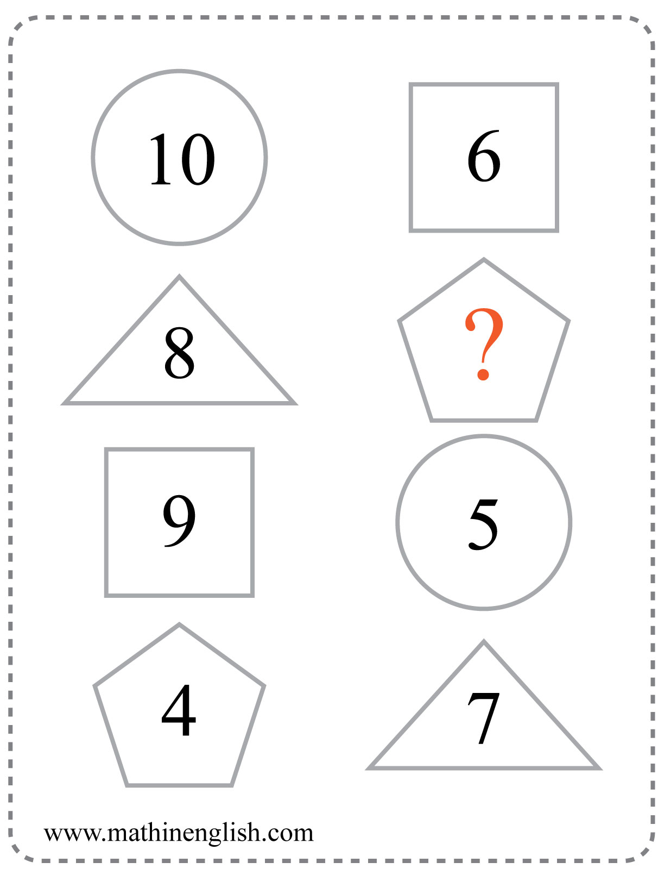
IQ Puzzle 7
Level 3D
Which number is missing?

Slide 9
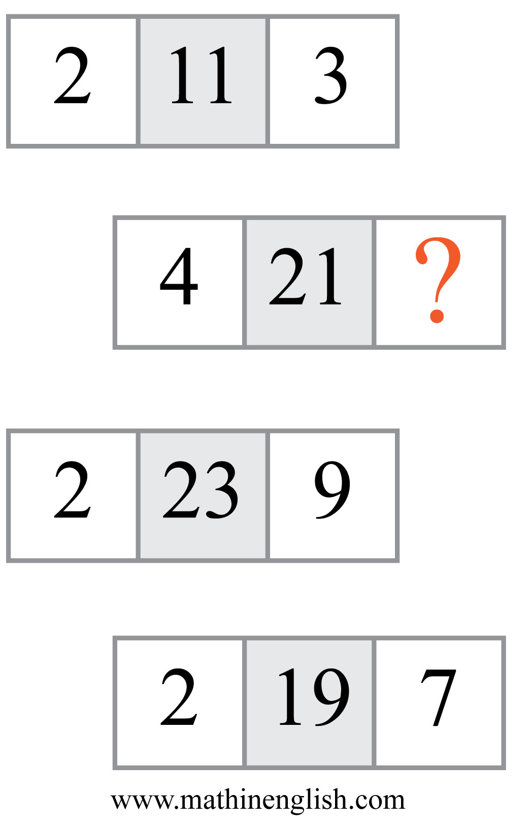
IQ Puzzle 8
Level 3D
Which number completes the pattern?

Slide 10
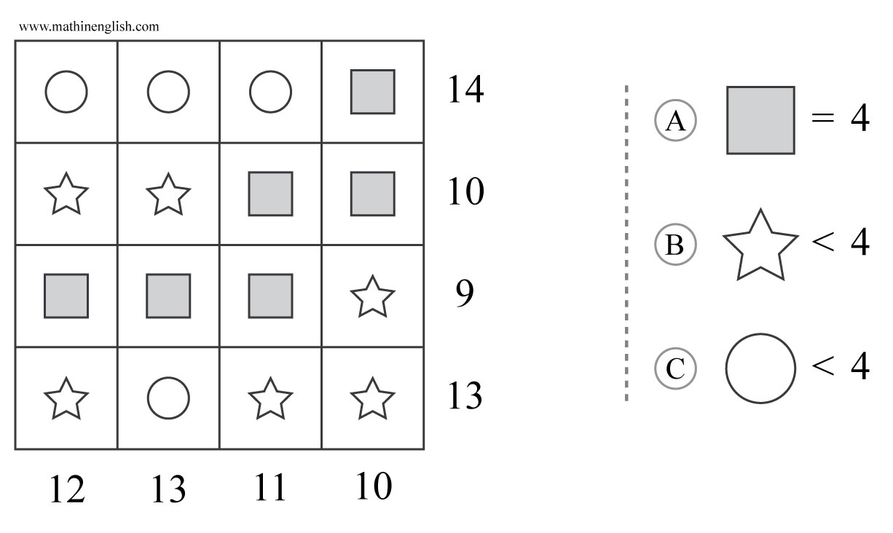
IQ Puzzle 9
Level 3D
Which option is correct?

Slide 11
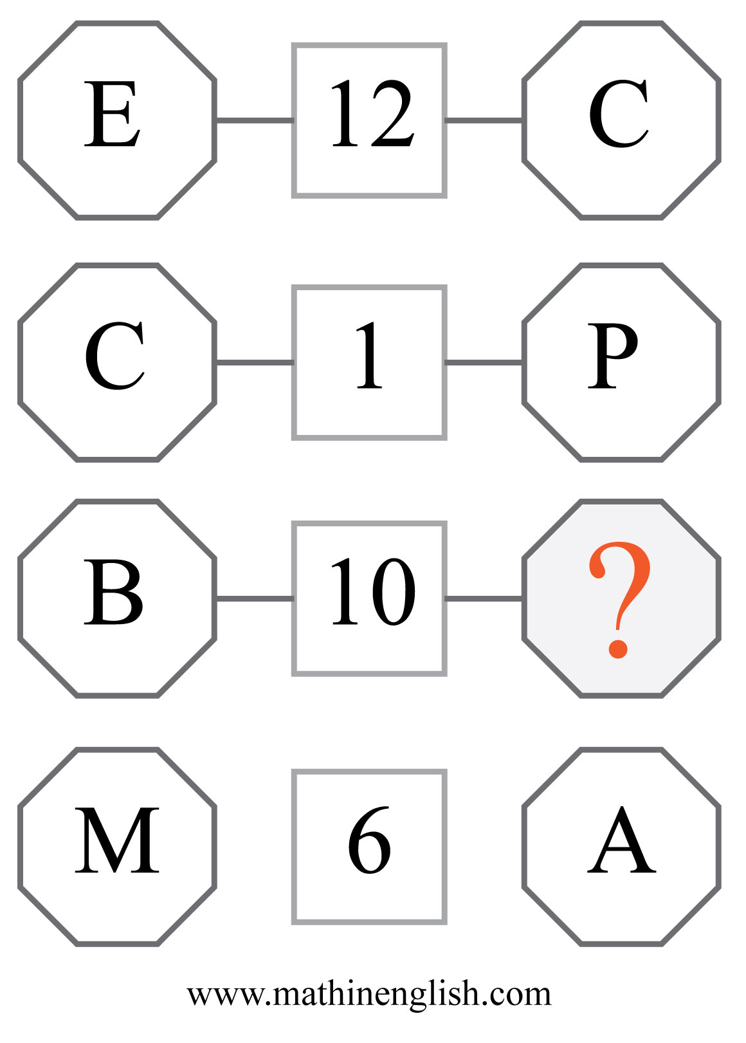
IQ Puzzle 10
Level 3D
Which letter is missing?

Slide 12
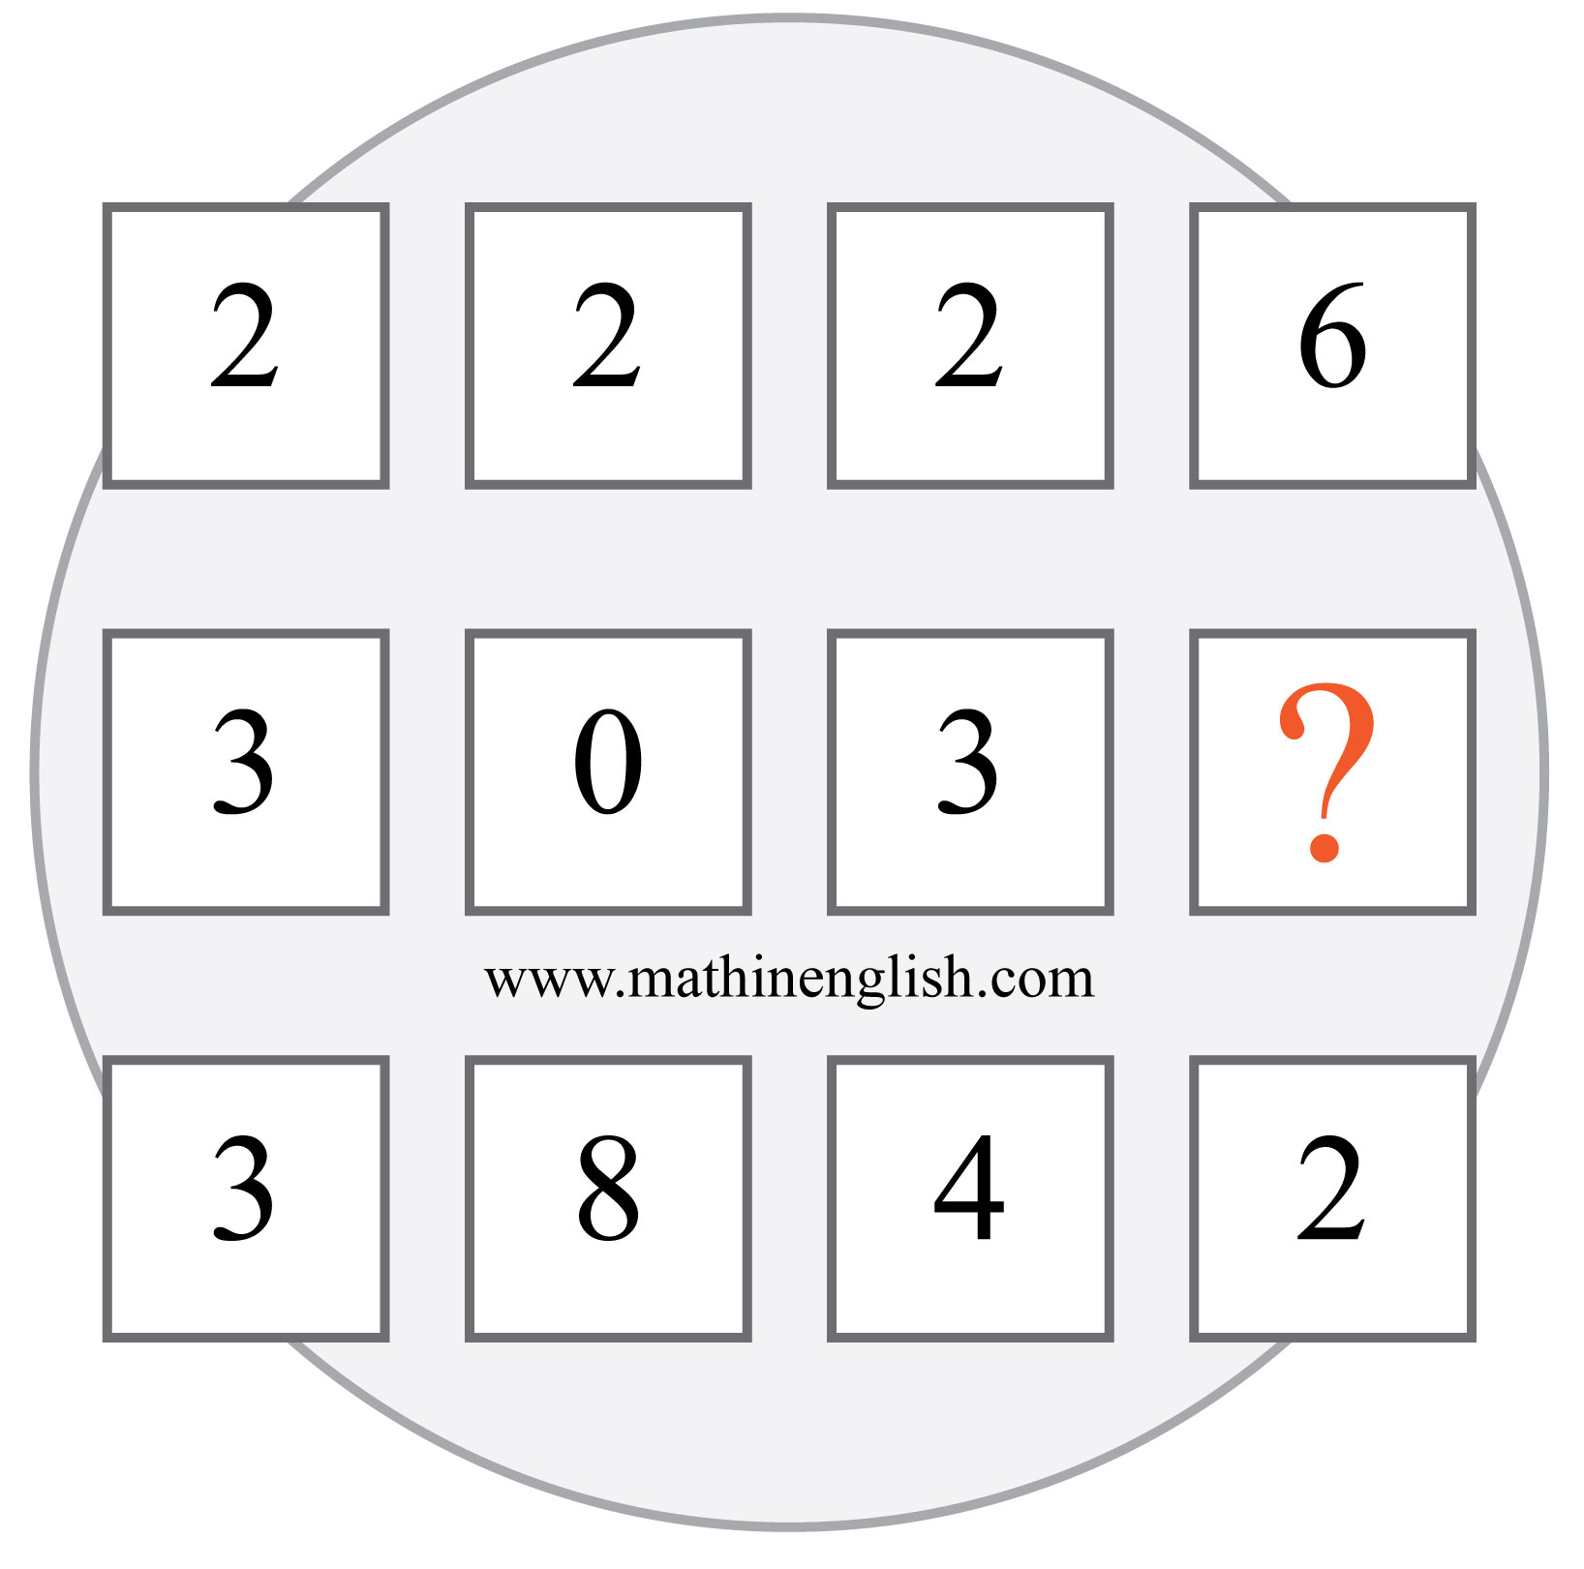
IQ Puzzle 11
Level 3D
Which number is missing?

Slide 13
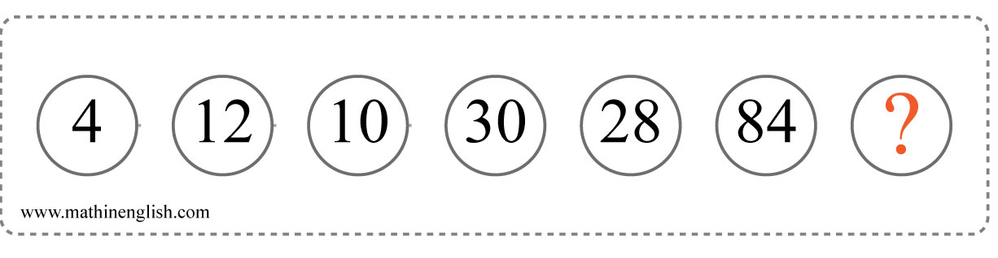
IQ Puzzle 12
Level 3D
Which number is missing?

Slide 14
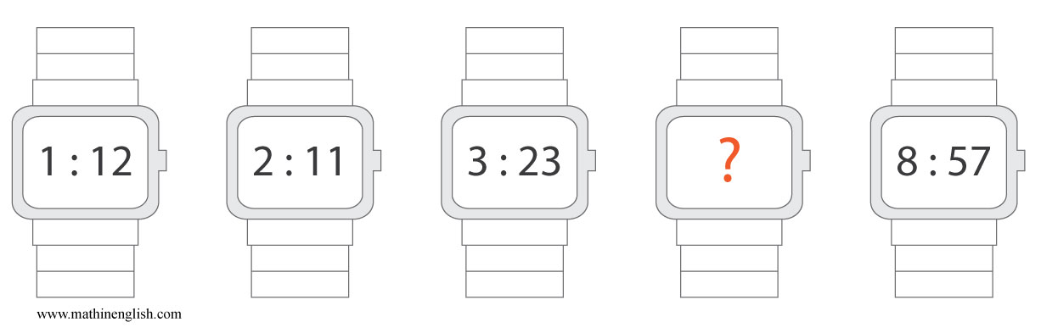
IQ Puzzle 13
Level 3D
What is the missing time?

Slide 15
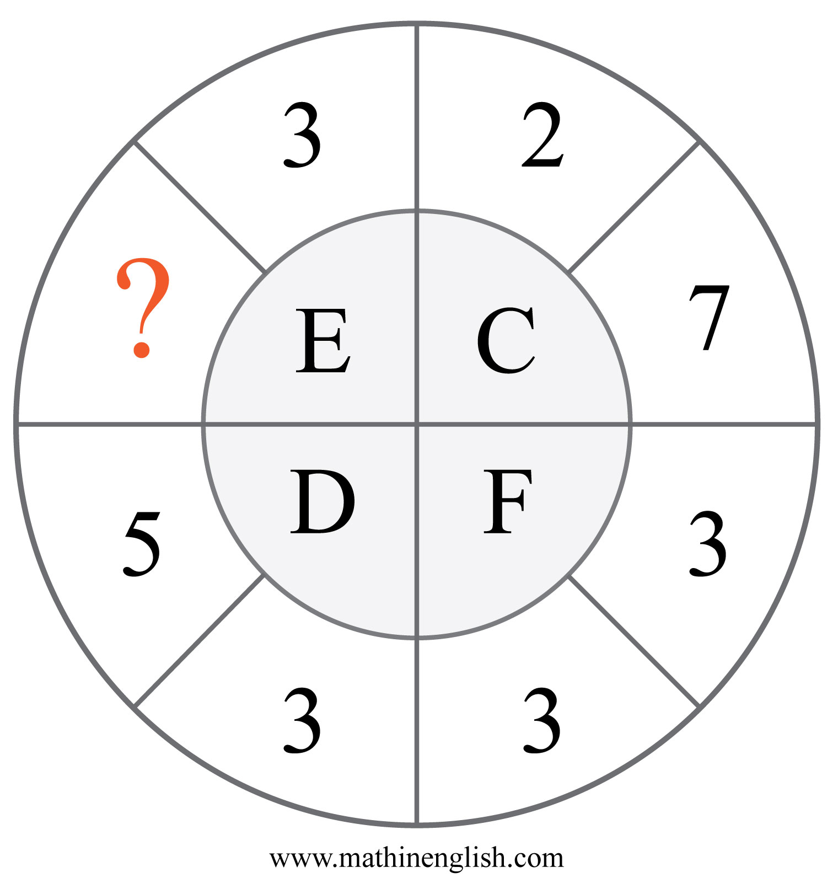
IQ Puzzle 14
Level 3D
What is the missing number?

Slide 16
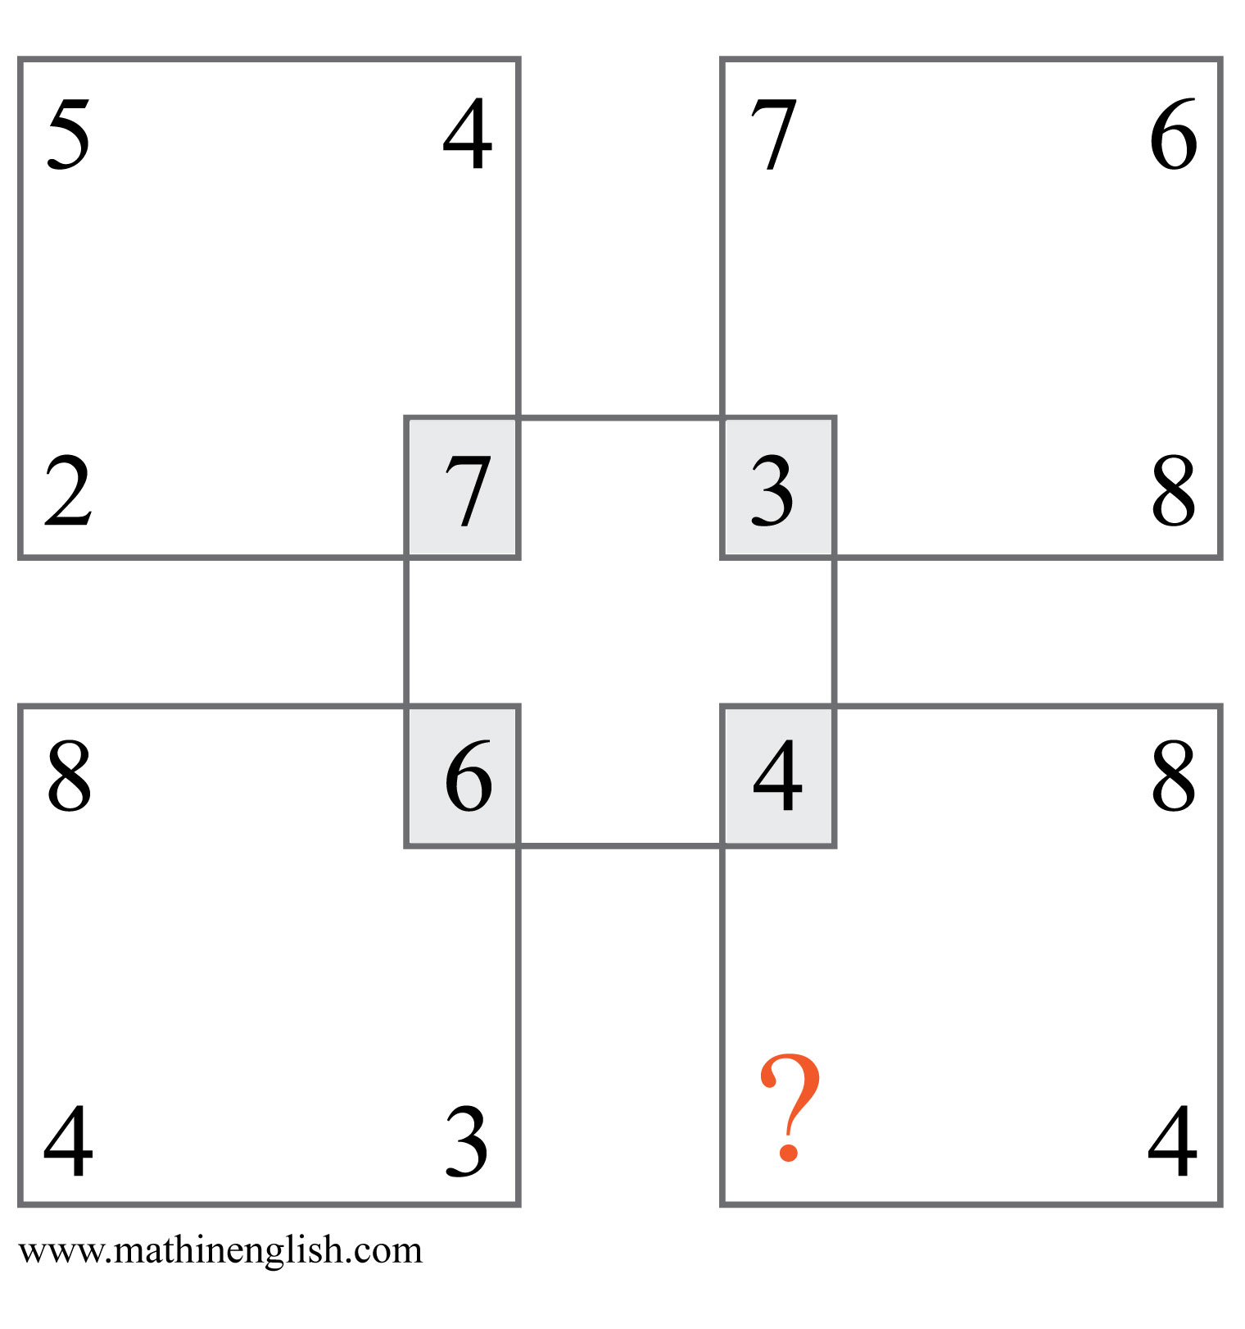
IQ Puzzle 15
Level 3D
Which number is missing?

Slide 17
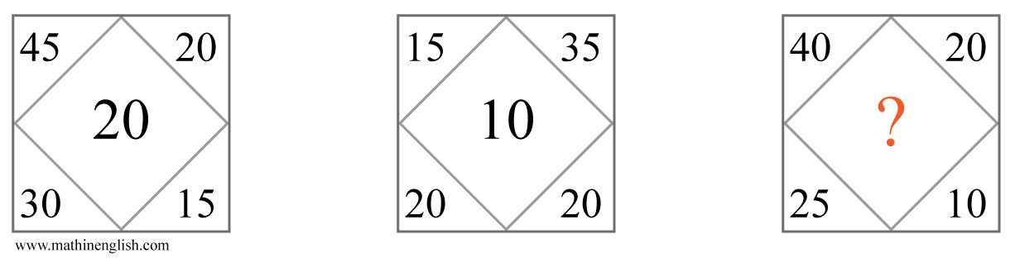
IQ Puzzle 16
Level 3D
Which number is needed here?

Slide 18
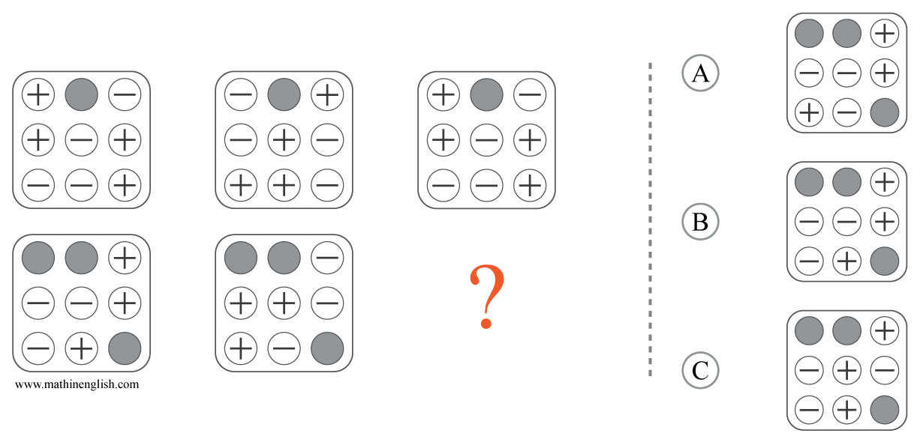
IQ Puzzle 17
Level 3D
Which option is correct?

Slide 19
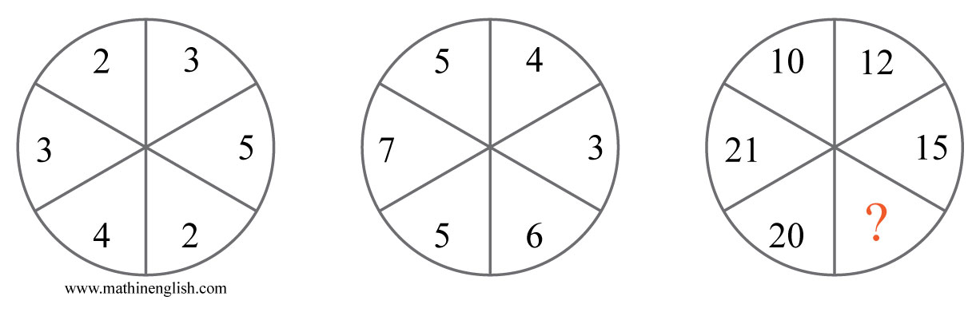
IQ Puzzle 18
Level 3D
Which number is missing?

Slide 20
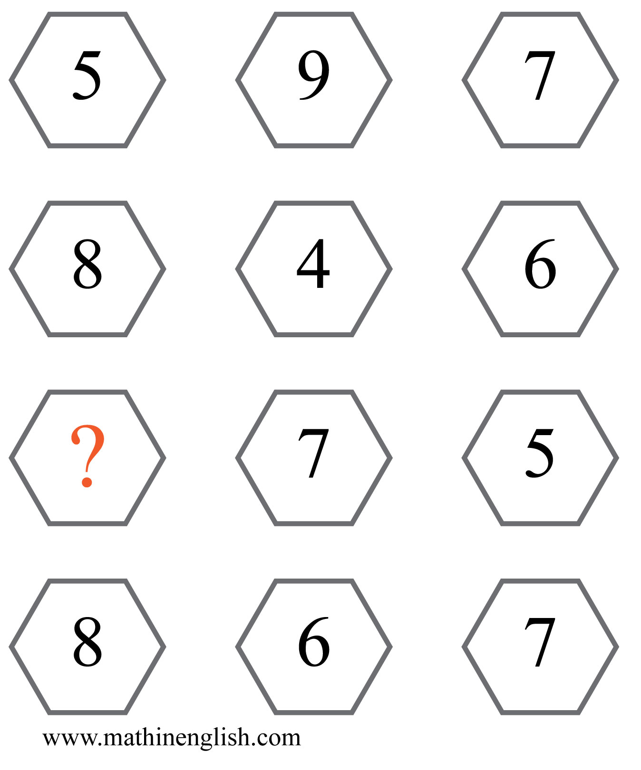
IQ Puzzle 19
Level 3D
Which number is missing?

Slide 21
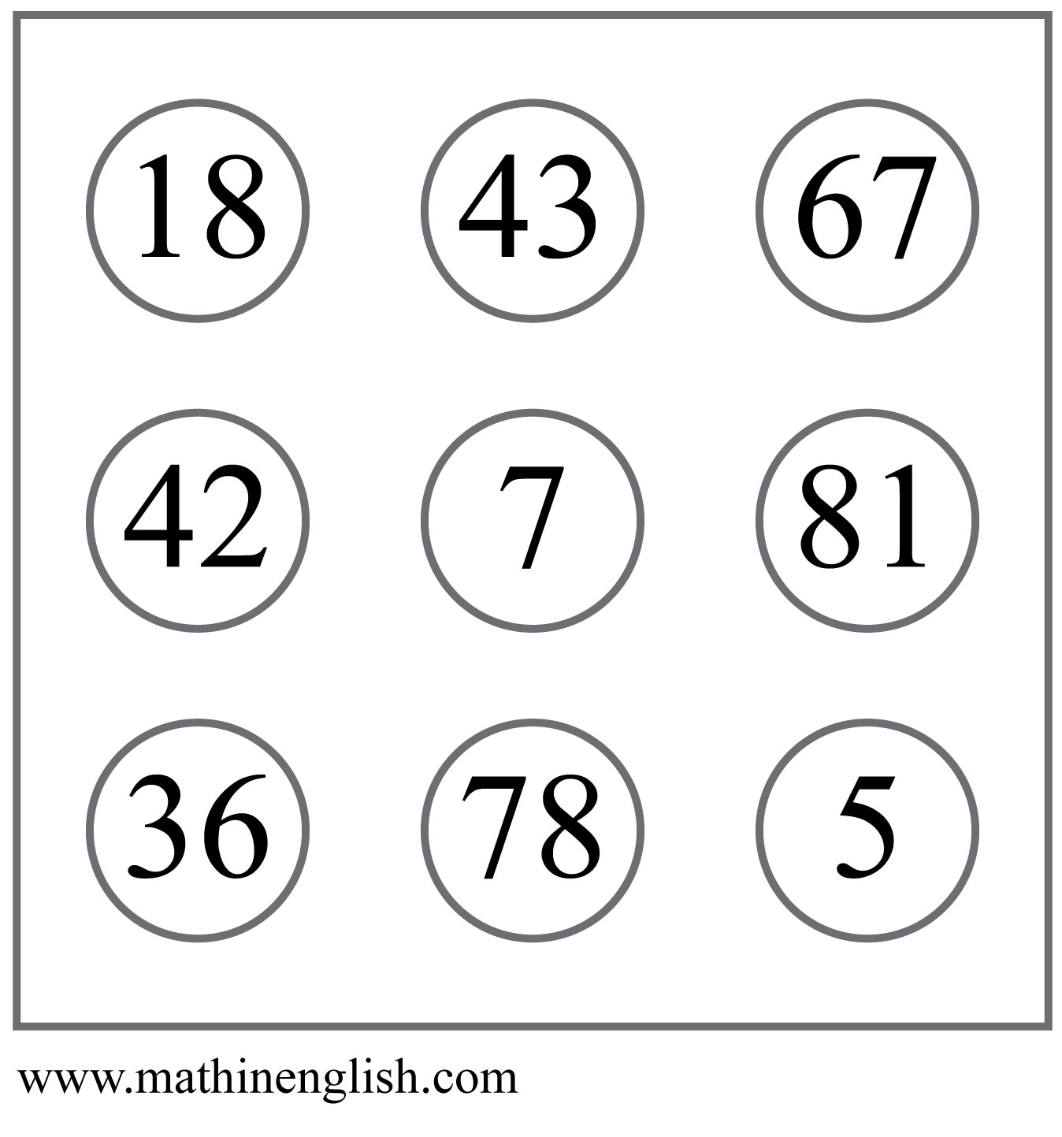
IQ Puzzle 20
Level 3D
Which number is the odd one out?

Slide 22
Answers to puzzles 1 to 4
puzzle 1 : A
Each column has a circle, diamond and square, with the square being
the sum of the diamond and circle.
puzzle 2 : 5
Each row of 3 numbers contains the digit 3, 5 and 6.
puzzle 3 : 6
Double the bottom row to get the 3rd row. Double the 3rd row
to get the 2nd row, etc.
puzzle 4 : S
The sequence follows a +2, +3, +4, etc pattern starting with Y. Y + 2 = A.
Copyright: www.mathinenglish.com
Level 3D

Slide 23
Answers to puzzles 5 to 8
puzzle 5 : C
The shaded dots move 2 places in the next square.
puzzle 6 : 19
The sums follow a +2, +3, +4 and +5 pattern. The start rotates in each next pyramid.
puzzle 7 : 11
All shape pairs add up to 15.
puzzle 8 : 4
In each row multiply the left and right number and add 5.
Copyright: www.mathinenglish.com
Level 3D

Slide 24
Answers to puzzles 9 to 12
puzzle 9 : B
The star is 3, circle 4 and the square 2.
puzzle 10 : H
Each row adds up to 20.
puzzle 11 : 4
Each 2 digits follow a pattern of +4, starting with 22.
puzzle 12 : 82
The sequence follows a times 3, minus 2 pattern.
Copyright: www.mathinenglish.com
Level 3D

Slide 25
Answers to puzzles 13 to 16
puzzle 13 : 5:34
Add the time of the 1st and 2nd to get the time on the 3rd. Add 2nd
and 3rd to get the time of the 4th watch, and so on.
puzzle 14 : 4
Each part in the circle adds up to 12.
puzzle 15 : 2
The digits of the bottom numbers together in each square are half
that of the top digits together.
puzzle 16 : 25
The difference between the sum of the top numbers and the sum of
the bottom numbers in each square.
Copyright: www.mathinenglish.com
Level 3D

Slide 26
Answers to puzzles 17 to 20
puzzle 17 : B
For each row, the plus symbol changes in a minus in the next square.
puzzle 18 : 12
The numbers in the 2 circles in the same position multiplied, give the
number in the 3rd.
puzzle 19 : 3
Add the first 2 cells in each row and divide the sum by 2 to get the 3rd cell.
puzzle 20 : 42
42 is the only number that is only made up off even numbers.
Copyright: www.mathinenglish.com
Level 3D

