Slide 1
IQ puzzles and brain teasers
Level 3E

Slide 2
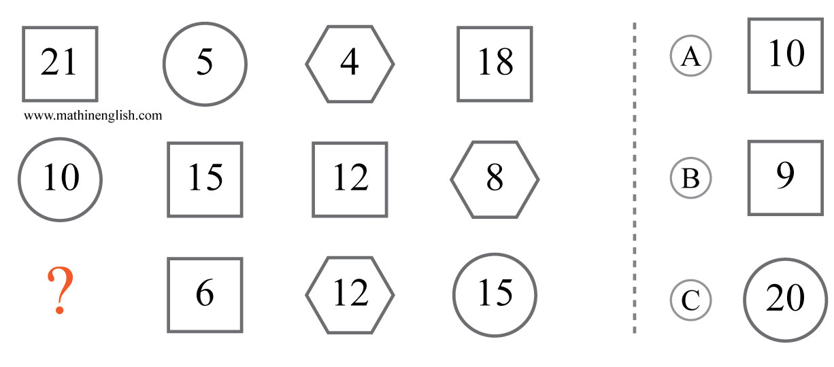
IQ Puzzle 1
Level 3E
Which option is correct?

Slide 3
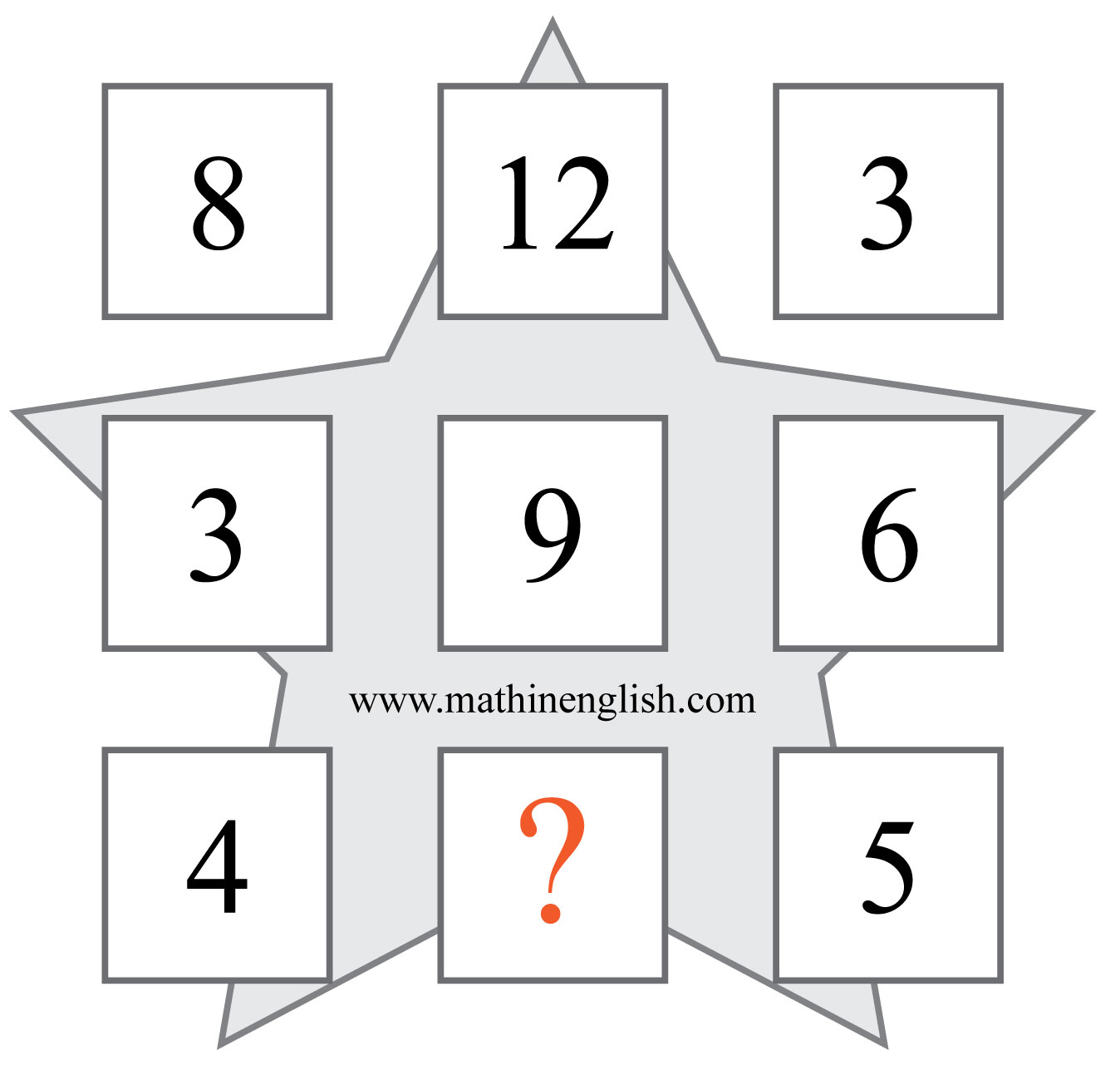
IQ Puzzle 2
Level 3E
Which number is missing?

Slide 4
IQ Puzzle 3
Level 3E
What is the missing letter?

Slide 5
IQ Puzzle 4
Level 3E
What number is needed here?

Slide 6
IQ Puzzle 5
Level 3E
What is the missing top number on the domino?

Slide 7
IQ Puzzle 6
Level 3E
Which letter is missing?

Slide 8
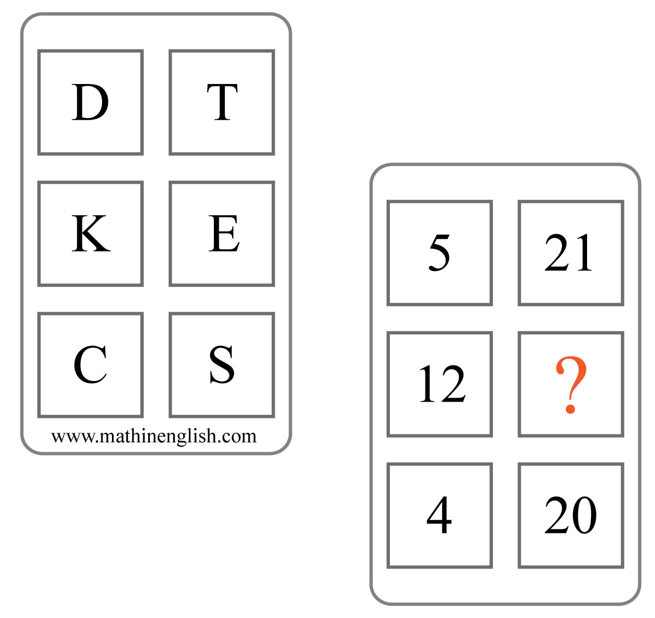
IQ Puzzle 7
Level 3E
Which number is missing?

Slide 9
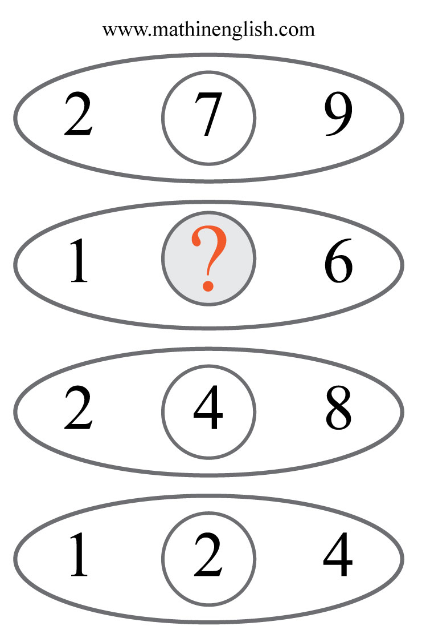
IQ Puzzle 8
Level 3E
Which number is needed here?

Slide 10
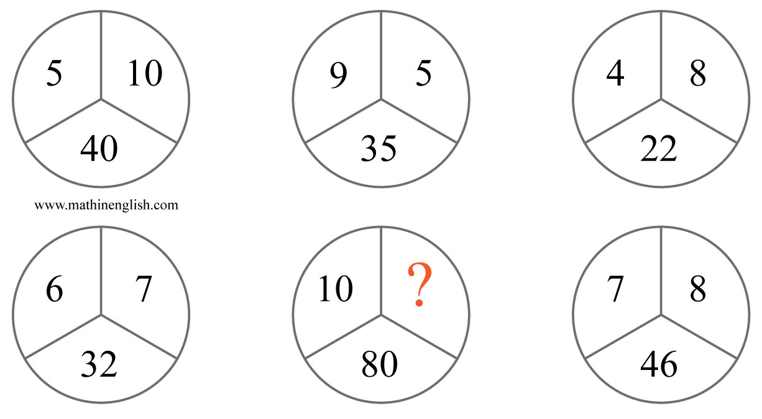
IQ Puzzle 9
Level 3E
Which number completes the pattern?

Slide 11
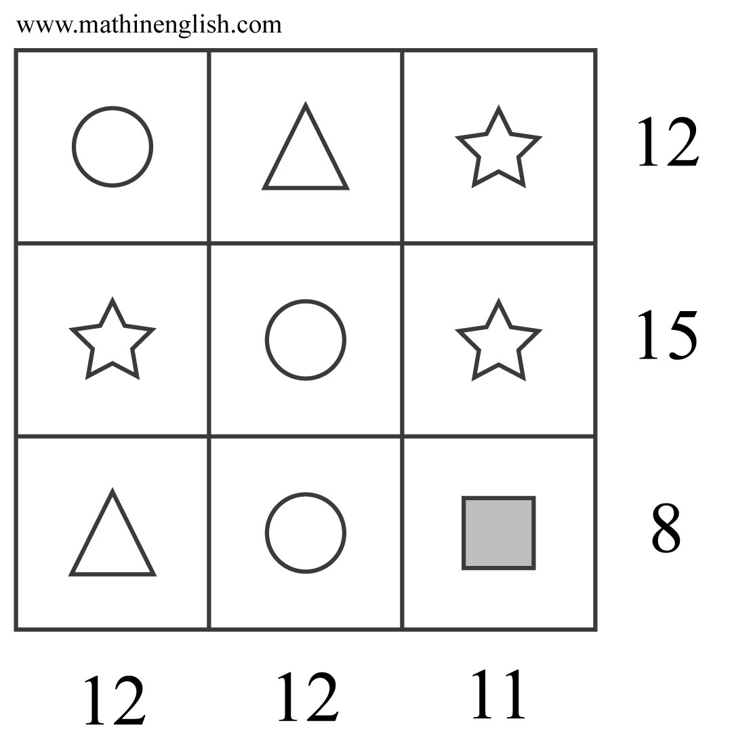
IQ Puzzle 10
Level 3E
Which is the value of the shapes?

Slide 12
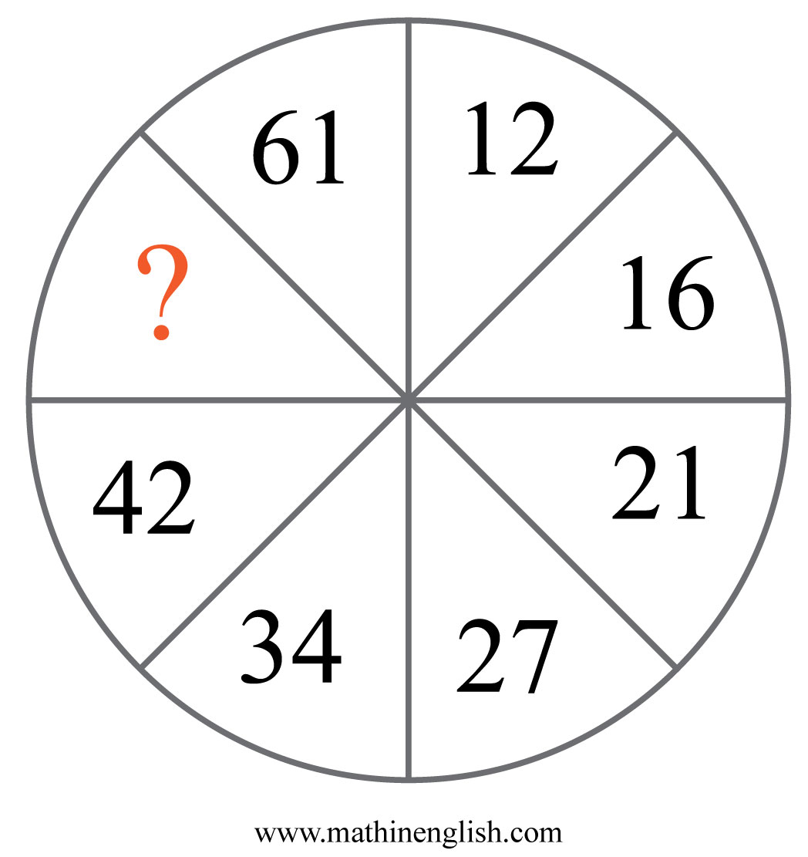
IQ Puzzle 11
Level 3E
Which number is missing?

Slide 13
IQ Puzzle 12
Level 3E
Which number is missing?

Slide 14
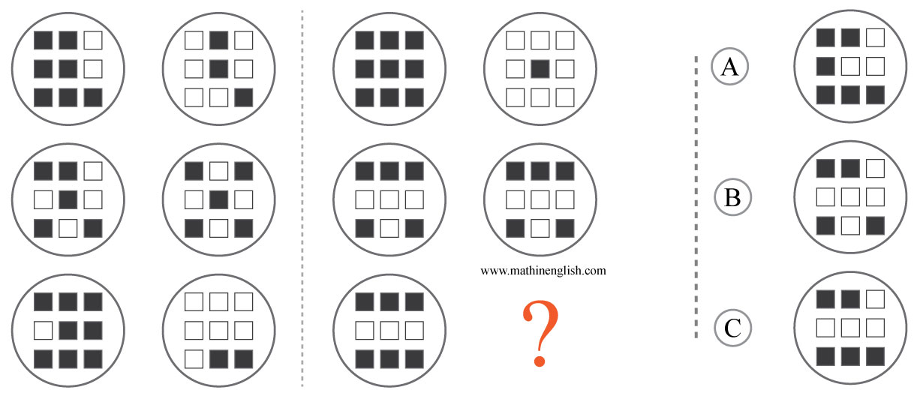
IQ Puzzle 13
Level 3E
Which option is correct?

Slide 15
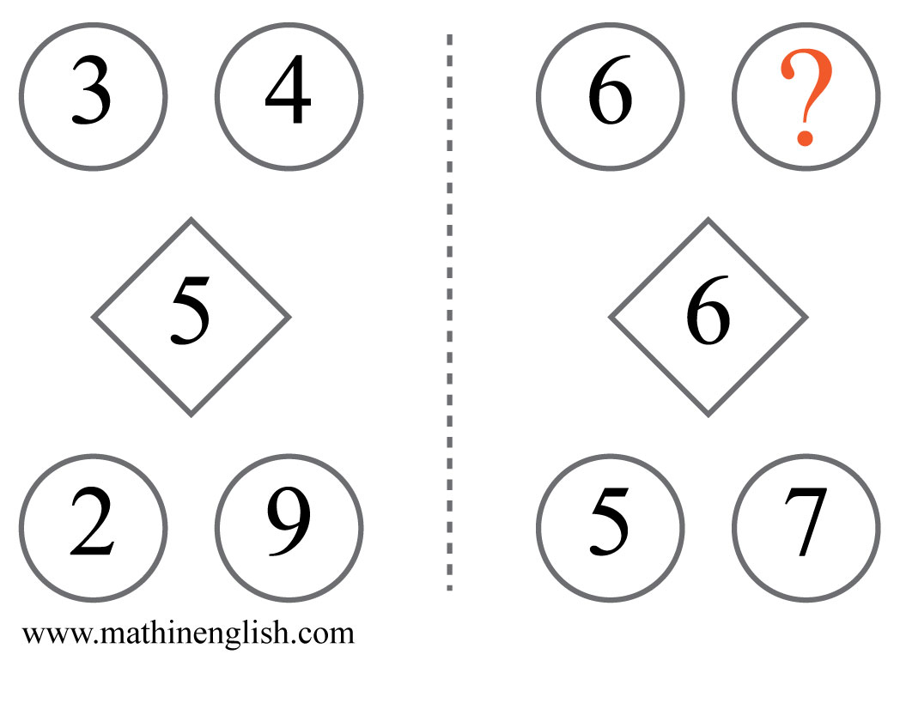
IQ Puzzle 14
Level 3E
What number is needed here?

Slide 16
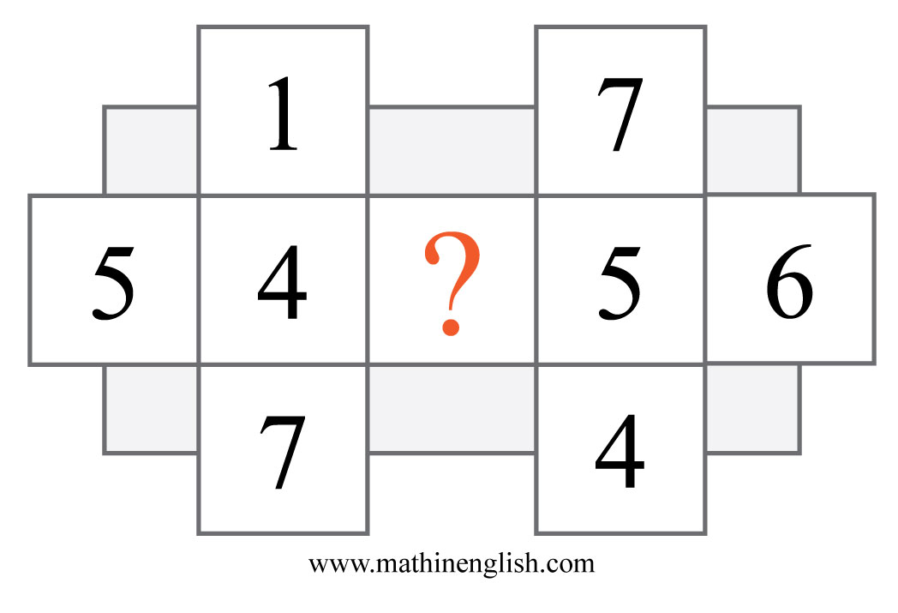
IQ Puzzle 15
Level 3E
Which number is missing?

Slide 17
IQ Puzzle 16
Level 3E
Which number completes the pattern?

Slide 18
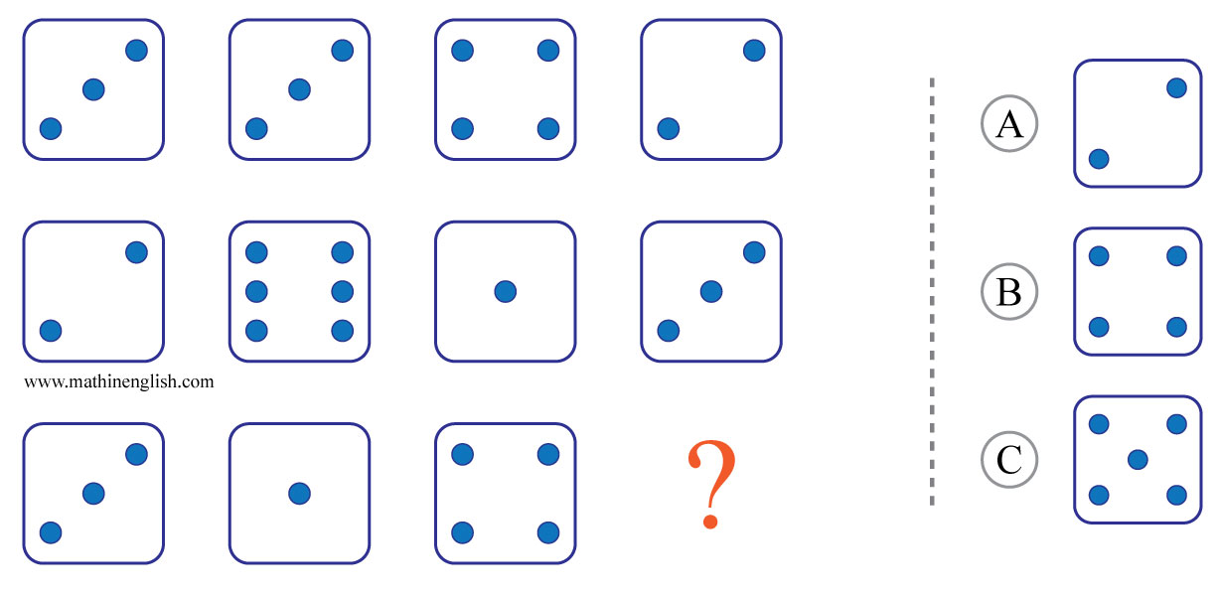
IQ Puzzle 17
Level 3E
Which option is correct?

Slide 19
IQ Puzzle 18
Level 3E
Which number is missing?

Slide 20
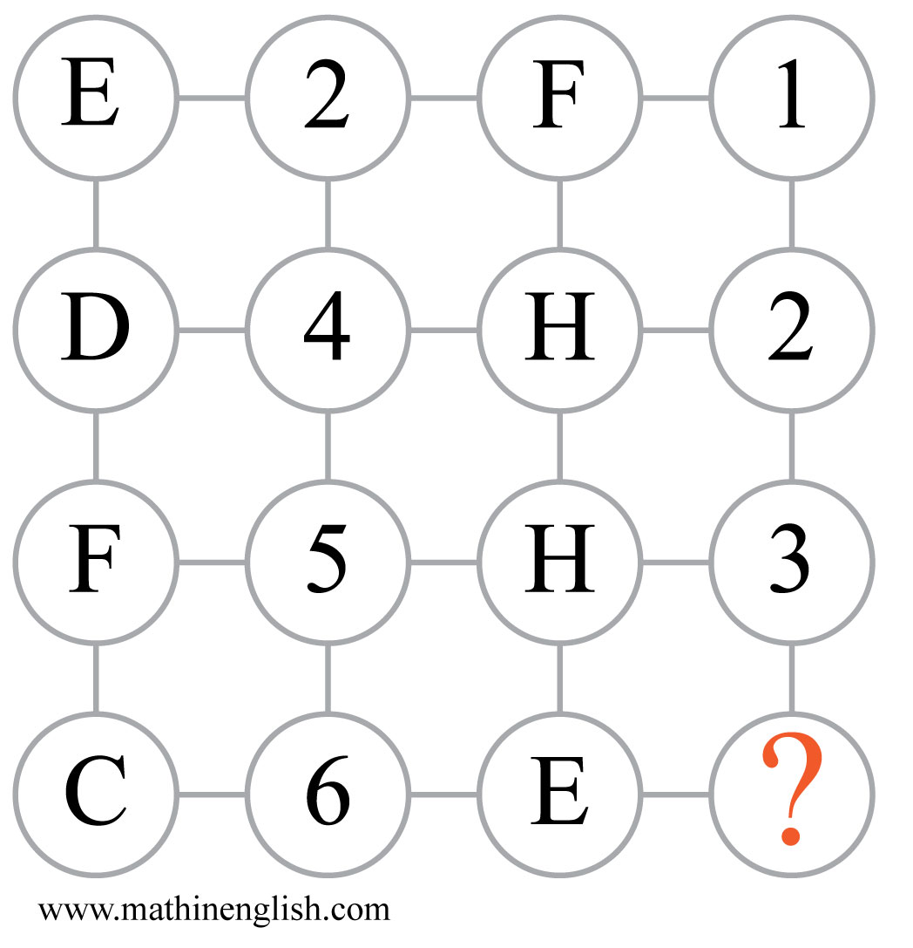
IQ Puzzle 19
Level 3E
Which number is missing here?

Slide 21
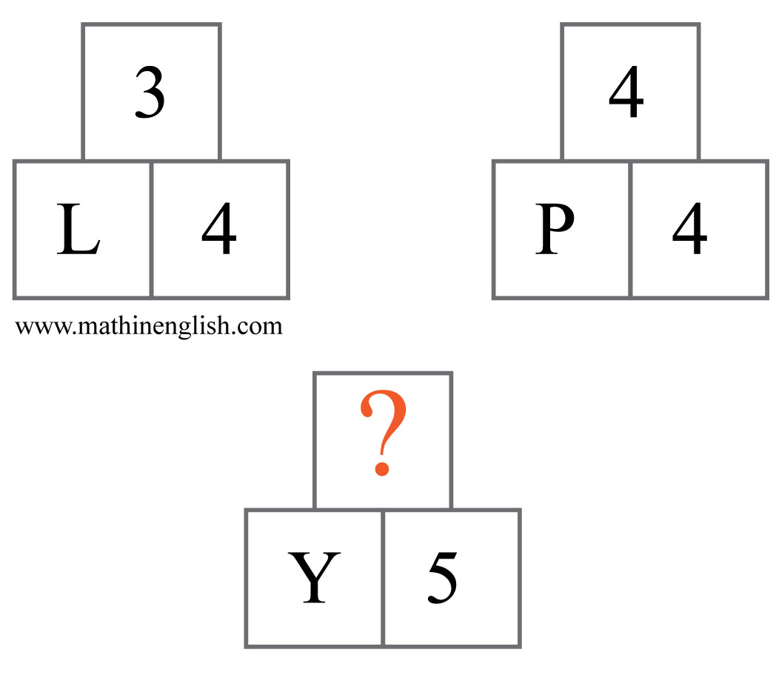
IQ Puzzle 20
Level 3E
Which number is missing?

Slide 22
Answers to puzzles 1 to 4
puzzle 1 : B
Each row has 2 squares with a decreasing -3 pattern.
puzzle 2 : 10
In each row, multiply the right and the left number then divide by 2
to get the middle number.
puzzle 3 : V
In each shape add the 1st and 2nd letter to get the value of the 3rd,
add the 2nd and 3rd to get the 4th, etc.
puzzle 4 : 3
Each row adds up to 20.
Copyright: www.mathinenglish.com
Level 3E

Slide 23
Answers to puzzles 5 to 8
puzzle 5 : 5
The dominoes show all the even numbers that can be made.
puzzle 6 : H
The letter and numbers in the 3rd star are the sum of those in the 1st and 2nd.
puzzle 7 : 6
Add 1 to the numbers to get the letter values in the 1st block.
puzzle 8 : 8
Divide the number formed by the 1st 2 digits by 3 to get the 3rd.
Copyright: www.mathinenglish.com
Level 3E

Slide 24
Answers to puzzles 9 to 12
puzzle 9 : 9
Multiply the 2 top numbers in each circle and subtract 10 to get the bottom numbers.
puzzle 10 : 1
Circle = 5, star = 2, triangle = 5 , square = 1.
puzzle 11 : 51
Starting with 12, the sequence follows a +4, +5, +6, etc pattern.
puzzle 12 : 6
The difference between the number formed by the top 2 digits, and that
made of the bottom 2, is 12.
Copyright: www.mathinenglish.com
Level 3E

Slide 25
Answers to puzzles 13 to 16
puzzle 13 : B
Each horizontal pair of circles is made up of 10 shaded squares altogether.
puzzle 14 : 3
63 minus 6 equals 57.
puzzle 15 : 3
The average of 1, 5, 7 and 3 is 4, and the average of 7, 6 , 4 and 3 is 5.
puzzle 16 : 9
The cells in the first 3 diamonds add up to the value of the 4th in the same position.
Copyright: www.mathinenglish.com
Level 3E

Slide 26
Answers to puzzles 17 to 20
puzzle 17 : B
Each row adds up to 12.
puzzle 18 : 5
The 3 digit numbers in the rows of the first 2 crosses add up to
that of the 3rd. Same applies to the columns.
puzzle 19 : 4
The sum of the first 2 cells in each row is equal to the sum of the 3rd and 4th.
puzzle 20 : 5
Y is the product of 5 times 5.
Copyright: www.mathinenglish.com
Level 3E

