Slide 1
IQ puzzles and brain teasers
Level 4A

Slide 2
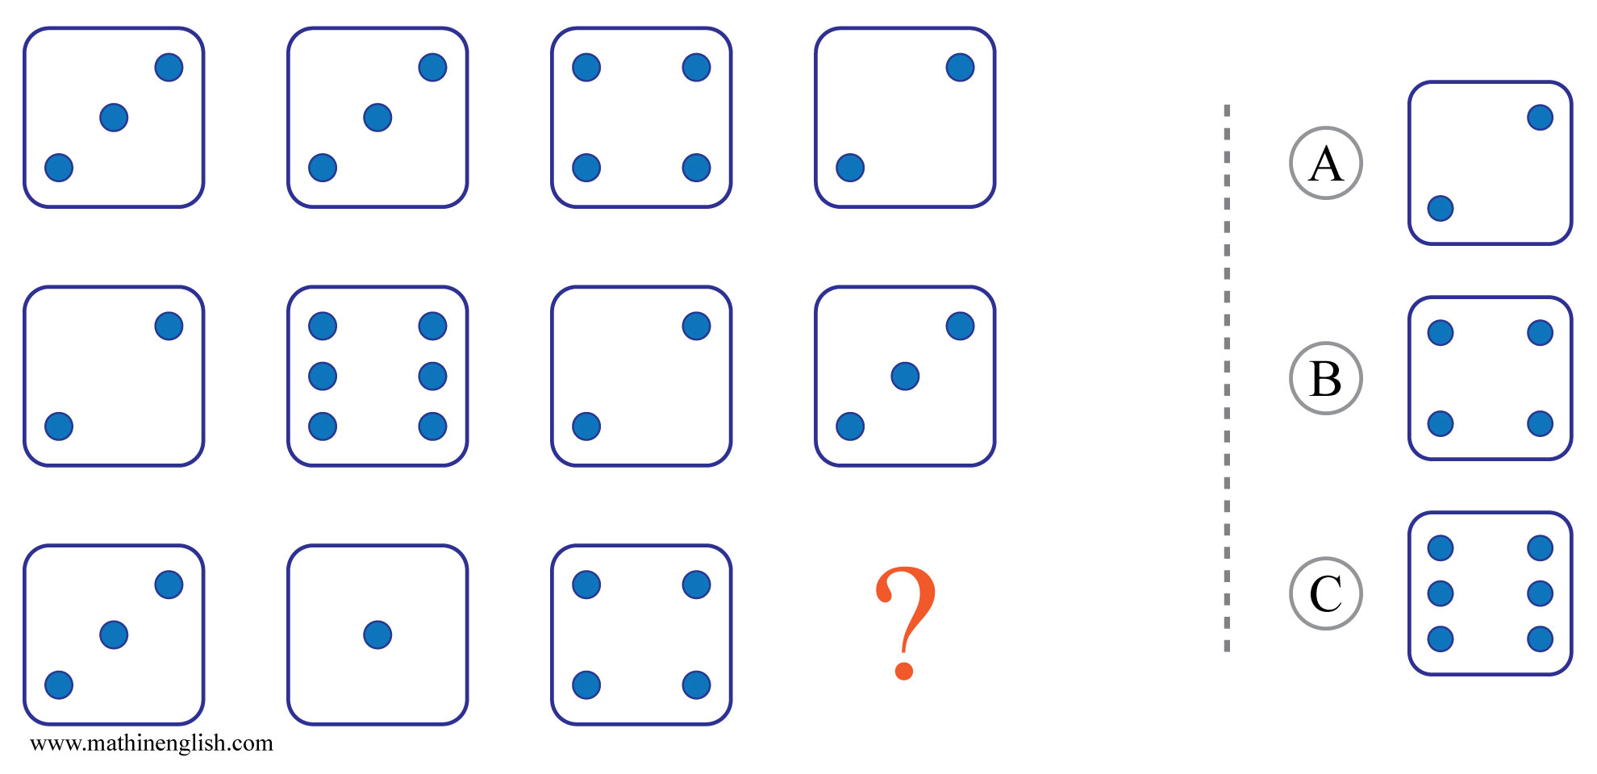
IQ Puzzle 1
Level 4A
Which option is correct?

Slide 3
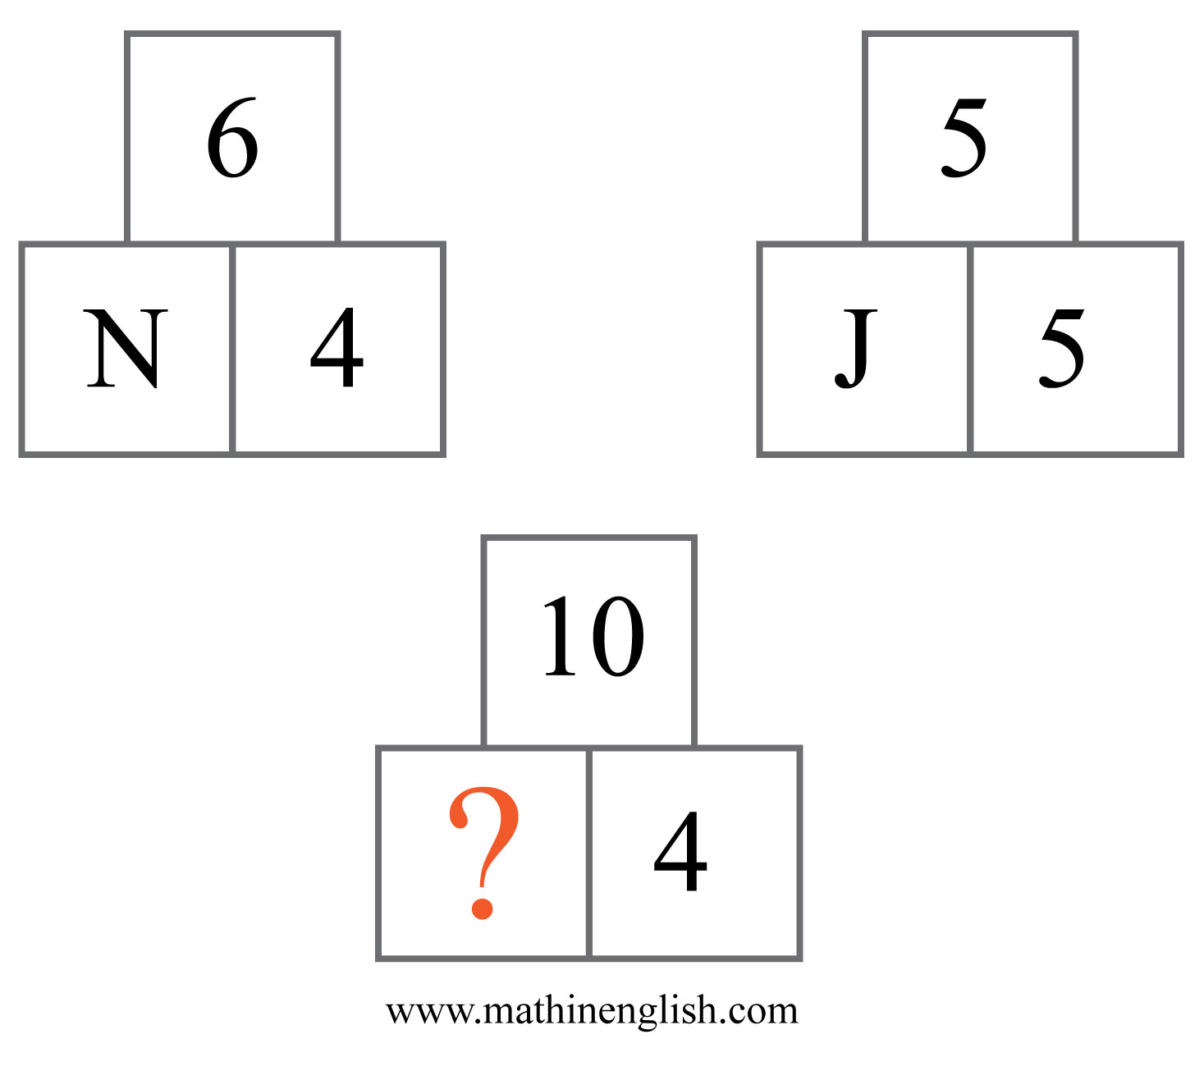
IQ Puzzle 2
Level 4A
Which letter is missing?

Slide 4
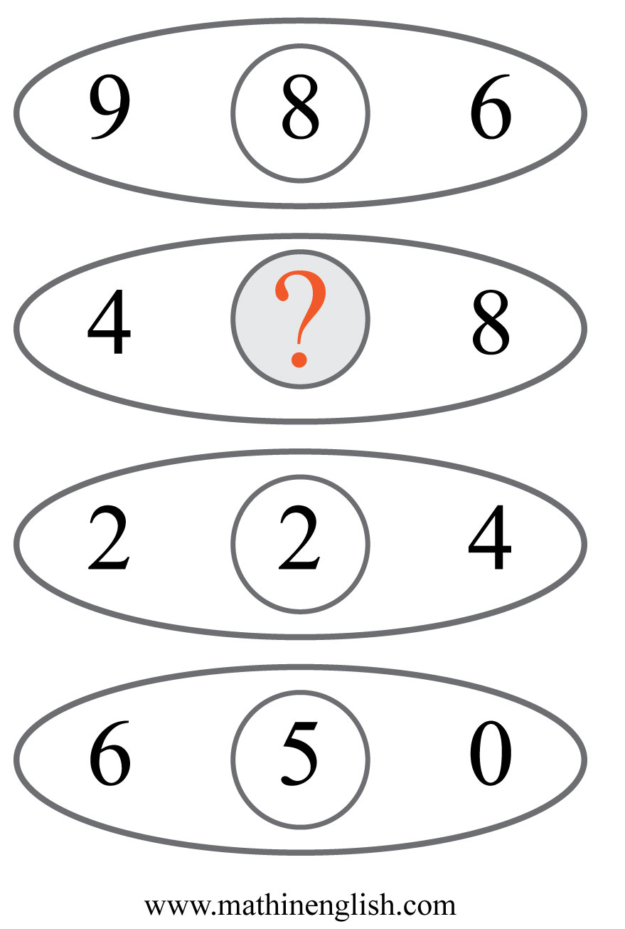
IQ Puzzle 3
Level 4A
What is the missing number?

Slide 5
IQ Puzzle 4
Level 4A
What number is needed here?

Slide 6
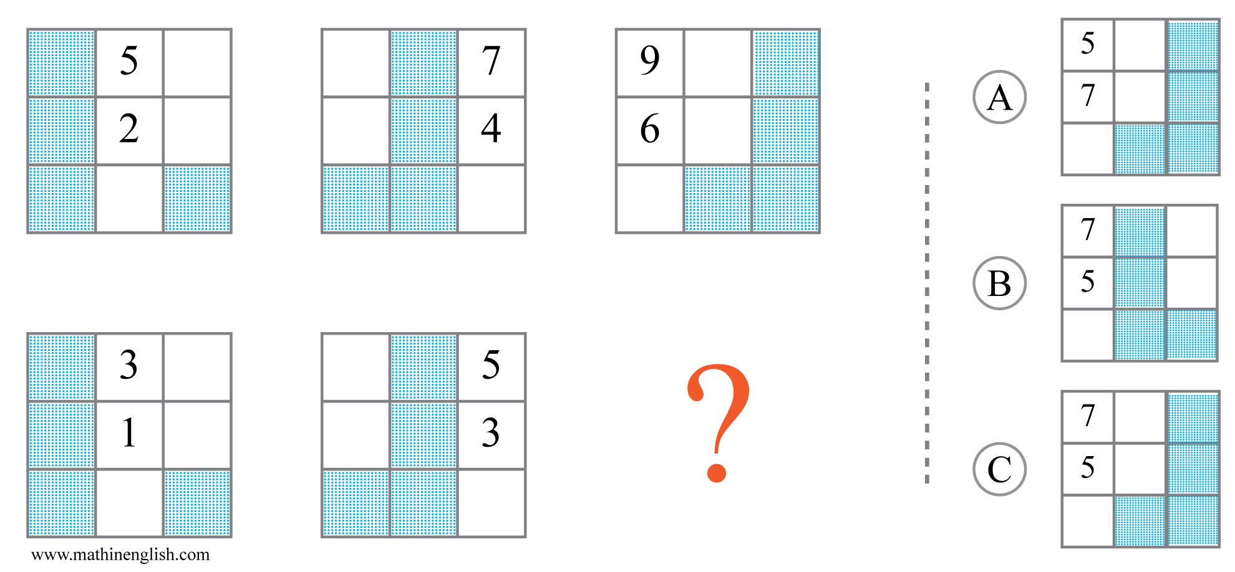
IQ Puzzle 5
Level 4A
Which option is correct?

Slide 7
IQ Puzzle 6
Level 4A
Which number is missing?

Slide 8
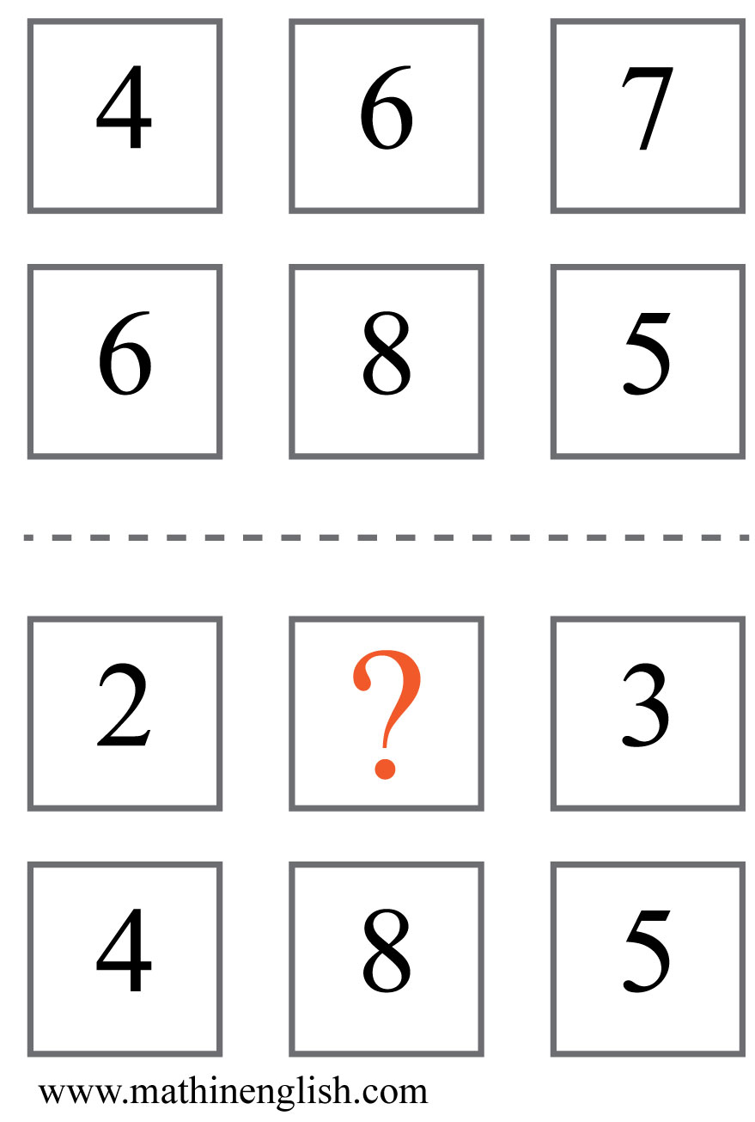
IQ Puzzle 7
Level 4A
Which number is missing?

Slide 9
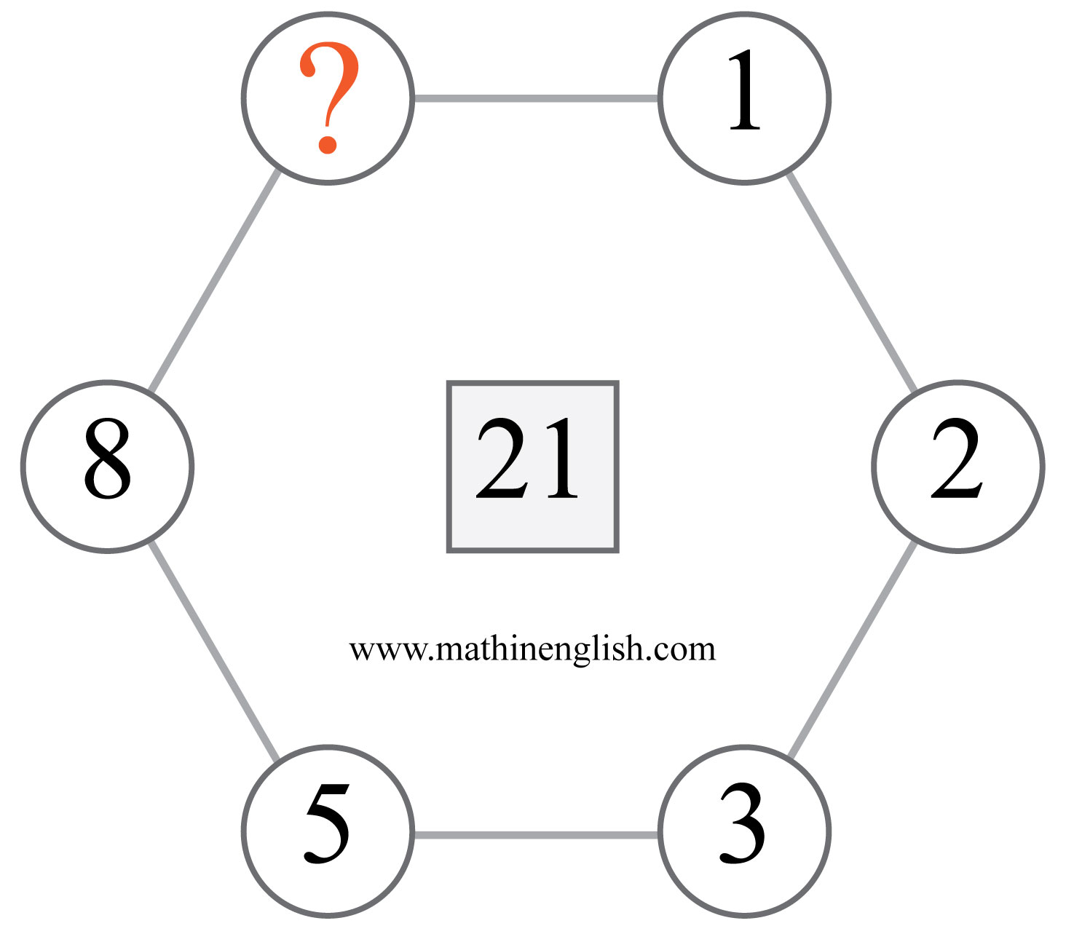
IQ Puzzle 8
Level 4A
Which number completes the pattern?

Slide 10
IQ Puzzle 9
Level 4A
Which time is missing here?

Slide 11
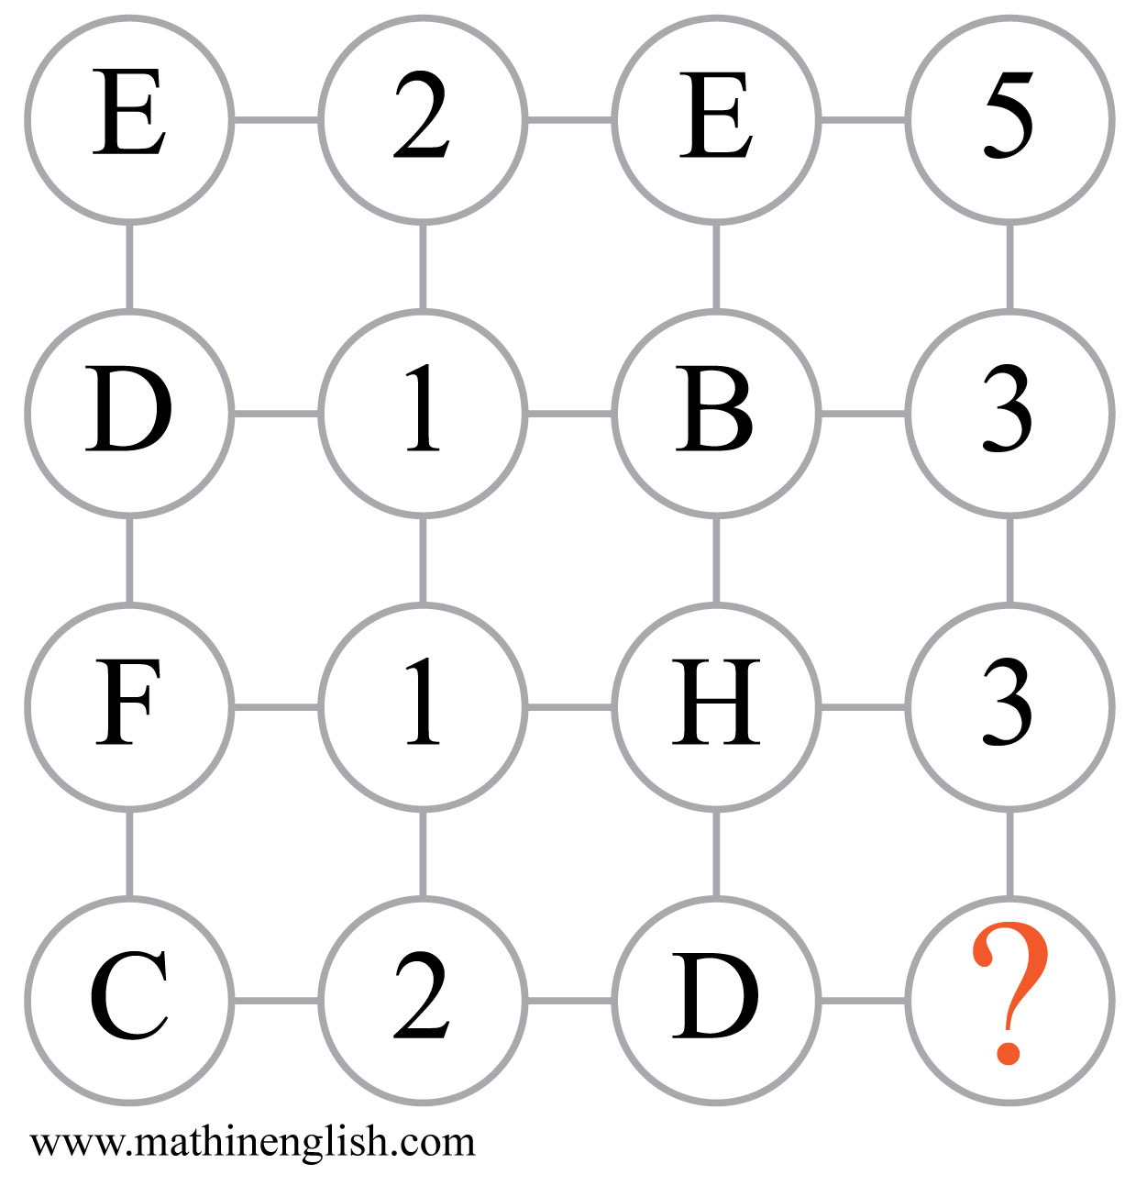
IQ Puzzle 10
Level 4A
Which number is missing?

Slide 12
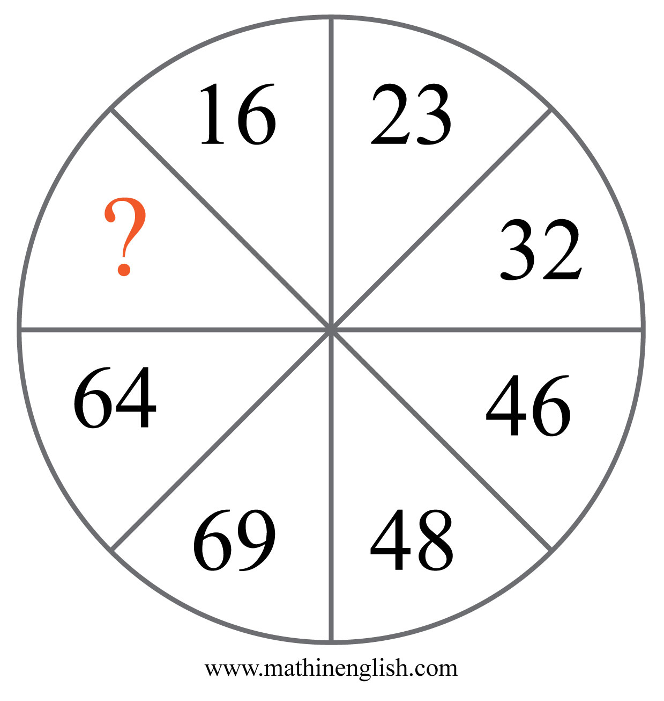
IQ Puzzle 11
Level 4A
Which number is missing?

Slide 13
IQ Puzzle 12
Level 4A
Which number completes the puzzles?

Slide 14
IQ Puzzle 13
Level 4A
Which top number completes the domino?

Slide 15
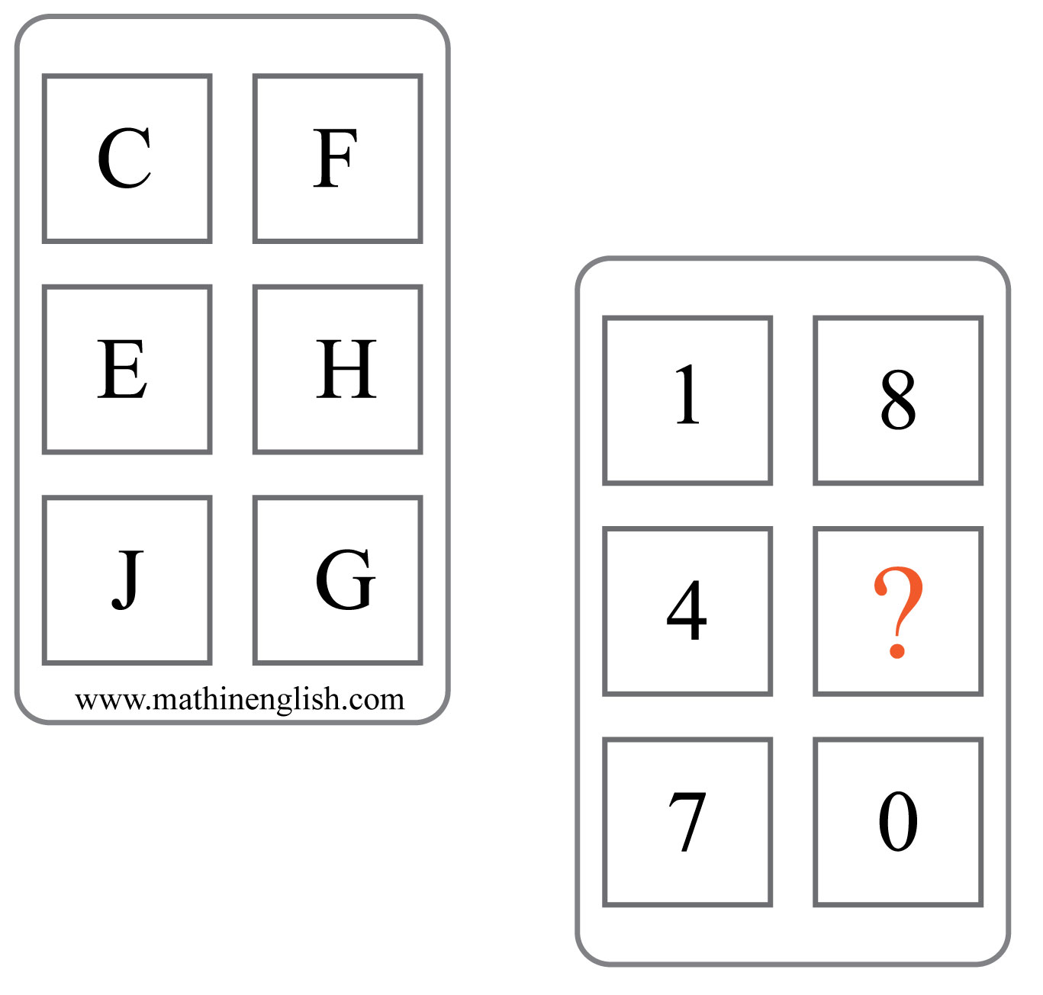
IQ Puzzle 14
Level 4A
What number is missing here?

Slide 16
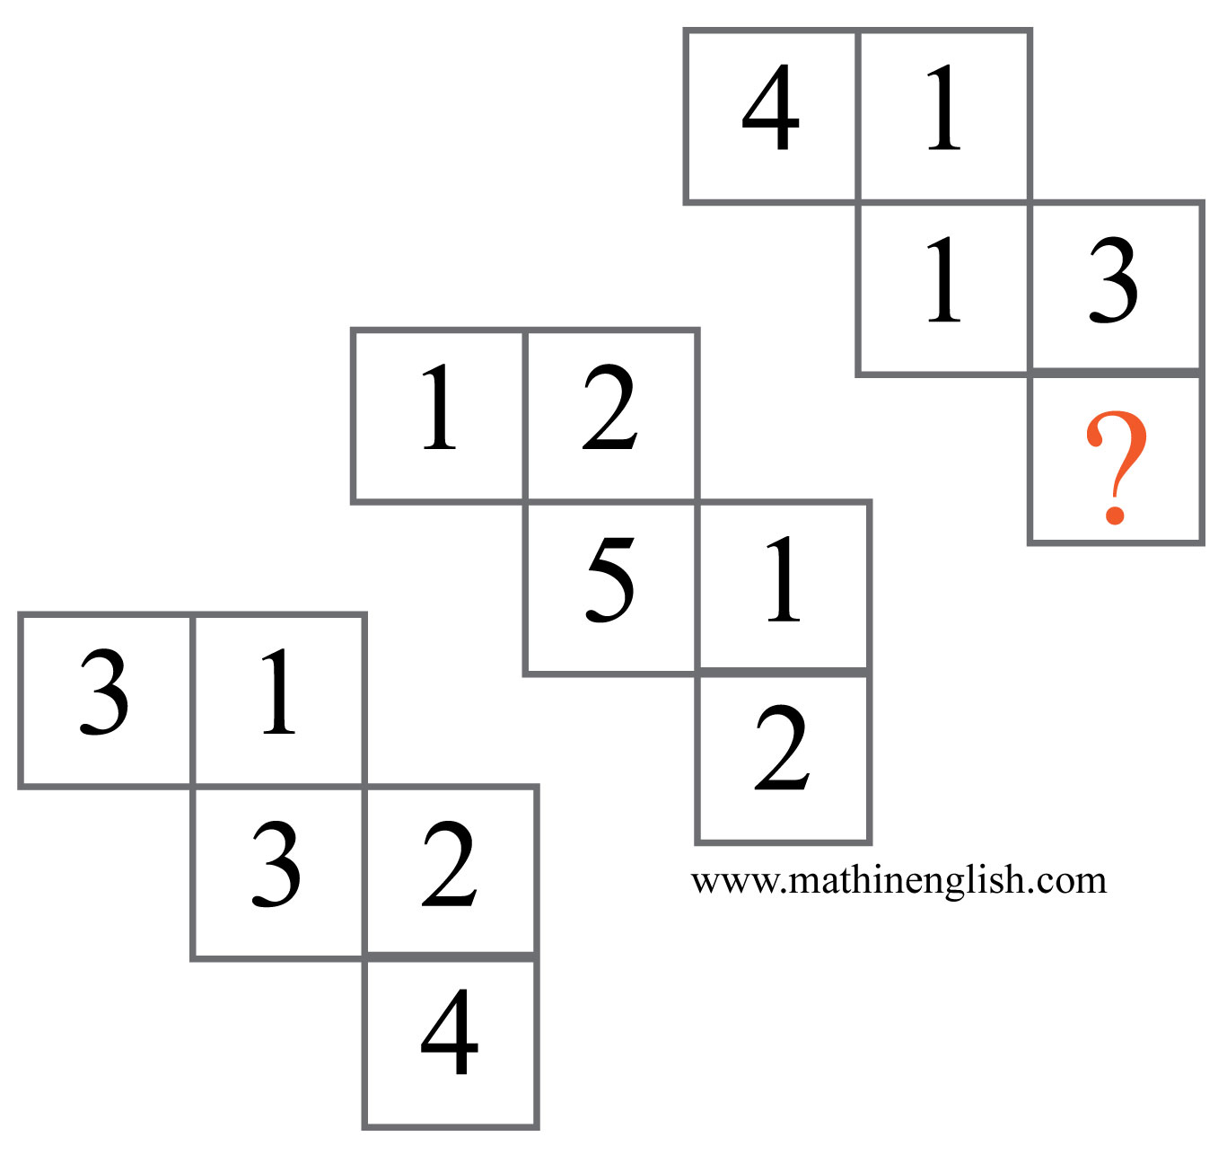
IQ Puzzle 15
Level 4A
Which number is missing?

Slide 17
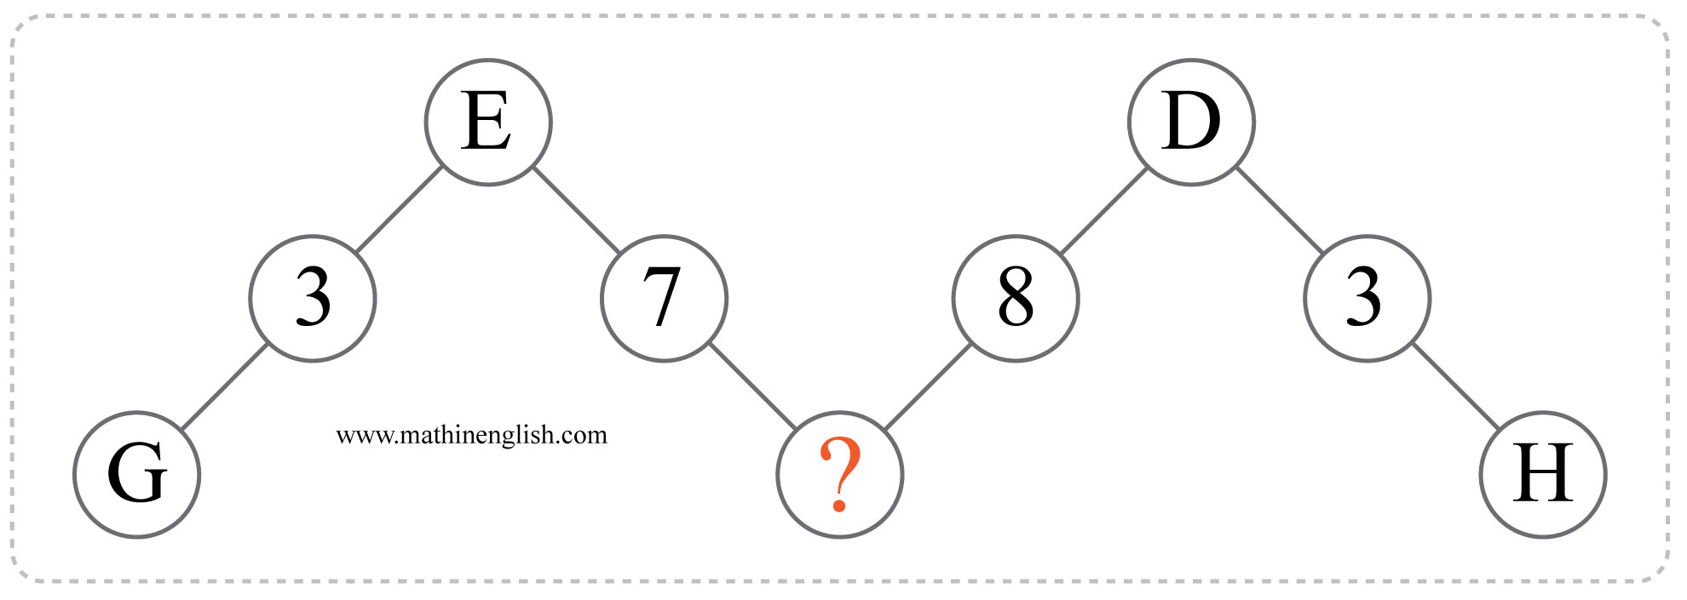
IQ Puzzle 16
Level 4A
Which letter is missing?

Slide 18
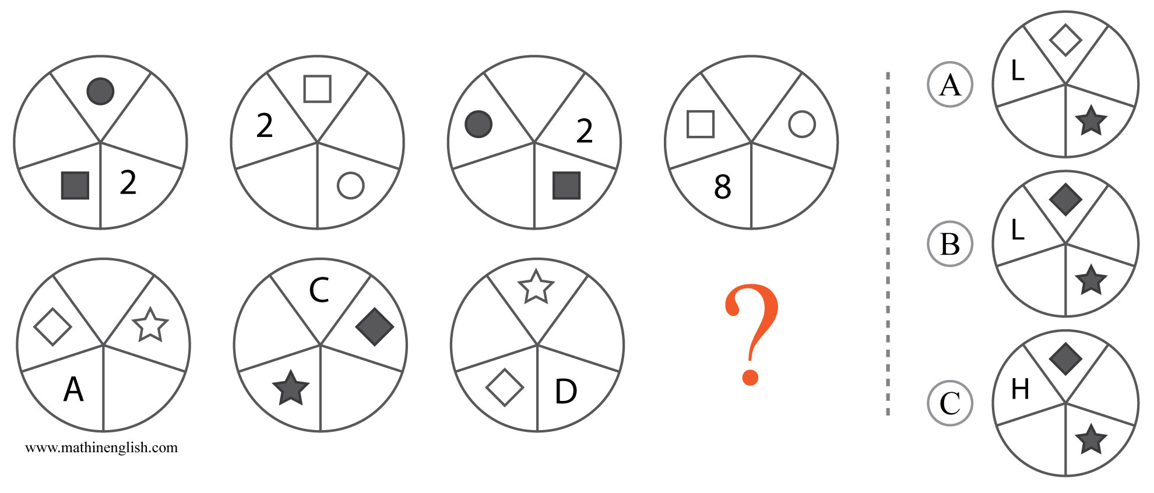
IQ Puzzle 17
Level 4A
Which option is correct?

Slide 19
IQ Puzzle 18
Level 4A
Which number is missing?

Slide 20
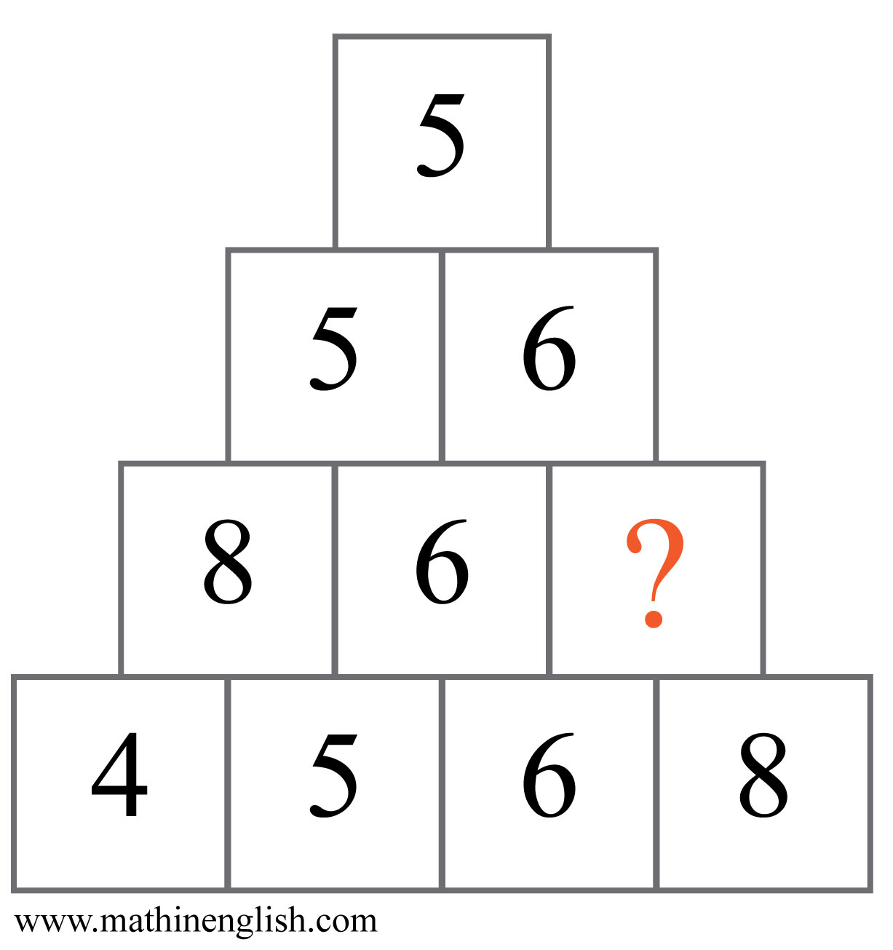
IQ Puzzle 19
Level 4A
Which number is missing?

Slide 21
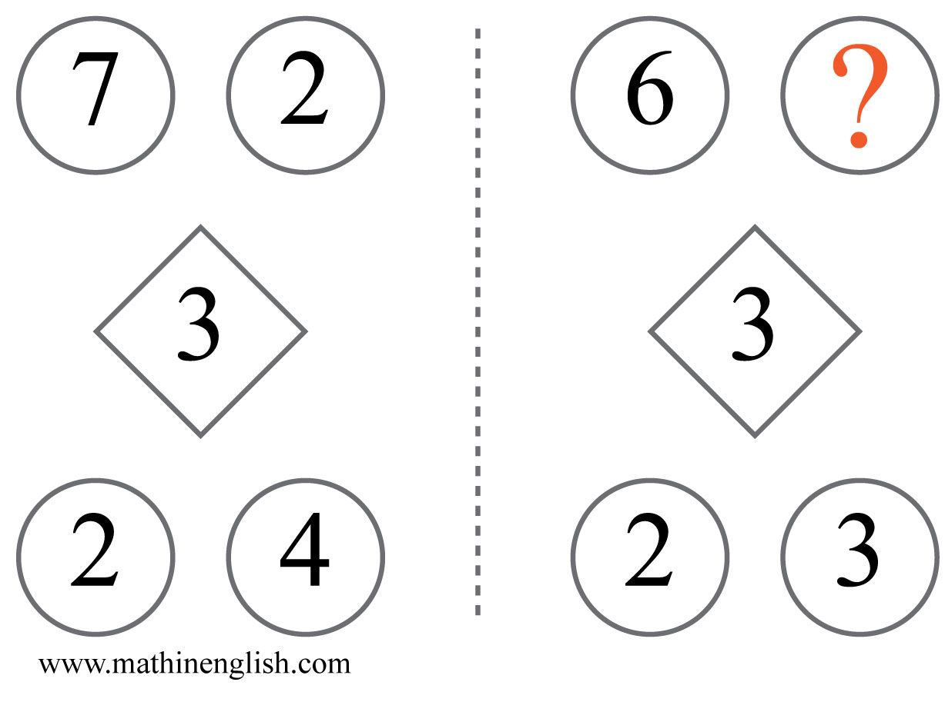
IQ Puzzle 20
Level 4A
Which number is missing?

Slide 22
Answers to puzzles 1 to 4
puzzle 1 : C
Each row of dice multiplies to 72.
puzzle 2 : Z
Divide the sum of the lower row by 3 to get the top number.
puzzle 3 : 4
The right and left digit put together and divided by 12.
puzzle 4 : 6
Subtract the numbers of the left from the right circle to get the
numbers in the middle circle.
Copyright: www.mathinenglish.com
Level 4A

Slide 23
Answers to puzzles 5 to 8
puzzle 5 : C
Each shaded part and symbol moves 1 step in the next square.
The numbers go up by +2.
puzzle 6 : 7
The difference between the horizontal and vertical number
in each cross is 300.
puzzle 7 : 4
Multiply the 1st and 2nd digit in each column to get the 3rd and 4th.
puzzle 8 : 13
Starting at the 1, 1 and 3 make 3, 2 and 3 make 5, and so on (Fibonacci).
Copyright: www.mathinenglish.com
Level 4A

Slide 24
Answers to puzzles 9 to 12
puzzle 9 : 1:11
8:58 - 5:35 = 3:23, 5:35 - 3: 23 = 2:12 and so on.
puzzle 10 : 8
Multiply the left and right cell in the 1st row to get the digits in the
middle (E × 5 = 25, or 2 E).
puzzle 11 : 92
Starting with 16 and 23, each next number is the next multiple of 16 and 23.
puzzle 12 : 2
Both the 2 top digits and bottom digits in each square add up to 9.
Copyright: www.mathinenglish.com
Level 4A

Slide 25
Answers to puzzles 13 to 16
puzzle 13 : 6
All dominoes are odd numbers from 1 to 11.
puzzle 14 : 0
Multiply the 2 letters to get the 2 digits in the same row. E × H = 4 and 0.
puzzle 15 : 5
Each shape contains 4 2-digit numbers and their sum is 100.
puzzle 16 : C
Each 2 letters and number in the middle add up to 15.
Copyright: www.mathinenglish.com
Level 4A

Slide 26
Answers to puzzles 17 to 20
puzzle 17 : B
The symbols move 2 steps in the next circle. Shapes alternate in shaded and non shaded and the numbers/letters of the 1st 3 circles multiplied form the one in the 4th.
puzzle 18 : 19
Going top-down, add each number to the one before to get the next one.
puzzle 19 : 5
Starting from the top, each lower row contains the same digits as the
one above it.
puzzle 20 : 9
The top 2 digits divided by the diamond are equal to the digits at the bottom.
Copyright: www.mathinenglish.com
Level 4A

