Slide 1
IQ puzzles and brain teasers
Level 4B

Slide 2
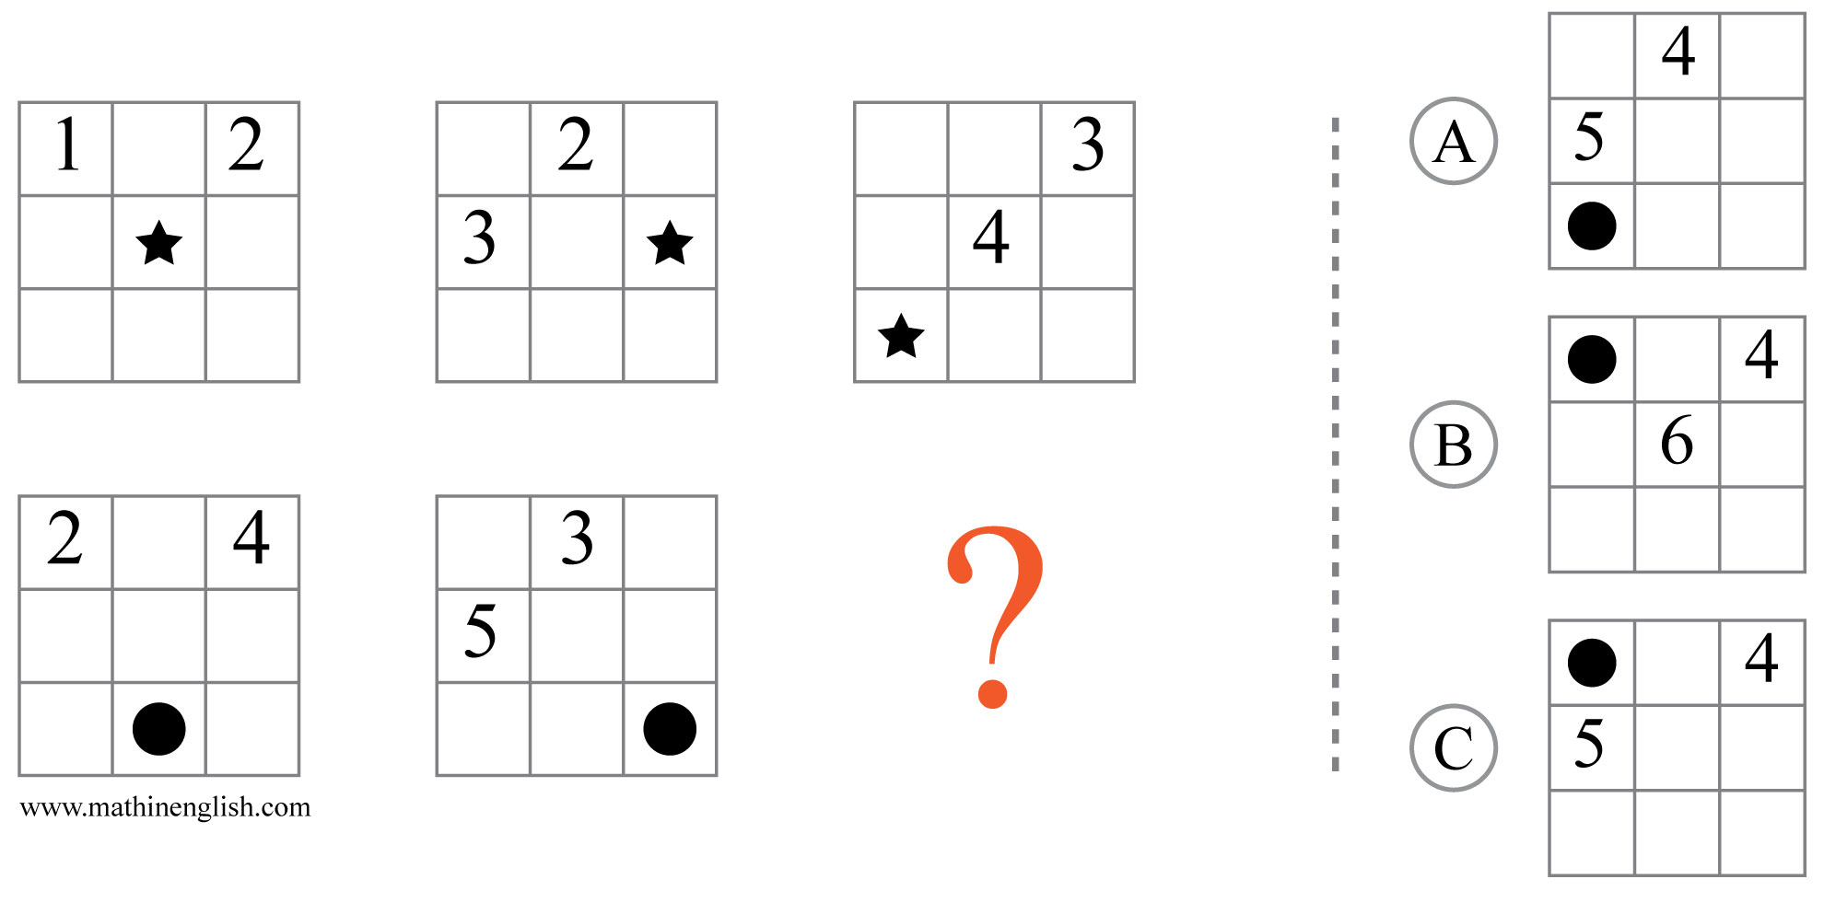
IQ Puzzle 1
Level 4B
Which option is correct?

Slide 3
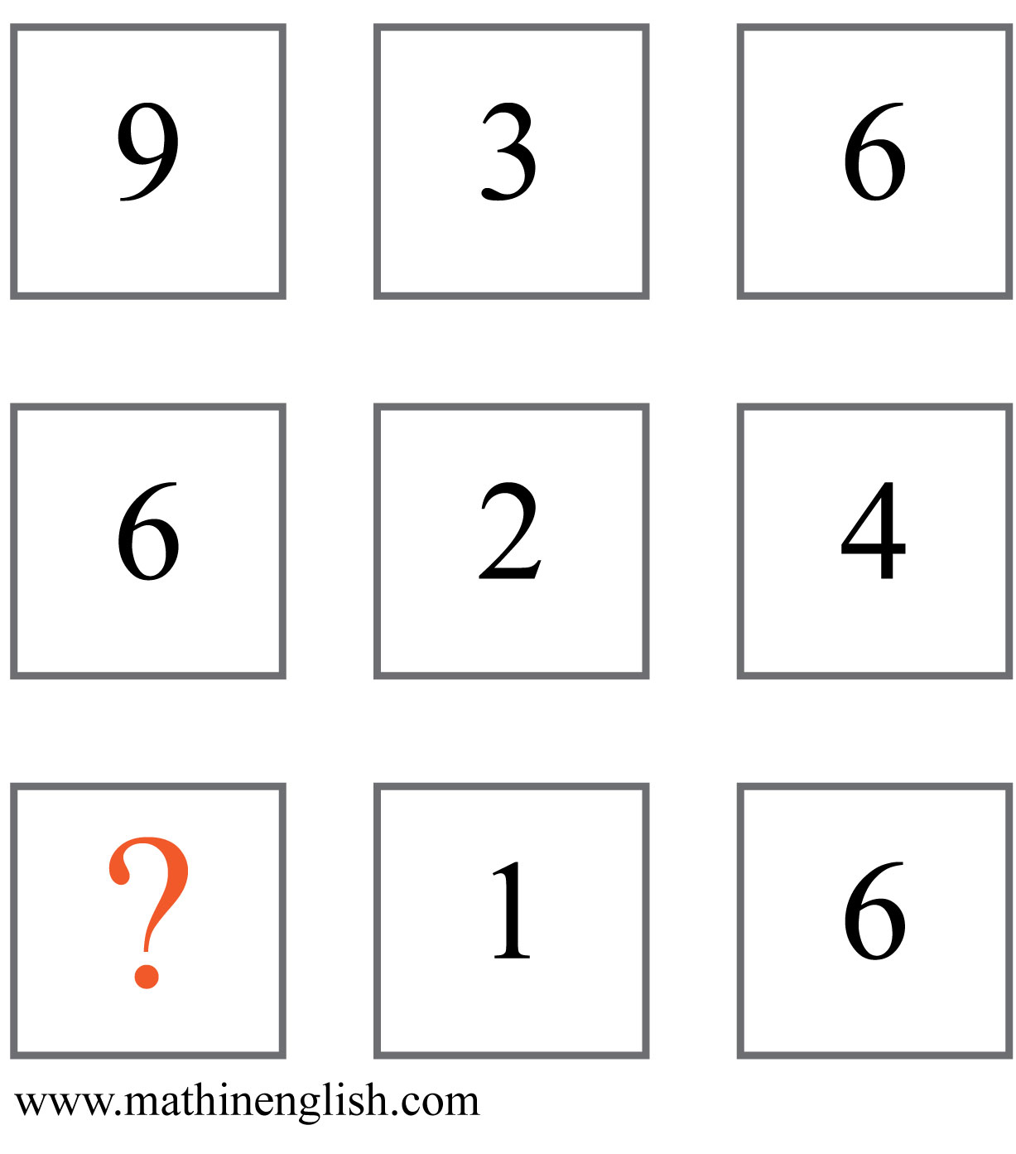
IQ Puzzle 2
Level 4B
Which number, less than 5 is missing?

Slide 4
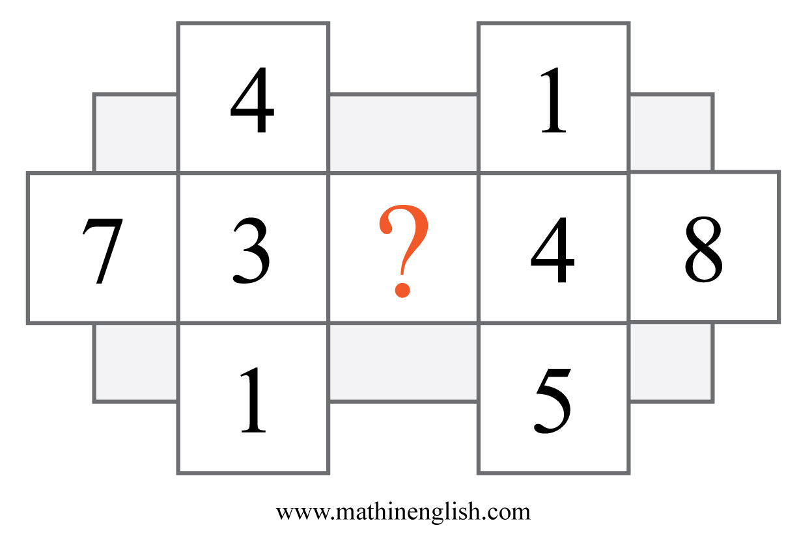
IQ Puzzle 3
Level 4B
What is the missing number?

Slide 5
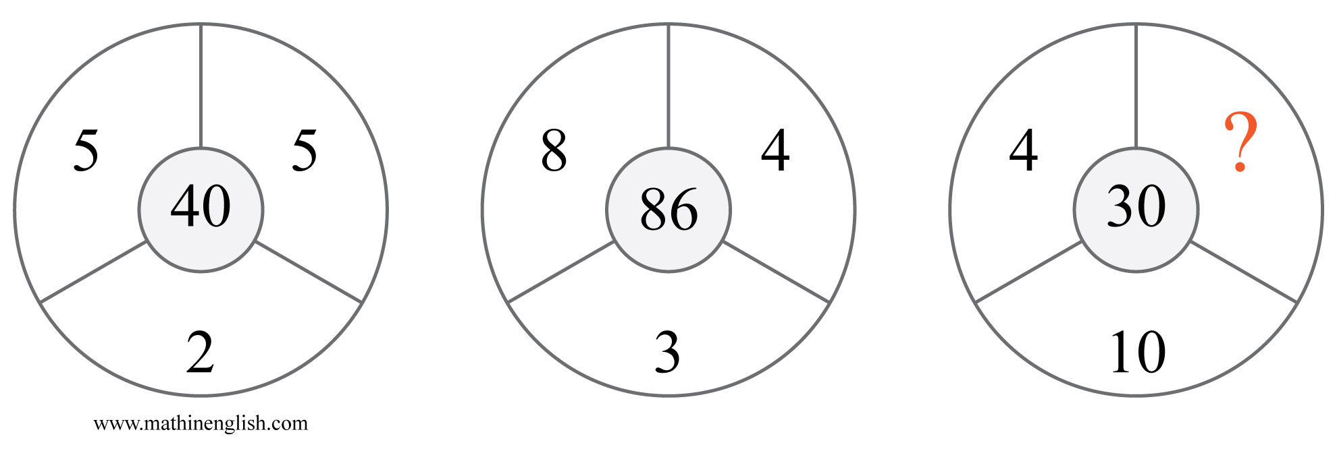
IQ Puzzle 4
Level 4B
What number is needed here?

Slide 6
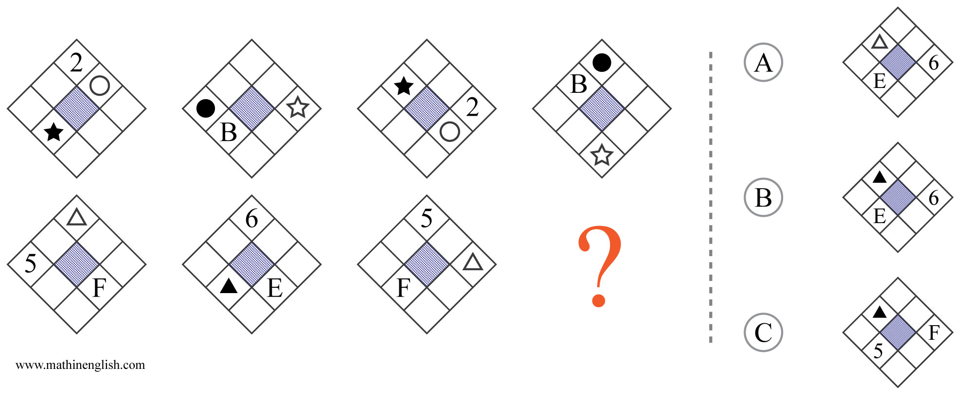
IQ Puzzle 5
Level 4B
Which option is correct?

Slide 7
IQ Puzzle 6
Level 4B
Which number is missing?

Slide 8
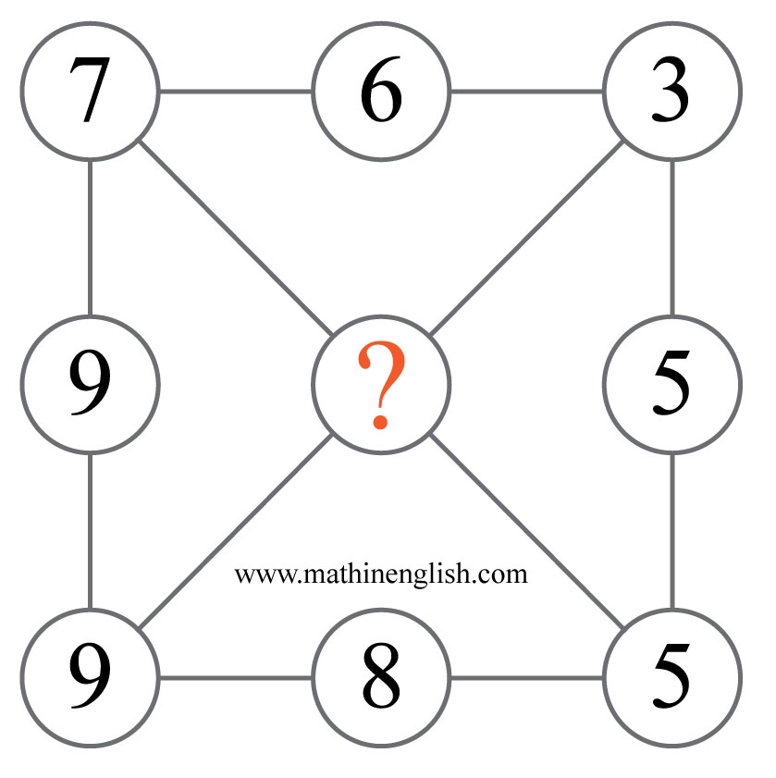
IQ Puzzle 7
Level 4B
Which number is missing?

Slide 9
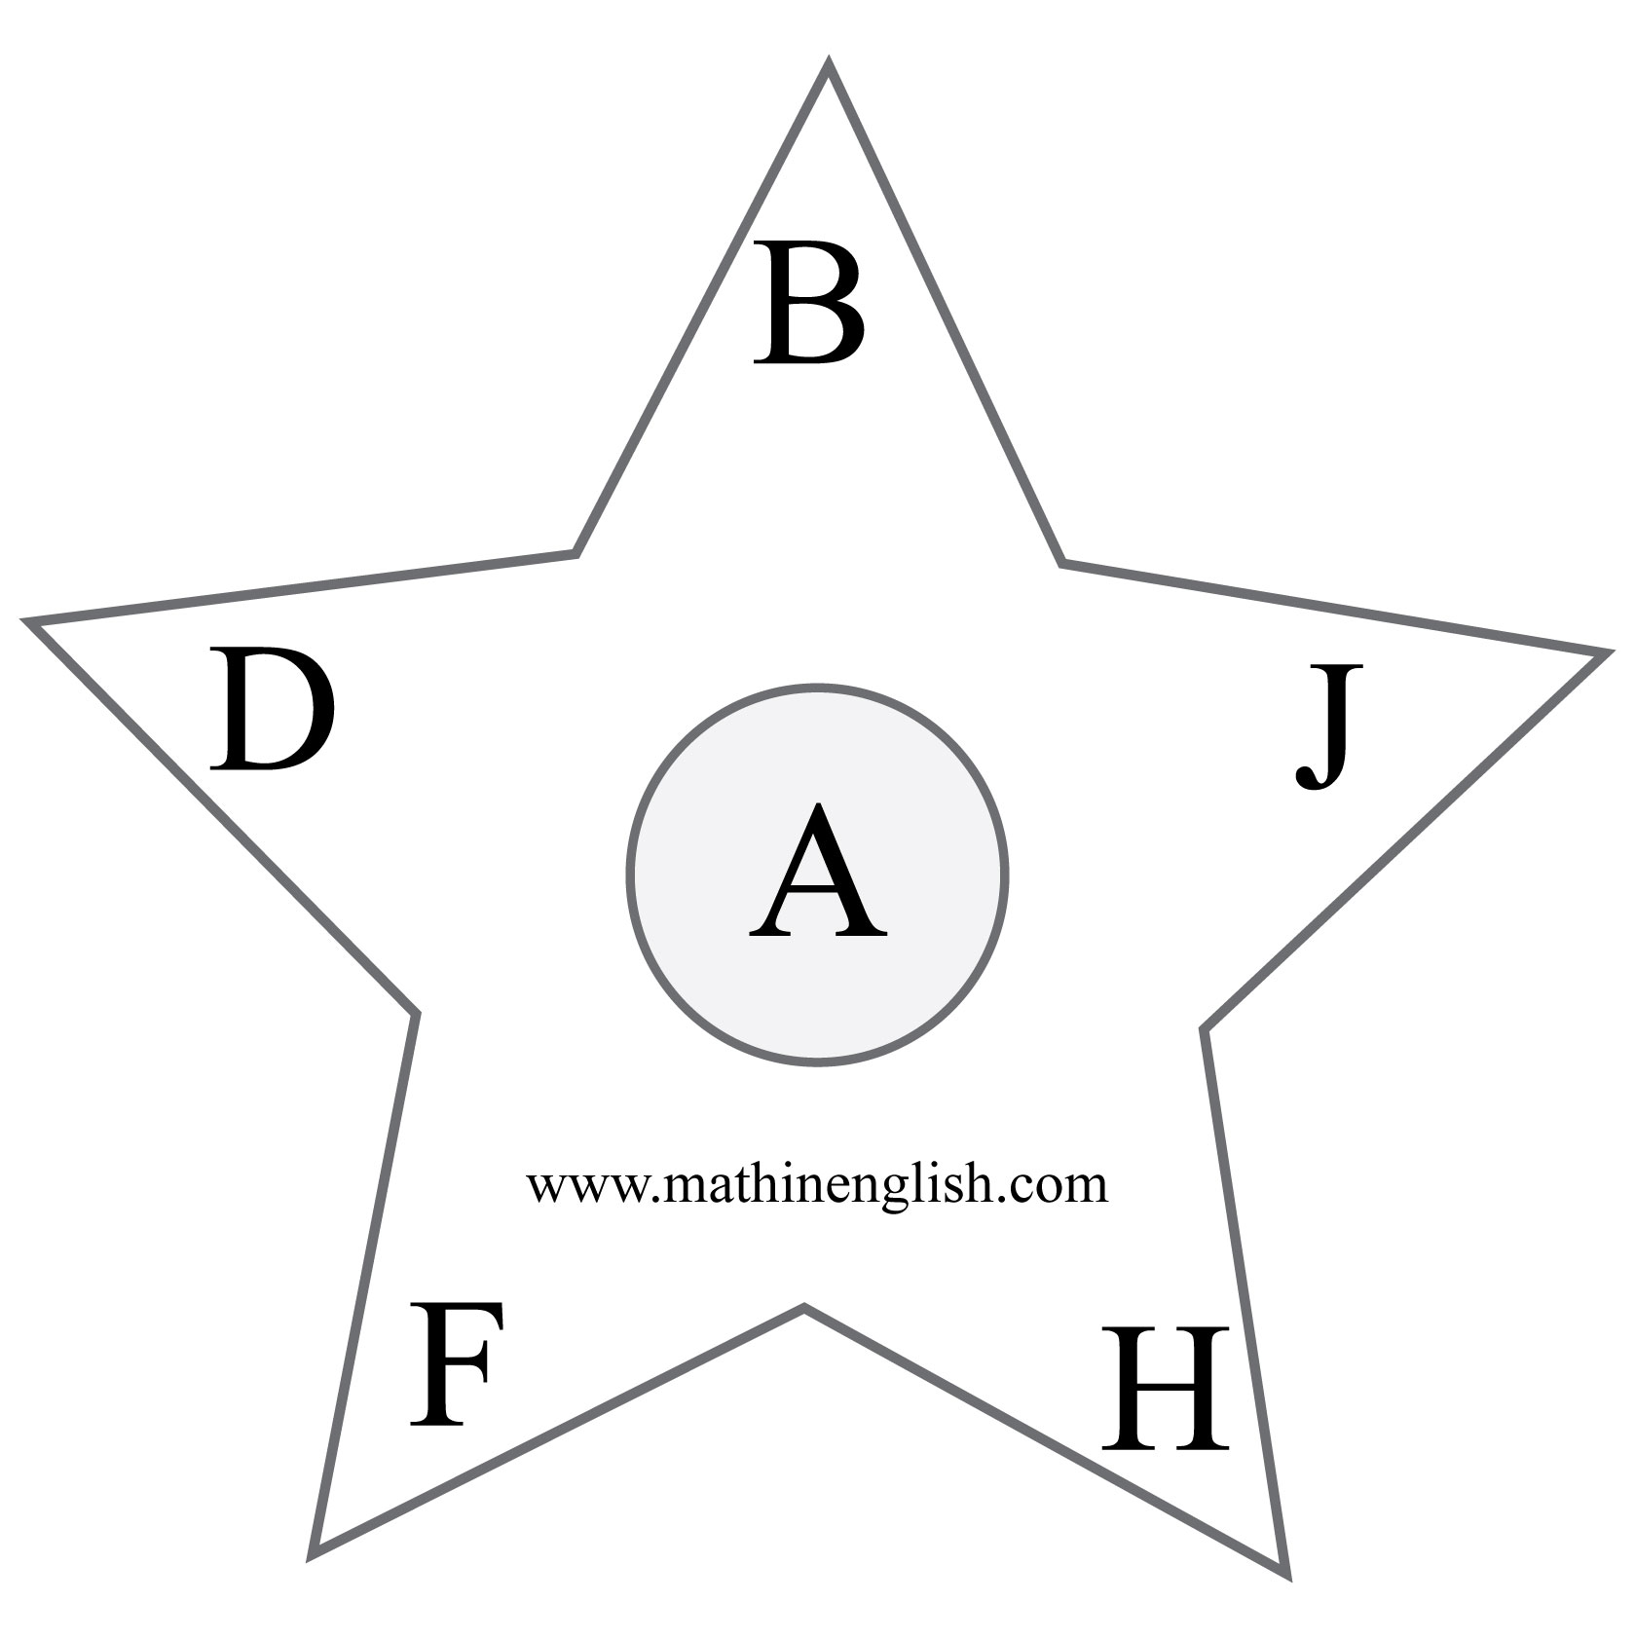
IQ Puzzle 8
Level 4B
Which letter is the odd one out?

Slide 10
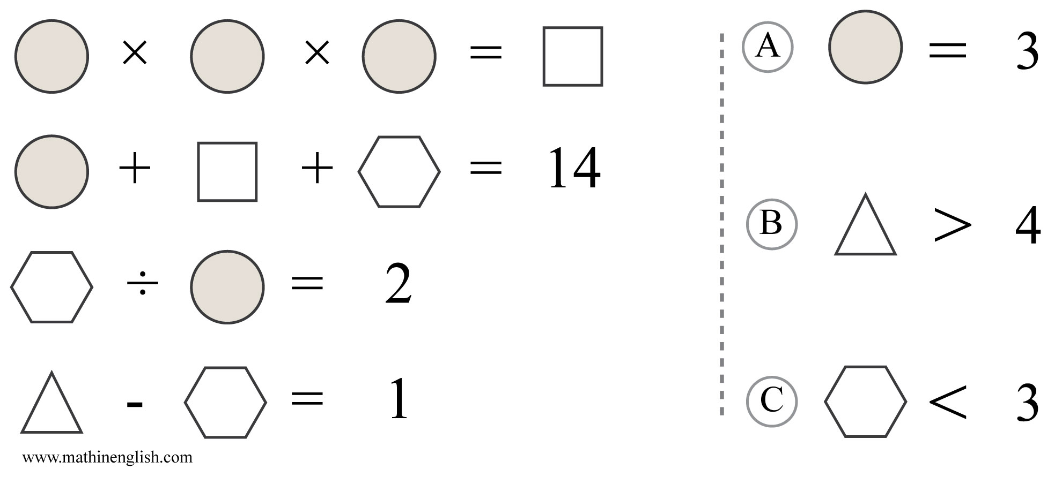
IQ Puzzle 9
Level 4B
Which option is correct?

Slide 11
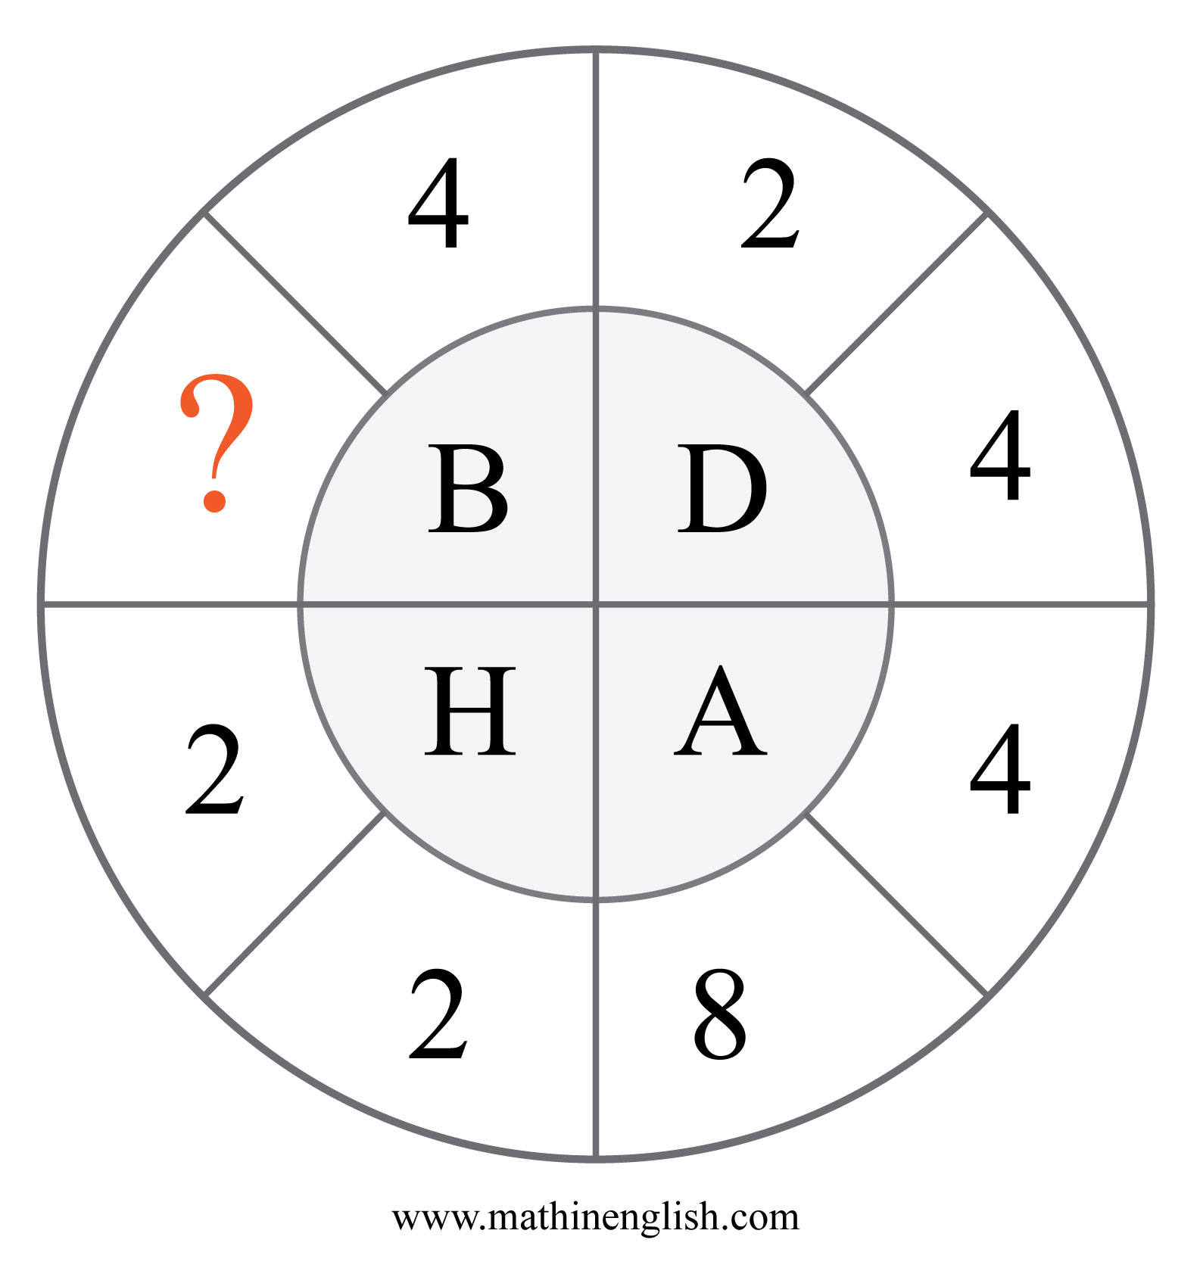
IQ Puzzle 10
Level 4B
Which number is missing?

Slide 12
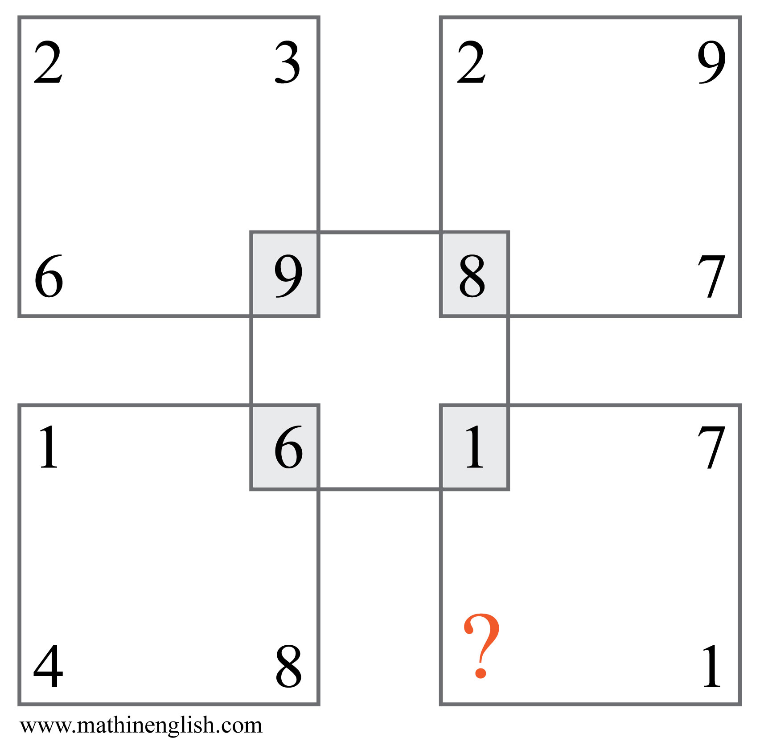
IQ Puzzle 11
Level 4B
Which number is missing?

Slide 13
IQ Puzzle 12
Level 4B
Which number completes the puzzle?

Slide 14
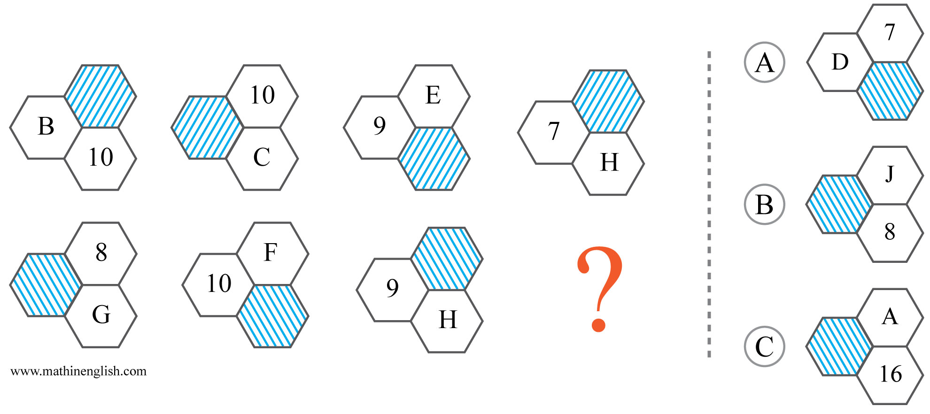
IQ Puzzle 13
Level 4B
Which option is correct?

Slide 15
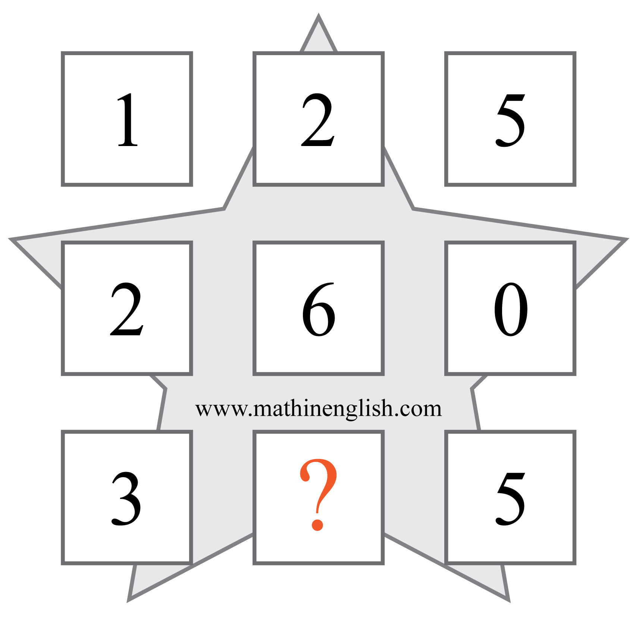
IQ Puzzle 14
Level 4B
What is the missing number here?

Slide 16
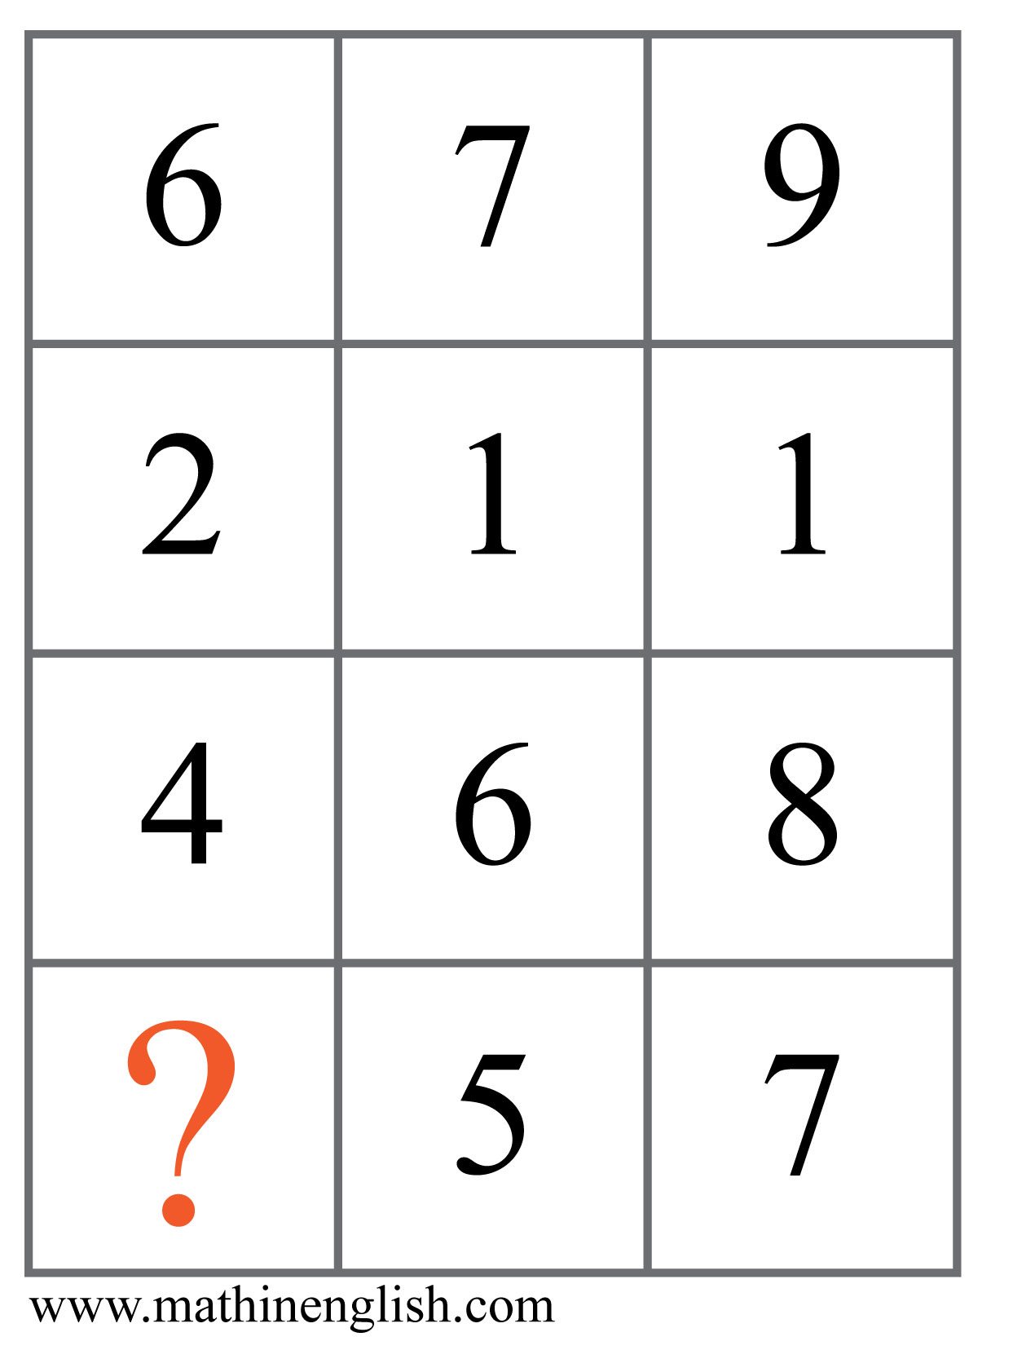
IQ Puzzle 15
Level 4B
Which number is missing?

Slide 17
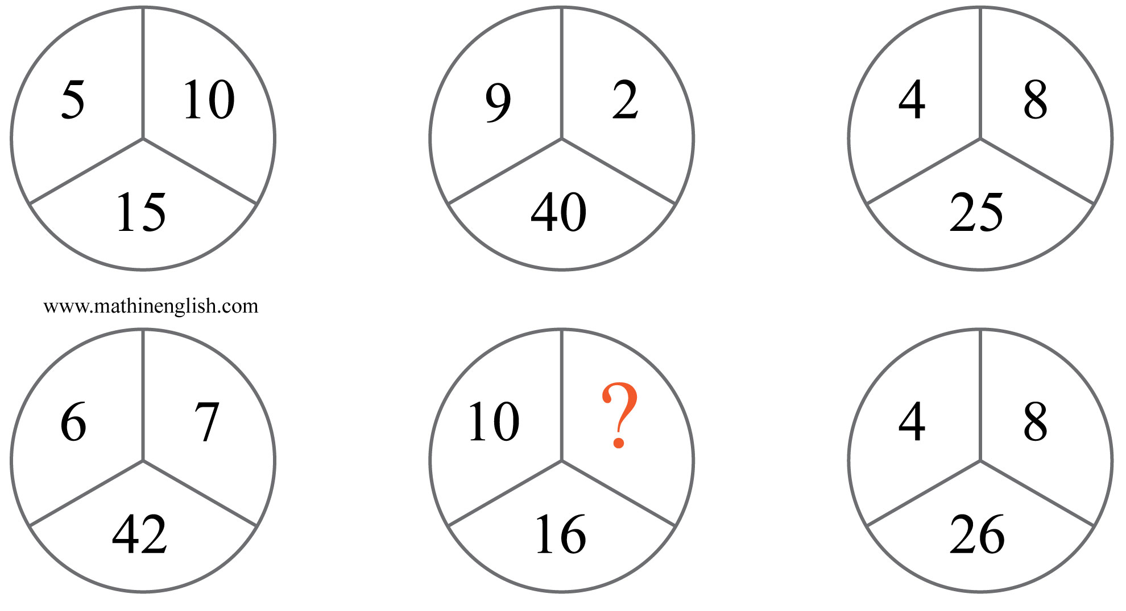
IQ Puzzle 16
Level 4B
Which number completes the puzzle?

Slide 18
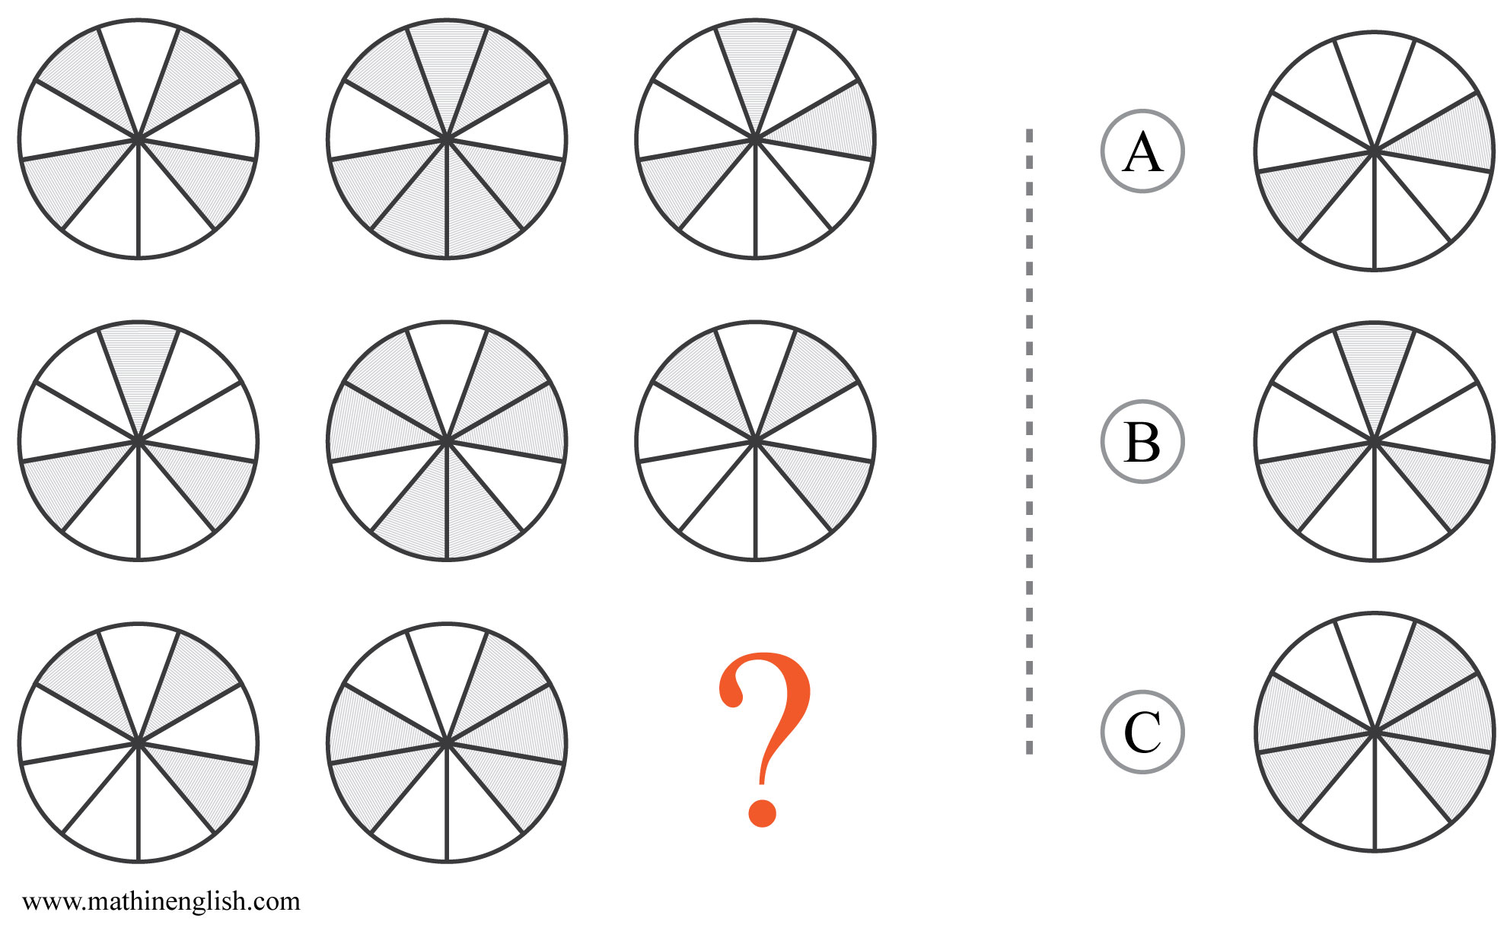
IQ Puzzle 17
Level 4B
Which option is correct?

Slide 19
IQ Puzzle 18
Level 4B
Which letter is missing in the sequence?

Slide 20
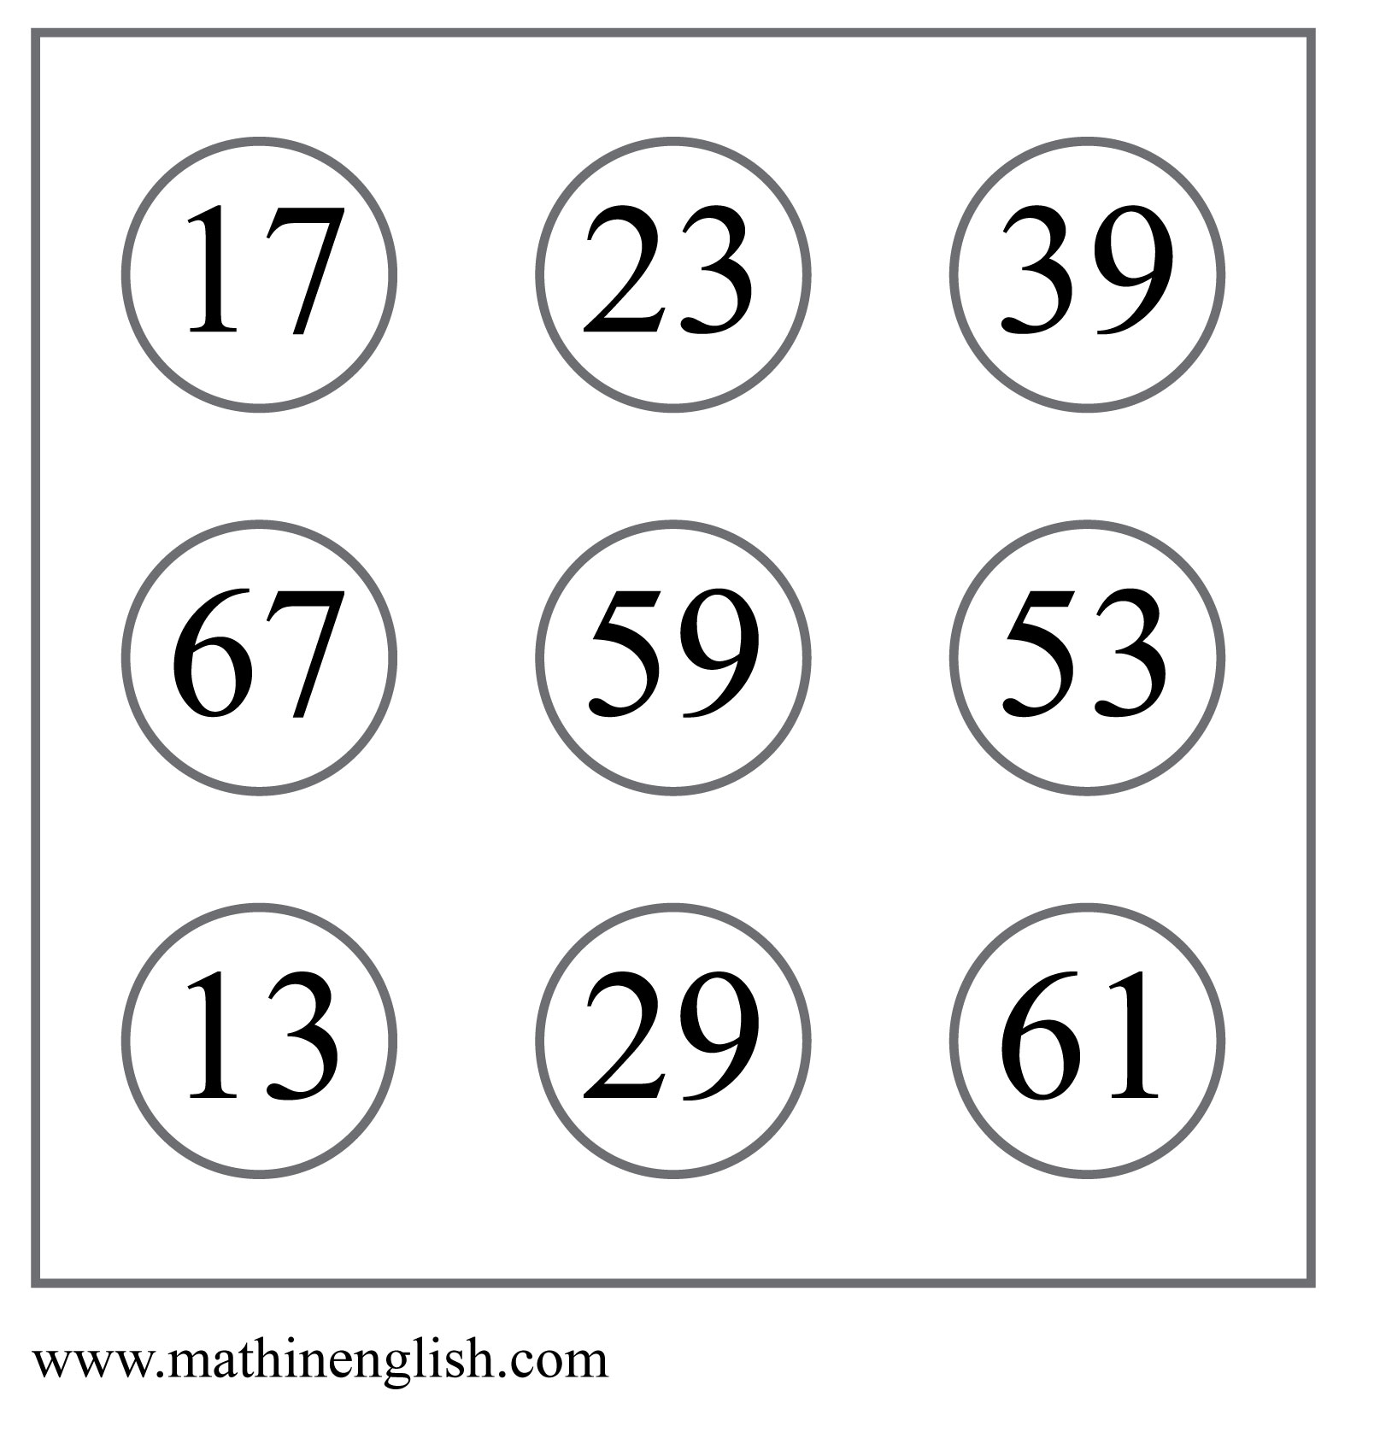
IQ Puzzle 19
Level 4B
Which number is the odd one out?

Slide 21
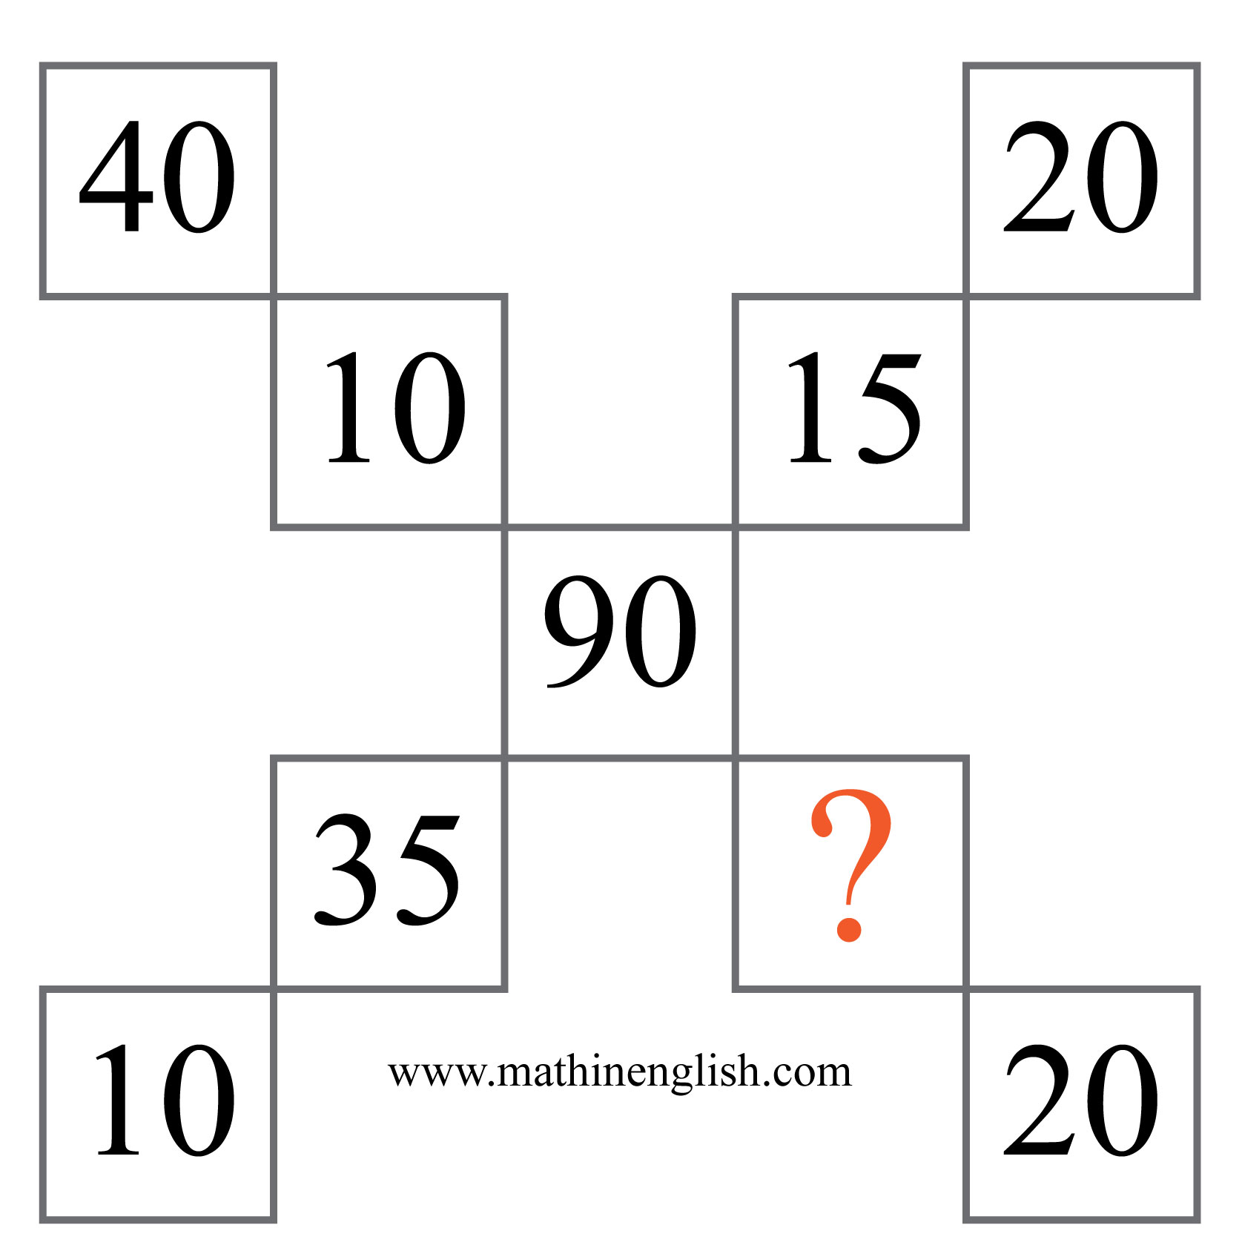
IQ Puzzle 20
Level 4B
Which number is missing?

Slide 22
Answers to puzzles 1 to 4
puzzle 1 : B
All symbols move 1 step in the next square and the numbers increase by +1.
puzzle 2 : 4
In each row, divide the last 2 cells by 4 to get the 1st cell.
puzzle 3 : 4
The difference between each opposite pair is either 3 or 4.
puzzle 4 : 1
Multiply the 3 numbers in each circle, then subtract 10 to get the center number.
Copyright: www.mathinenglish.com
Level 4B

Slide 23
Answers to puzzles 5 to 8
puzzle 5 : B
Each symbol rotate 5 steps around the center. Shapes alternate being shaded
and non shaded. Letters change in numbers in each next diamond.
puzzle 6 : 25
Divide each pair of opposite numbers by 2 and subtract 5.
puzzle 7 : 7
Take the average of opposite numbers and add 1 to get the middle number.
puzzle 8 : A
A is the only letter with and odd letter number value.
Copyright: www.mathinenglish.com
Level 4B

Slide 24
Answers to puzzles 9 to 12
puzzle 9 : B
Circle = 2, square = 8, hexagon = 4, triangle = 5.
puzzle 10 : 4
Multiplying the 2 numbers and the letter in each circle part equals 32.
puzzle 11 : 5
Multiply the number formed by the top 2 digits in each square by 3
to get the bottom 2 digits.
puzzle 12 : 4
Multiply the 2 connecting numbers in each triangle and add 2 to the result.
Copyright: www.mathinenglish.com
Level 4B

Slide 25
Answers to puzzles 13 to 16
puzzle 13 : B
The shaded part and symbols in each shape move 2 places clockwise.
The sum of the letter and number increase by 1 in both rows.
puzzle 14 : 8
Bottom row minus the middle row equal the top row.
puzzle 15 : 2
Top row is the sum of the 2nd and 3rd row, bottom row the difference.
puzzle 16 : 15
In each row, the 3rd circle shows the difference between the
numbers in the 1st and 2nd circle.
Copyright: www.mathinenglish.com
Level 4B

Slide 26
Answers to puzzles 17 to 20
puzzle 17 : A
In each row, the middle circle show the sum of shaded parts
of the 1st and 3rd circle.
puzzle 18 : S
Starting with the M of Monday, the pattern ends with S of Sunday.
puzzle 19 : 13
13 is not a prime number.
puzzle 20 : 30
The 4 numbers on the outside, the 4 numbers in the 4 middle,
and the center number add up to 90.
Copyright: www.mathinenglish.com
Level 4B

