Slide 1

IQ puzzles and brain teasers
Level 4C

Slide 2
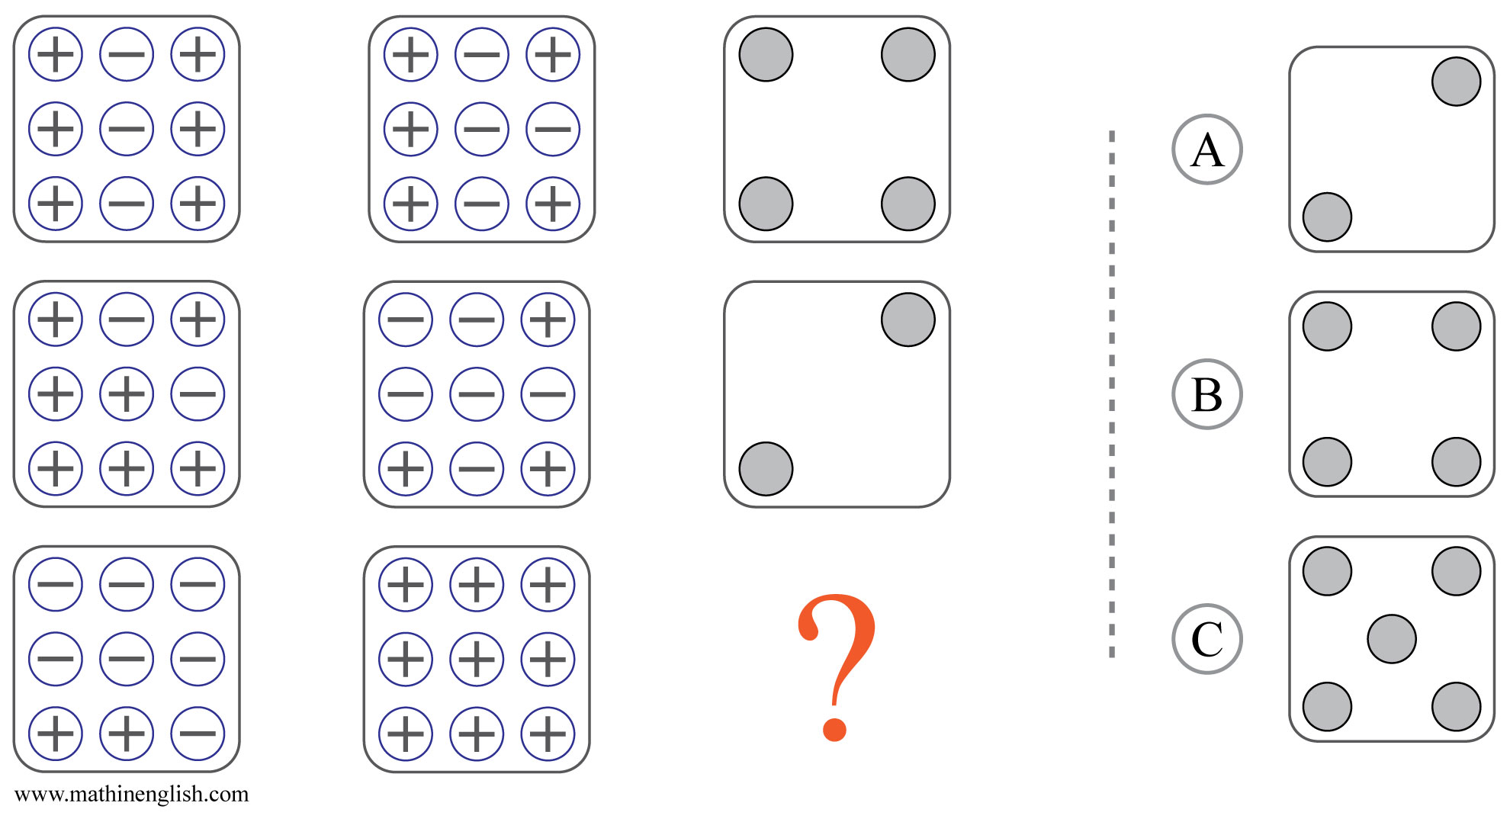



IQ Puzzle 1
Level 4C
Which option is correct?

Slide 3
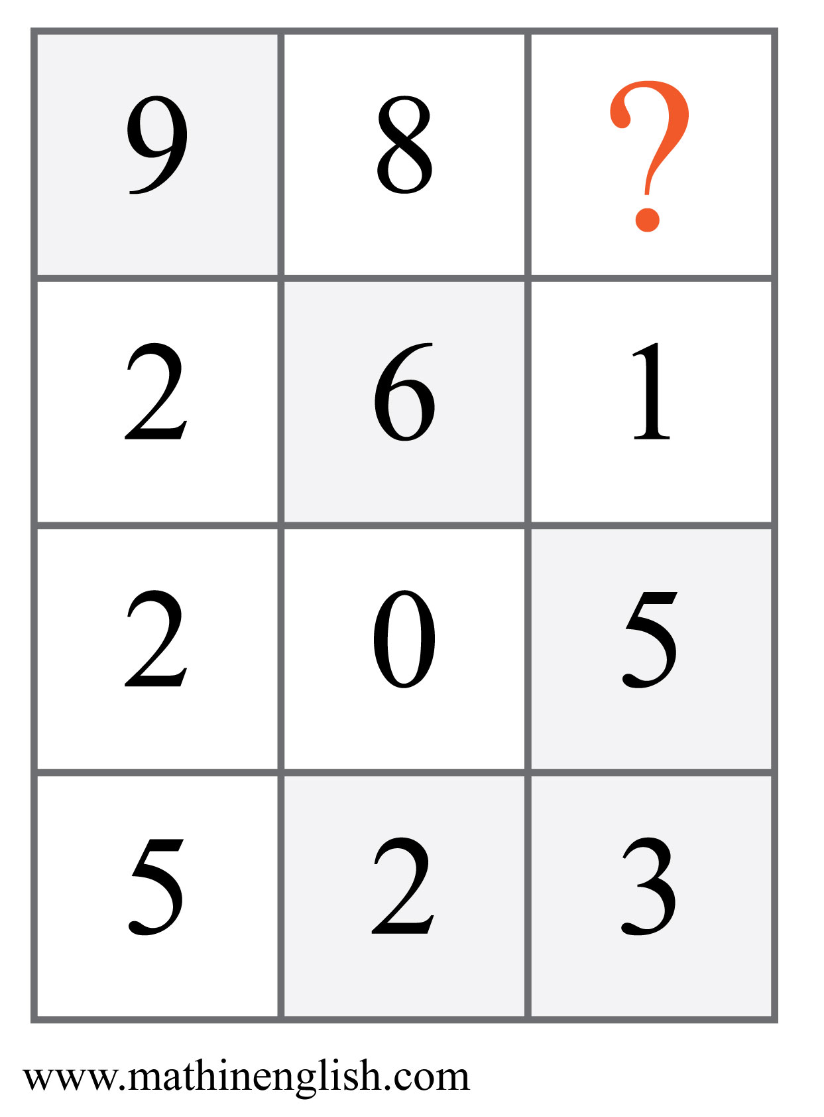
IQ Puzzle 2
Level 4C
Which number is missing?

Slide 4
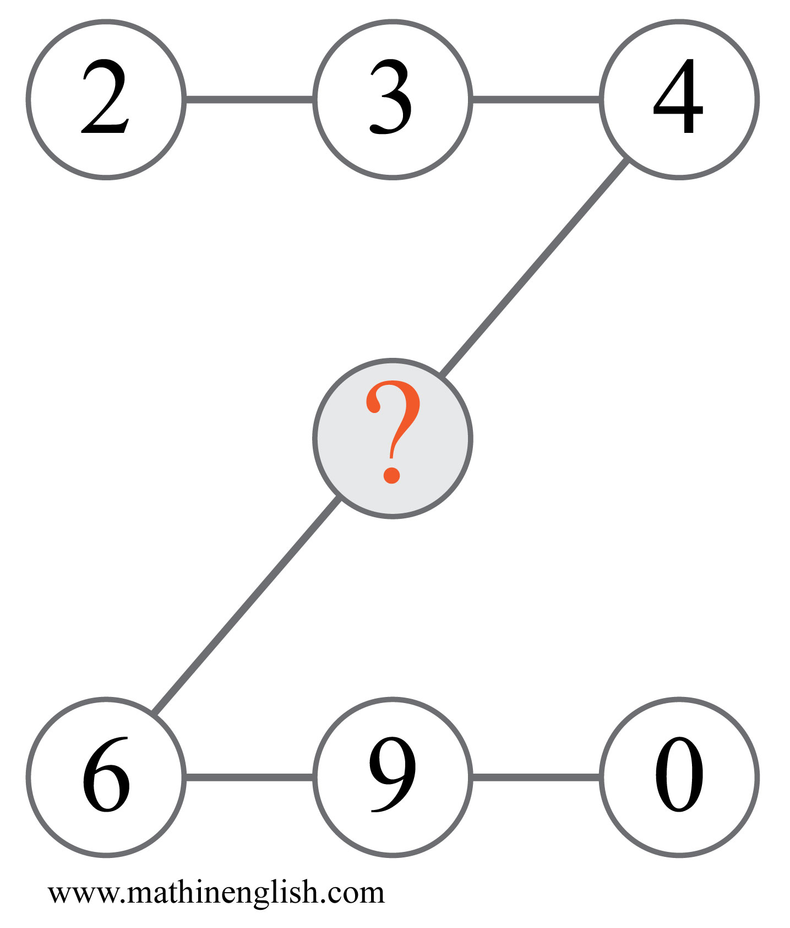
IQ Puzzle 3
Level 4C
What is the missing number?

Slide 5
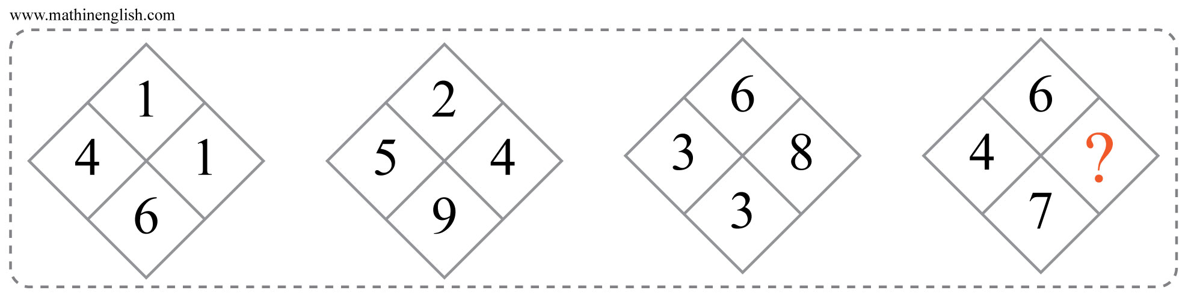
IQ Puzzle 4
Level 4C
What number is needed here?

Slide 6
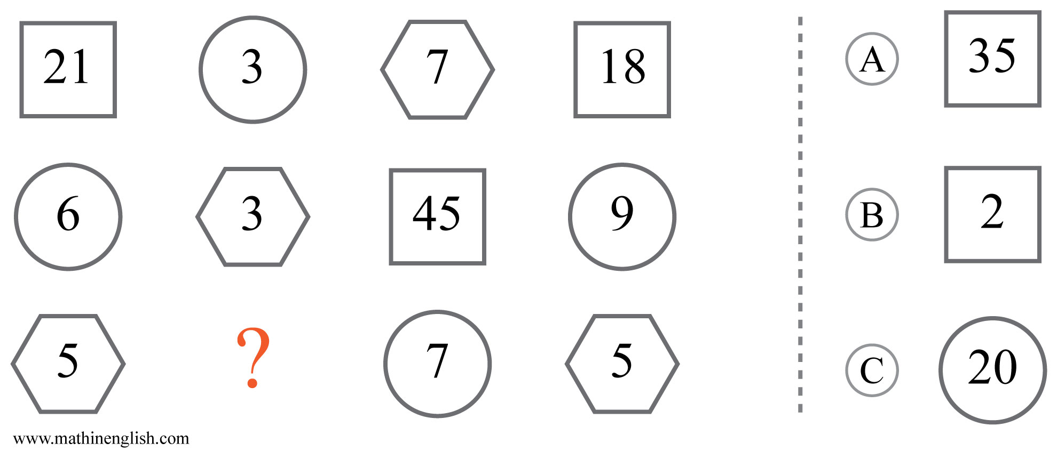
IQ Puzzle 5
Level 4C
Which option is correct?

Slide 7
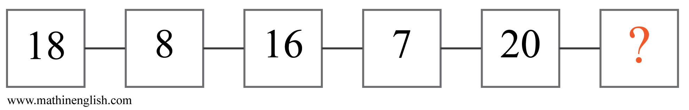
IQ Puzzle 6
Level 4C
Which number is missing?

Slide 8
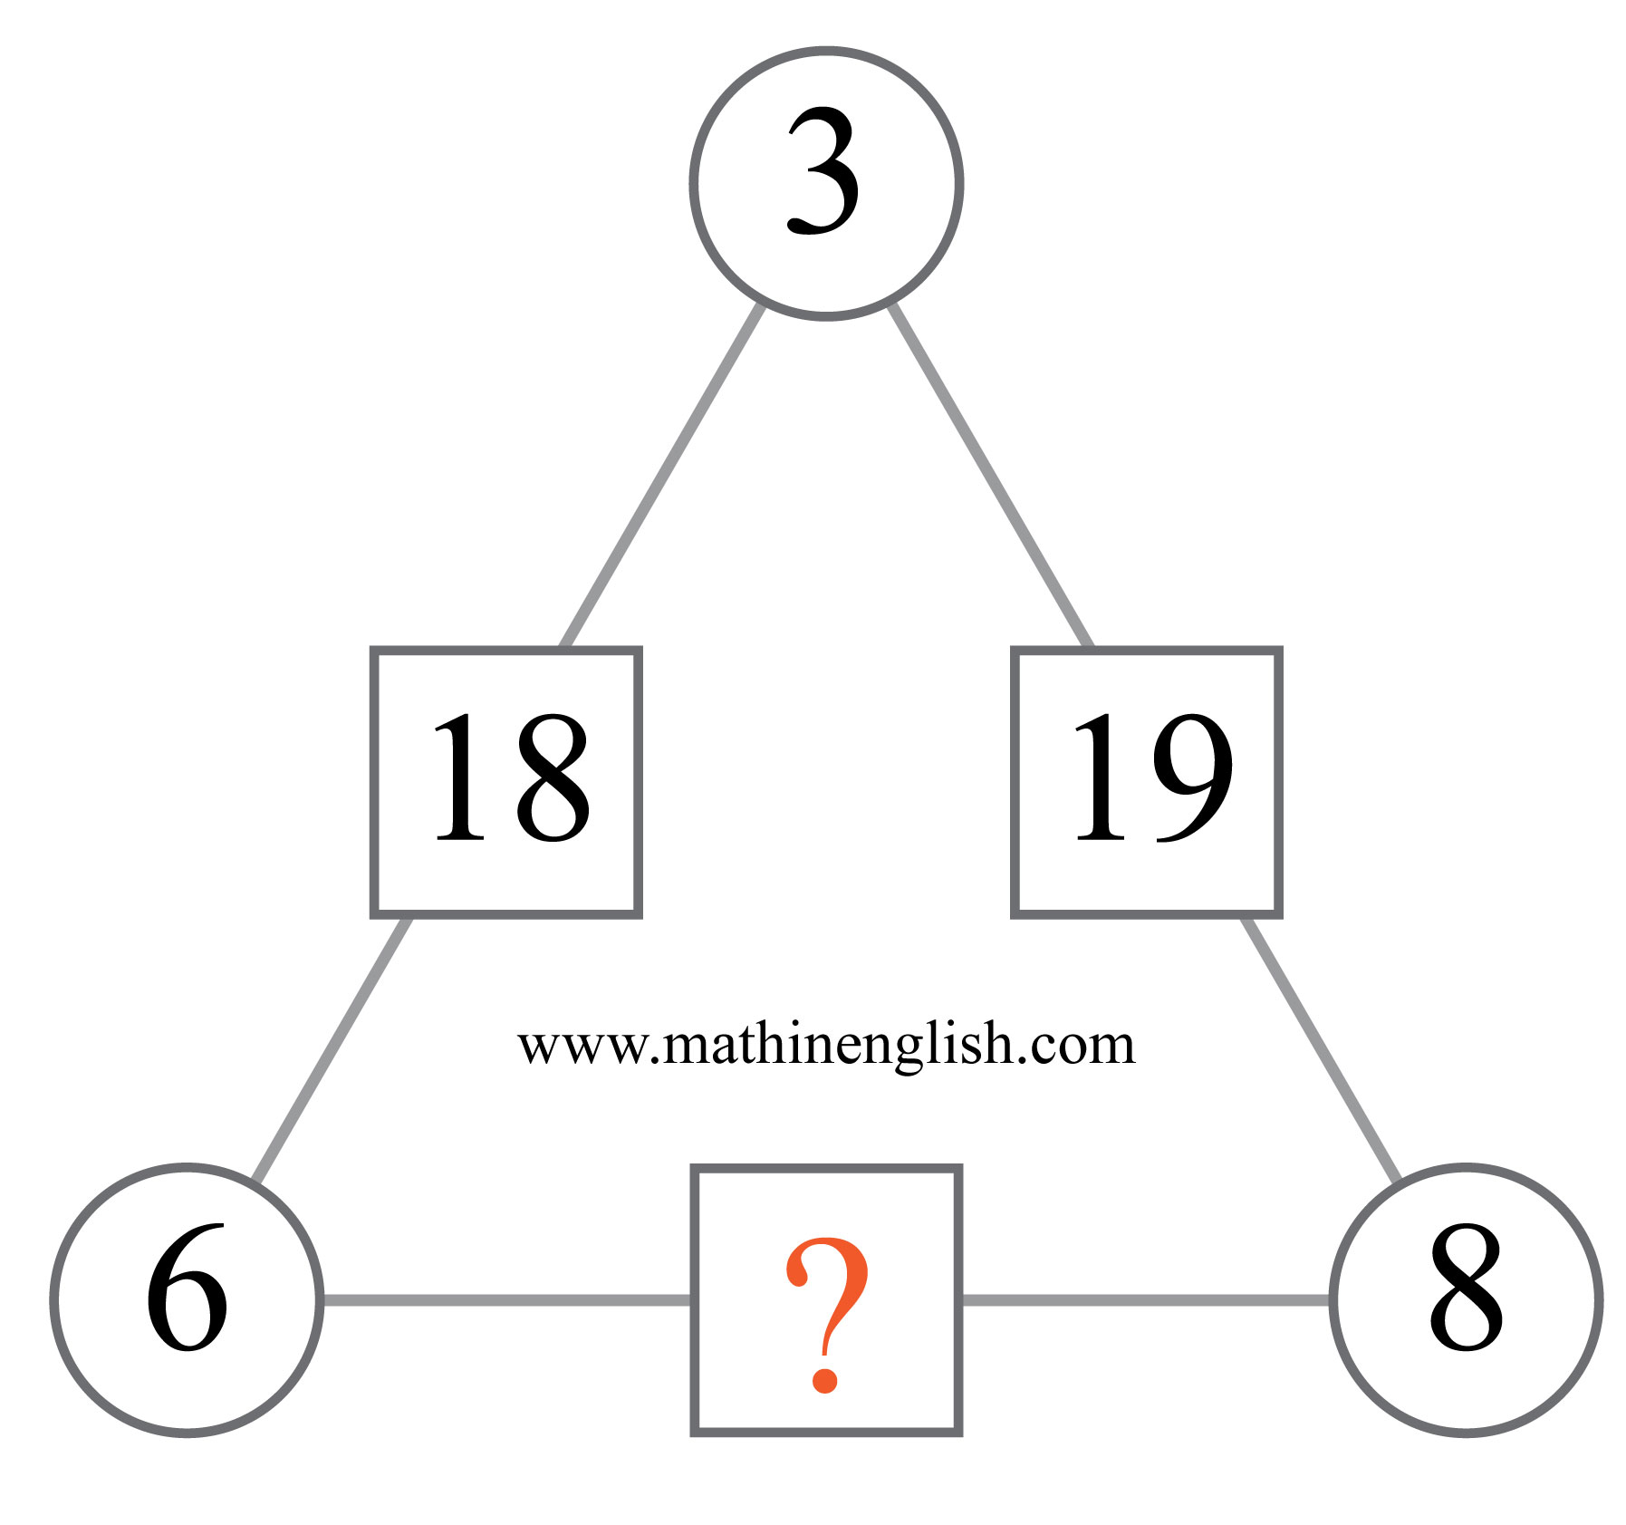
IQ Puzzle 7
Level 4C
Which number is missing?

Slide 9
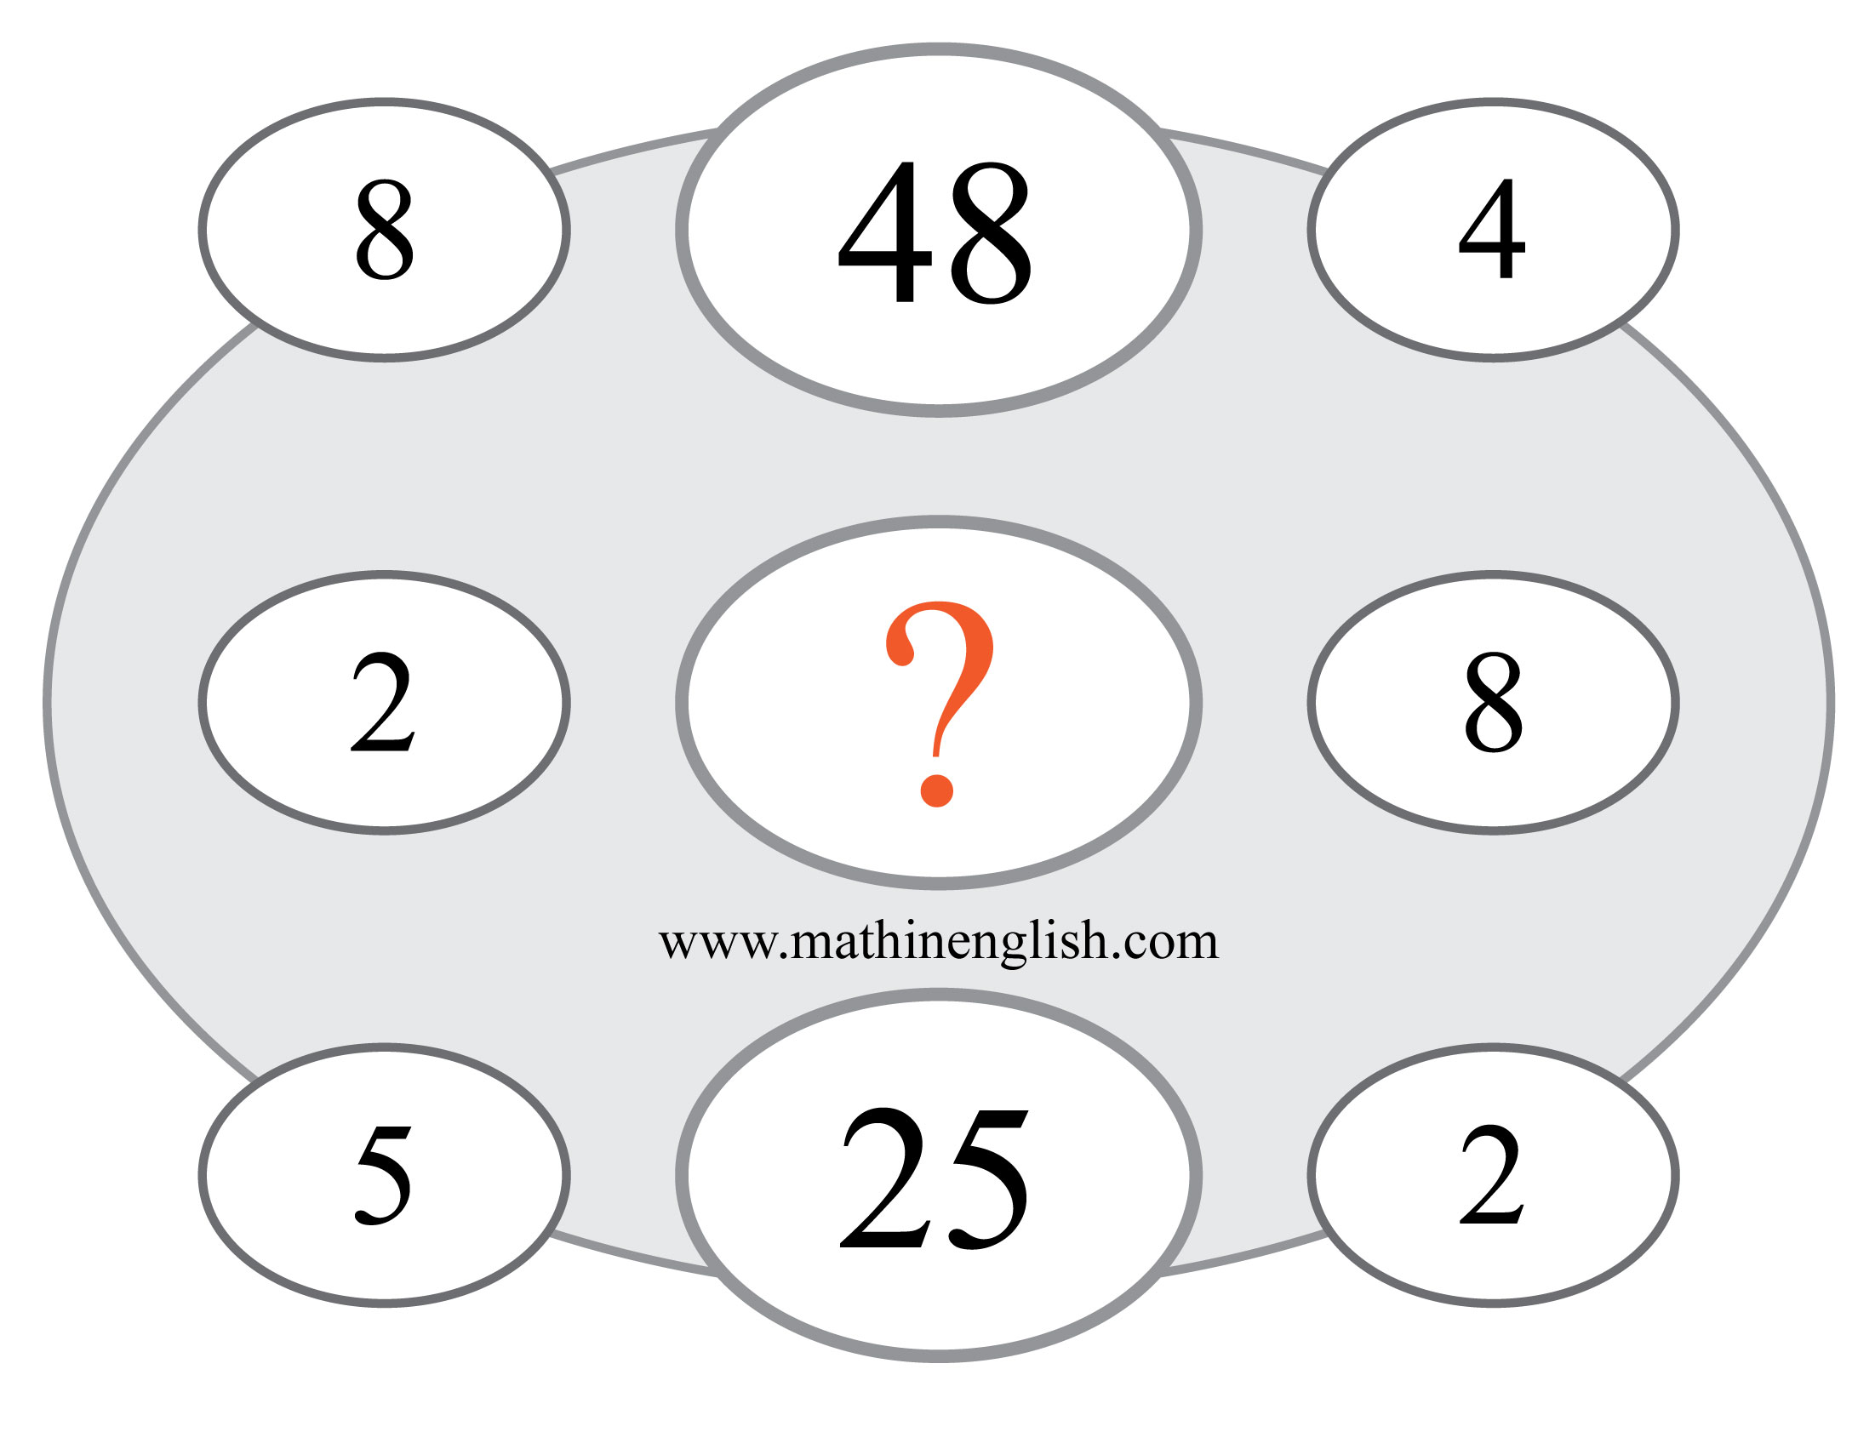
IQ Puzzle 8
Level 4C
Which number completes the pattern?

Slide 10
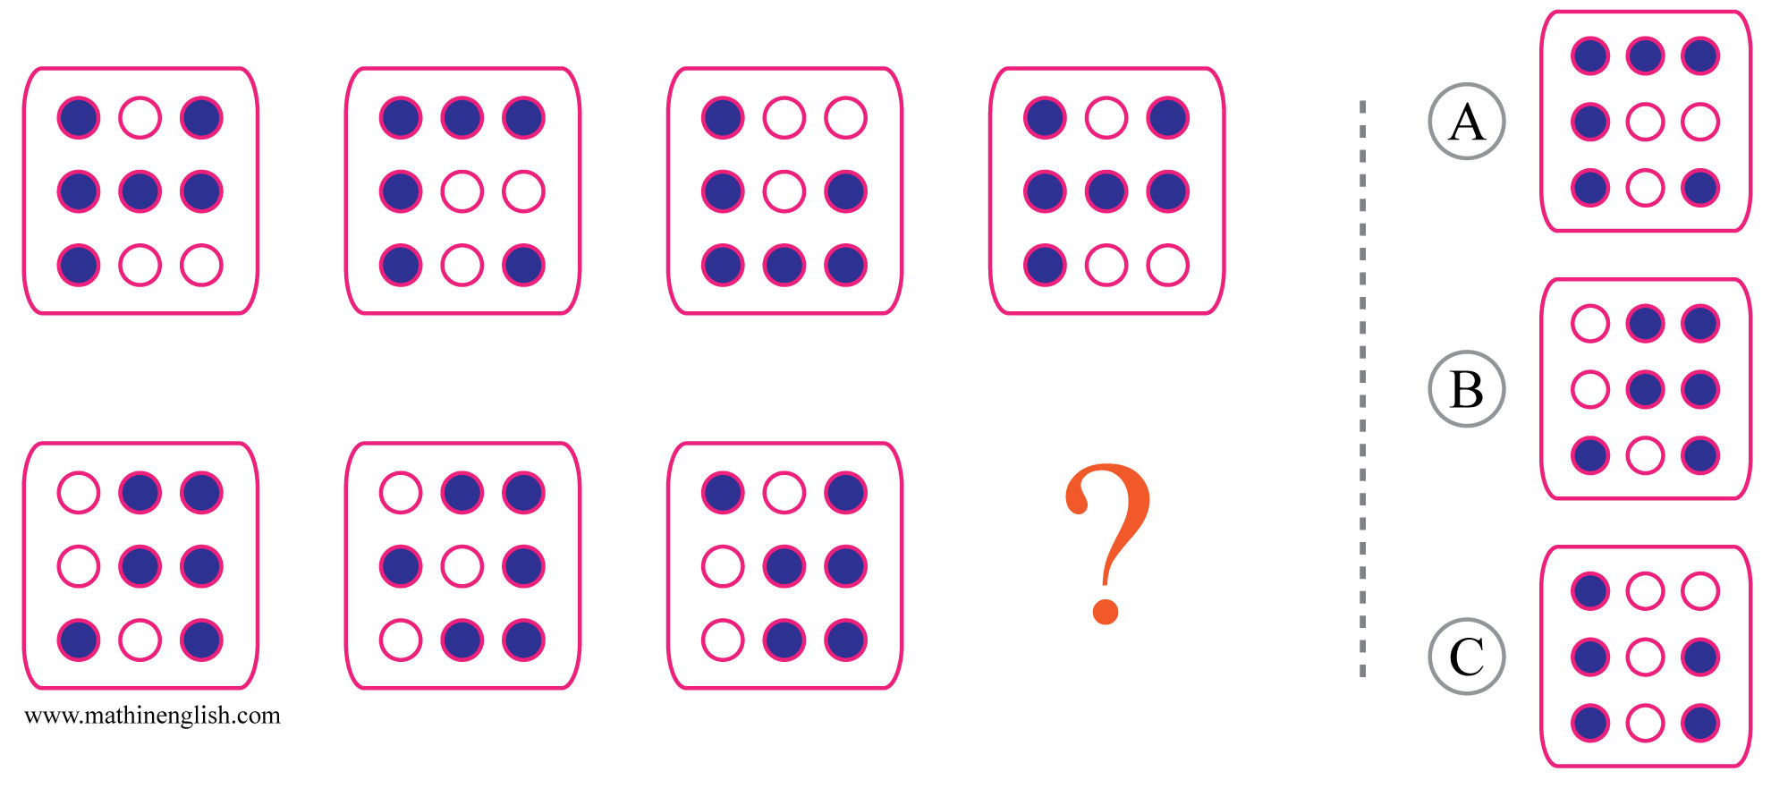
IQ Puzzle 9
Level 4C
Which option is correct?

Slide 11
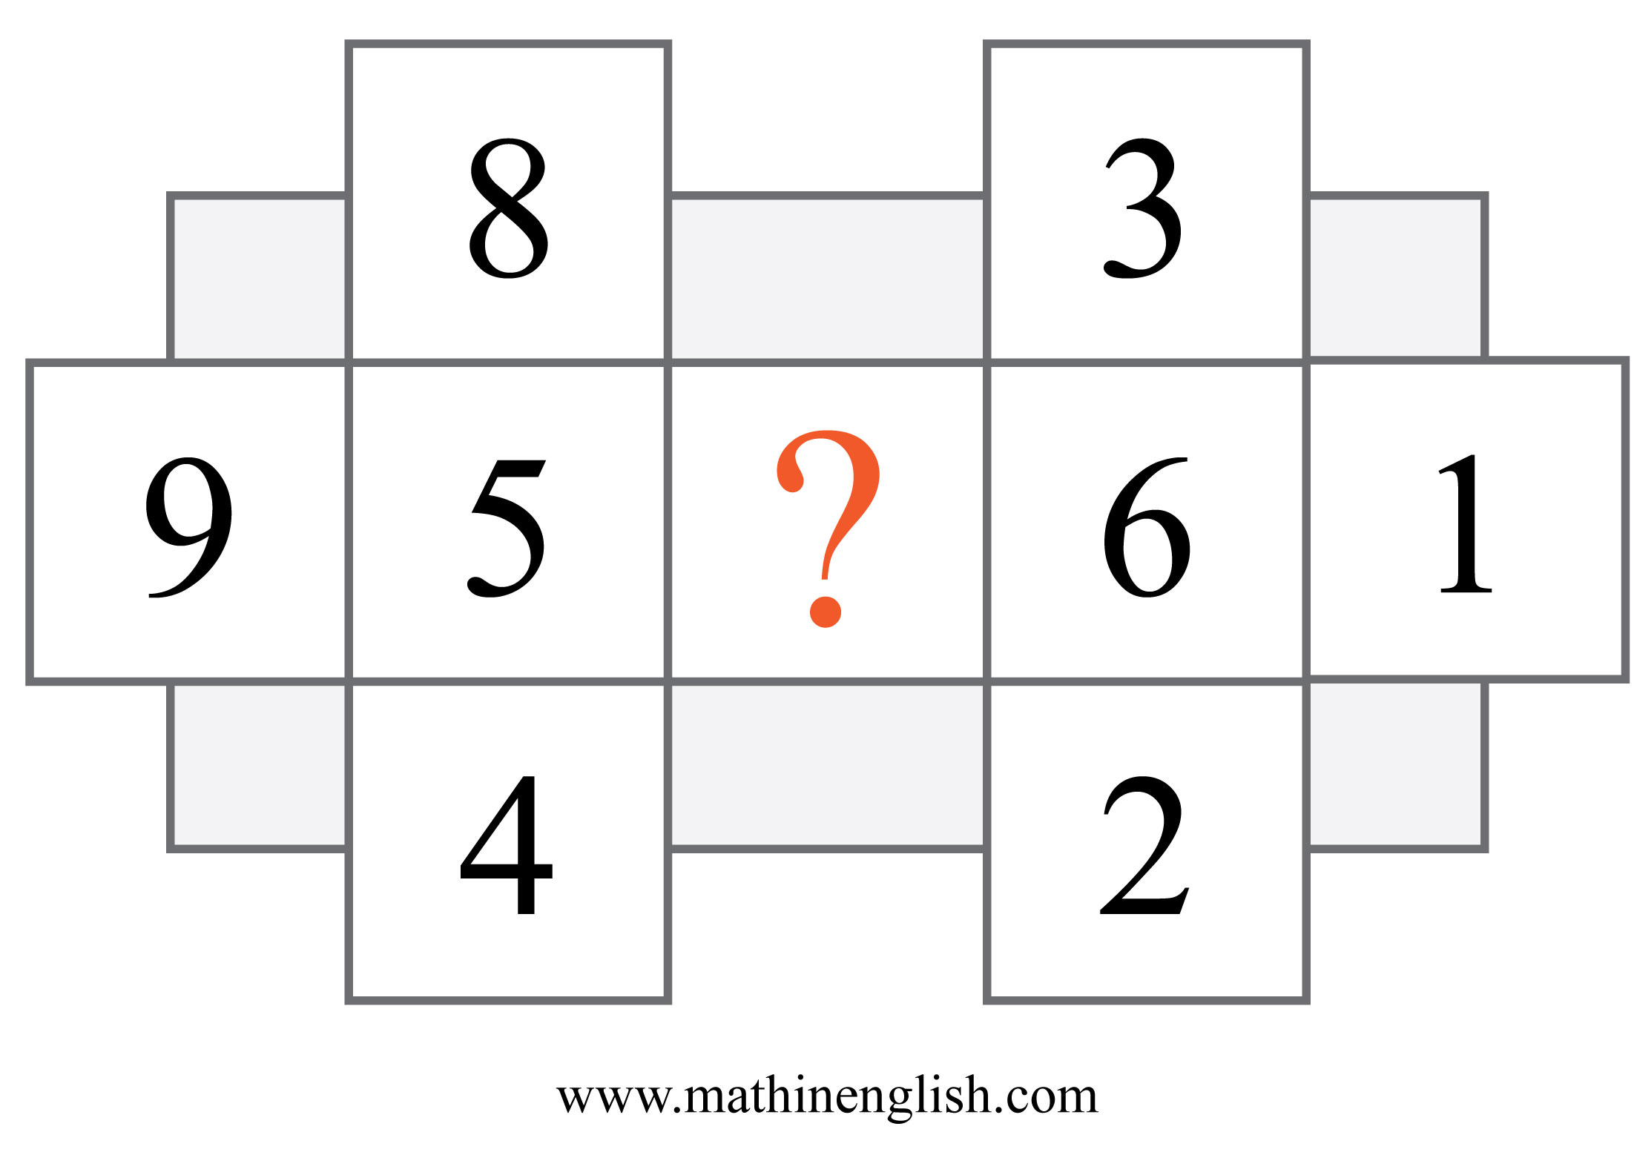
IQ Puzzle 10
Level 4C
Which number is missing?

Slide 12
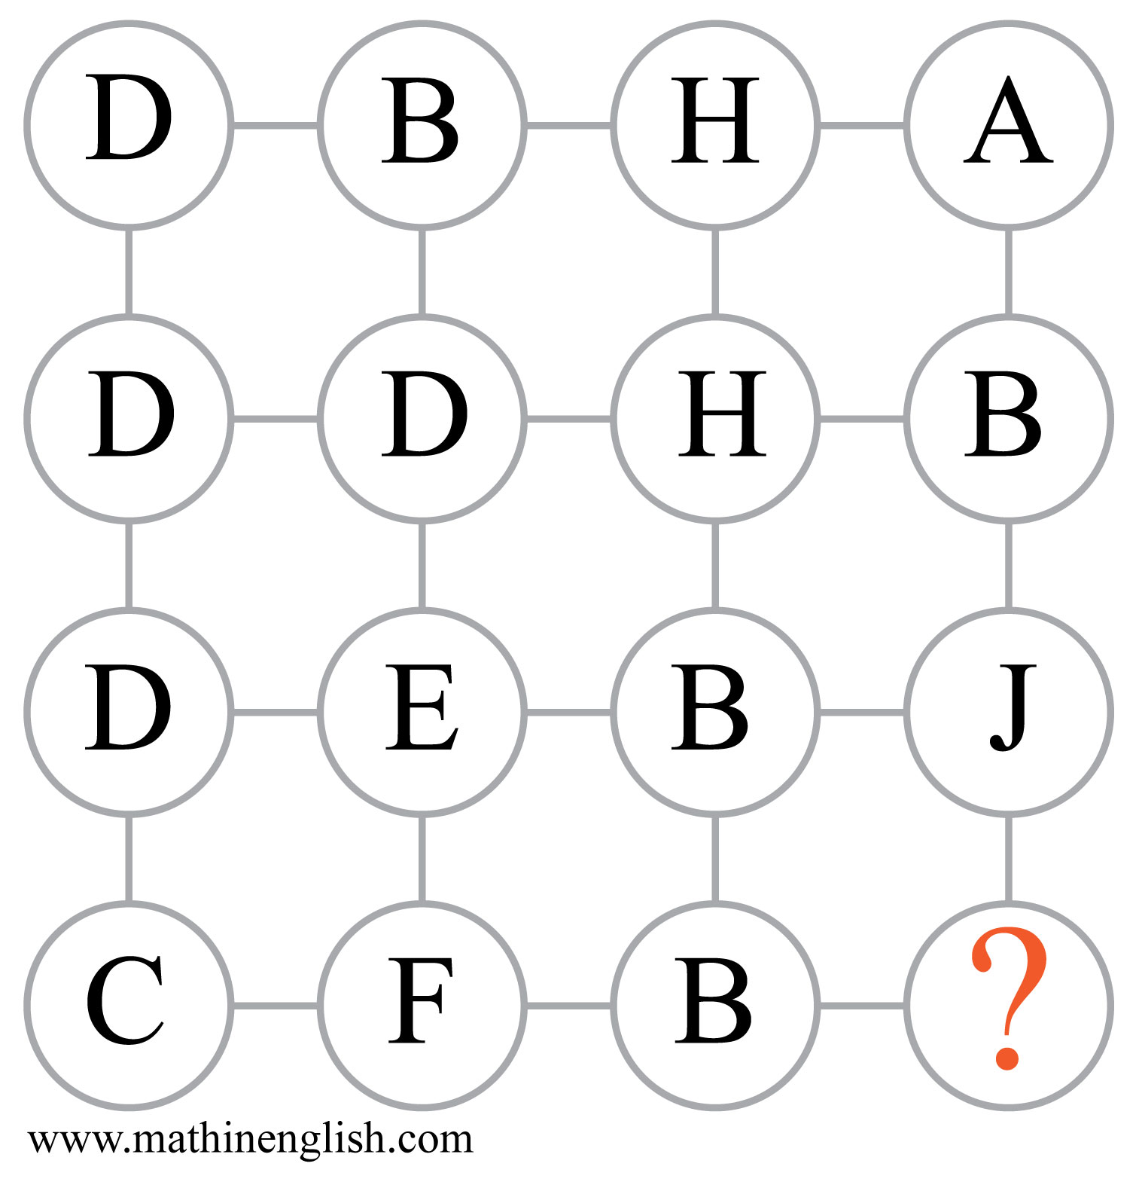
IQ Puzzle 11
Level 4C
Which letter is missing?

Slide 13
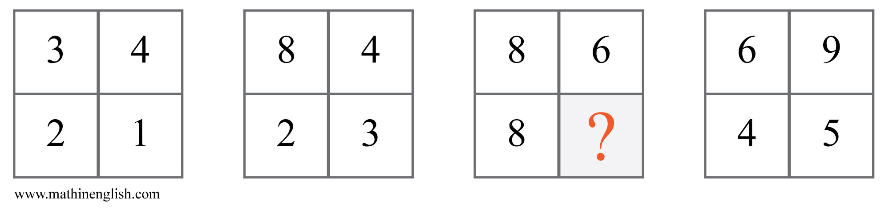
IQ Puzzle 12
Level 4C
Which number is needed here?

Slide 14
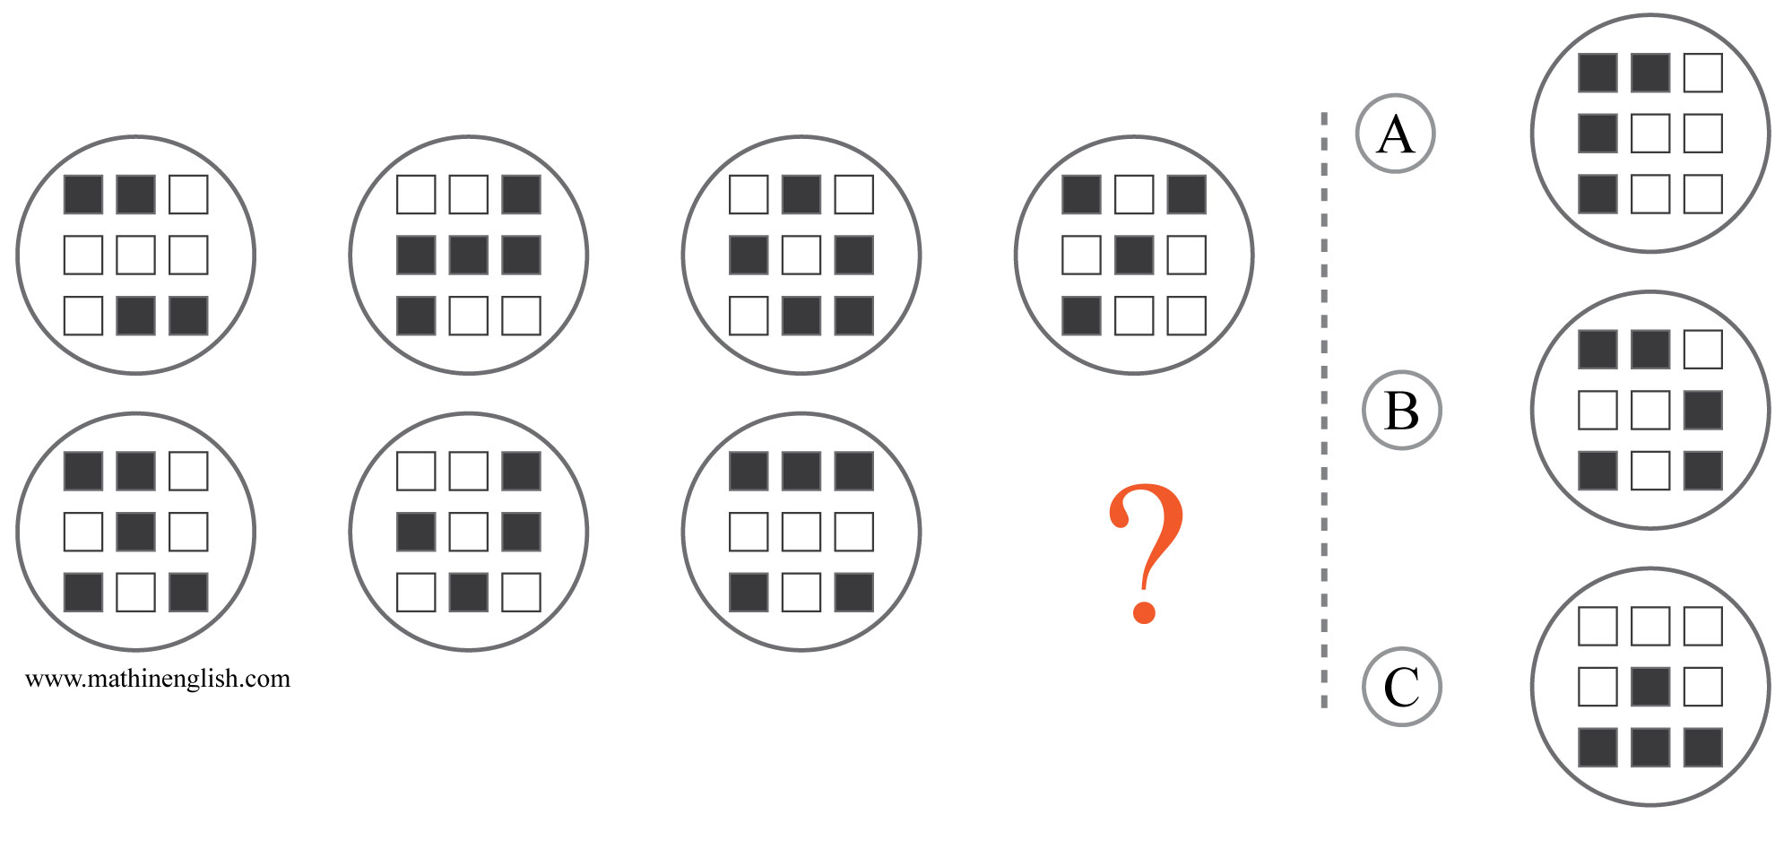
IQ Puzzle 13
Level 4C
Which option is correct?

Slide 15
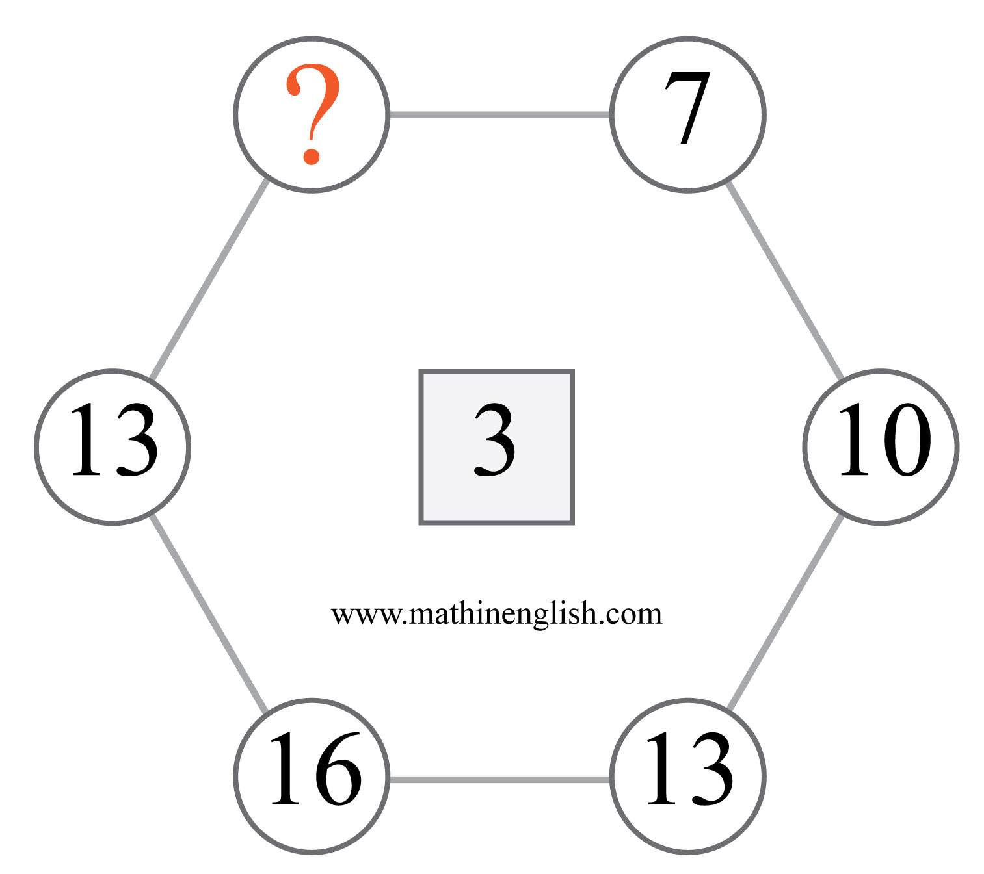
IQ Puzzle 14
Level 4C
What is the missing number here?

Slide 16
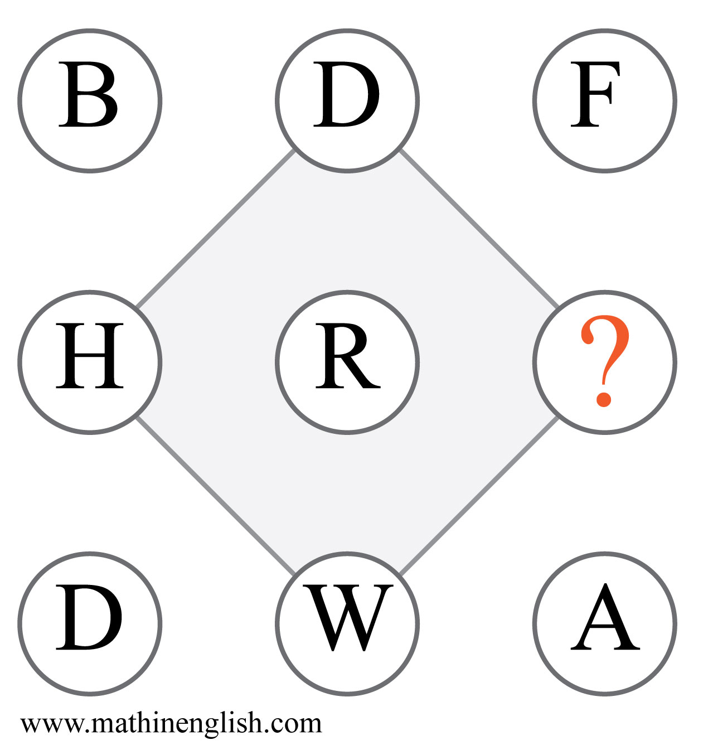
IQ Puzzle 15
Level 4C
Which letter completes the puzzle?

Slide 17
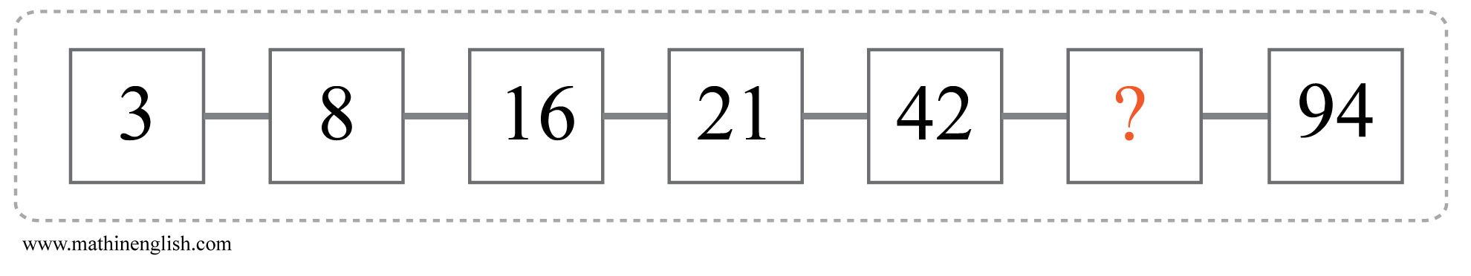
IQ Puzzle 16
Level 4C
Which number is missing?

Slide 18
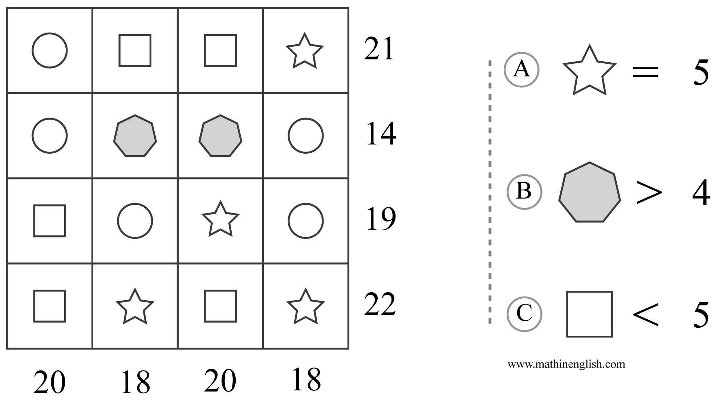
IQ Puzzle 17
Level 4C
Which option is correct?

Slide 19
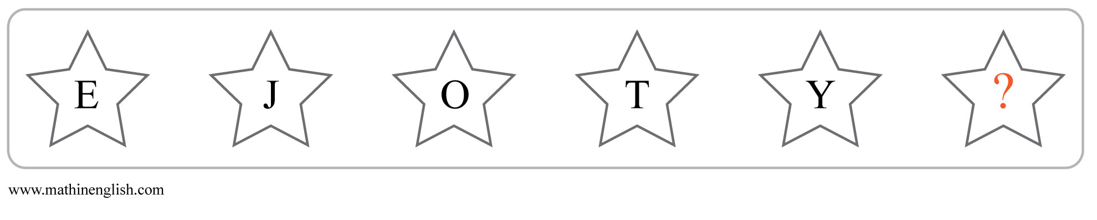
IQ Puzzle 18
Level 4C
Which letter is missing?

Slide 20
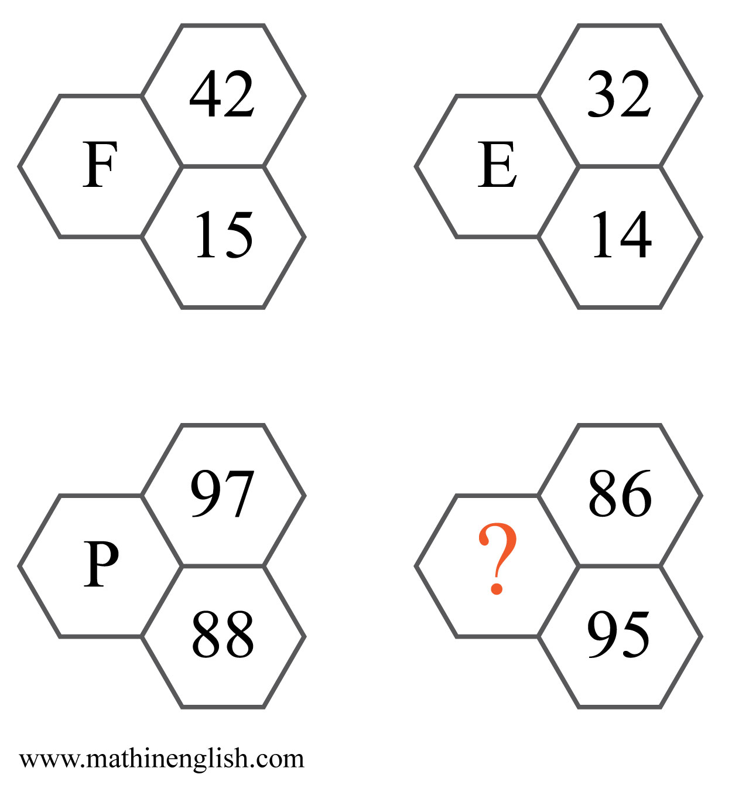
IQ Puzzle 19
Level 4C
Which letter is missing?

Slide 21
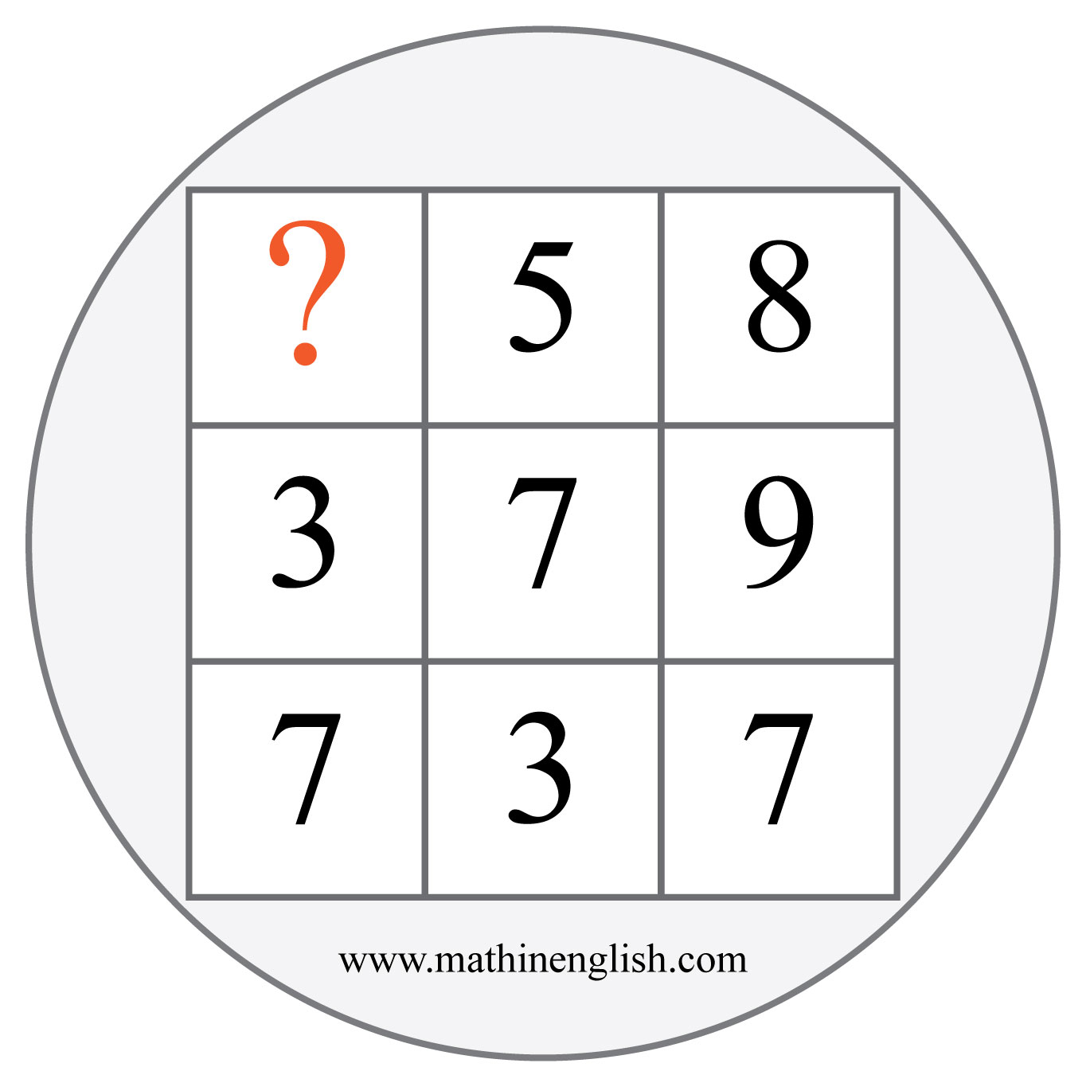
IQ Puzzle 20
Level 4C
Which number is missing?

Slide 22
Answers to puzzles 1 to 4
puzzle 1 : C
In each row, count the number of positive cells and subtract the negative cells. The 3rd cell gives the difference.
puzzle 2 : 9
For each column, the top digit is equal to the sum of the other 3.
puzzle 3 : 5
Basic addition: 234 + 456 equals 690
puzzle 4 : 2
The difference between the vertical and horizontal 2 digit
number is 25 in each diamond .
Copyright: www.mathinenglish.com
Level 4C

Slide 23
Answers to puzzles 5 to 8
puzzle 5 : A
Horizontal square , circle, hexagon pattern. The circle and hexagon
multiplied are equal to the square.
puzzle 6 : 9
Divide the 1st cell by 2 and subtract 1 to get the 2nd cell.
puzzle 7 : 34
Divide the number formed by the corner digits by 2 to get the middle number (68÷2).
puzzle 8 : 82
Reverse the number made of the right and left digit in each row.
Copyright: www.mathinenglish.com
Level 4C

Slide 24
Answers to puzzles 9 to 12
puzzle 9 : B
The dots in a square move 2 steps in vertical direction in the next
square in the rows.
puzzle 10 : 7
7 is missing in the 1 to 9 range.
puzzle 11 : I
The product of the first 2 cells is equal to the product of the 3rd and 4th cell in each row.
puzzle 12 : 4
Multiply the top 2 digits in a square to get the bottom 2 digits reversed.
Copyright: www.mathinenglish.com
Level 4C

Slide 25
Answers to puzzles 13 to 16
puzzle 13 : C
When added together, each horizontal pair of 2 shapes is completely shaded.
puzzle 14 : 10
The difference between 2 adjacent numbers in the hexagon ring is always 3.
puzzle 15 : Z
The 3rd cell in each row is the sum of the values of the first 2.
puzzle 16 : 47
First step is + 5, second step is ×2, third + 5, 4th ×2, and so on.
Copyright: www.mathinenglish.com
Level 4C

Slide 26
Answers to puzzles 17 to 20
puzzle 17 : A
Hexagon = 3, square = 4, circle = 4, star = 5.
puzzle 18 : D
The sequence follows a +5 pattern, so the last star has a value of 30, or D.
puzzle 19 : N
The digits in each cell add up to 14, or N.
puzzle 20 : 3
358 plus 379 equals 737.
Copyright: www.mathinenglish.com
Level 4C

