Slide 1
IQ puzzles and brain teasers
Level 4D

Slide 2
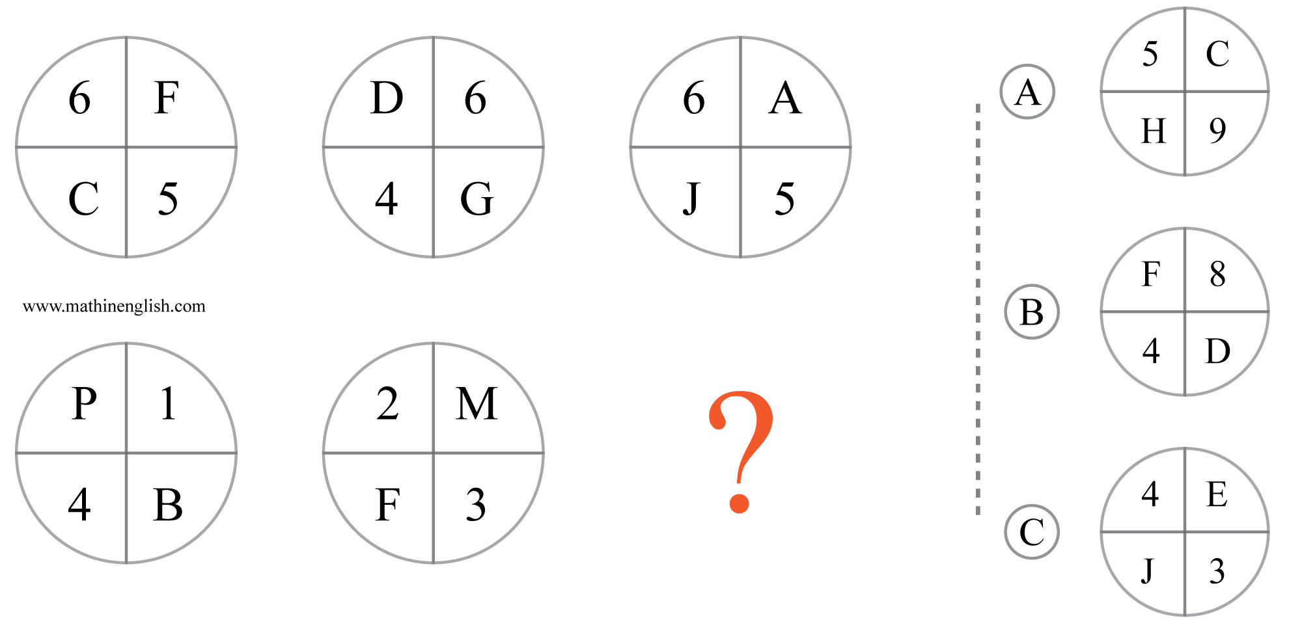
IQ Puzzle 1
Level 4D
Which option is correct?

Slide 3
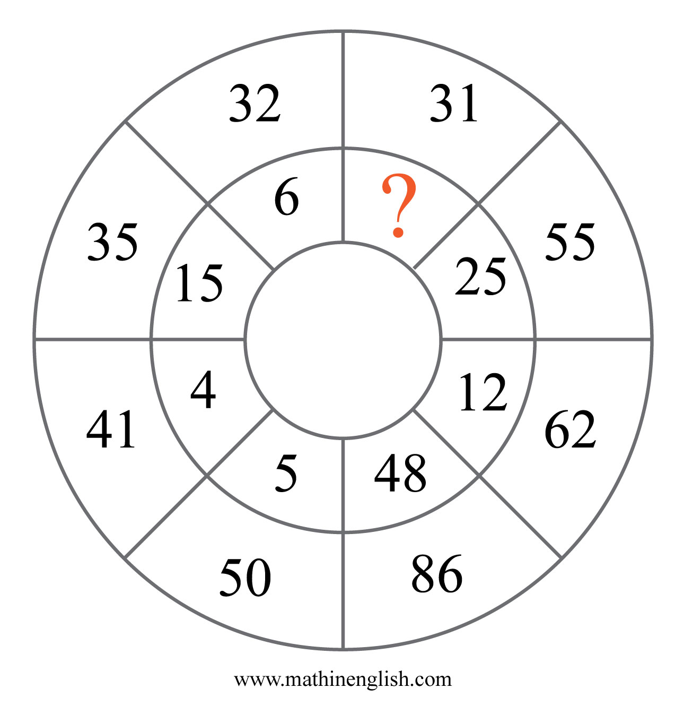
IQ Puzzle 2
Level 4D
Which number is missing?

Slide 4
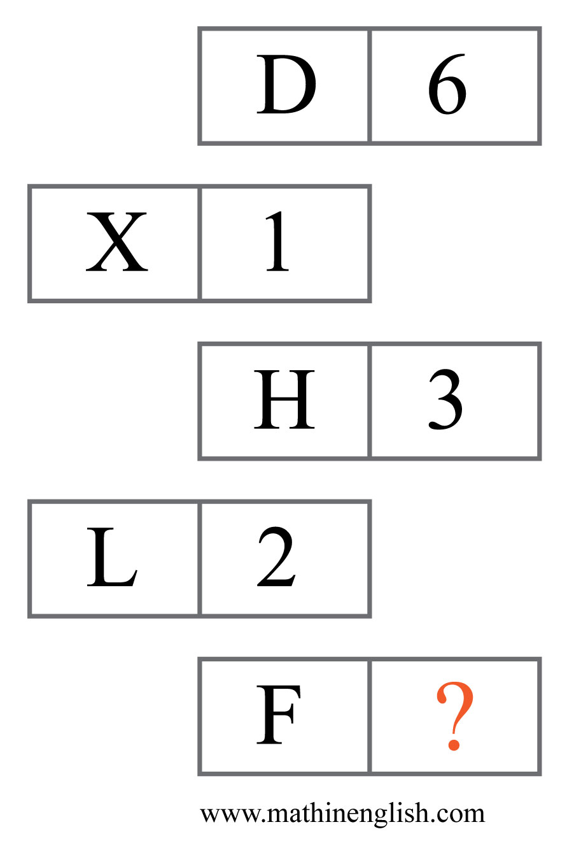
IQ Puzzle 3
Level 4D
What is the missing number?

Slide 5
IQ Puzzle 4
Level 4D
What number is needed here?

Slide 6
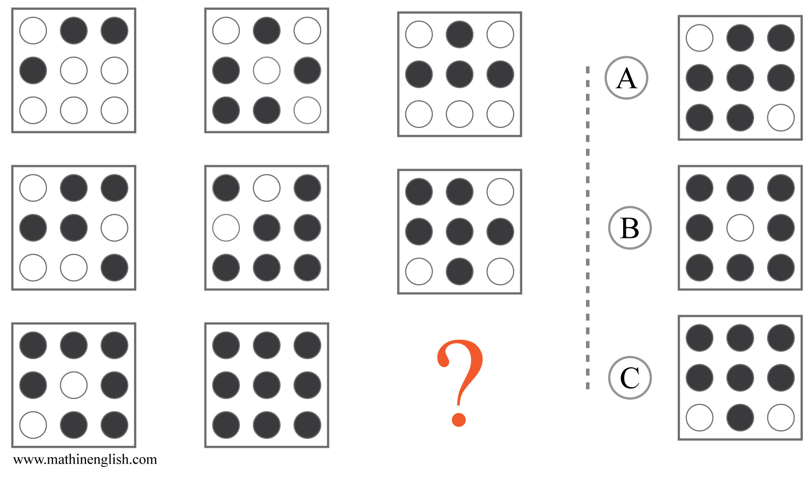
IQ Puzzle 5
Level 4D
Which option is correct?

Slide 7
IQ Puzzle 6
Level 4D
Which number is missing?

Slide 8
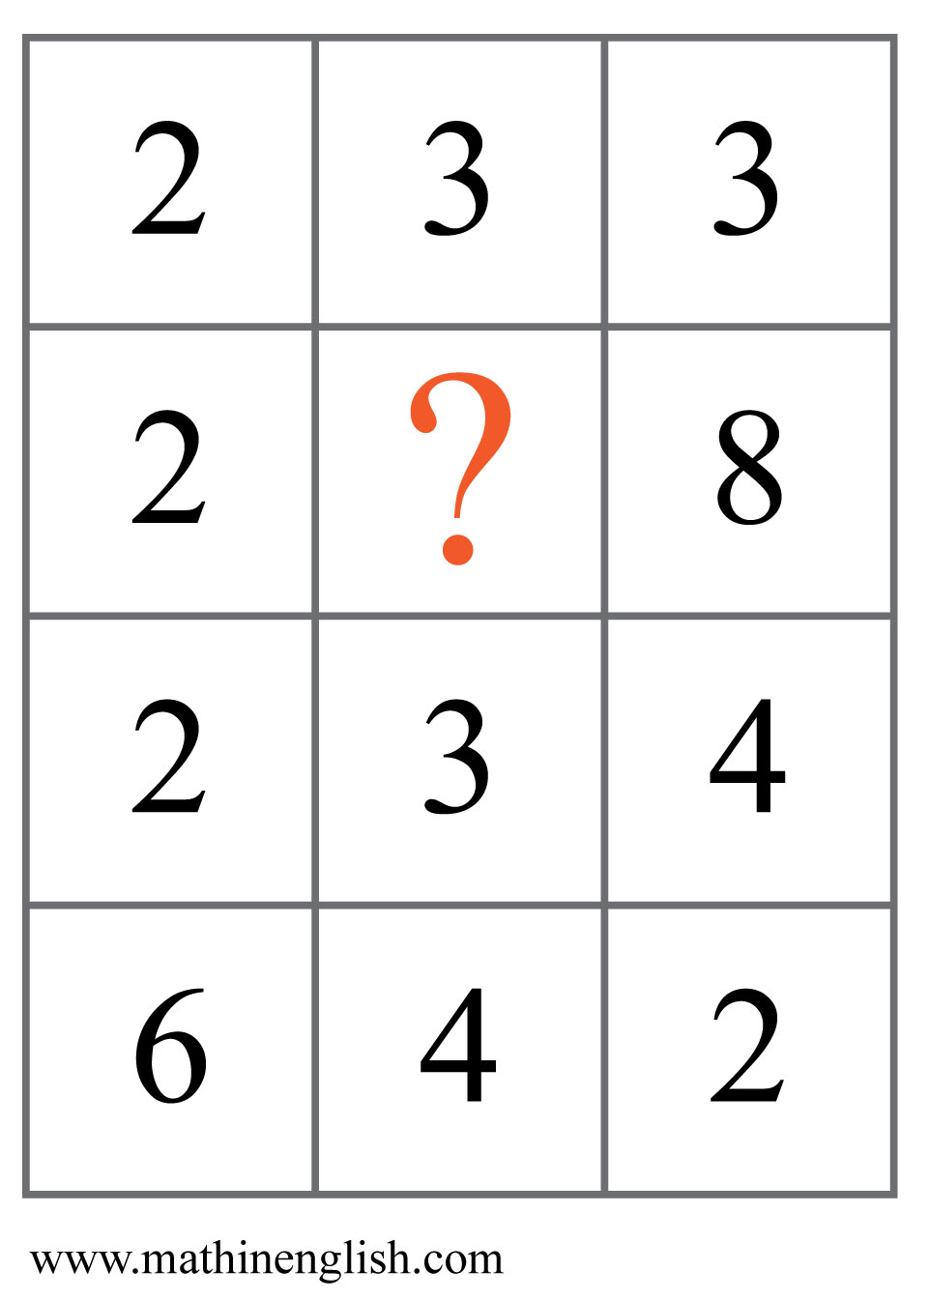
IQ Puzzle 7
Level 4D
Which number is missing?

Slide 9
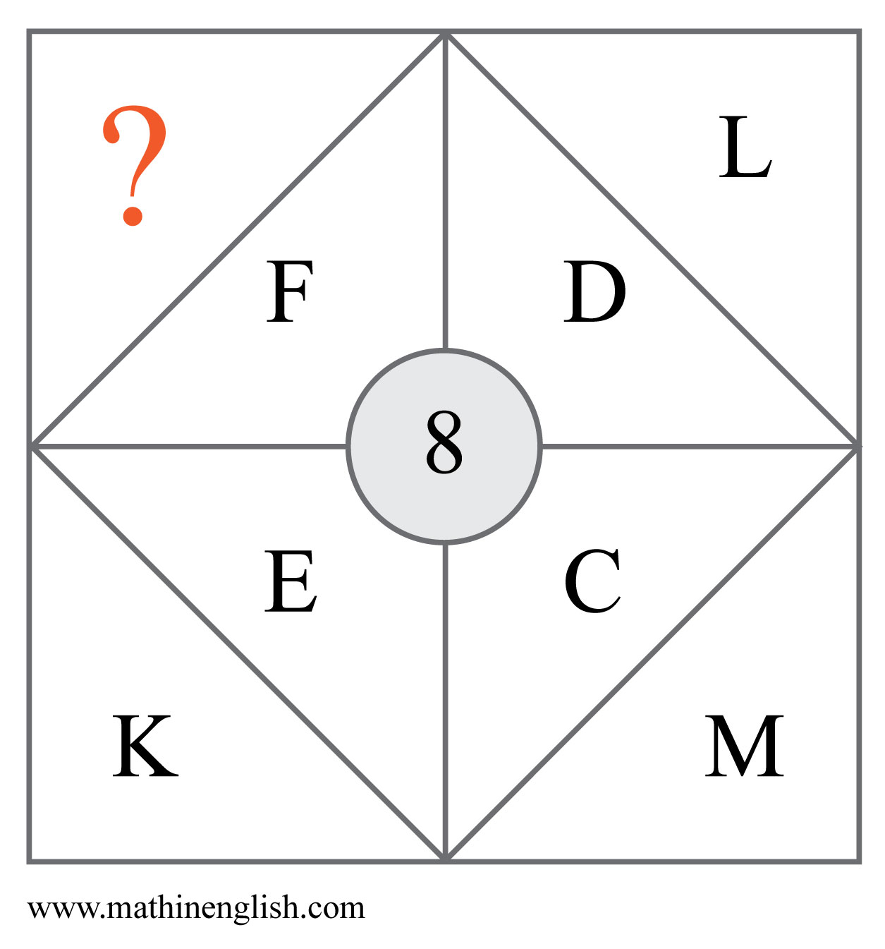
IQ Puzzle 8
Level 4D
Which letter completes the pattern?

Slide 10
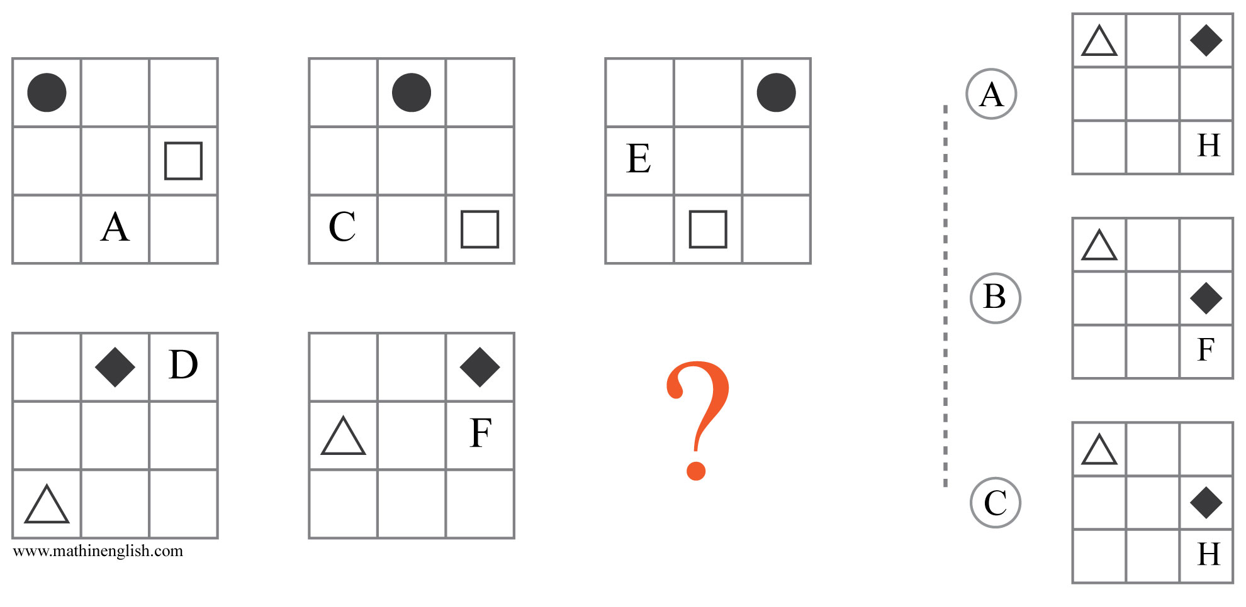
IQ Puzzle 9
Level 4D
Which option is correct?

Slide 11
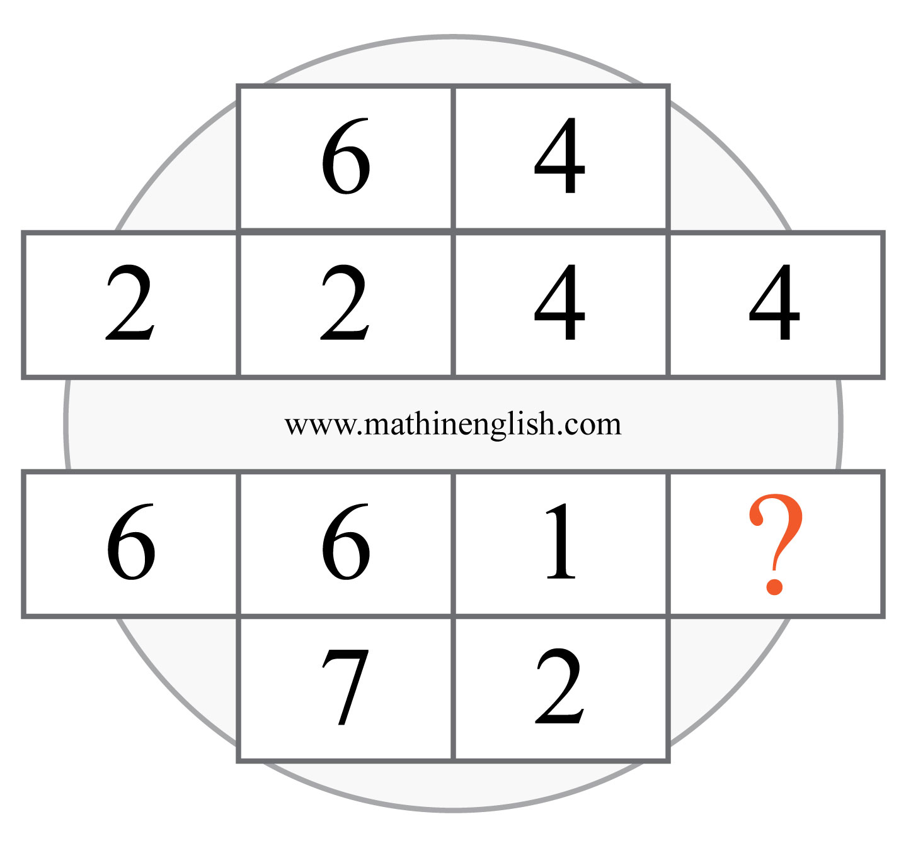
IQ Puzzle 10
Level 4D
Which number is missing?

Slide 12
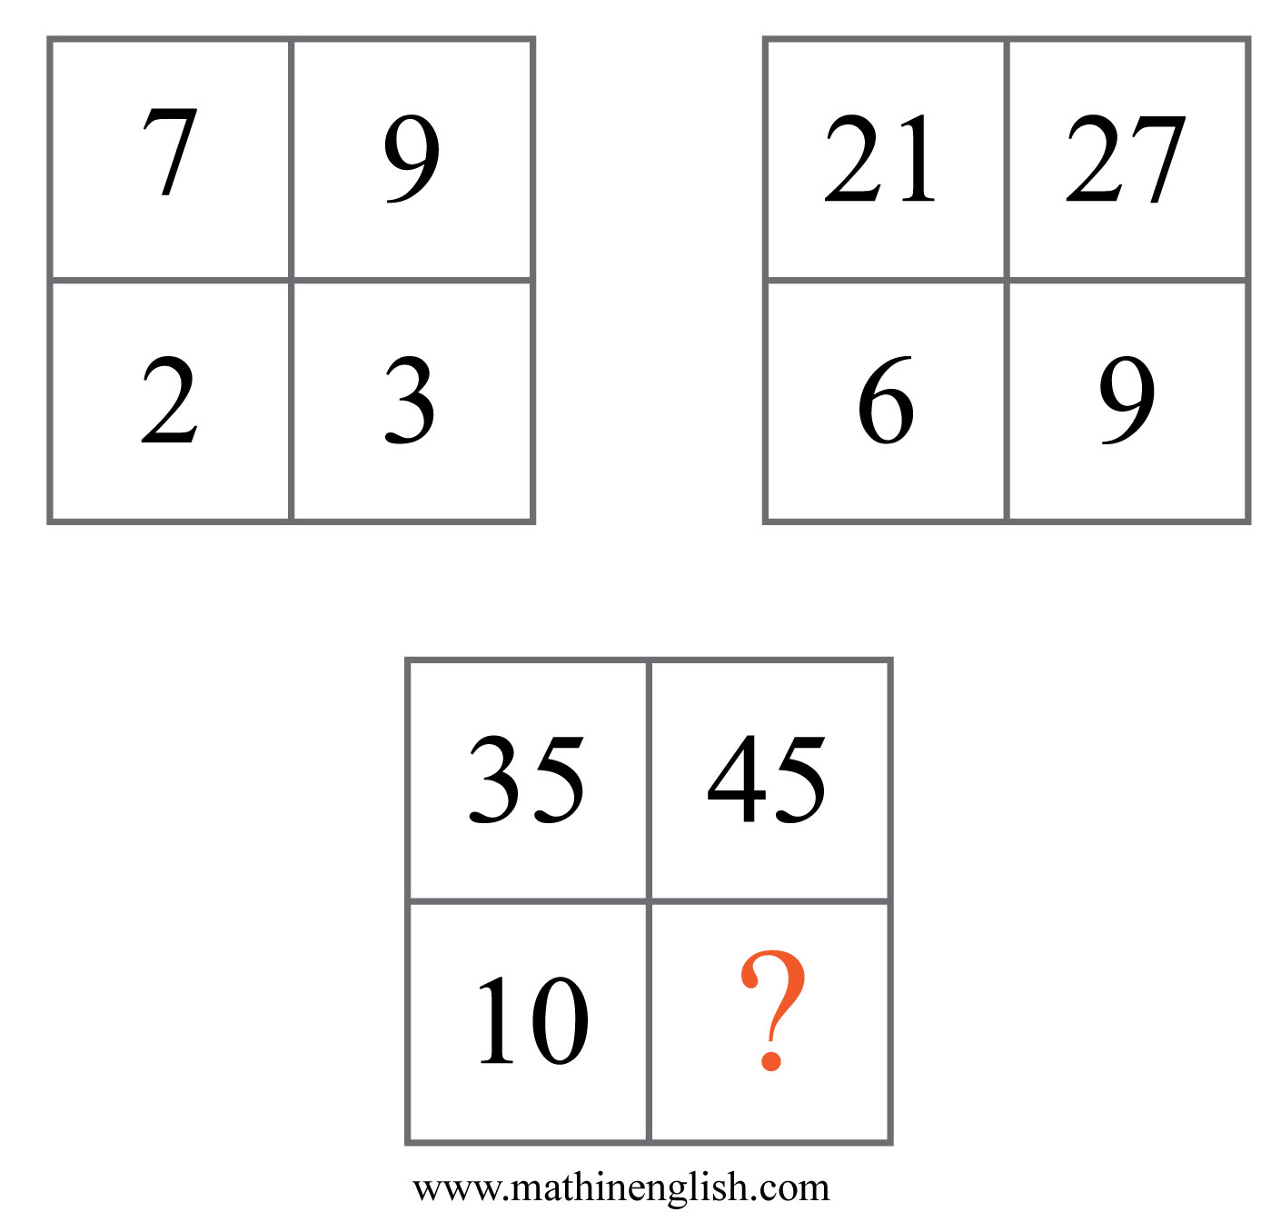
IQ Puzzle 11
Level 4D
Which number is missing?

Slide 13
IQ Puzzle 12
Level 4D
Which number is missing here?

Slide 14
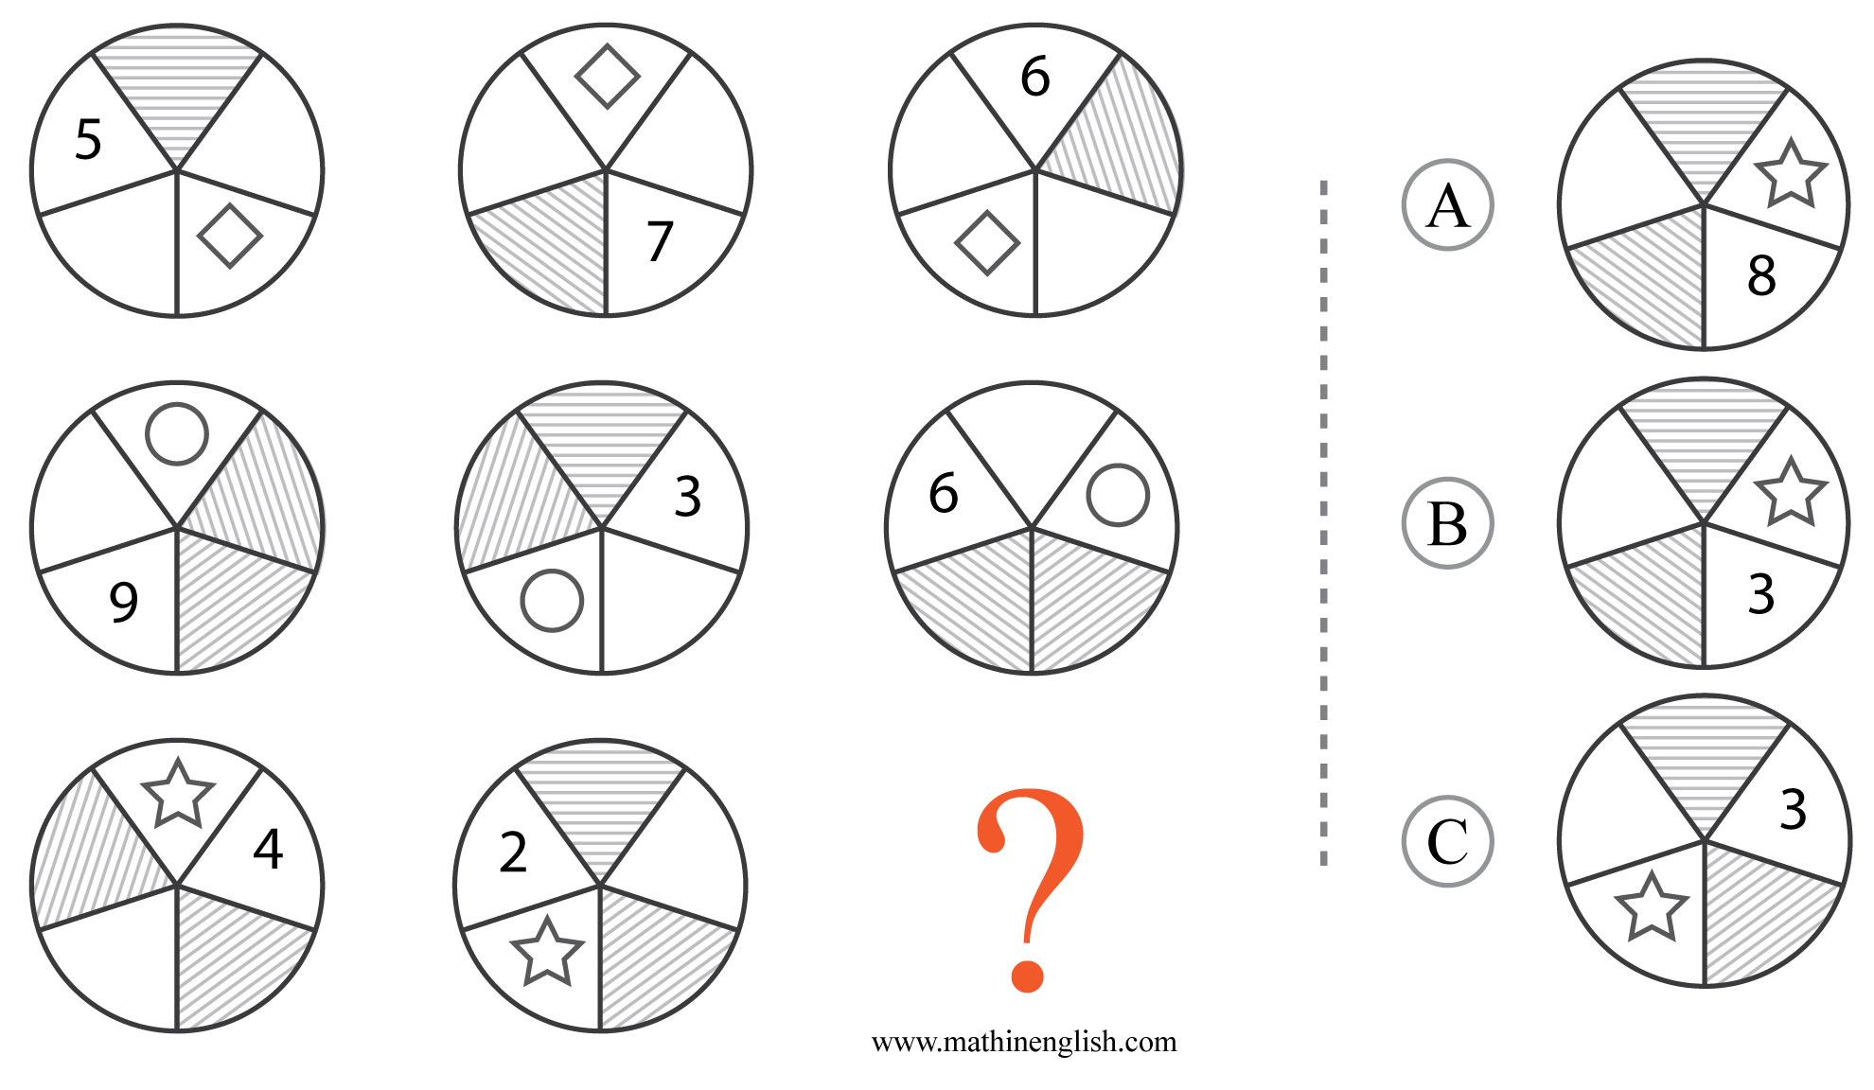
IQ Puzzle 13
Level 4D
Which option is correct?

Slide 15
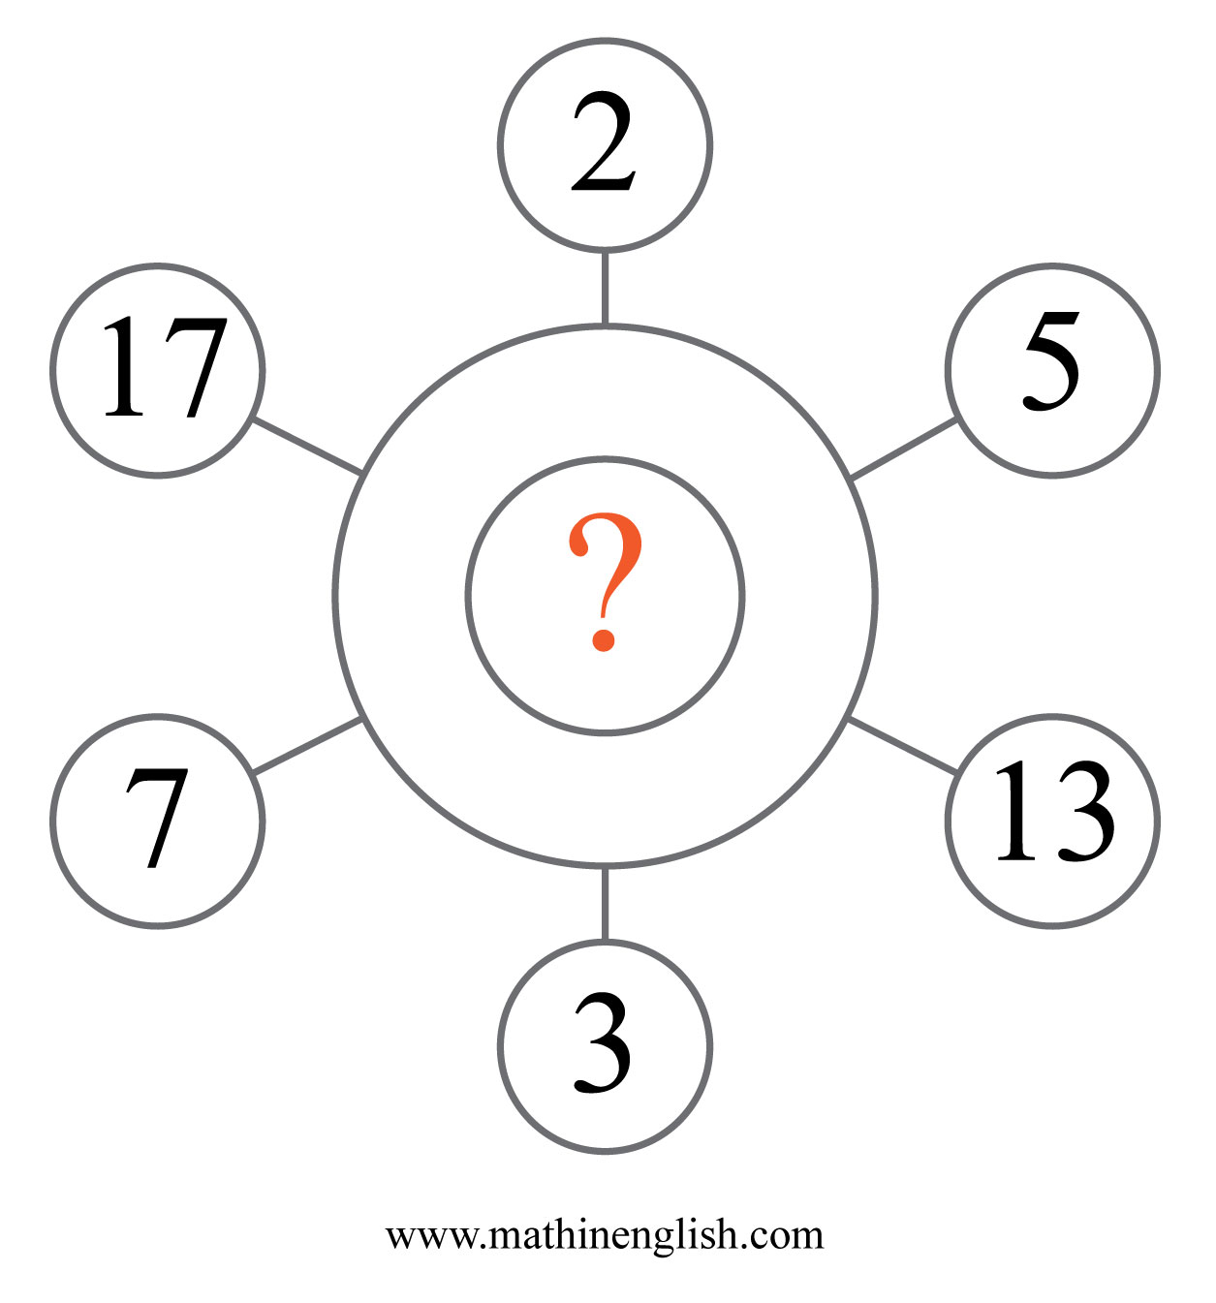
IQ Puzzle 14
Level 4D
What is the odd number out?

Slide 16
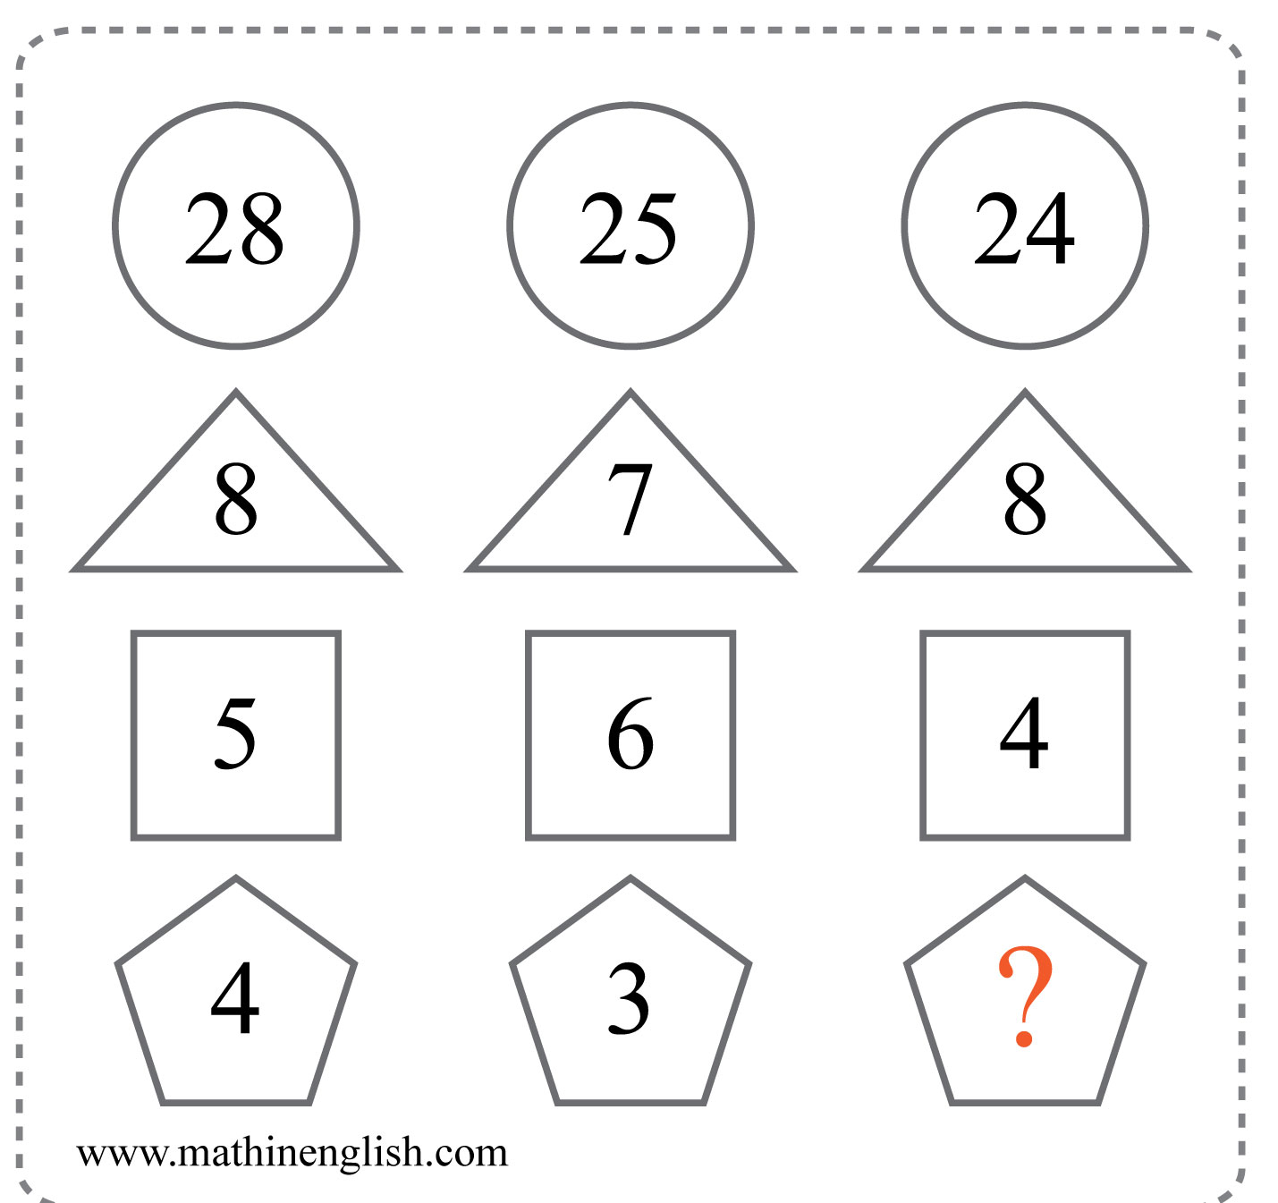
IQ Puzzle 15
Level 4D
Which number is missing?

Slide 17
IQ Puzzle 16
Level 4D
Which number is missing?

Slide 18
IQ Puzzle 17
Level 4D
Which number completes the domino ?

Slide 19
IQ Puzzle 18
Level 4D
Which number is missing?

Slide 20
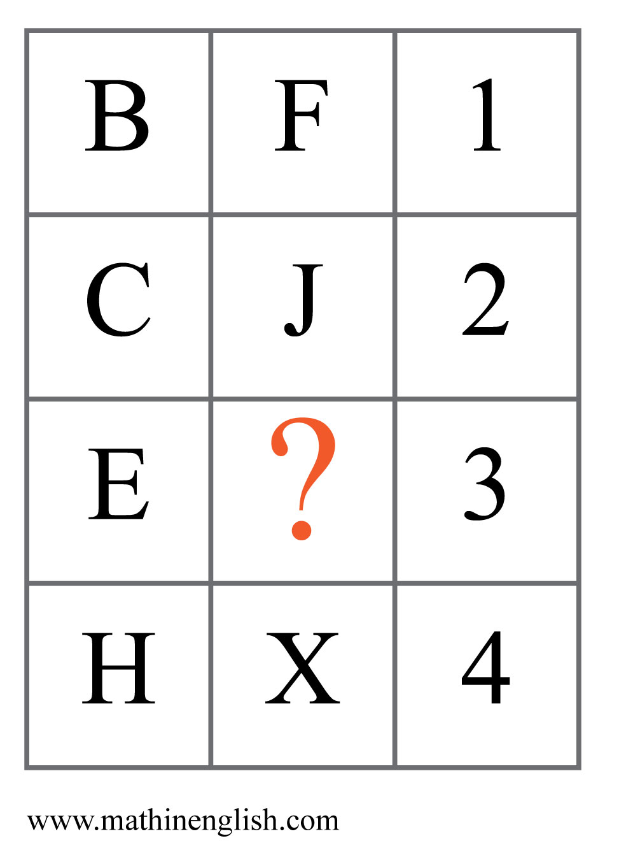
IQ Puzzle 19
Level 4D
Which letter is missing?

Slide 21
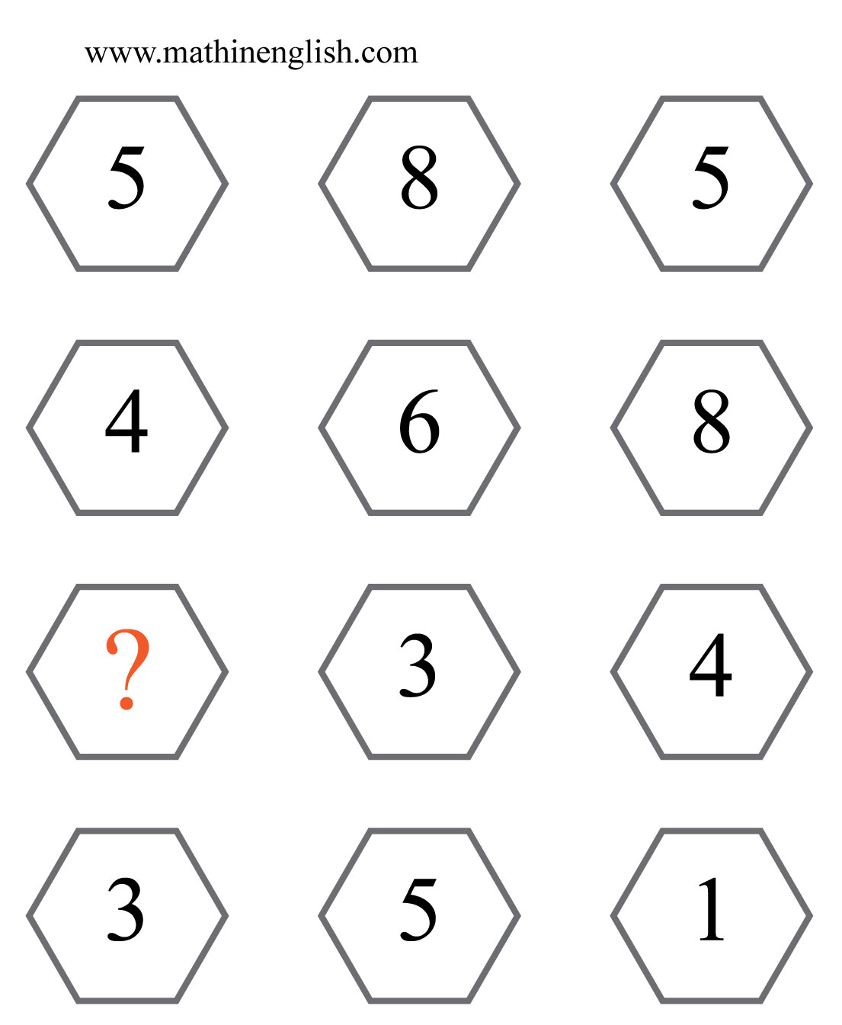
IQ Puzzle 20
Level 4D
Which number is missing?

Slide 22
Answers to puzzles 1 to 4
puzzle 1 : A
The circles follow a +1 sequence, starting with 20 in the 1st circle
and 25 is the missing circle.
puzzle 2 : 3
Multiply the digits of the numbers to get the inner circle.
puzzle 3 : 4
The product of each row is 24.
puzzle 4 : 9
The pyramids follow a +2, +3 and +4 pattern starting with
a sum of 18 in the 1st.
Copyright: www.mathinenglish.com
Level 4D

Slide 23
Answers to puzzles 5 to 8
puzzle 5 : B
Each column follows a pattern of +2 shaded dots.
puzzle 6 : 7
The average of the 6 numbers in each oval of 10.
puzzle 7 : 0
The puzzle follows a vertical pattern of +4, starting with 22.
puzzle 8 : J
The average number value of each corner pair is 8.
Copyright: www.mathinenglish.com
Level 4D

Slide 24
Answers to puzzles 9 to 12
puzzle 9 : C
All symbols move 1 step clockwise around the center. The letters follow a +2 pattern.
puzzle 10 : 2
The digits in the 2nd row multiply to 64, those in the 3rd to 72.
puzzle 11 : 15
The numbers in the square follow a ratio of 1:3:5.
puzzle 12 : 4
The numbers in the same position in the first 3 squares add up to the
numbers in the 4th square.
Copyright: www.mathinenglish.com
Level 4D

Slide 25
Answers to puzzles 13 to 16
puzzle 13 : B
The shaded parts and symbols rotate 3 steps in each next circle.
The number in the middle circle is the average of the other 2 in the row.
puzzle 14 : 11
All prime numbers up to 17.
puzzle 15 : 4
In each column, multiply the lowest 2 numbers and add the 3rd
to get the top number.
puzzle 16 : 6
The sequence follows a sum of digits and +15 pattern. The 2nd cell
is 1+5, and the 3rd cell is 15 + 15.
Copyright: www.mathinenglish.com
Level 4D

Slide 26
Answers to puzzles 17 to 20
puzzle 17 : 6
The total pips on each of the 5 dominos are the first 5 primes.
puzzle 18 : 4
Reverse the sum of the 3 outer numbers in each circle to get the center number.
puzzle 19 : P
In each row, add the left and right cell and multiply by 2 to get the middle.
puzzle 20 : 2
The last 2 numbers in each row are multiples of 17. 34 is 2 x 17.
Copyright: www.mathinenglish.com
Level 4D

