Slide 1

IQ puzzles and brain teasers
Level 4E

Slide 2
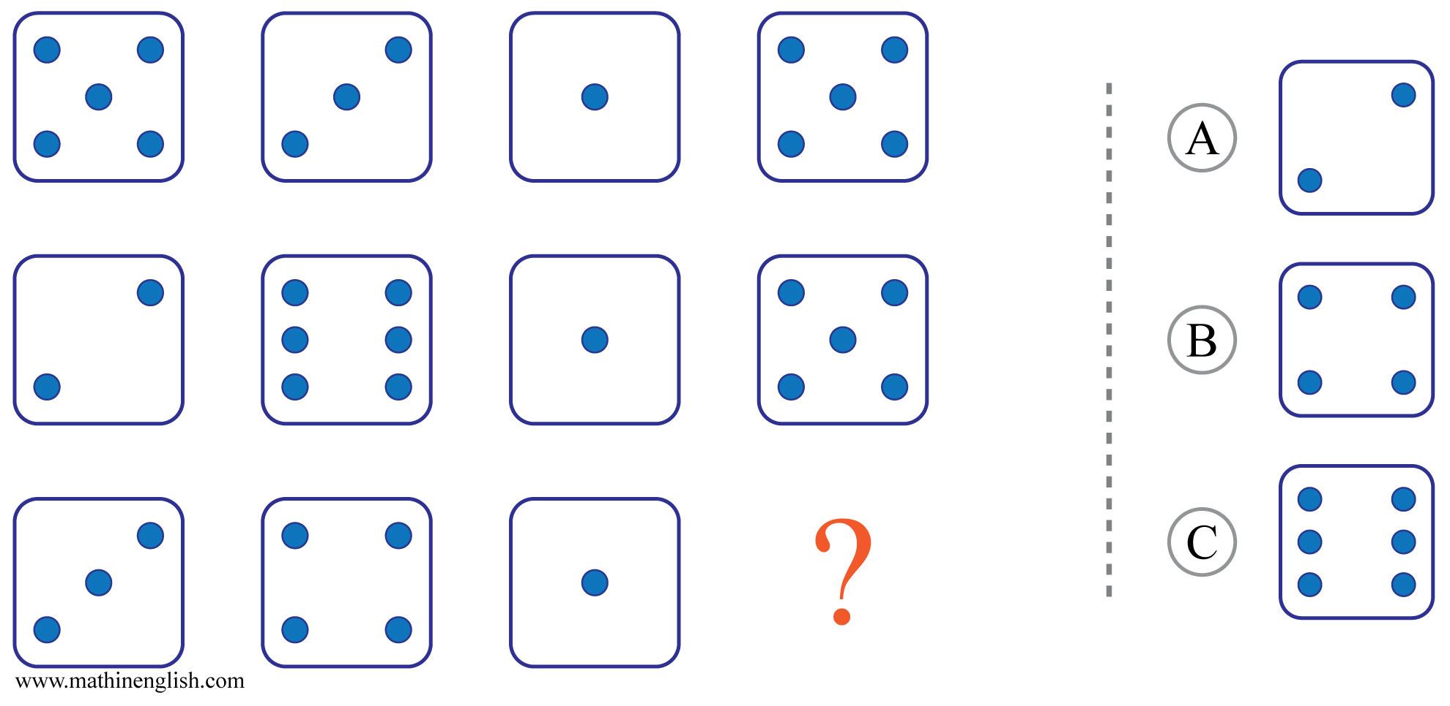



IQ Puzzle 1
Level 4E
Which option is correct?

Slide 3
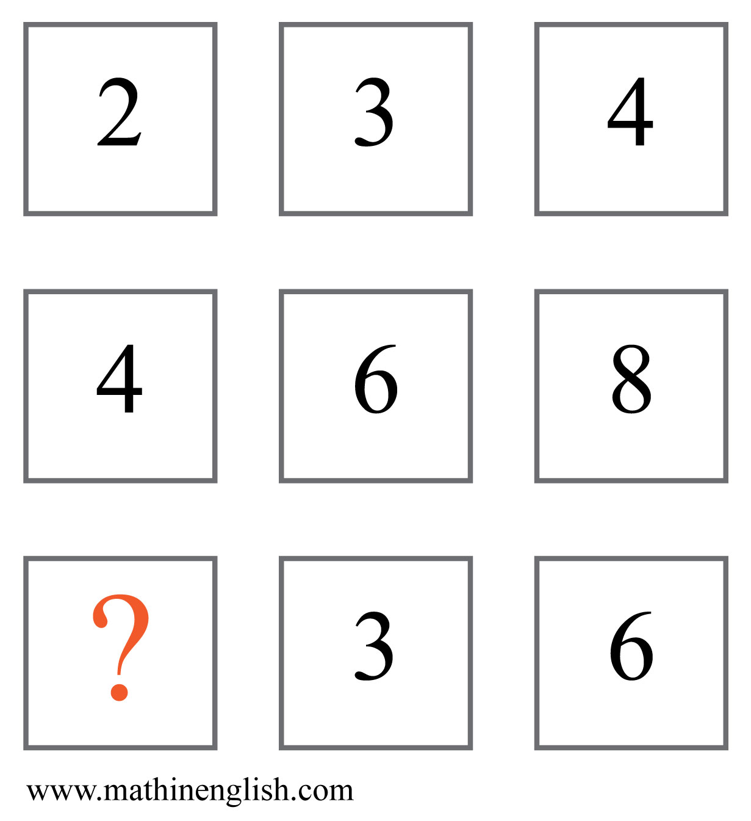
IQ Puzzle 2
Level 4E
Which number is missing?

Slide 4
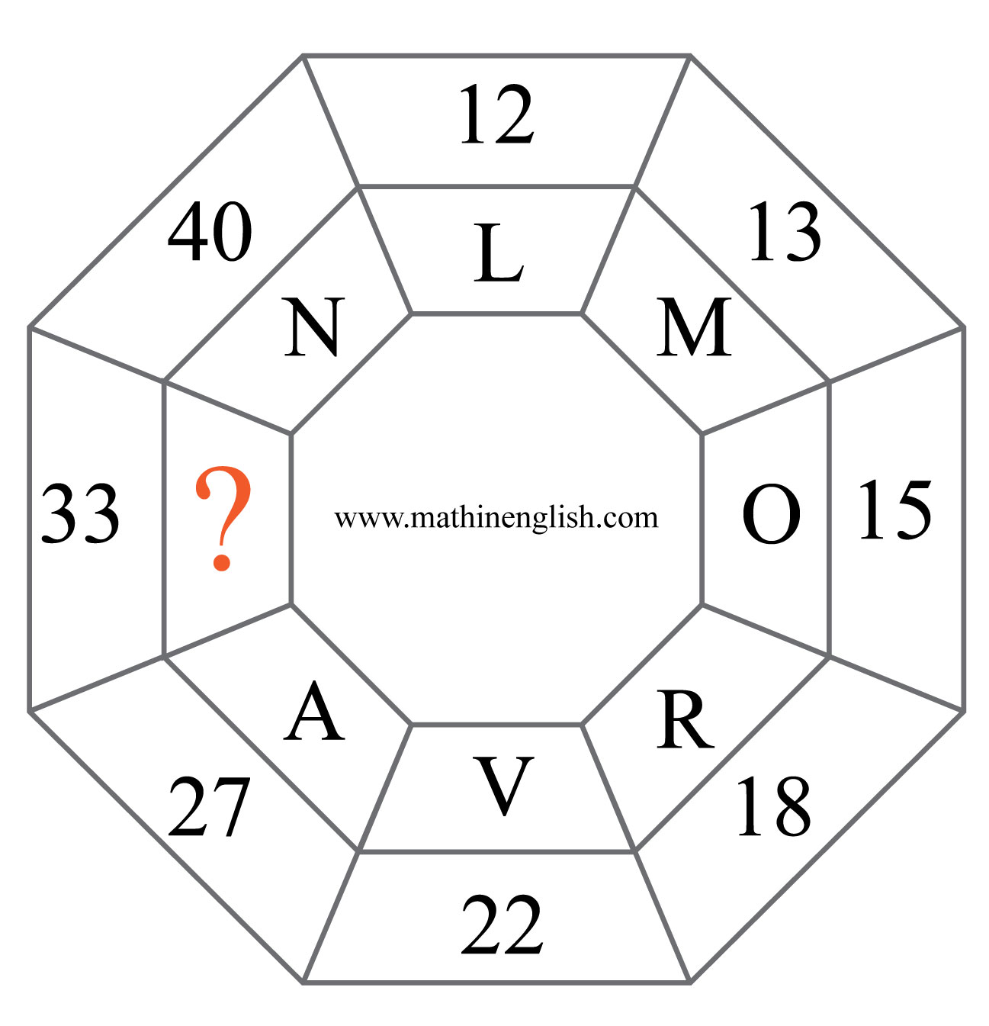
IQ Puzzle 3
Level 4E
What is the missing letter?

Slide 5
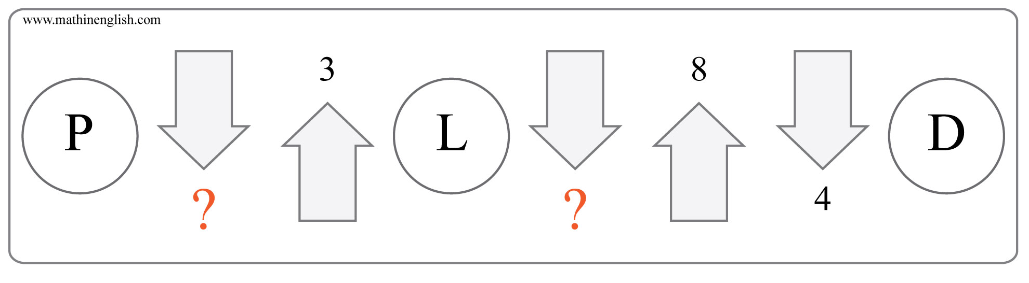
IQ Puzzle 4
Level 4E
What number is needed here?

Slide 6
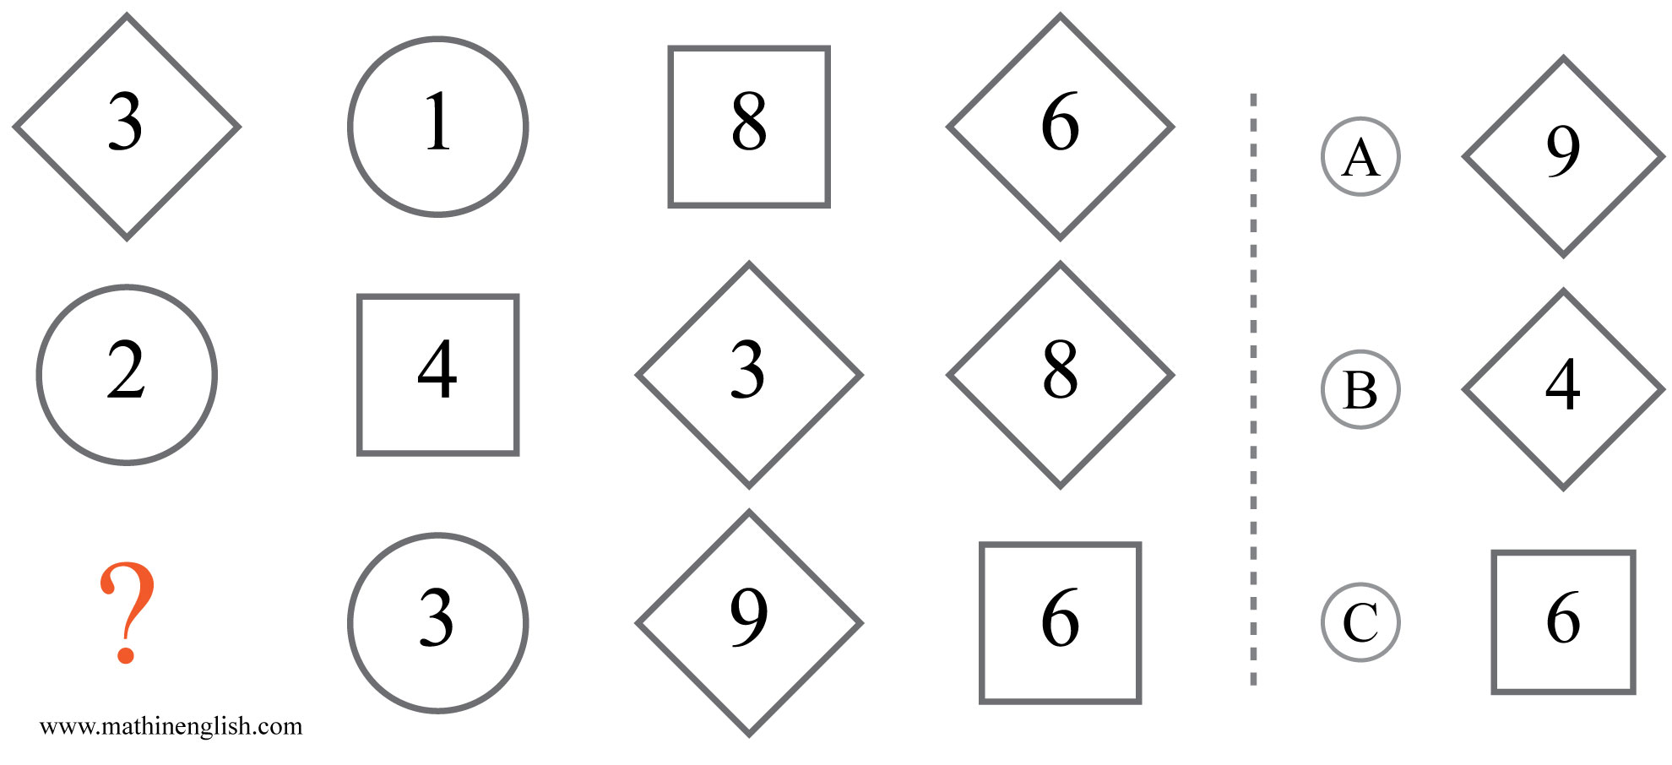
IQ Puzzle 5
Level 4E
What is the correct option?

Slide 7
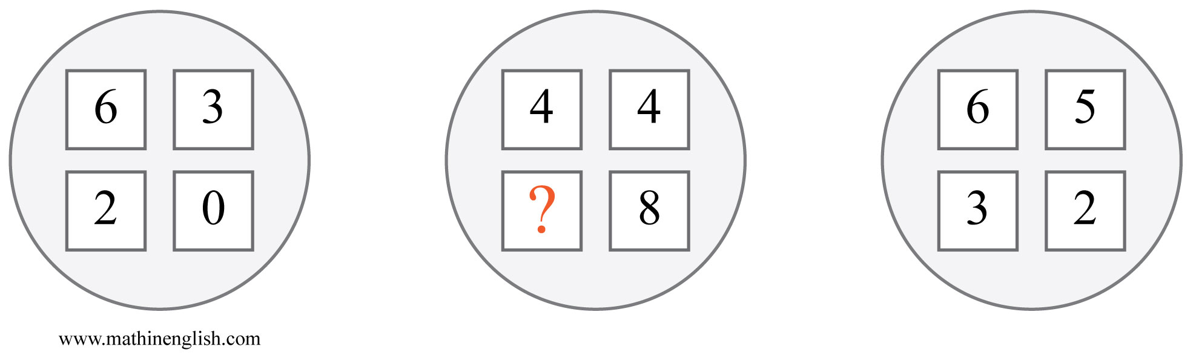
IQ Puzzle 6
Level 4E
Which number is missing?

Slide 8
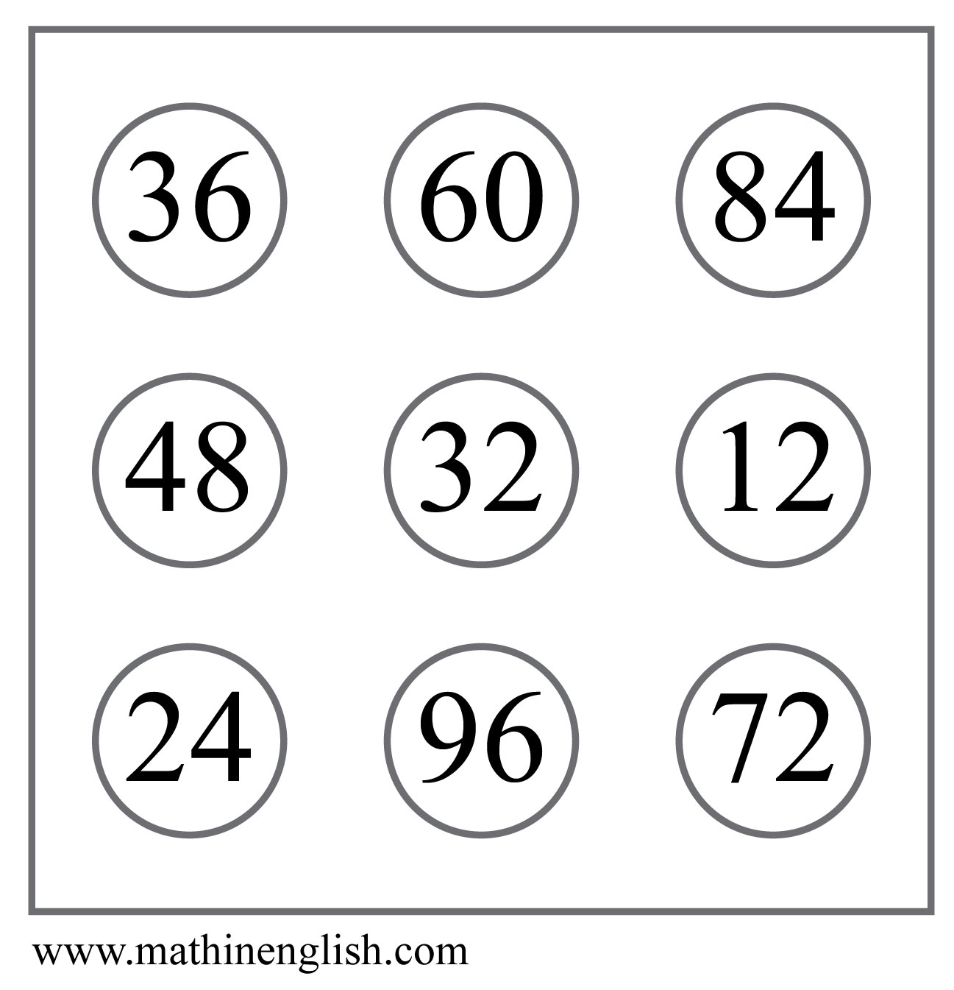
IQ Puzzle 7
Level 4E
Which number is the odd one out?

Slide 9
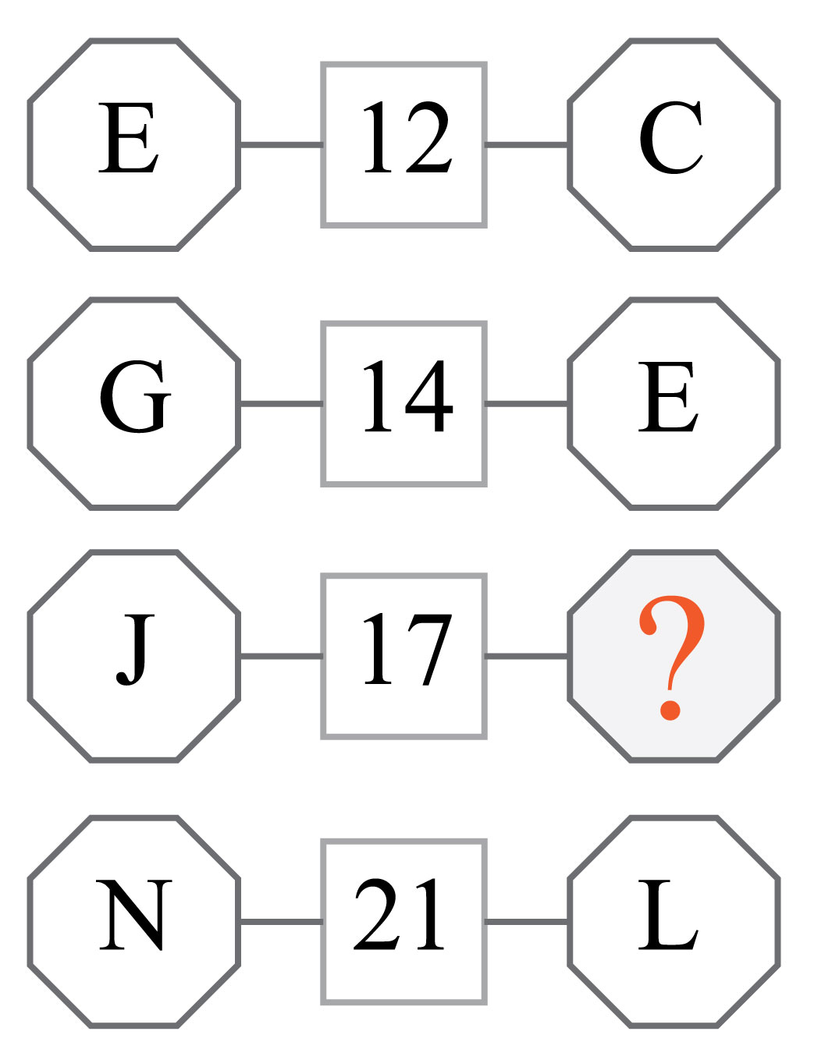
IQ Puzzle 8
Level 4E
Which letter completes the pattern?

Slide 10
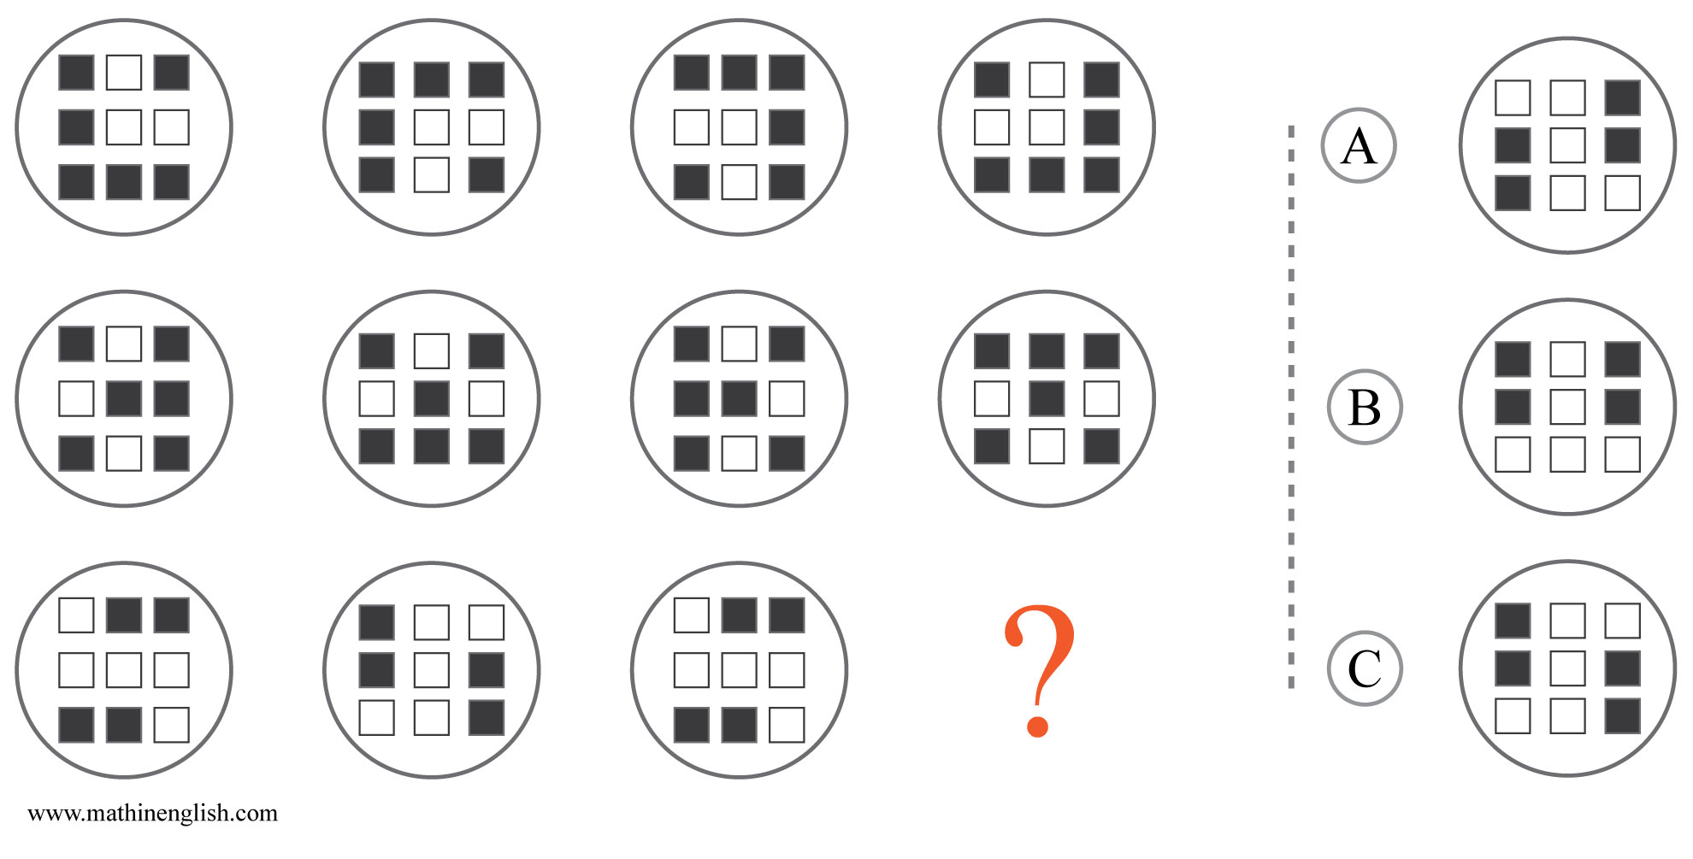
IQ Puzzle 9
Level 4E
Which option is correct?

Slide 11
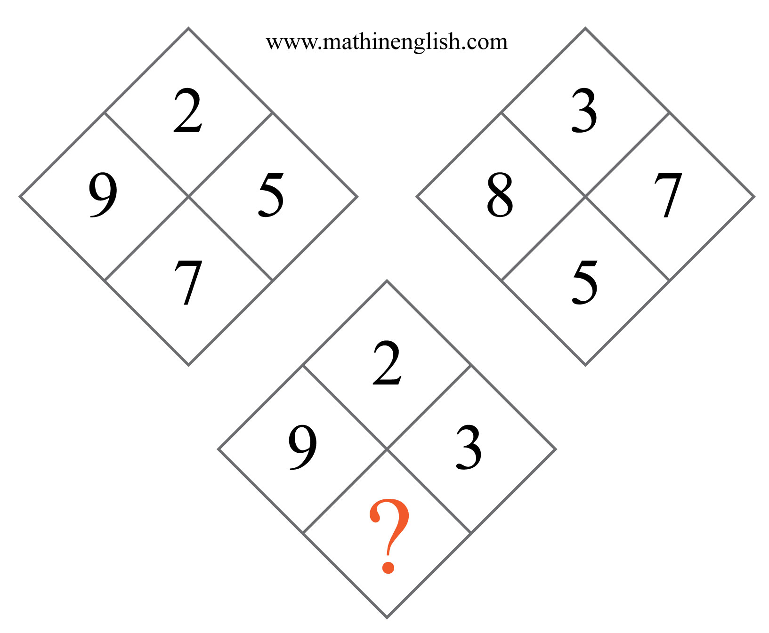
IQ Puzzle 10
Level 4E
Which number is missing?

Slide 12
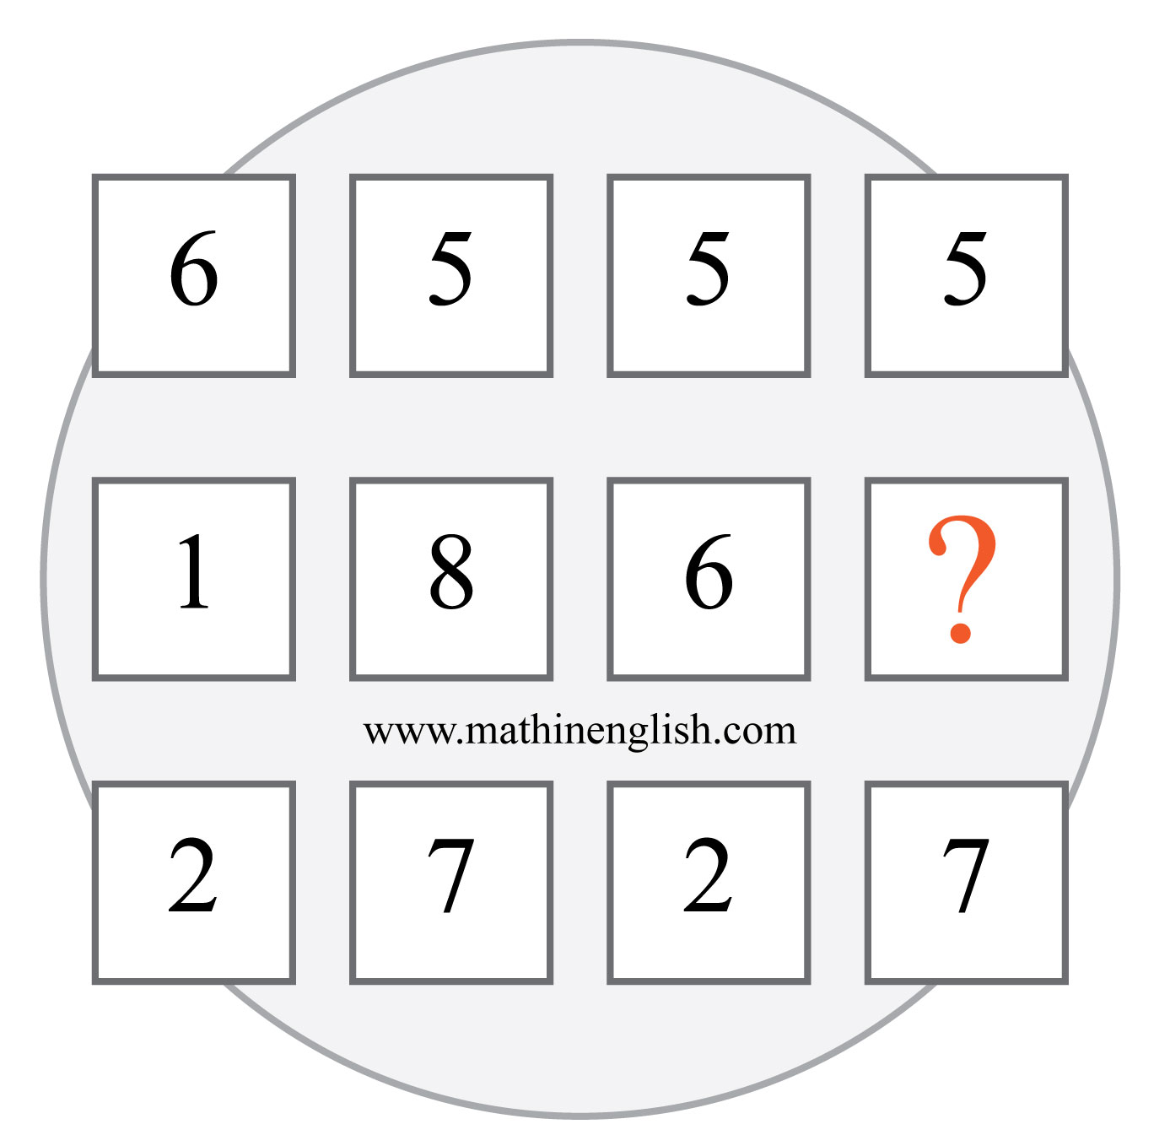
IQ Puzzle 11
Level 4E
Which number is missing?

Slide 13
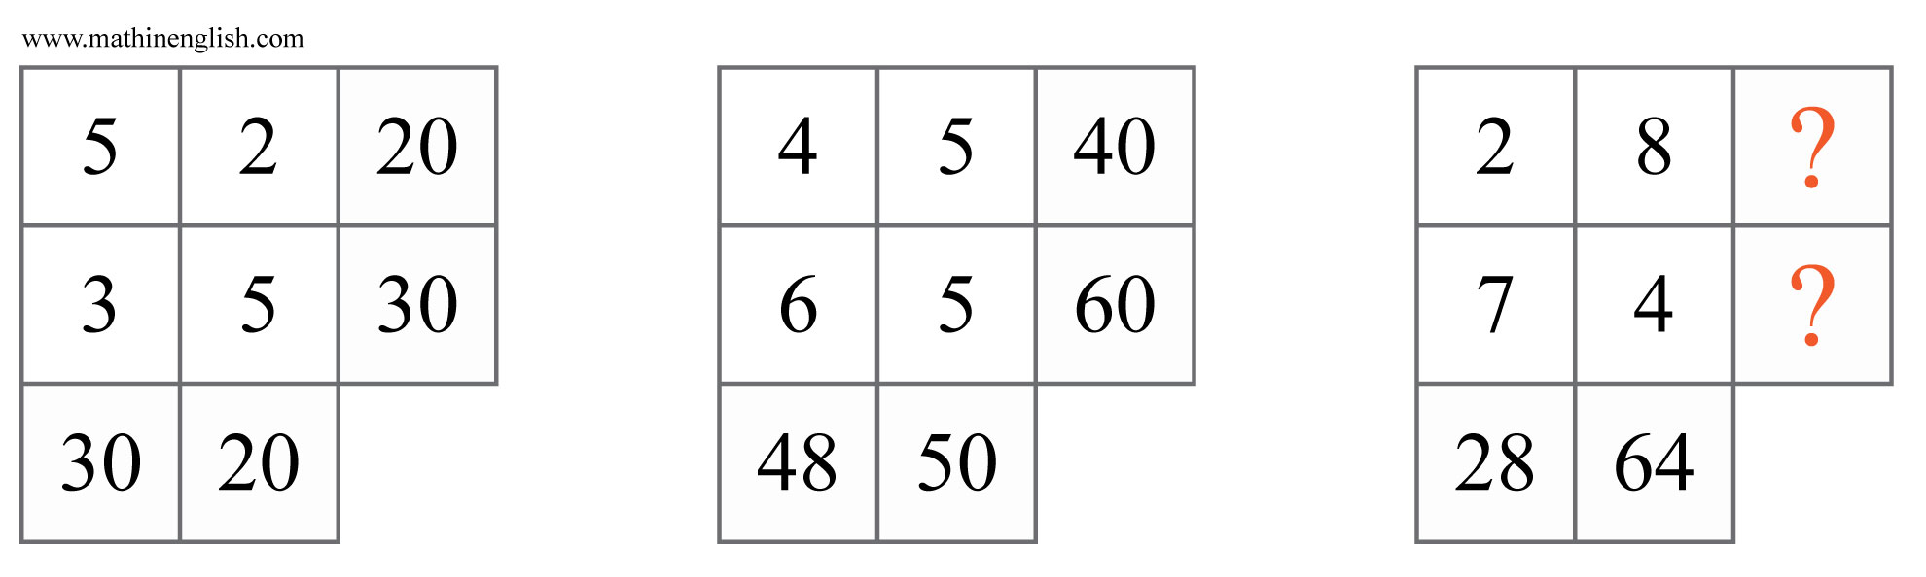
IQ Puzzle 12
Level 4E
Which numbers are missing?

Slide 14
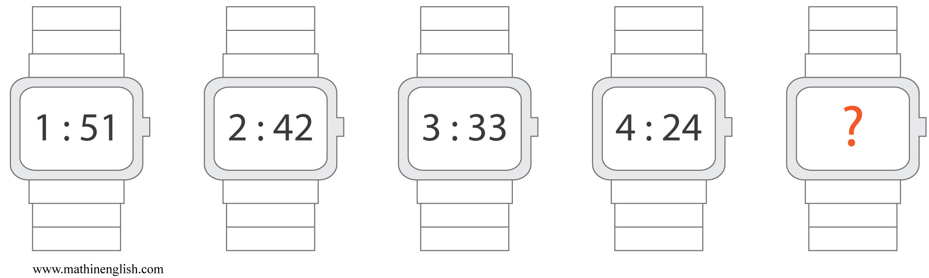
IQ Puzzle 13
Level 4E
What time is missing here?

Slide 15
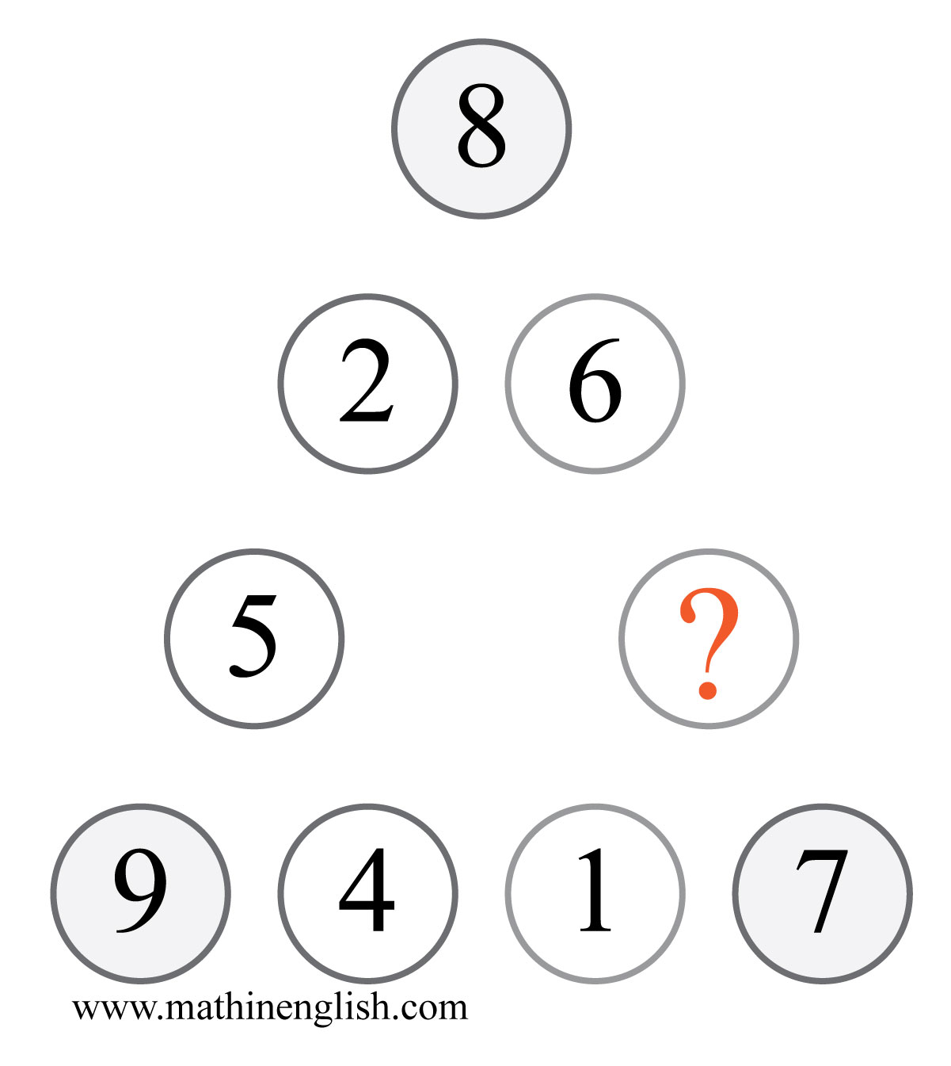
IQ Puzzle 14
Level 4E
What is the missing number?

Slide 16
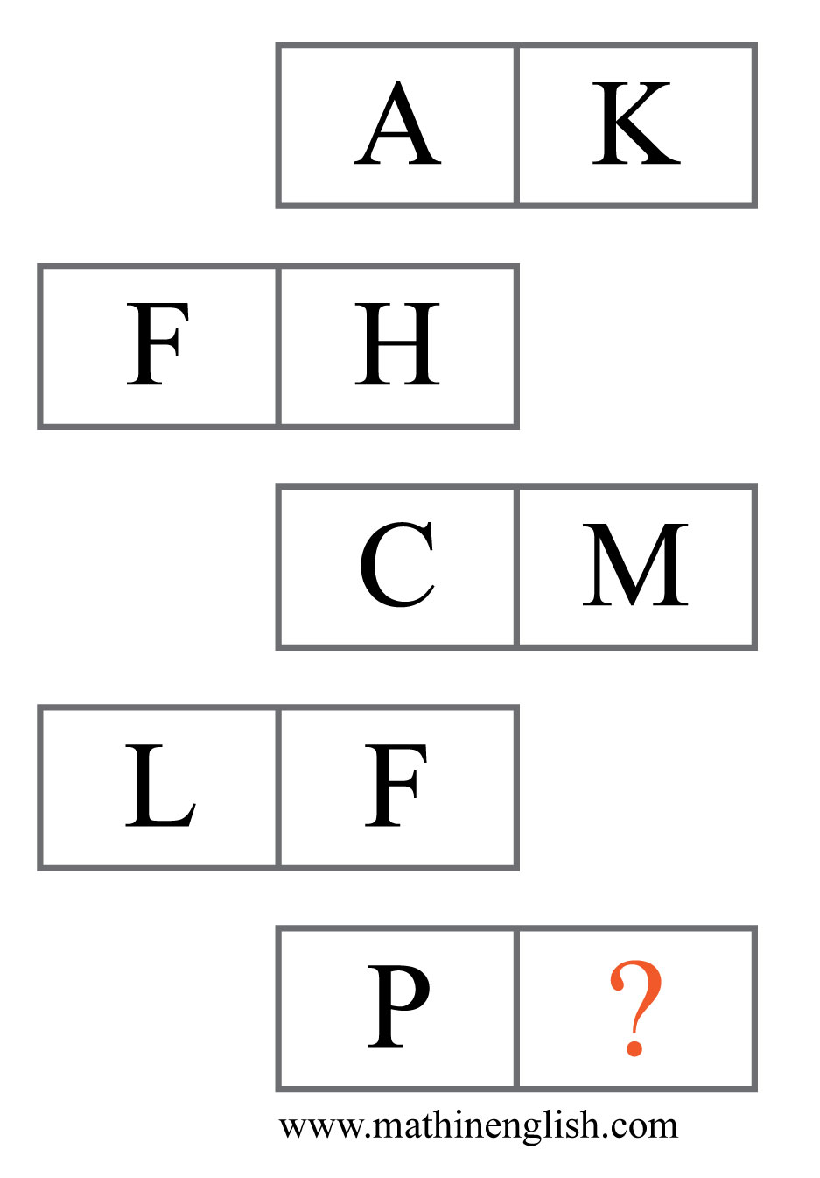
IQ Puzzle 15
Level 4E
Which letter is missing?

Slide 17
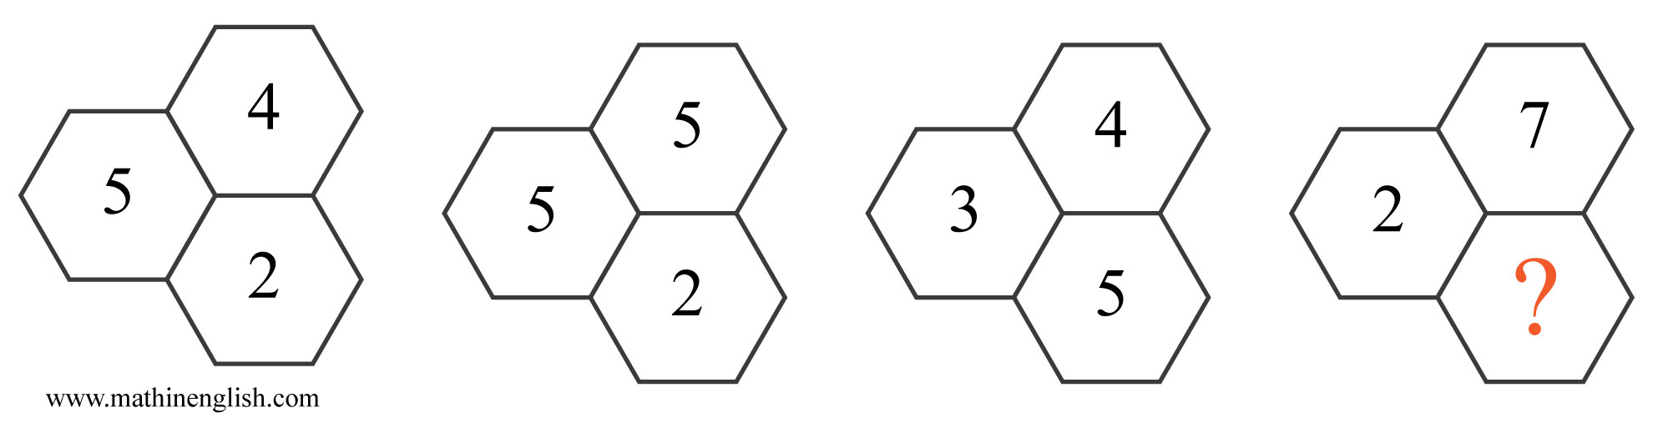
IQ Puzzle 16
Level 4E
Which number is missing?

Slide 18
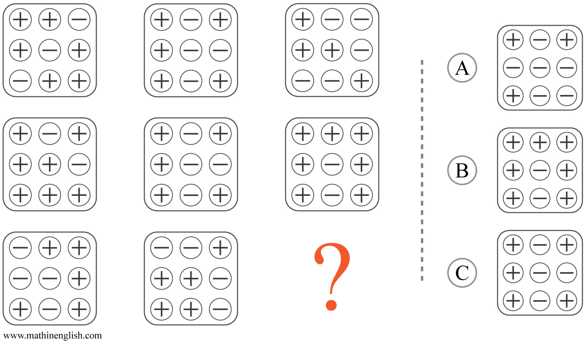
IQ Puzzle 17
Level 4E
Which option is correct?

Slide 19
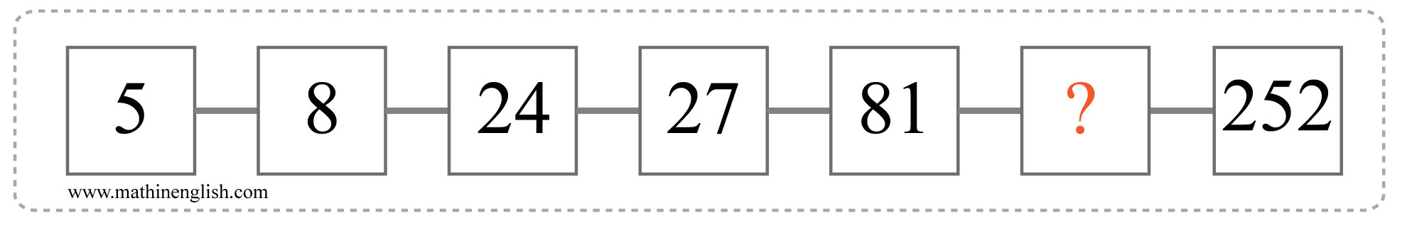
IQ Puzzle 18
Level 4E
Which number is missing?

Slide 20
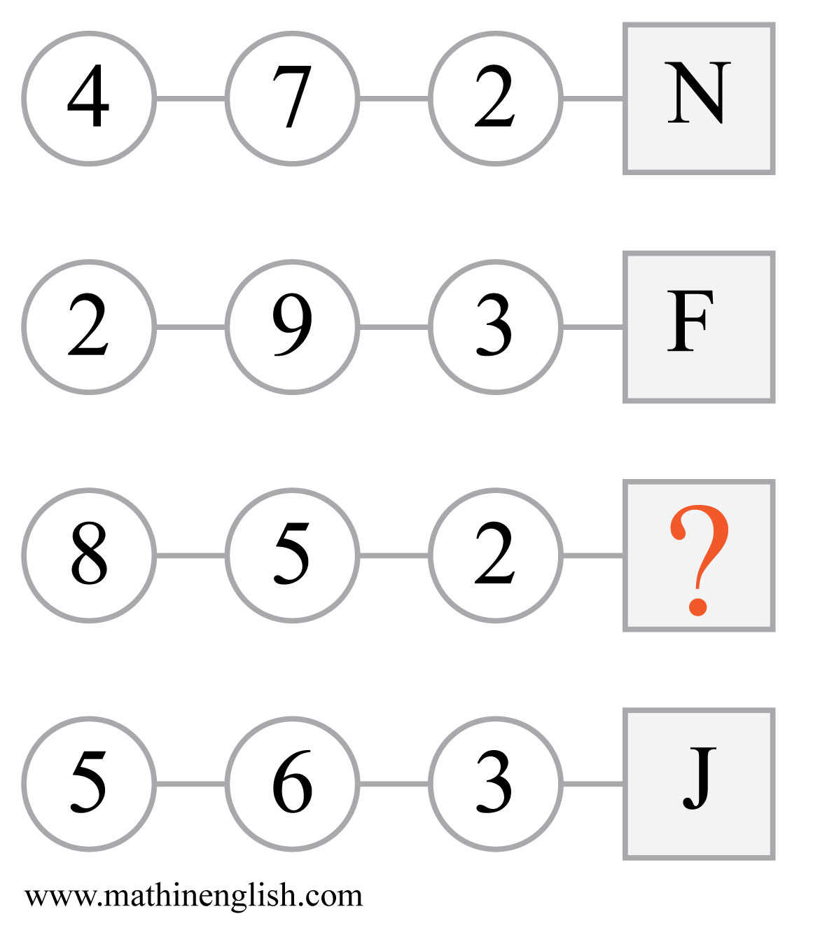
IQ Puzzle 19
Level 4E
Which letter is missing?

Slide 21
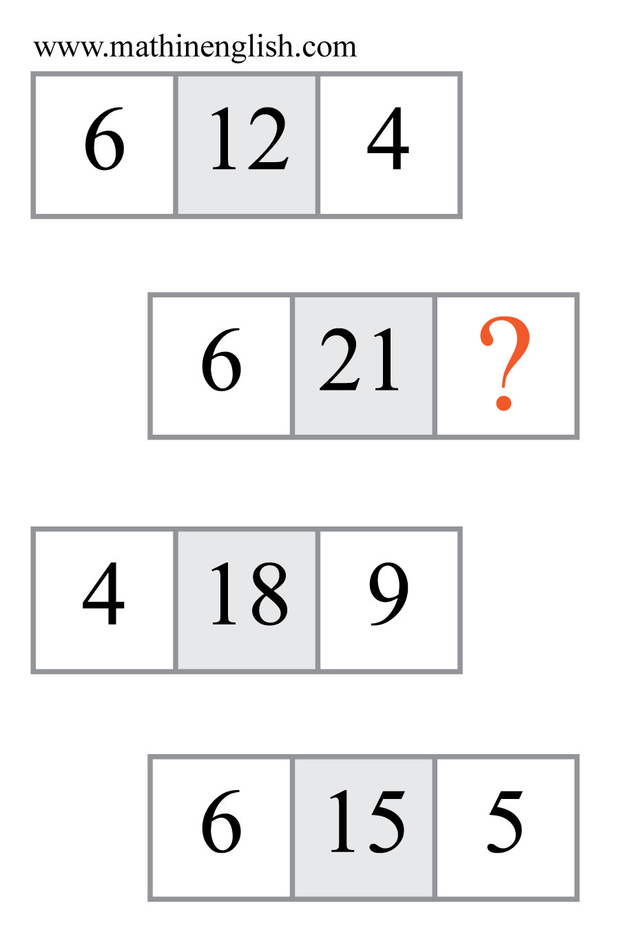
IQ Puzzle 20
Level 4E
Which number is missing?

Slide 22
Answers to puzzles 1 to 4
puzzle 1 : C
Each row of dice adds up to 14.
puzzle 2 : 9
The 2nd row is 2 times the 1st row, and the 3rd row 2 times the 1st.
puzzle 3 : G
The numbers and letters follow a +1,+2,+3,+4, etc pattern.
puzzle 4 : 4 and 6
Arrow up is multiplying, and arrow down dividing.
Copyright: www.mathinenglish.com
Level 4E

Slide 23
Answers to puzzles 5 to 8
puzzle 5 : B
In each row, multiply the 2 diamonds to get the other 2 digits.
puzzle 6 : 1
The first 2 digits multiplied plus 2 gives the number formed by the
bottom 2 digits in each shape.
puzzle 7 : 32
32 is not a multiple of 12.
puzzle 8 : H
Each column follows a +2, +3, +4 pattern.
Copyright: www.mathinenglish.com
Level 4E

Slide 24
Answers to puzzles 9 to 12
puzzle 9 : C
The circles in each row rotate each step by 90 degrees.
puzzle 10 : 6
The rule is: 2 times 6 equals 9 +3.
puzzle 11 : 3
Subtract 25 from the 3 digit column number to get the next column.
puzzle 12 : 32 and 56
In each square multiply the center digits and then multiply the
product by 2.
Copyright: www.mathinenglish.com
Level 4E

Slide 25
Answers to puzzles 13 to 16
puzzle 13 : 5:15
The1 digit +1, 2nd digits -1, 3rd digit +1 in each next watch.
puzzle 14 : 6
The corner numbers are the sum of their 2 adjacent numbers.
puzzle 15 : D
The values of the 2 cells in each row follow a 12,14,16, 18, 20 pattern.
puzzle 16 : 5
The cells in each group of hexagons multiplied follow a 40, 50, 60, 70 pattern.
Copyright: www.mathinenglish.com
Level 4E

Slide 26
Answers to puzzles 17 to 20
puzzle 17 : A
In each row multipy the 1st square by the 2nd to get the 3rd. + times
+ equals +, - times - equals +, and + times - equals -.
puzzle 18 : 84
The sequence follows a +3, ×3 pattern.
puzzle 19 : T
In each row, multiply the first 2 circles and divide this by the 3rd,
to get the letter value.
puzzle 20 : 7
Multiply the left and right digit in each row and divide this by 2
to get the middle number.
Copyright: www.mathinenglish.com
Level 4E

